Slide 1
HMP Berwyn
By Anya Hughes
Service supported by Pharmacy (Elizabeth Hurry, Sarah Hulse), Phlebotomy (Karen Halliwell-Williams), PHW, SMS, Primary care, HCT.

Slide 2



How we achieved micro-elimination
Checked over 2000 prisoners' records and made a list of who needed a test.
Made sure primary care were testing the new arrivals during initial screen ( This was reviewed every morning and still is).
Started mini mass testing at the gym, wings and workshops.
Started the peer programme.
Used the peers to overturn declines and assist with testing and training.
Provided prisoner and staff training.
Gave prisoners a chance to promote their own health.

Slide 3
Statistics collected for micro-elimination announcement (31/01/24).
We had a roll of 1963 prisoners, 1852 of these had a test from HIV, HBV , HCV and syphillis and 35 people had a mouth swab for HCV.
There was approx 364 PCRs completed in the previous 12 months.
41 of these were positive for HCV.
In september 95% of positive patients started treatment and 100% in October, November, December and January.

Slide 4
Continued...
October to January we had 78% uptake of DBSTs during their first night screen. 93% within seven days, 95% within 14 days, 96% 14+ days. We had 13 arrivals that left within 7 days (1.4%).

Slide 5
Hepatitis C trust data.
October 2022 - Feb 2024

Slide 6
Testing pathway.
New arrivals who have had HCV before
DBST in reception
CEPHID PCR within the first few days of arrival ( before DBST results are back)
New arrivals with no history of HCV
DBST in reception.
Positive results in 4-10 days and CEPHID PCR obtained as soon as possible.
If are PCR negative and they've been putting themselves at risk in community, repeat in three months with CEPHID PCR
If CEPHID PCR is negative and they've been putting themselves at risk in community, repeat in three months.
If PCR negative, then repeat 9-12 months later ( DBST PCR)
If PCR negative again repeat 9-12 months later ( DBST PCR)
Needlephobia
Decline in reception
Followed up with an appointment in healthcare for a oral swab
Declined in reception
Seen in the next few days of arrival with hcv peer.
Education and harm reduction given and re offered a test.
If negative, and they've been putting themselves at risk in community, repeat in three months
If they decline and they've been putting themselves at risk in community, re-offer in three months.
If negative, then repeat in 9-12 months.
If they decline re-offer in 9-12 months.

Slide 7
Treatment Pathway.
Fibro-scan .
Pre-treatment bloods.
MDT with pharmacy.
Treatment start.
Ongoing regular support.
Treatment complete

Slide 8
How we are maintaining it.
Primary care reception screening opt out is being monitored daily and followed up.
SMS band fours are then going to see people who have declined a DBST the day after arrival, they are also picking up DNAs for 3m and 12m DBSTs.
Primary care are doing two afternoon clinics a week for 3 month and 12 month tests and SMS are also doing one morning a week.
Training band 6 SMS nurses to complete cephid PCRs.

Slide 9
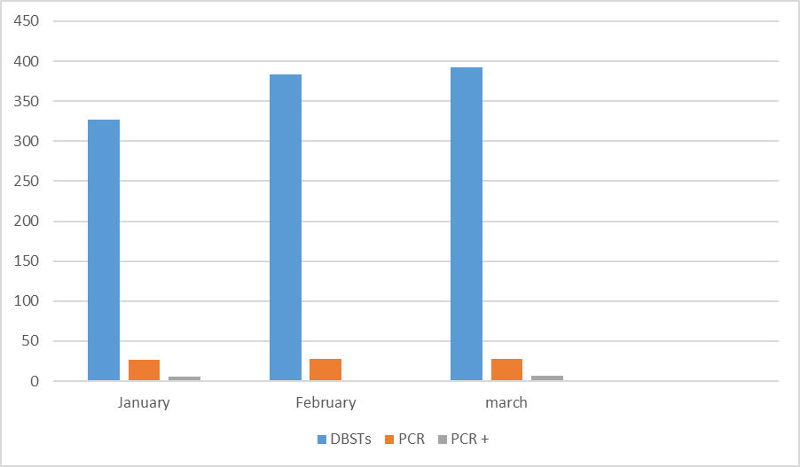
Maintenance
When we reached micro-elimination, we thought the testing would slow down. However, we were wrong.
January – 327 DBSTs, 27 PCRs, 6 positives.
February- 383 DBSTs, 28 PCRs, 1 positive.
March- 392 DBSTs, 28 PCRs, 7 positives.

Slide 10
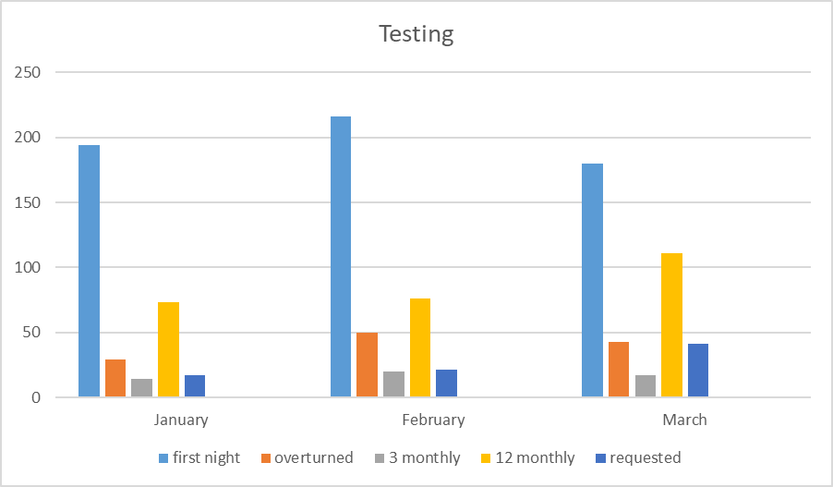
DBST breakdown
January-
FN- 194
OT- 29
3M- 14
12M- 73
RQ- 17
Feb-
FN- 216
OT- 50
3M-30
12M-76
RQ- 21
March-
FN- 180
OT- 43
3M-17
12M- 111
RQ- 41

Slide 11
Issues
We are having a high number of prisoners who are trasfered, which means they were tested a few days or even weeks ago. These decline as they do not need one.
More people being released early then coming back in the same day or a few days, weeks later. These decline as they do not need one.
No official peer programme is currently running.
Officer and prisoner training has been put on hold due to staffing.
Lost two full time staff members ( Jenessa and Neil).
Seeing more resistance and failed treatments with prisoners coming in.
More people are likely to decline their yearly test.
Prisoners released from court ( no meds).
Last minute releases/ early release.

Slide 12
Positives.
We achieved micro-elimination and have managed to maintain it for 6 months, despite unfortunately losing two full time staff members 2 months ago.
Our abstract of the work we did at HMP Berwyn got accepted and presented at the World Hepatitis Summit.
Newley appointed band four is due to start in June 2024.
We have employed admin to help support this service.
We have not had a new HCV positive on their yearly test, since doing micro-elimination.

Slide 13
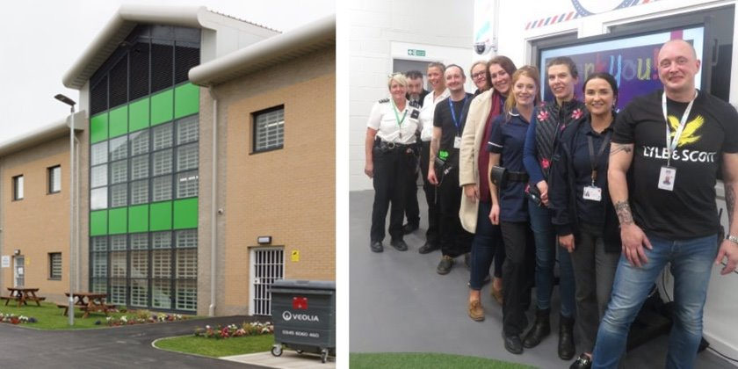
Any Questions?
Put patients first
Work together
Value and respect each other
Learn and innovate
Communicate openly and honestly

