Slide 1
Dashboards and Elimination
National Hepatitis Elimination Meeting
Arran Ludlow-Rhodes & Matt Milner - Gilead Sciences
April 2024
Date of preparation: April 2024
Job bag no:UK-UNB-5394
Notes:
As of 2/21/2020

Slide 2
Employees of Gilead Sciences
Disclosures

Slide 3
HM Prisons

Slide 4
Prison Micro-Elimination definition
  Welsh Health Circular :-
    100% of the prison population being offered a hepatitis C test.
    90% of those having then been tested.
    90% of those who been diagnosed with hepatitis C having started treatment.

Slide 5
Data extracted directly from SystmOne (prison electronic health records)
Reports produce data based read codes
“Near Live” data review
Data Capture

Slide 6
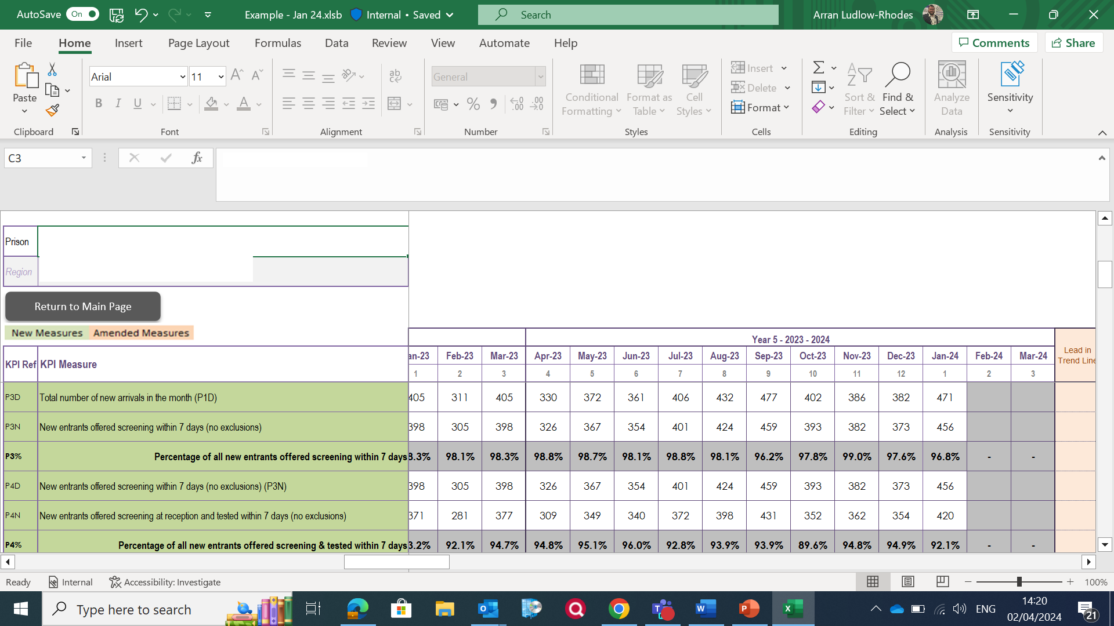
HMP Micro Elimination 1 example

Slide 7
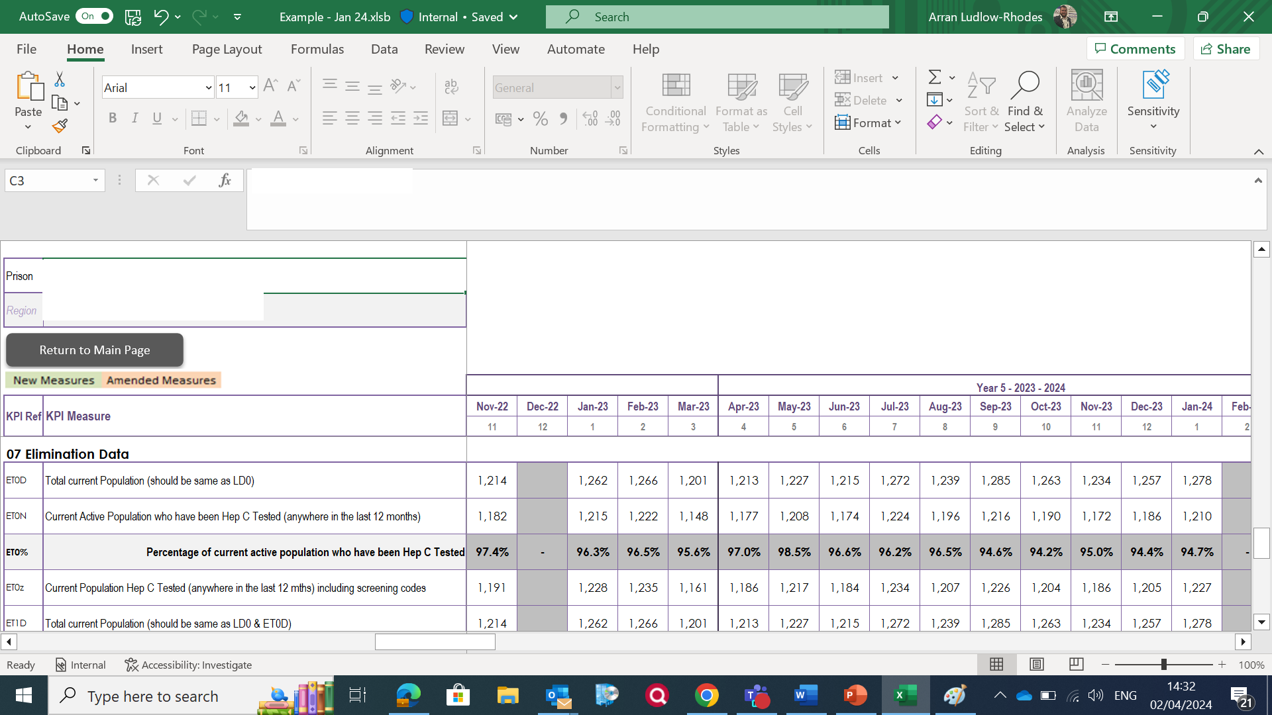
HMP Micro Elimination 2 example

Slide 8
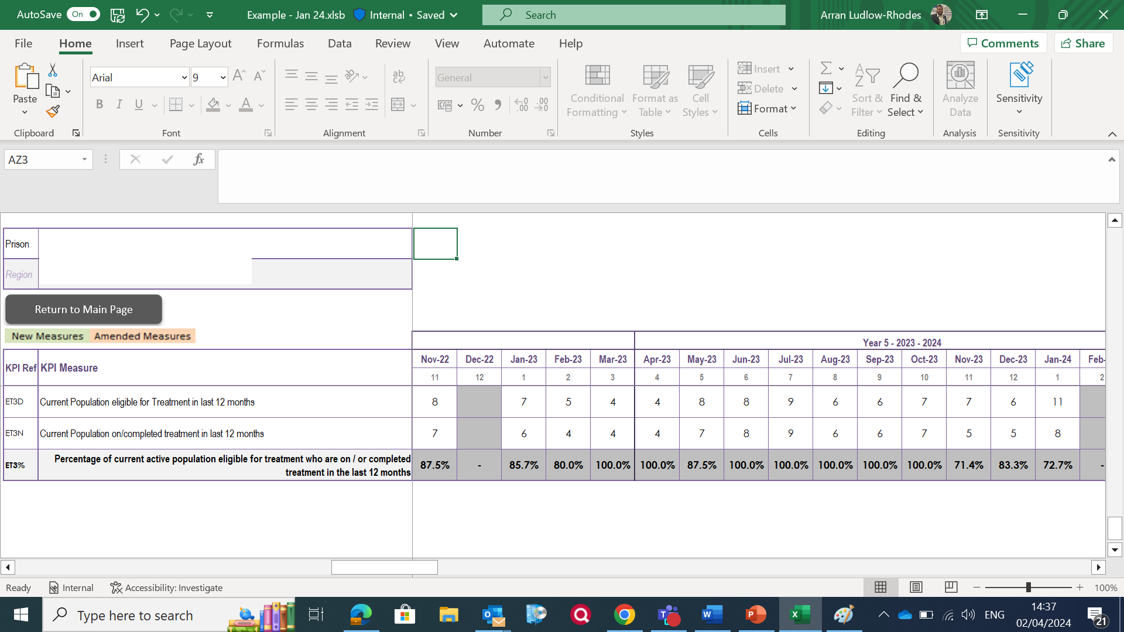
HMP Micro Elimination 3 example

Slide 9
Drug Treatment Services

Slide 10
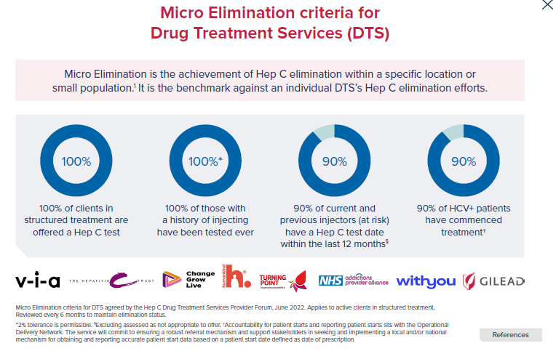

Micro Elimination in Drug Treatment Services

Slide 11
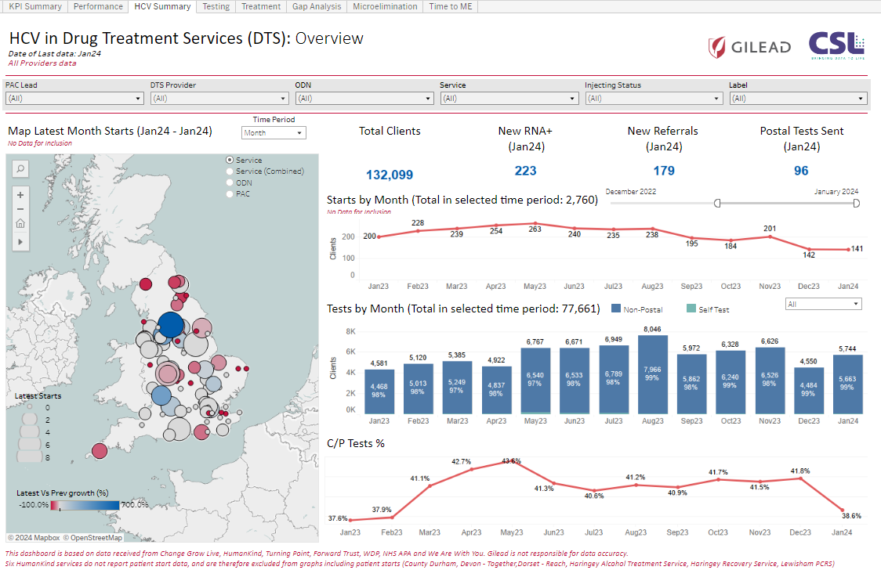
HCV in Drug Treatment Services : Overview

Slide 12
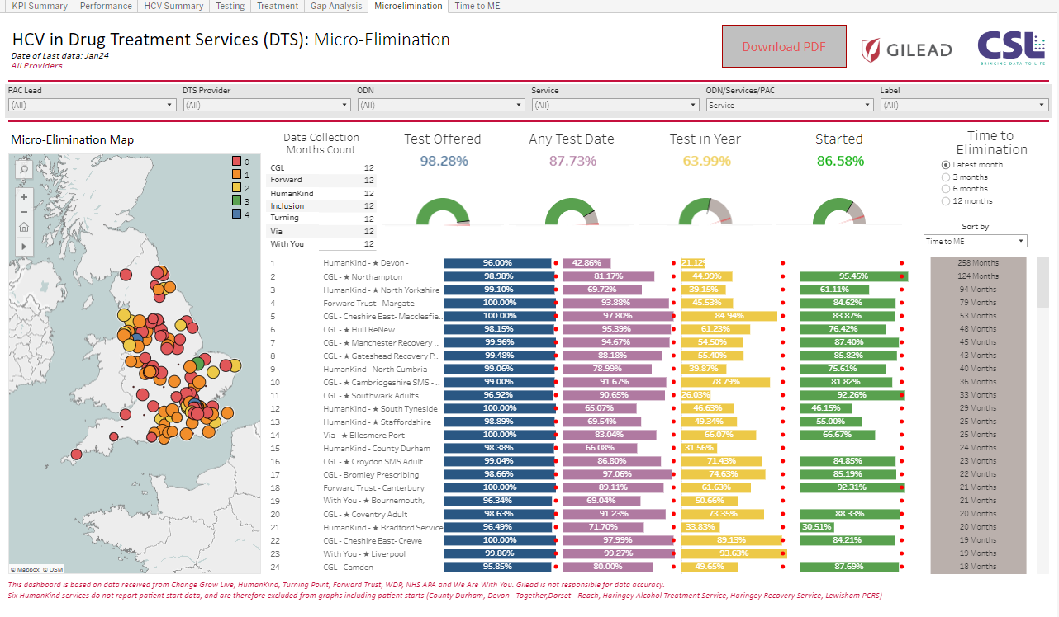
HCV in Drug Treatment Services : Micro Elimination
Data Anonymised

Slide 13
A Welsh Drug Treatment Service Dashboard?
NEO ID | Surname | First Name | Gender | D.O.B | Date of test | Date re-test required | Neo | Date Booster Received | Date Booster Received | Date Booster Received | Vaccinated Hep B Y/N | anti-HCV | HCV PCR | Comments | Referred | Treatment

Slide 14
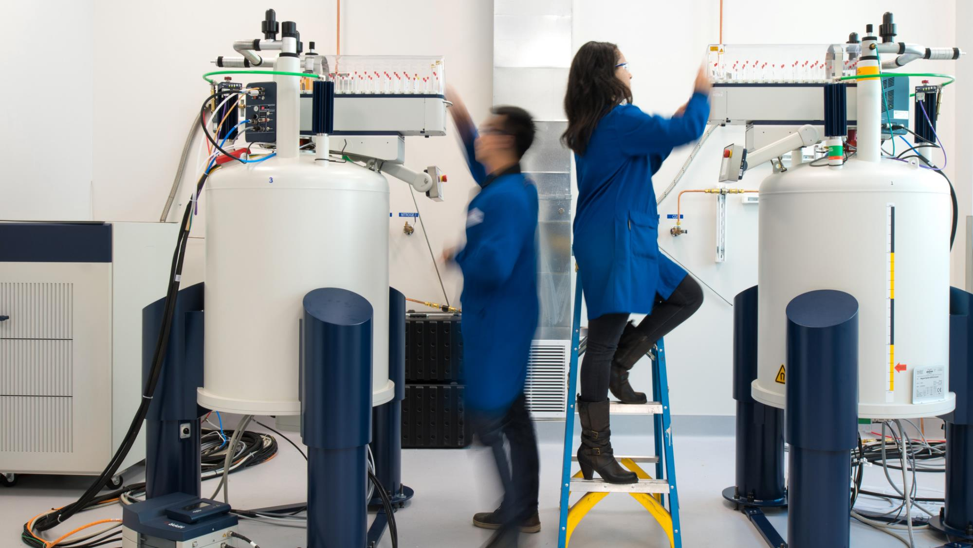
THANK YOU

