Slide 1
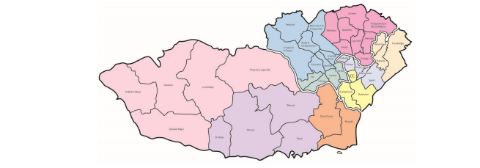
Mapping Out Your Service
Dr Bazga Ali
(Consultant Infectious Diseases)
Notes:
I’m not sure I can add cartography to my skill set as what I did was really simple and done mostly for my own benefit.
There appeared to be loads of people in loads of silos delivering HCV care. Each team (silo) had its own uninterpretable acronym, was funded apparently through organisations which had their own accronyms. So mostly I felt like I was quite confused with a minimental of about 2/10.
So when I took over the infectious hepatitis elimination role in Cardiff and Vale I was asked to support writing the CAV recovery plan.
I didn’t feel able to contribute to the recovery plan without understanding what we had available to us.
. ‘The WHO estimate that 296 million people were living with chronic hepatitis B and 58 million people living with hepatitis C infection in 2019 with 1.5 million new infections each year for each infection. Deaths are estimated at 820 000 for hepatitis b and 290 000 for hepatitis c with most deaths attributed to cirrhosis and hepatocellular carcinoma (primary liver cancer).

Slide 2
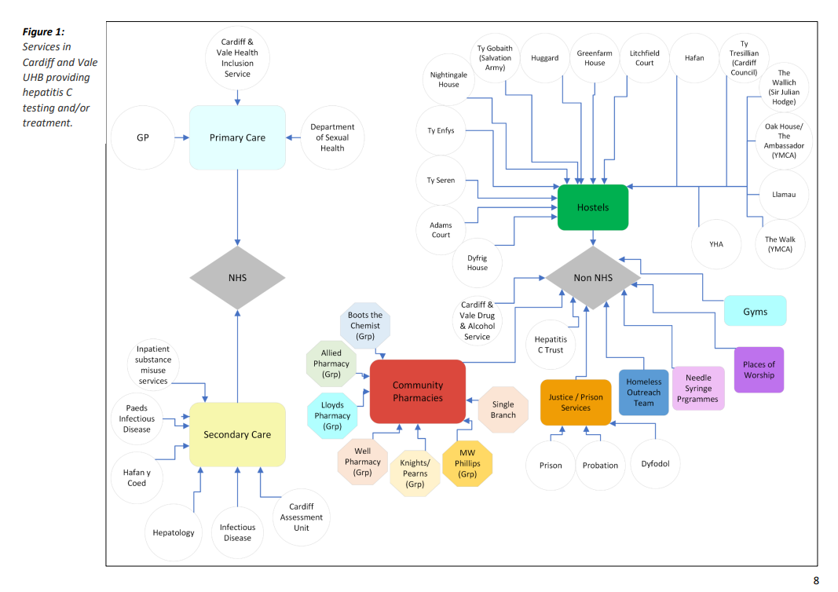
Notes:
When I mapped our service in Cardiff, I did it like this, because it made the most sense to me, however theres obviously loads of ways to skin the preverbial cat!
I split it up by thinking about NHS and Non NHS organisations which are stake holders in delivering Hepatitis care, either intentionally or as a byproduct of working with higher risk populations
The NHS was split into primary and secondary care
And broadly approached non NHS organisations as separate entities. (although the homeless outreach team are now actually part of CAVHIS)
Some of the Non NHS partnerships we have pre-existing relationships with – and have seen many of their cohorts. Others are untapped reservoirs of infection
e.g. bodybuilding gyms
Community pharmacies ended up with their own mapping page because their services/ skills are very variable and inconsistent between businesses

Slide 3
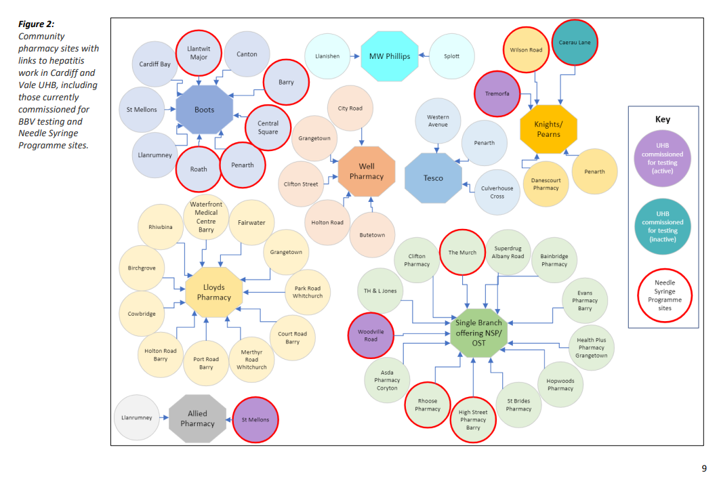
Notes:
Slightly mad diagram – but this is a map of all the CAV pharmacies with links to hepatitis work.
Additionally it shows clearly – those with active NSPs and which sites are active/ commissioned for testing for HCV.
It gives a clear diagrammatic view of where we could easily approach to encourage testing (red circles)

Slide 4
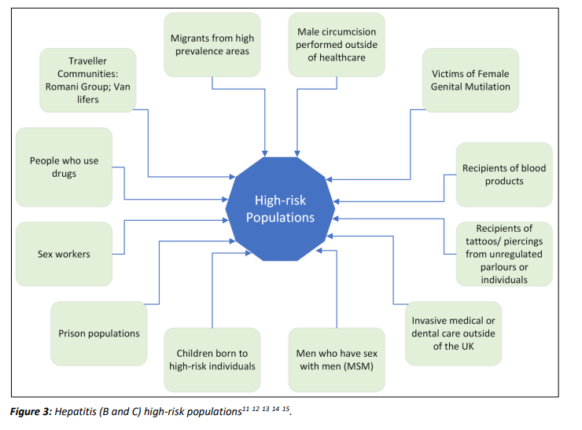
Notes:
And this final ‘map’ is of the populations at risk. In Cardiff the majority of our untreated HCV lies within the homeless/ prison/ DU population BUT there are other untapped communities that we should be thinking about. But if we don’t clearly identify them as target populations, they will always be missed.

Slide 5

Notes:
The maps are essentially like hit lists. So we can be systematic in our approach.

