Slide 1


Probation testing : Newport Style
Bethan Bowden
Consultant in Public Health
Aneurin Bevan University Health Board

Slide 2
Gwent approach to elimination
Key themes
1. Building partnerships for collaborative working across health, social care and commissioned services and with communities (Addressing WHC Action 1 and 2)
2. Prevention of infection through hepatitis B vaccination and provision of clean injecting equipment (Addressing WHC Action 3)
3. Increase testing in groups who are at greatest risk of hepatitis B and C infection through flexible testing models and increased awareness of risk factors for infection (Addressing WHC Action 4, 5, 6, 7 and 9)
4. Improving access to treatment through flexible treatment models (Addressing Action 8, 10 and 11)
5. Develop our understanding of our local data to identify those at greatest risk and target interventions at those at greatest need (Addressing WHC Action 12 and 13)

Slide 3

Key theme: Increase testing within high-risk groups
People in contact with criminal justice system
Joint Recovery Plan identified settings of custody suites, probation services and prisons
Developed partnership with HMPPS through Health and Justice Partnership Coordinator
Standing on the shoulders of Swansea Bay Probation Delivery Unit pilot
High intensity testing event
Explore Probation Delivery Unit as setting for healthcare intervention

Slide 4
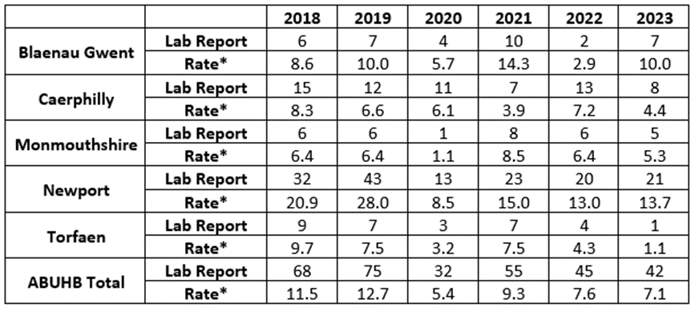
Why Newport?
Highest numbers and rates of people with Hep C in ABUHB
Highest footfall within Probation Delivery Unit in ABUHB areas

Slide 5
Key theme: Building partnerships for collaborative working
Gwent approach to collaboration
Initial conversations summer 2023
Detailed planning October/November 2023
Key members of team:
ABUHB - BBV Clinical Specialist, Health Protection Team, Public Health
Gwent Drug and Alcohol services - BBV Clinical Lead and Criminal Justice service
HMPPS - Health and Wellbeing Partnership Coordinator
Pilot to run for four weeks from 8 January to 2 February 2024

Slide 6
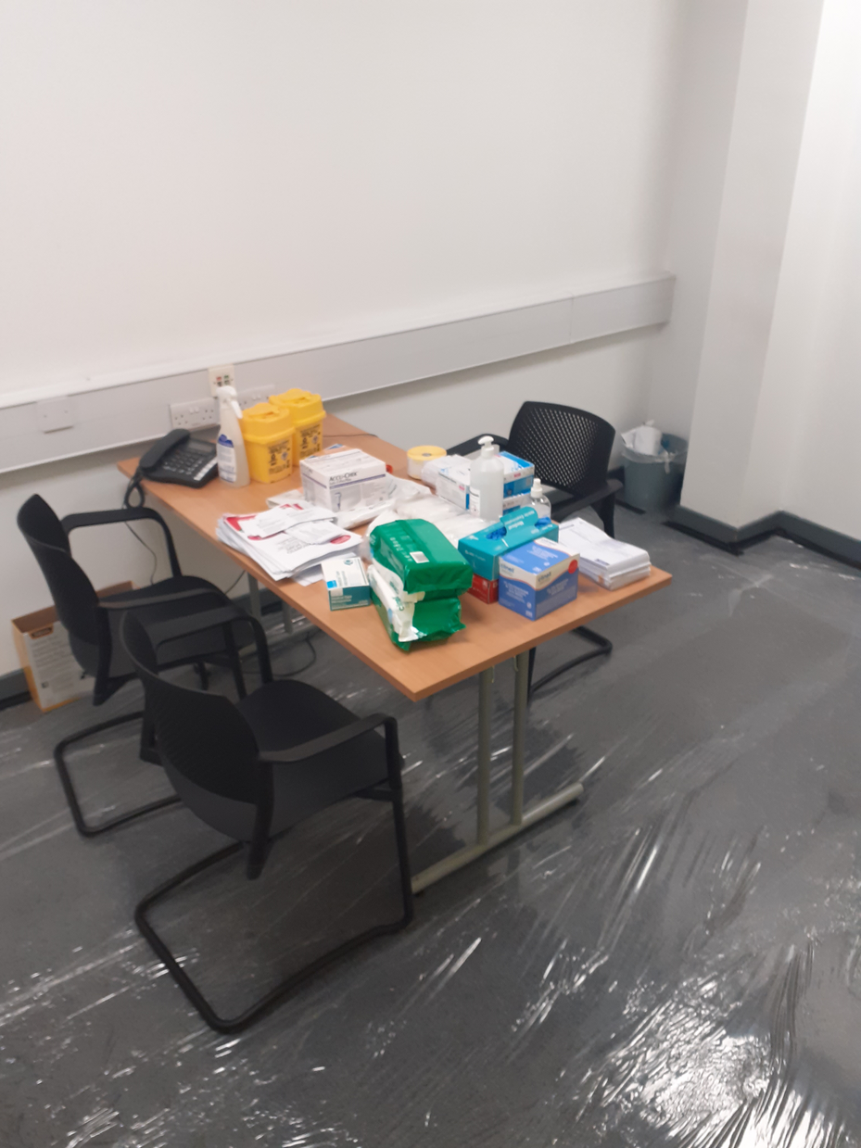
Pre-pilot planning
Site visit to consider best set-up and H+S requirements
Developed SOPs, Information Sheets (BBV testing and DBST information sheets) and database
Training for probation staff from Clinical Leads in GDAS and AB
Additional training for HCSW on syphilis
Linked with sexual health service around referral pathway
Coordinated staffing from across Health Protection Team, Hepatology Team and GDAS - two members of staff present every day
Text messages for negative results

Slide 7
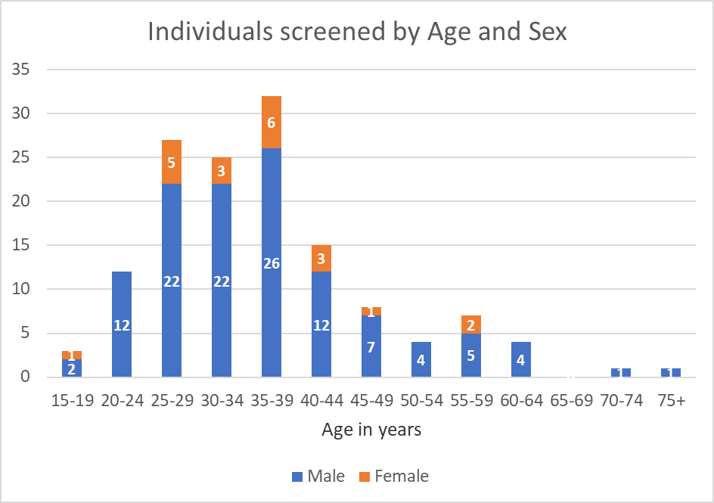
Who did we screen?
139 people screened
Nearly 1/4 screened were 35-39 years
85% self-reported as male

Slide 8
What did we find?
Samples collected | Hep B surface antigen (positive) | Hep C antibody (positive) | Hep C PCR (positive) | Hep C antibody (Equiv) | HIV (positive) | Syphilis (positive) | Void
139 | 1 | 5 | 1 | 2 | 0 | 1 | 3
Patient pathway
All patients with positive results followed up by telephone
Referral into sexual health services as needed
Negative results via text

Slide 9
Acceptability to service users
Additional staff deployed by Health Protection service to support and ensure proactive offer within reception area
21% uptake (139 tests from 657 unique appointments)
Uptake varied from nearly 30% to 0% on the same day potentially due to repeated presentation
Drop off through the pilot from 54 tests in week 1 to 17 tests in Week 4
Health Protection team gathered insights into why individuals refused the offer
Notes:
Probation service data indicated 657 unique appointments scheduled
139 individuals took up offer

Slide 10
Behavioural Insights approach to
identify and address barriers to BBV testing
The majority of people offered BBV testing during their probation appointments as part of this pilot, did not take up the test.
Approximately 59 people who declined the offer provided a reason for doing so
The majority of respondents gave no reason, just didn’t want it, or were not really interested, however 8 broad themes were identified in total.
All responses were coded and analysed using the COM-B Model and The Theory and Technique Tool, which links Modes of Actions to Behaviour Change Techniques.
Most commonly stated (≥5) | Next most commonly stated (<5) | Least commonly stated (<5)
No reason given/didn’t want it | Lack of financial incentive | Planned future screening
Previously screened | Personal circumstances | Privacy concerns
Disinterested | Transmission misconceptions

Slide 11
Psychological Capability
Transmission misconceptions
Previously screened
No reason given/Didn’t want it/ Disinterested
Physical & Social Opportunity
Experiencing homelessness
Personal circumstances
Proximity to release date
Reflective and Automatic Motivation
Lack of financial incentive
Privacy concerns
Previously screened
No reason given/Didn’t want it/ Disinterested
Planned future screening
Notes:
Capability: The reasons given for declining the screening offer suggest that not all people attending probation appointments had the psychological capability needed to make informed decisions and carry out the behaviour.
For example, there was a misconception by a small number that BBV screening was not needed if someone did not take drugs.
There is also the potential that those who rejected the offer because they had previously been screened for BBV, had been exposed to BBVs since having their last test. Along with those who gave no reason for not getting tested, or who were not interested, these respondents may or may not have understood the potential health consequences of not engaging with the behaviour.
Opportunity: A small number of the reasons given for declining the screening offer suggest that not all people attending probation appointments had the physical or social opportunity needed to carry out the behaviour. Personal circumstances, such as experiencing homelessness, or just getting out of prison, were cited as reasons for declining the screening offer, suggesting some people on probation saw these as barriers.
Motivation: The reasons given for declining the screening offer suggest that not all people attending probation appointments had the reflective or automatic motivation needed to carry out the behaviour.
Motivation must always be considered in the moment. The respondents who said they had already been tested for BBVs, were not motivated at the point of this testing pilot to engage in the behaviour, despite having been so previously. On the other hand, suggestions that people would get screened at another setting where they believed incentives were being offered show that while motivation may have been lacking for some at that moment, they may be motivated to take up the offer in the future.
Concerns around privacy, and not wanting to share any more personal information, suggest some people on probation were motivated to make conscious decisions not to engage in the behaviour. Those who stated that they just did not want it or were not really interested, may have also declined through conscious decision-making, may have been automatically motivated to decline, or may have just lacked the motivation needed to engage in the behaviour all together.

Slide 12
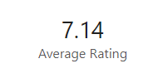
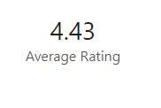


Staff Survey – 7 responses so far
Notes:
A survey has gone out to clinical, support and probation staff who were involved in the pilot. Initial results of a staff survey show largely positive opinions on how well the event went, how prepared people felt, how well staff worked together and how valuable and appropriate staff felt BBV testing in probation was. We are going to wait for more results to come in before analysing the results, but answers are generally positive that it should run in the future and there are some good suggestions coming through on how we can improve on the offer for those future events – including ideas about how we communicate and how we incentivise the offer.

Slide 13
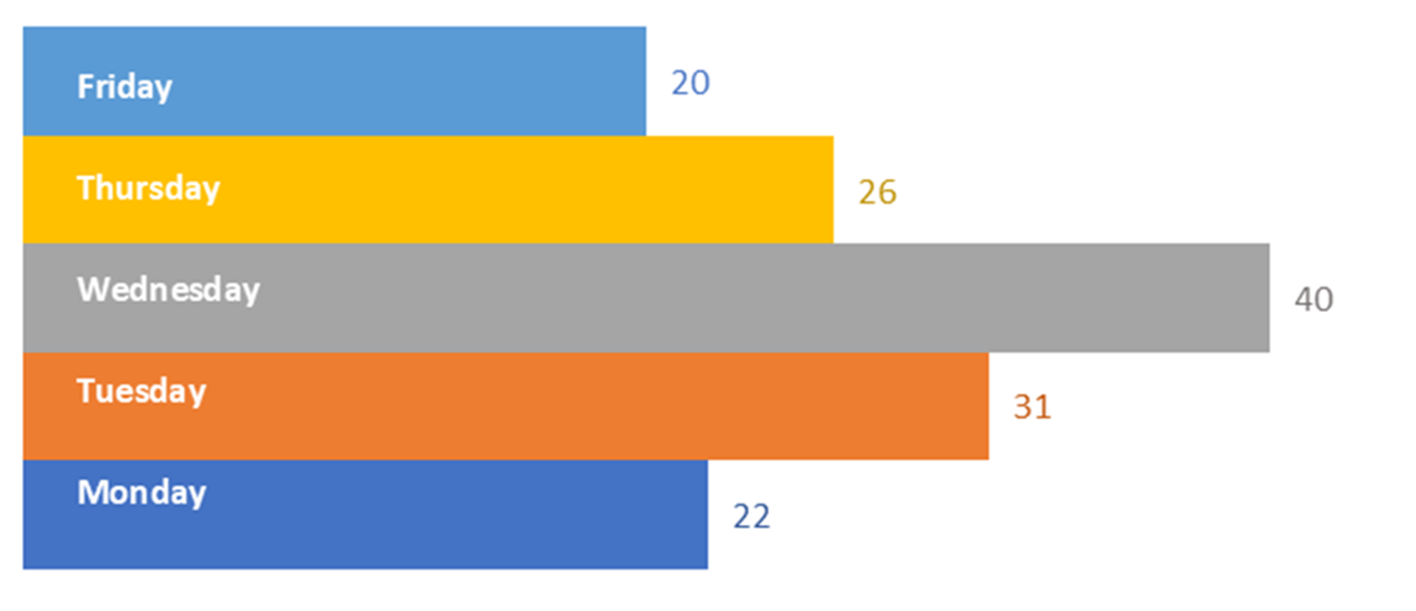
What would we do next time?
More information and training for probation staff
Clearer information leaflets for people on probation
Broaden offer of STI testing
Targeted days as part of sustainable model
Notes:
Mondays had less appointments than Wednesdays
Greatest number of tests on Wednesdays

Slide 14
Improve capability through information about health, social and environmental consequences and the salience of them
Improve motivation through advising people on probation to identify and compare the pros and cons of the behaviour and consider providing them with an incentive
Improve opportunity through providing practical social support to those who need it
Notes:
Information: The Theory and Techniques tool suggests that by providing information about health, social and environmental consequences of getting tested for BBVs (or not) to people on probation, their knowledge about, attitude towards and intention to carry out the behaviour could be increased.
Information could not only change their beliefs about the consequences of engaging in testing, but also their perceived susceptibility and vulnerability to BBVs. Information on consequences and providing this in a way that is memorable, could reduce misconceptions about how BBVs are transmitted, for example, by helping them understand snorting or injecting drugs is not the only way BBVs are contracted.
Very early analysis of information from a small number of professionals involved in the pilot suggest careful consideration should be given to how, when and by who information on BBV testing is communicated. For example, providing easy read leaflets during appointments and advance verbal briefings from health care staff to both probation services users and staff have been suggested.
Pros and Cons: Following on from receiving appropriate health, social and environmental information, people on probation could be advised to identify and compare their reasons for wanting, and not wanting, to engage in BBV testing. This could affect their general attitudes and beliefs; attitudes about BBVs and testing; beliefs about the consequences; and their motivation to carry out the behaviour.
Weighing up the pros and cons could support those asking about incentives or concerned about privacy, to engage in testing despite their concerns.
Incentives:
Informing people on probation that a reward will be delivered if they engage in BBV testing could influence their beliefs about consequences about the behaviour, along with their intention and motivation to carry it out. Food, small financial rewards or honorariums have been suggested by professionals responding to a survey on the pilot, however further discussions would need to take place over the most appropriate incentives and any ethical implications.
Practical Support: This includes advising, arranging or providing practical help from friends, relatives or staff for the performance of a behaviour. For BBV testing, this could effectively influence the environmental context and resources that are a barrier for some people on probation, such as those experiencing homelessness and those very recently released from prison. Social support would not only need to support people on probation with having the test, but also with any implications of testing, such as accessing and processing results and supporting any follow up behaviours or treatment needed.

Slide 15
Next steps
Complete formal evaluation of pilot – probation, clinical and support staff
Sustainable model for ongoing BBV testing within probation setting
Consider alternative Probation Delivery Units in Gwent (Caerphilly)
Planning ongoing with HMPPS and other Health Board areas
Opportunities for Probation Delivery Units as setting for other health and wellbeing interventions
Thanks to all involved in delivering the project:
Gavin Hardcastle
Sadie FosterJohn from HMPPS
Georgina O’Connor and Chris Lewis from GDAS
Lisa, Sania and Ross from Health Protection
HCSW from Sampling and Testing Team

