Slide 1
Community treatment – accelerated treatment in action
Liz Hurry - April 2024

Slide 2
Preferred accelerated treatment algorithm
What the algorithm says
Bloods for FBC, U&E, eGFR, LFT, AST, GGT, INR, genotype, confirmatory viral load, (hep B core)
Perform Fibroscan or calculate APRI and FIB-4
Review with team if Fibroscan >13, APRI >1 or FIB-4 >1.45
Otherwise offer pangenotypic treatment
Check bloods 2-4 weeks into treatment: U&E, LFT, FBC, eGFR, viral load
Venous PCR 12 weeks after treatment completion

Slide 3
Where blood test/ Fibroscan not possible
DBST for HCV antibody with reflex PCR
Assess for signs of advanced liver disease
Refer for assessment or discuss with team if signs identified
Otherwise pangenotypic treatment
Venepuncture 12 weeks post treatment for SVR (Only if venepuncture not possible – DBST at 24 weeks but suboptimal)

Slide 4

Where it started
Wrexham community care hub
Street homeless or very vulnerable
Cepheid machine
Challenging venepuncture but generally achieved
Pangenotypic treatment taken to hub
Seeing the people weekly so ideal for accelerated treatment – but pace driven by patient – more on this later….

Slide 5
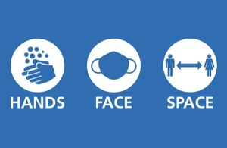
Covid times
Hub closed
Able to see patients at SMS after a few months
Could this work with appointments?
Use of Teams calls to limit unnecessary contact
Harder to get key worker support etc
But we still had success

Slide 6
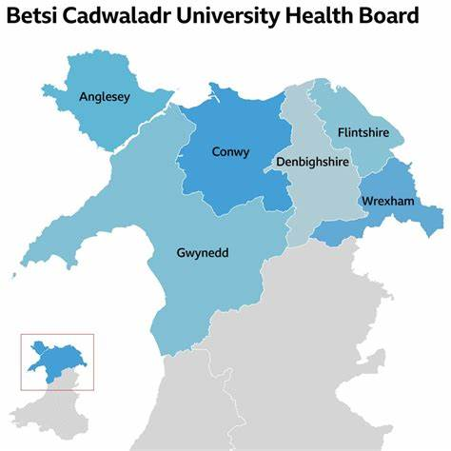
Rollout
Rolled out community clinics across North Wales
Some known positives
Testing projects
Almost all get pre-treatment bloods
Pangenotypic treatment
Often only do mid-treatment bloods if 1st bloods abnormal, but mid way PCR

Slide 7

Successes
Over 175 patients treated across North Wales
Many had failed to engage with treatment previously - one man finally managed treatment 23 years after diagnosis
People now come and ask for tests and/or treatment and we hear patients telling their friends how easy treatment is
Treatment can have impact beyond clearing the virus

Slide 8
How accelerated is “accelerated”?
Obtain bloods in most cases
Sometimes halfway between the preferred pathway and that for those who won’t have bloods
Ability to treat people the following week – team of nurses and pharmacists, pangenotypic treatment, support available for patients
But we have to treat the person at the right time for them – starting treatment more quickly than the patient is ready for makes our figures look good but doesn’t mean they will take it

Slide 9
How accelerated is “accelerated”? - A
Patient A
Came along to a testing event but already knew he was positive
Hates hospitals and had felt judged in A&E previously so had never attended his appointments
Bloods taken and all fine
Started treatment a week later
SVR12 achieved

Slide 10
How accelerated is “accelerated”? - B
Patient B
Got tested because he wanted a voucher
Positive result was a total shock
He came back several weeks running to cry, shout a bit, and tell us how unfair it was that he had hep C
Wouldn’t have bloods but there were some from a recent hospital visit
We had medication ready after 1 week but he wasn’t ready to start for around a month
Treatment completed and SVR achieved

Slide 11
How accelerated is “accelerated”? - C
Patient C
We met him in 2019. Positive but wanted a phone more than he wanted treatment. Much persuasion needed. Refused bloods
Admitted to hospital one week we planned to start, stalled a bit, made a plan to start then Covid hit
Seen again 2021. Persuaded lots of people to get tested but said treatment wasn’t for him
Seen several times over the years and sometimes expressed a wish to start treatment but then did not engage
Started in prison Jan 23. Didn’t take after release – failed
Finally successfully treated Sept 23.(Still refusing bloods) SVR this year!

Slide 12
Any questions/comments?

