Slide 1

Mosque BBV Testing in ABUHB
Gavin Hardcastle
Hepatitis Clinical Nurse Specialist
Aneurin Bevan University Health Board

Slide 2
Joint Recovery Plan
Key theme: Increase testing within high-risk groups
Action 4: Increase case finding
Action to improve outreach service
To engage with people from high prevalence countries of origin, a series of community screening events are planned
To prevent stigma associated with infectious diseases these were held as community health fairs

Slide 3
Hep B in Wales
Wales is a low prevalence country for hepatitis B with the prevalence of chronic HBV estimated at 0.78% (PHW 2023).
Most cases of hepatitis B are acquired outside of the UK.
Most cases result from migration from high-prevalence including South East Asia, South Asia and Sub-Saharan Africa.

Slide 4
Hep B in Newport
Newport has a higher proportion of the population from an ethnic minority background with 20% of the population from a non-white British/Welsh background.
This is compared to 10% across Wales. .
Communities where people’s country of origin is a high prevalence country are at higher risk of HBV infection.
Risks include vertical transmission, horizontal transmission through childhood infection and from use of non-sterile medical equipment if undergone procedures or medical treatment.

Slide 5
Purpose
To increase awareness of communicable and non-communicable diseases within diverse communities in Newport
To support community members to engage with preventative and diagnostic interventions including screening for high-risk groups.
To strengthen community engagement so members of the community are active participants with ownership of any future care or treatment required.

Slide 6
What we did
Held Community Health fairs in Mosques in Newport
Worked in partnership with Muslim Doctors Cymru as trusted voices.
If mosques are not of suitable size utilise community centres or locations e.g. Community House Eton Road.
Original plan for the events to be held as bi-monthly events beginning in August 2023 to cover 6 locations over 1 year period.
Following evaluation, if successful, then to consider hosting regular events within communities.

Slide 7
Stigma??
BBV Testing event?
NO!
Health event/fair?
YES?

Slide 8
Mosque Health Event
Takes the focus from BBV and makes it part of wider health assessment and advice.
B/P, AF, BMI, TB, Fibroscan etc…………….
Health promotion advice including in relation to cancer screening, immunisation and smoking cessation
These have developed with each successive event……..

Slide 9
September 2023
Community House, Eton Rd, Newport
Multi-cultural, multi-faith community centre in Newport, serving the neighbourhood of Maindee and beyond.
Targeting Al Noor Mosque
DBS Testing only
32 Tested
Demand greater than supply!
Bar the doors!

Slide 10
November 2023
Central Mosque, Stow Hill, Newport
DBS only
38 Tested
Demand = Supply!

Slide 11
January 2024
Iqra Masjid Mosque & Community Centre, Commercial Road, Newport.
Venous bloods for BBV and T Spot
DBS for BBV
43 tested
Demand = Supply
TB Team
Jo Hughes and Karrina Goodwin Fibroscanning
Andrew Yeoman!!!

Slide 12
What did BBV testing find?
Not a lot!
No Hep B or HIV
One person Hep C Ab+ve / PCR Not Detected (Previous Interferon Treatment)
Great news for all those attending

Slide 13
Why?
Primary care have done it already?
Wrong Mosque to test in?
Do we have the prevalence we might expect?
Lets see what we find in other Mosques………..

Slide 14
Tip of the iceberg??
Locality | No of individuals who answered ‘Muslim’ under religion category
Newport | 11,276
Caerphilly | 592
Monmouthshire | 439
Torfaen | 368
Blaenau Gwent | 285

Slide 15
Fibroscan
Scanned after screening criteria
44 Scanned
8 raised and offered follow-up appointments
4 of the 8 were NIDDM

Slide 16
Fibroscan Criteria
WEIGHT ­­________ BMI __________
REGION OF BIRTH _____________________
DIABETES TYPE 2 YES / NO
Any other Concerns
Alcohol YES / NO
If yes how often do you drink Monthly 2-4 time a month
Weekly Once a week 2/4 time a week Daily
Overweight YES/NO BMI >30 YES /NO

Slide 17
Demographics: Age

Slide 18
Demographics: Ethnicity

Slide 19
What we did well……
Working in partnership with Muslim Doctors Cymru colleagues and developing links with Mosque committee members.
Huge acceptance for Hepatitis testing in community setting.
We were supported by both MDC colleagues and people in the community to take up the offer
Developing this opportunity for further screening such as with fibroscan
BBV screening as part of a broader offer to community
Dedicated admin support to ensure that data capture and follow up individuals results

Slide 20
What we did less well…..
Each venue is different with different capacity so need to think about flow through the venue and not having bottlenecks in system.
Not everyone who attended made it to BBV testing area
Need to consider other faith communities e.g. Pakistani Christians……

Slide 21
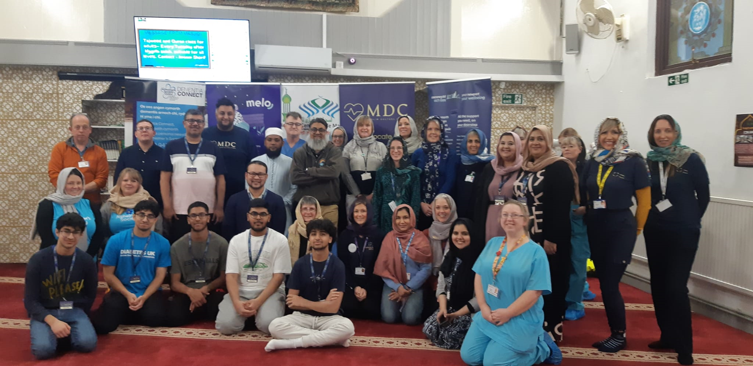
The Team!

Slide 22
Thanks
Kasim Ramzan (GP Newport)
Muslim Doctors Cymru
Bethan Bowden – Public Health Consultant
Joanne Hughes, Karrina Mitchell & Andrew Yeoman
Public Health Team: Rhian Hobbs, Lisa Verallo & Sania Sadiq

