Slide 1





Working in partnership to undertake BBV Screening Pathway Mapping exercise
Jim Henton
Alliance Manager
jim.henton@cavdas.com
07854230557
0300 300 7000
www.cavdas.com

Slide 2
Trust, Relationship and Value Alignment
Trust
Experience
Innovation
Candour
Collaboration
Co-Production

Slide 3
BBV Statement
Naloxone
DBST
Urine Drug Screen Testing
Needle Exchange
Health and Social Care Services
This post has been identified as requiring evidence of BBV immunisation status to carry out the role effectively. The role may require the post hold to undertake Dry Blood Spot Testing/ Substance Use Testing/ Working in Needle Exchange or is a clinical role and therefore CAVDAS wishes to ensure that staff are not at risk of infection or transmission of a disease that may affect their own or patient safety. Staff will therefore need to evidence their immunisation history, exemption, or non-responder on commencement of employment or at routine intervals at the request of the Alliance.
All staff are expected to support CAVDAS BBV action plan and the Welsh Government commitment to ‘Eliminating hepatitis (B and C) as a public health threat in Wales – Actions for 2022-23 and 2023-24’

Slide 4
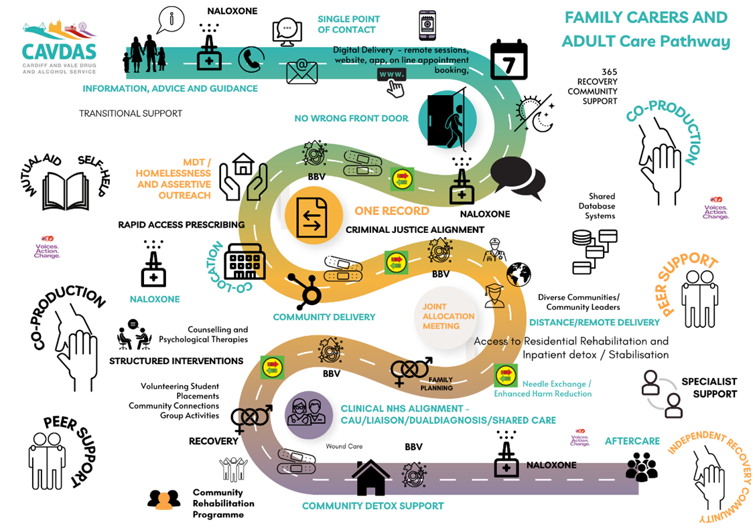

Slide 5
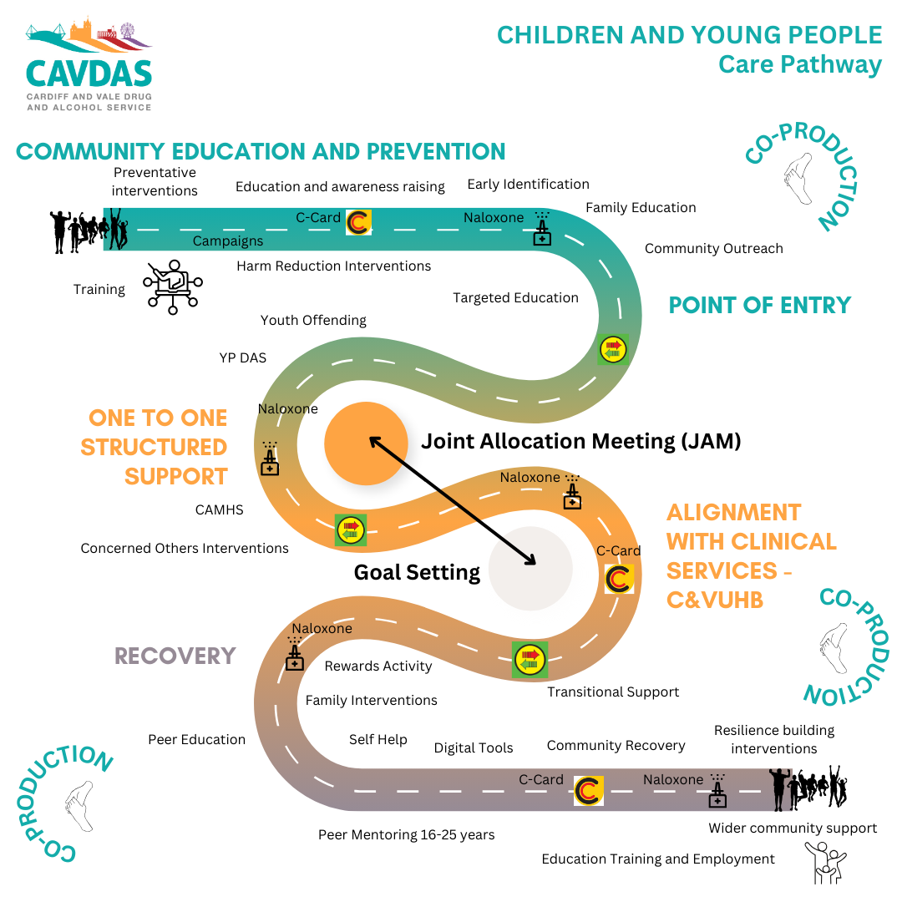

Slide 6
Workforce Development
Management of change
Culture of Learning
Skills Audit
Coproduction
Trauma Informed Approach
Psychologically safe environment

Slide 7



Slide 8
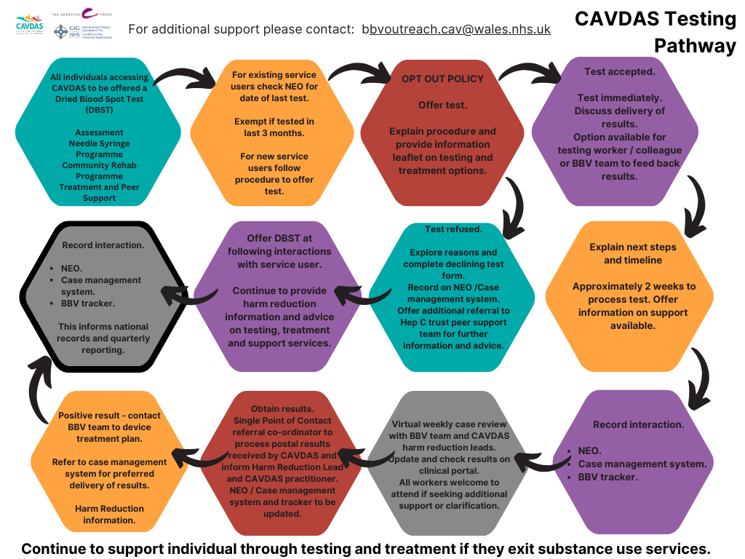

Slide 9
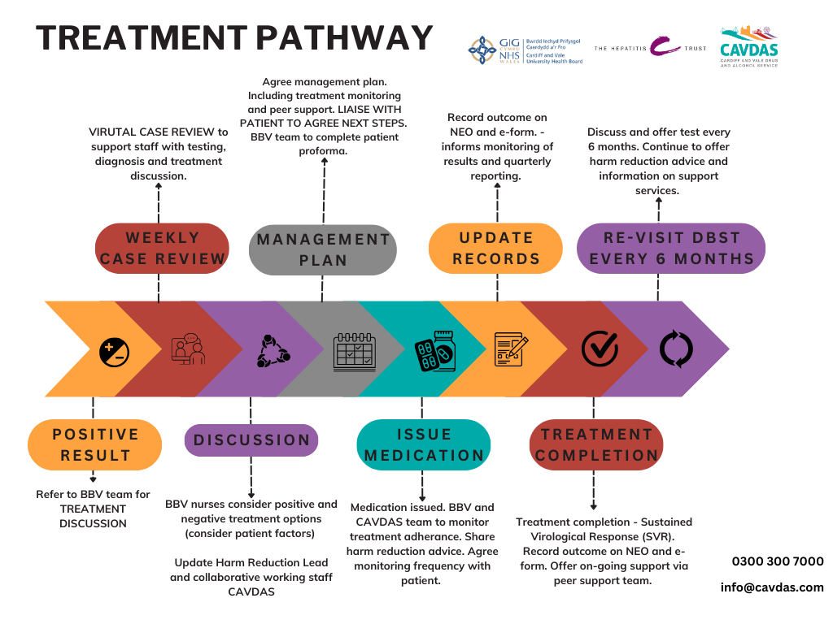

Slide 10
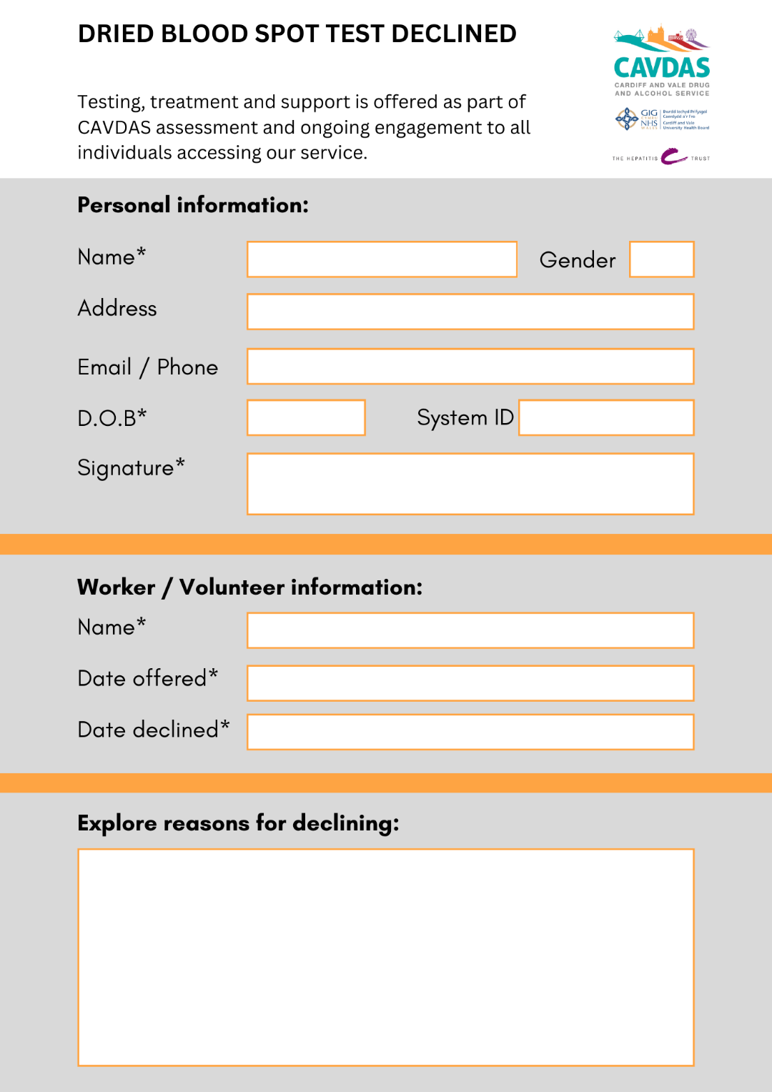

Slide 11

Next steps
Wales service provider forum
Micro elimination
CYP BBV pathway
Continue to challenge stigma
Partnership working
Innovation for access to testing and treatment models
Continue to focus on co-location
Harm Reduction Van

