Slide 1
Update from PHW
Hepatitis C National Workshop 2024
BBV, STI, TB and Inequalities team, CDSC
18.04.2024

Slide 2
BBV-PET

Slide 3
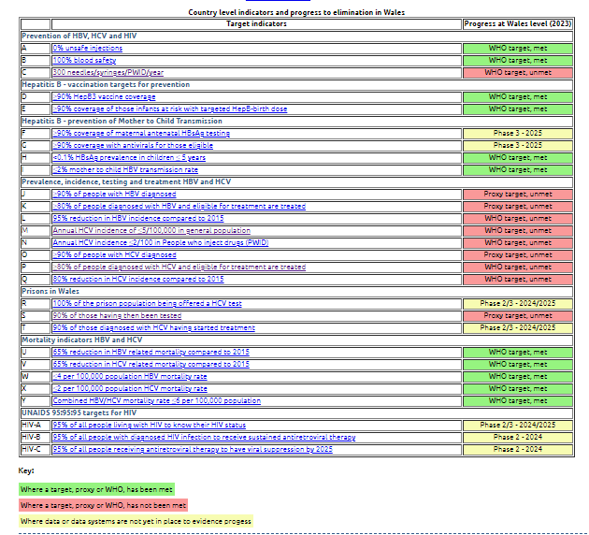
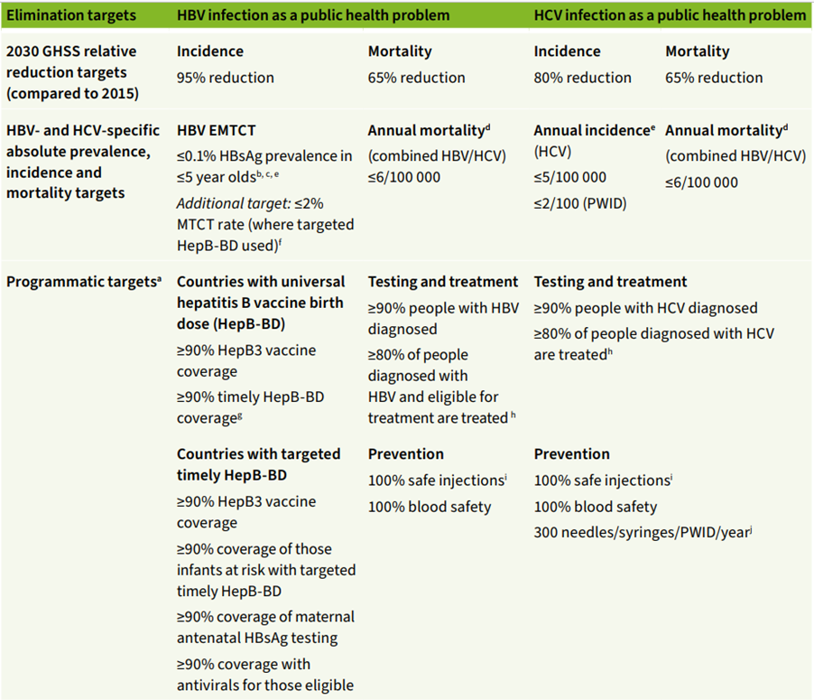
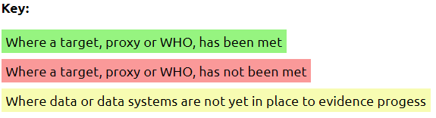
WHO and UNAIDS indicators
Headline progress in Wales

Slide 4
Data definitions (formal, proxy and operational) and limitations
Example
WHO indicator: ≥90% of people with HBV diagnosed
WHO statement: Focused testing for hepatitis B infection is recommended for individuals from populations most affected by HBV infection. These include those who are either part of a population with a higher seroprevalence (e.g. mobile/migrant populations from countries with high/intermediate endemicity, and certain Indigenous populations), or who have a history of exposure to, or high-risk behaviours for HBV (e.g. men who have sex with men [MSM], people living with HIV, their partners, family members and children of people living with CHB). Use of recent or multiple biomarker surveys and modelled estimates
Proxy interim definition for reporting against WHO indicator
Number of individuals without prior history of infection, tested for HBV infection (any test including Hepatitis B Surface Antigen (HBsAg), Hepatitis B e antigen (HBeAg), Antibody to HBeAg (Anti-HBe), Antibody to HBcAg (anti-HBc), IgM antibody to hepatitis core antigen (anti-HBc IgM)) and the number and proportion testing positive (stratified by acute, chronic and to be confirmed) by year
Data source: Datastore is a copy of the all Wales laboratory information management system LIMS. It holds the results of all laboratory tests performed in NHS Wales laboratories
Data limitations: However, it does not contain all laboratory results undertaken on Welsh residents. This is because some residents will have tests requested in other UK regions, especially near to the UK boarder. These tests results are not found on Datastore and, therefore, not included in this analysis.

Slide 5
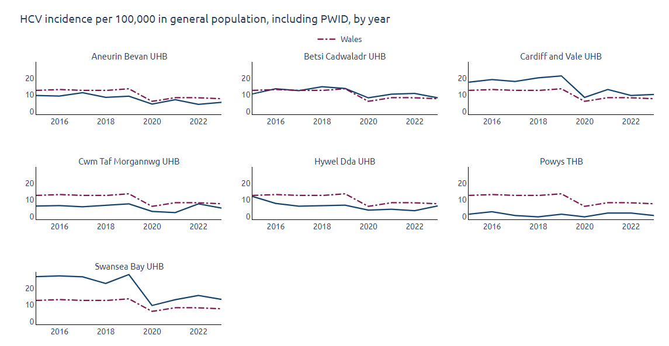

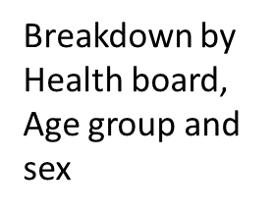
M: Annual HCV incidence of ≤5/100,000 in general population. In 2023, Wales rate: 8.33 per 100,000
A proxy measure of annual incidence rate has been calculated as the number of individuals without prior history of infection, tested for HCV infection (HCV-RNA) and the number and proportion testing positive by year. It is important to note that from 2017-2023, amongst individuals testing anti-HCV positive, confirmatory testing for chronic HCV infection was not completed for 34.5% of individuals

Slide 6
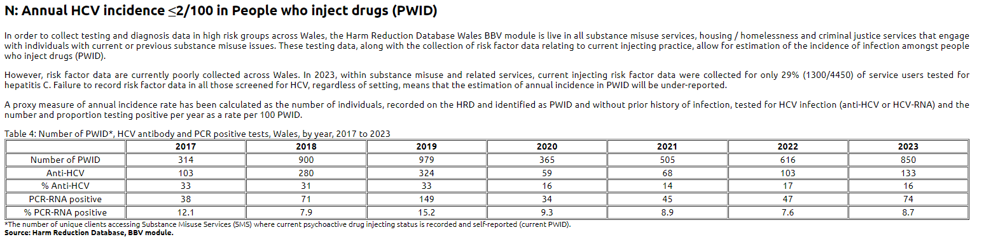
Risk factor data essential
Currently unable to evidence incidence by risk and general population
In 2023 – injecting risk factor data only asked for 29% individuals tested

Slide 7
Developments within the BBV module of the Harm Reduction Database

Slide 8
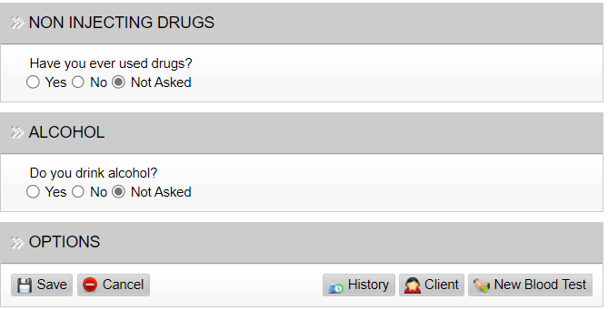
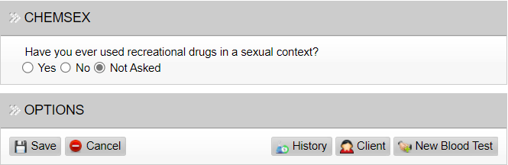
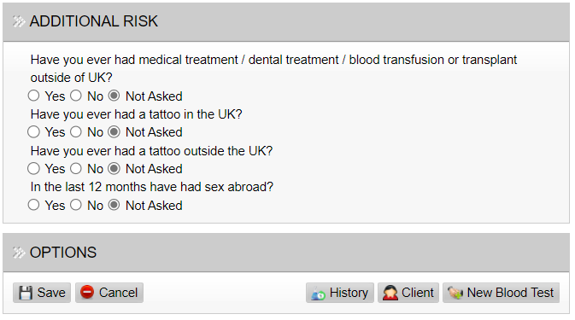
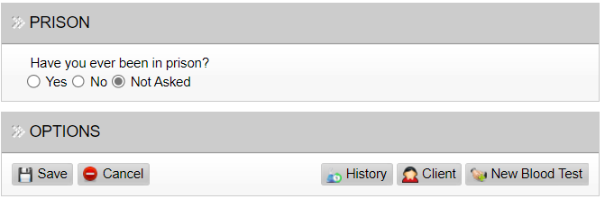
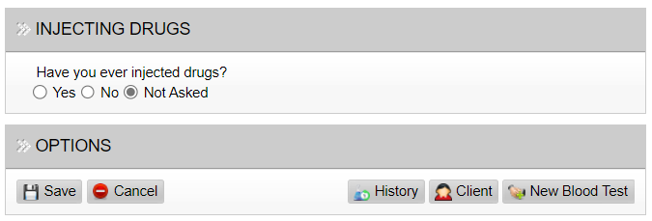
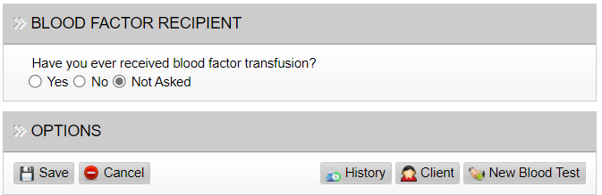
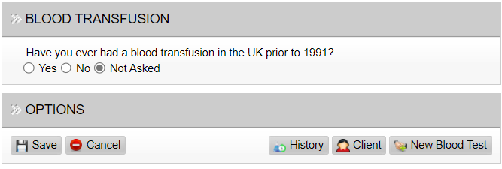
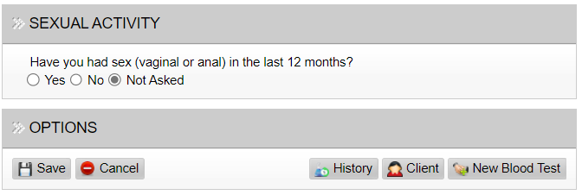
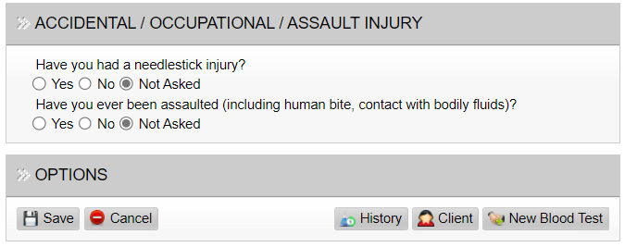
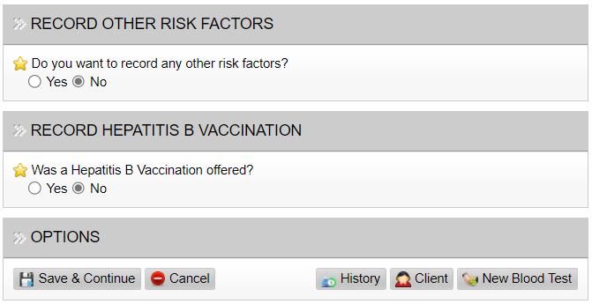
Risk Questionnaire
To improve risk factor data collection (and provide HR intervention)
Public Health Wales

Slide 9
Risk Questionnaire
To improve risk factor data collection (and provide HR intervention)
Prison
Sex
Substance use inc. injecting
Keep substance use inc injecting, sexual activity, and Prison
Sexual risk questions changing to:
“Have you been sexually active in the last 12 months?” followed up with offer of Self-test STI kit
If STI Home Test is selected, fields appear below, to gather the following information:
Date test kit provided and type of kit (drop down):
Penile (green bag)
Vaginal (white bag)
Universal (red bag)
Harm Reduction Database BBV module remains only mechanism to record risk behaviours and HR advice in a number of settings inc. homeless hostels
Public Health Wales

Slide 10
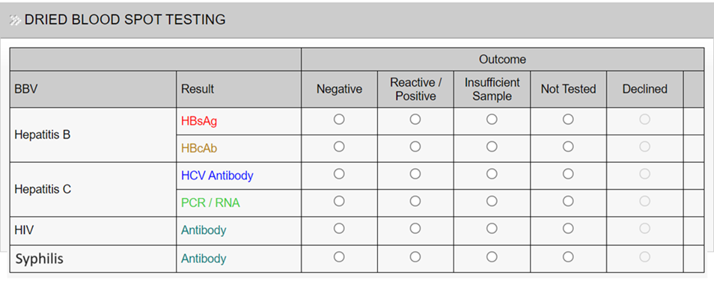
Other improvements
Addition of Syphilis testing on DBST

Slide 11
Hep C reengagement project

Slide 12
Methods
All LIMS tests for Hep C since 1990
Exclude those with evidence of SVR
  2 Negative PCR results 3 months apart following a positive PCR
Phase 1 (complete)
  Patients with a positive PCR (without evidence of SVR)
  Existing communication pathway via GP registration
Phase 2 (in progress)
  All positive and equivocal results (without evidence of SVR)
  Antibody or PCR results included
Public Health Wales
xxxxxxxxxxxxx
Notes:
So the re engagement process an is basically to try and get people back into services where we have evidence of testing but no evidence that they've been treated for it or cleared the infection, so when we think about methods we need to think about how that would exhibit itself in our data
that led us to go back to all of our test data in LIMS and we looked at all tests for hepatitis C right back to 1990
We can identify people who have been treated by seeing if they have SVR, this is sustained virological response and basically you need to be negative for a prolonged period of 3 months following infection
So what that looks like in the data is two negative PCR results three months apart following a positive PCR result and and that’s how we excluded people we thought were treated
phase one was completed a couple of years ago, it looked at patients with a confirmed pcr positive only, and used an existing communication pathway so was only people who are registered with the GP and basically sent a letter through that system
phase two is about more complex, we're looking at positive and equivocal results so maybe people that need further testing, and we're also including antibody results here so people haven't had that follow up test

Slide 13
Re-engagement Phase 2
Updating follow up lists
At start of Phase 1 – 3055 identified
Patients were removed from reengagement lists using local intelligence if they had achieved SVR following treatment, naturally cleared the virus, declined treatment, were already engaging with services, or passed away.
At start of Phase 2:
  1,517 individuals remain on updated lists, of which:
    1,352 (89%): registered with a Welsh GP (and 17 with an English GP)
    764 (50%): matched with substance misuse services (50 with HRD only, 290 with WNDSM only, 424 with both)
    132 (9%): were not matched with SMS or GP
Public Health Wales
xxxxxxxxxxxxx
Notes:
For reference, over half of patients on the updated follow up lists were successfully matched with the harm reduction database and/or WNDSM (which is the welsh national database for substance misuse). As touched on previously, this information provides an alternative point of contact for patients, one which they may be more likely to engage with. Otherwise, the vast majority of patients were registered with a GP, so we may utilise this communication pathway particularly where it is the only one identified.

Slide 14
Re-engagement Phase 2 next steps
Early follow up data returned to PHW from Health Boards on 1st March 2024, analysis ongoing for presentation at next implementation group
Need to establish consensus on finish date for Phase 2 – marking the end of the reengagement project and start of business as usual
Need to agree with all clinical teams, PHW and DHCW the automations and mechanisms to ensure that positive HCV-RNA results in referral to treatment and no one lost to follow up
Thank you to all clinical teams for updating records and providing progress updates and look forward to working with you to establish HCV registry as business as usual
Public Health Wales
xxxxxxxxxxxx
Notes:
For reference, over half of patients on the updated follow up lists were successfully matched with the harm reduction database and/or WNDSM (which is the welsh national database for substance misuse). As touched on previously, this information provides an alternative point of contact for patients, one which they may be more likely to engage with. Otherwise, the vast majority of patients were registered with a GP, so we may utilise this communication pathway particularly where it is the only one identified.

Slide 15
KPI 6 – all those engaged with substance misuse services are offered testing on at least an annual basis

Slide 16
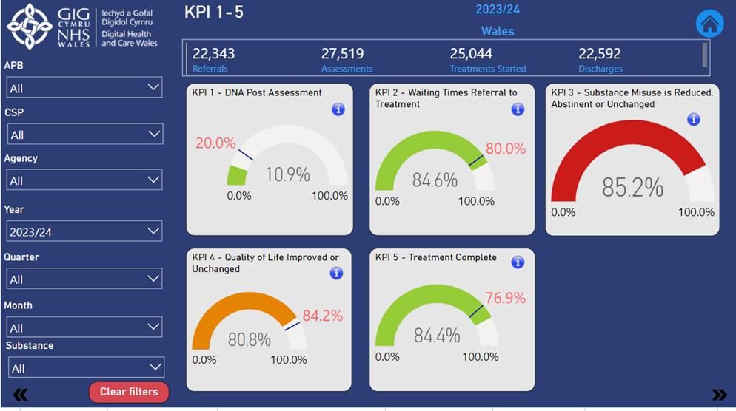
Substance misuse Key performance indicator
KPI 6 – All those engaged with substance misuse services should be offered BBV testing on at least an annual basis
Work underway with DHCW to update KPI 6 monthly via dashboard at Health board, local authority and agency level
Includes all NHS and third sector substance misuse services

Slide 17
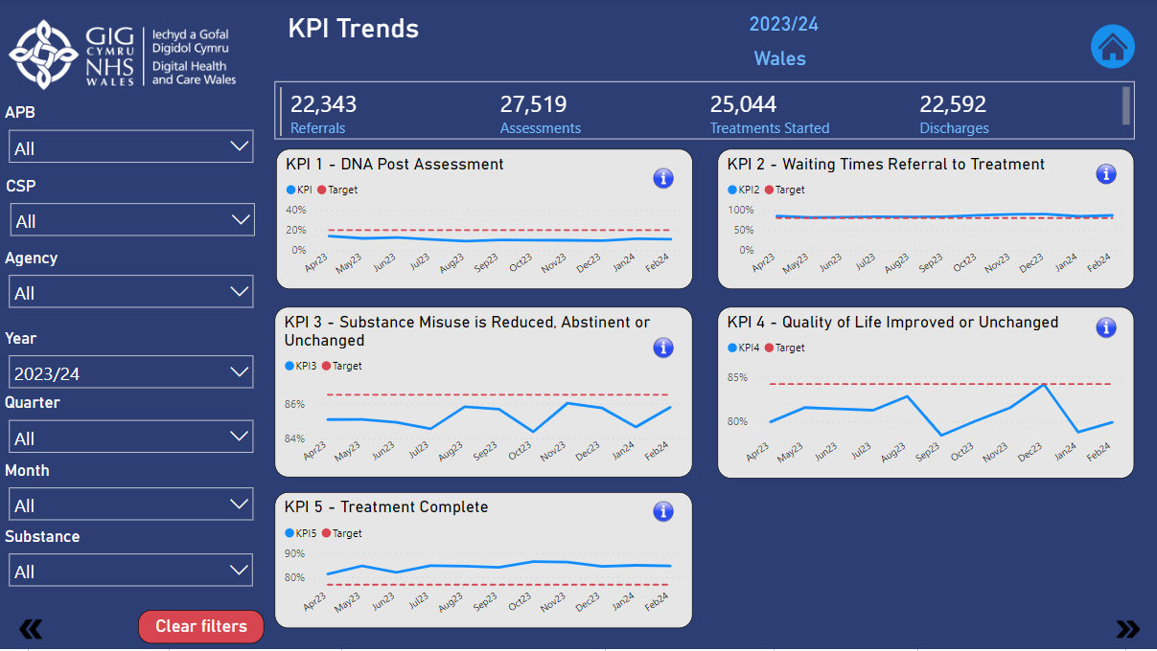

Slide 18
Thank you
Further information:
Savannah King, Information Analyst Specialist: savannah.king@wales.nhs.uk
Josie Smith, Senior Epi: josie.smith@wales.nhs.uk
Daniel Harman, Harm Reduction Lead: Daniel.Harman@wales.nhs.uk

