Slide 1



Matthew Rafferty
Harm Reduction Lead
Western Bay Area Planning Board

Slide 2

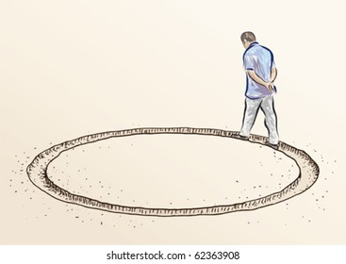

Background and Context
(How Harm Reduction Leads were feeling)

Slide 3



Background and Context
(How services were feeling)

Slide 4


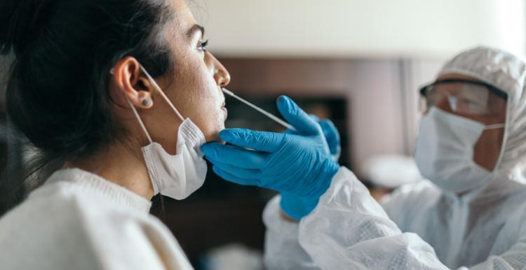

Then along came……..

Slide 5
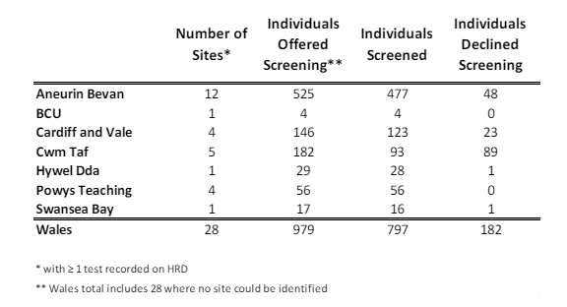
Data Source: PHW Infectious Disease Report
The reality………..

Slide 6


Slide 7

“We haven’t been vaccinated”
“I’m not a nurse”
“Not my job”
“They drink alcohol so don’t need a test”
“Haven’t got NEO access”
“NO ONE WANTS TO BE TESTED”
“I haven’t been trained”

Slide 8
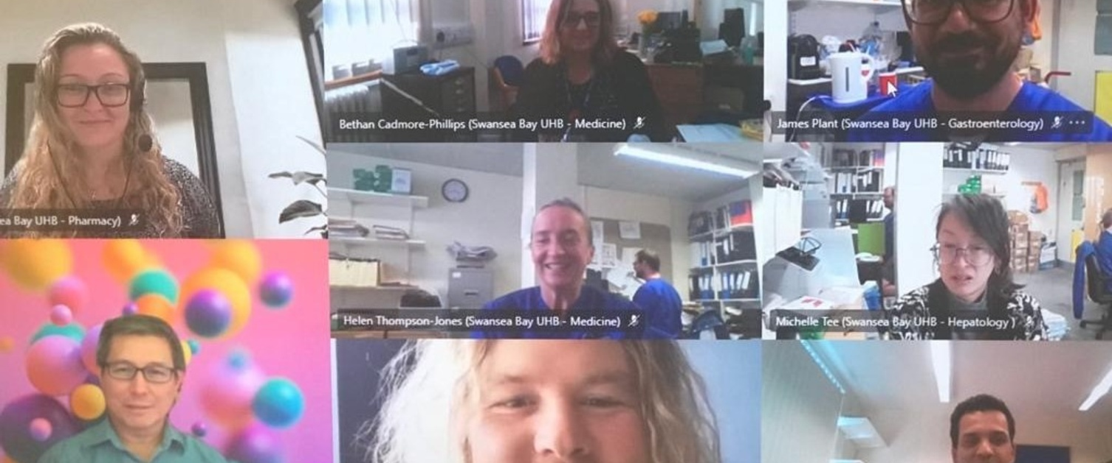
Through adversity came opportunity….

Slide 9
Progress to date…..
Year | 2023 | 2022 | 2021
Number of BBV tests completed | 1982 | 1054 | 335
492% increase in screening rates.
Data Source: Harm Reduction Database, Wales

Slide 10

PSALT
(Low Threshold Prescribing of OST)
Then…..
3 Tests completed in 8 years
Notion that this patient group were not at risk, deemed “low risk”
Now…….
228 tests completed since Oct 2022
Employed a BBV SPOC within the organisation
Test on entry, along with 6 monthly re-test
On-site treatment pathway

Slide 11

Dyfodol Swansea and NPT
Then…..
Peaks of troughs of testing, sometimes recording 6+ months with zero activity.
Reliant on the support of BBV Lead or BBV Clinical Team
Now…….
437 tests completed since Jan 2023 (testing approx. 30 people per month)
BBV Testing and Naloxone forms part of every medical/non-medical assessment on entry
Standard 6 monthly re-test as part of monitoring
Streamlined treatment pathway in place with the BBV Team delivering on-site clinics.

Slide 12

Rapid Access Prescribing Service (RAPs)
First service to make “test on entry” as part of standard practice.
Post-pandemic RAP’s has consistently screened 100% of caseload.
First service in WB to deliver outreach in the community in its truest form.
RAP’s have become the first service in WB to meet micro-elimination criteria (mirroring the criteria set in England).
Project ADDER funding has allowed Dyfodol to expand this model.

Slide 13
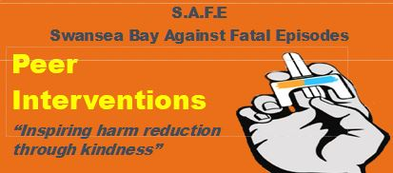
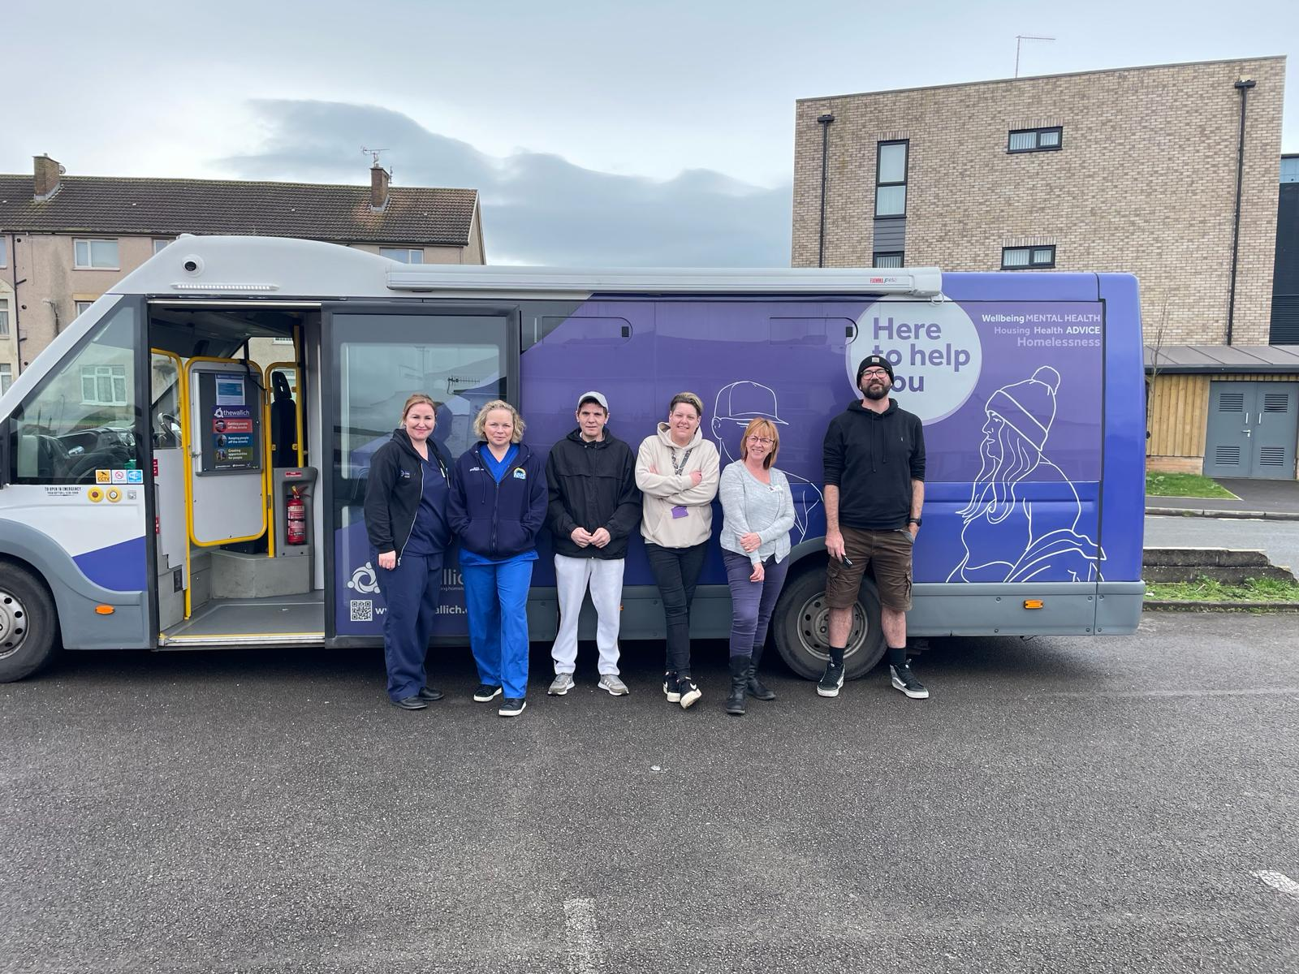
Peer Interventions
Successful peer led project delivered since March 2022.
Offering all 3 specialist harm reduction interventions- BBV Screening, NSP & THN.
Supported the BBV Team in the delivery x2 HIT days across Neath Port Talbot and Swansea.
A member of the Peer Interventions Project supports The Wallich Welfare Vehicle (WWV).
Provide services outside of “normal” working hours.
Pivotal in supporting and testing, those not known to services in the region (make up around 50% of DRD’s each year).

Slide 14


