Slide 1






Re-audit of the management of hepatitis B in pregnancy
Re-audit of the management of hepatitis B in pregnancy and the neonatal period
18th April 2024
Emily Clark (Specialty Registrar, PHW)
Susannah Froude (Consultant Virologist, PHW)
Vanessa Taylor (Specialty Registrar, PHW)
James Crocker (Senior Health Protection Nurse, PHW)
Kindry Williams (Antenatal Screening Wales, PHW)

Slide 2
Hepatitis B Virus: Introduction
Acute hepatitis
Jaundice, fatigue, nausea, vomiting, abdominal pains
Chronic hepatitis
>6 months
Can also be asymptomatic
Fulminant hepatitis
Usually <6 months
Often asymptomatic; over the long term → cirrhosis, liver failure, hepatocellular carcinoma
Risk of chronic hepatitis B is inverse to age when the virus is acquired:
Under 1 year old: >90%
Transmission
IV drug use
Children aged 1-5: <50%
Healthy adults: 5-10%
Vertical – mother to child
Bodily fluids – blood, semen, vaginal fluids
Notes:
Chronic hep B
Cirrhosis – 30% of which ~25% will develop liver failure within 5 years
Hepatocellular carcinoma – 5-10%

Slide 3
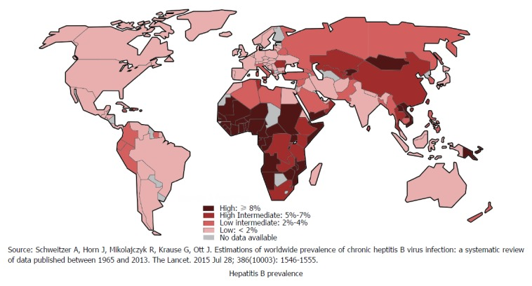
Hepatitis B Worldwide
WHO
2019
296 million living with chronic hepatitis B
829,000 deaths
  Of which 80% infected at birth/early childhood
https://www.who.int/news-room/fact-sheets/detail/hepatitis-b
Notes:
https://www.who.int/news-room/fact-sheets/detail/hepatitis-b
80% of deaths in those infected at birth or early childhood

Slide 4
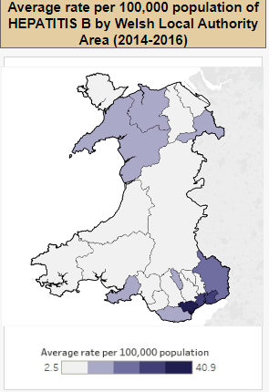
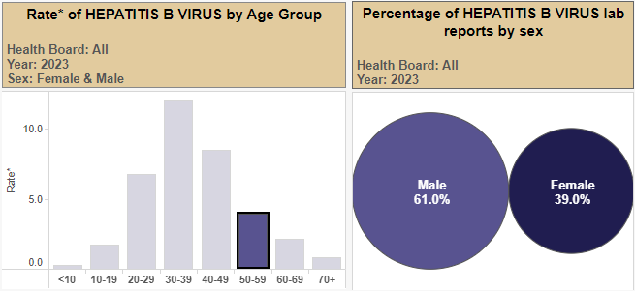
Hepatitis B in Wales
2023
Communicable Disease Surveillance Centre, PHW
https://public.tableau.com/app/profile/public.health.wales.health.protection/viz/LaboratoryreportsofHEPATITISBinWales/Dashboard2
Notes:
Most recent data
Different rates according to geography, age, gender
Main take homes – highest rates in SE Wales, and people of reproductive age (20-50yo)

Slide 5
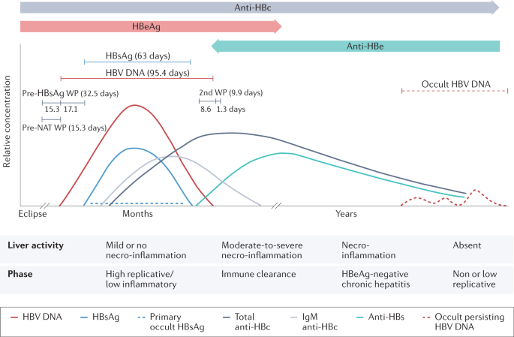
Diagnosis
Screening – HB surface Ag (HBsAg)
  3-4 weeks
Confirmation
  HBsAg (x2)
  HB total core Ab (Anti HBc)
  HB core IgM (Anti HBc IgM)
  HB e Ag (HBe)
  HB e Ab (Anti-HBe)
HBV DNA viral load
Kramvis, A., Chang, KM., Dandri, M. et al. A roadmap for serum biomarkers for hepatitis B virus: current status and future outlook. Nat Rev Gastroenterol Hepatol 19, 727–745 (2022).
Notes:
Immune tolerant
Immune active
Immune control
Immune clearance

Slide 6




Antenatal Hepatitis B Screening: Aims
        Enable the identification of women who are infected with hepatitis B whose infants will be at significant risk of contracting hepatitis B at or around the time of delivery
        Enable the offer of post-exposure prophylaxis of neonates
        Prevent mother to child transmission of Hepatitis B

Slide 7
Prevention of MTCT
Diagnose antenatally
  Communicable disease screening at booking appointment
Robust pathways to manage results
Options depend on the mother and baby
  Treat the mother
  HBIg
  Hepatitis B vaccine at birth
  Blood test at 12 months

Slide 8
Initial Audit (2017): Results
59 positive HBsAg: 26 (44%) new diagnoses, 33 (56%) known Hepatitis B positive
  Appropriate follow-up samples sent: 90%
  Appropriate completion of request card: 69%
  New diagnosis:
    Evidence of contact with antenatal clinic : 96%
    Evidence of referral to gastroenterology/hepatology : 96%
.
HBV DNA viral load sample not taken: 2 (6%)
Antenatal Screening Sample for patients with known
Hepatitis B: 33
Sample taken at the same time as the antenatal screening sample:
7 (23%)
HBV DNA viral load sample taken: 31 (94%)
Sample taken at a later date to the antenatal screening sample: 24 (77%)
Reasons why patients did not have a Gastroenterology/ Hepatology review (all cases)
38 ‘reactive’ HBsAg
  Appropriate follow-up samples sent: 35 (92%)
  No indication of HBV infection on confirmatory testing: 35 (100%)
Notes:
HBsAg positive:
The appropriate follow-up samples were taken for 53 (90%) patients. Three (5%) of the patients had insufficient follow-up samples taken, and 3 had no follow up samples taken.
Previously known Hep B: Of the 2 patients that did not have a HBV DNA viral load, one gave birth 2 weeks after having their antenatal screening sample taken, and one did not attend any of their follow-up antenatal appointments.
Fifty-one (86%) patients had reviews with the Gastroenterology/ Hepatology team, 24 (41%) were within 6 weeks of the antenatal screening sample result.
HBsAg Reactive Samples (n=38)
The appropriate follow-up samples were received for 35 (92%) out of 38 patients. Two of the 3 patients that had no confirmatory sample sent had been tested for HBsAg prior to their antenatal screening sample being taken.
All 35 patients showed no indication of HBV infection on confirmatory testing.
----
Evidence of reactive HBsAg results being communicated with the midwives is likely an underestimate (47%) as this information is not routinely recorded. All results are reported electronically.

Slide 9
Initial Audit (2017): Recommendations
Audit results to be shared with:
  Health Board Head of Midwifery, Antenatal Screening Coordinators and MAC Governance Leads
  Joint screening co-ordinators and governance leads meeting
  Virology/microbiology laboratories in Wales
  All Wales Health Board Gastroenterology Leads
Template/checklist for Hepatitis B positive women for use by health boards
Re audit following introduction of template/checklist

Slide 10
Re-Audit: Aims
Multi-professional collaboration to audit the pathway:
        Antenatal screening during pregnancy
        Post-exposure prophylaxis of neonates
        Assessment of outcome: was mother to child transmission of hepatitis B successful?

Slide 11
Re-Audit: Methods
Retrospective audit of clinical practice against the guidelines
All positive or reactive hepatitis B Surface Antigen test (HBsAG) reported from C&V Virology laboratory, ABMUHB Virology lab, CTMUHB Virology laboratory for the time period Jan 1 2021-December 31 2021
This time frame will enable audit of:
  management of the pregnancy
  early neonatal management
  late neonatal and infant management ie the pregnancy from early antenatal testing 10 weeks of pregnancy to the baby undergoing testing when they are 12-13 months of age.
Notes:
Guidelines:
1. All Wales ASW Policy, Standards and Protocols (Antenatal screening HIV, Hep B, Syphilis: pages 20-40)
Screening Information for Professionals - Standards and protocols 2019 V5 English Links to intranet site .pdf - All Documents (sharepoint.com)
2. National summary of neonatal hepatitis B immunisation in Wales. The reports summarise the uptake and timeliness of hepatitis B immunisation in neonates born to hepatitis B positive mothers in Wales. https://phw.nhs.wales/topics/immunisation-and-vaccines/neonatal-hepatitis-b-immunisation/

Slide 12

Identification of Hepatitis B positive women

Slide 13
Identification of Hepatitis B positive women
Hepatitis B positive women: 23
(2017: 59)
Previously known: 16/23 (70%)
(2017: 33; 56%)
New diagnosis = 7/23 (30%)
(2017: 26; 44%)
Repeat test taken during pregnancy: 16/16 (100%)
(2017: 33; 100%)
HBV viral load taken at booking: 1/16 (6%)
(2017: 7/33; 21%)
HBV viral load measured: 15/16 (94%)
(2017: 31/33; 94%)
Repeat serology taken: 7/7 (100%)
(2017: 22/26; 85%)
HBV DNA viral load taken: 7/7 (100%)
(2017: 24/26; 91%)
Test requesting:
Patient demographics: 100% (100%)
Sample details: 100% (100%)
Clinical information: 48% (69%)
Midwives informed: 7/7 (100%)
Midwives contacted within one working day: 2/7 (29%)
Notes:
2017: 59 women with hepatitis B positive samples. The re-audit (2021 data) identified 23 women. This may be reflective of the reduction in birth rate during this period; demographic changes in terms of risk factors for hepatitis B; or other reasons.
Test requesting
Although high standard of practice was maintained regarding completion of demographic and sample details on test requests, there was still room for improvement in inclusion of clinical details – mainly hep B diagnosis is key omission
Viral load
None of the women had a copy of the HBV DNA viral load requested to hepatology/gastroenterology. In women known to have hepatitis B, HBVDNA viral load should be taken at the same time as the booking sample.
Midwives contacted?
Note that 5/16 amongst women known have hepatitis B there was no documentation that midwives were contacted. It is likely actions have been completed but not documented. Current practice is to send an email to named screening coordinators. There is a failsafe whereby all screening results are sent to the antenatal screening coordinator or deputy via a generic email inbox.
Recommendation: for antenatal screening teams and microbiology to discuss and decide regarding the best mechanism by which to inform of hepatitis B results.

Slide 14
Time to repeat serology
2017 | No sample received | 4/26 (15%) | 2/26 (9%) | 2/33 (6%)
results | Sample received after 6 weeks | 5/26 (19%) | 2/26 (9%) | 5/33 (15%)
 | Sample received within 6 weeks | 17/26 (65%) | 22/26 (85%) | 26/33 (79%)
Notes:
New – TAT to repeat serology – much better now than 2017.
In women known to have hepatitis B, HBV DNA viral load should be taken at the same time as the booking sample. The test is done by community midwife.
By 2026 all maternity records will be online with the functionality to add flags. For example, if women are known to have hepatitis B, a flag will pop up for the community midwife to take a HBV DNA sample at booking.
Recommendation: In the meantime, highlight to community team the importance of taking HBV DNA viral load at the same time as booking bloods.

Slide 15
Referral to gastroenterology / hepatology
No women had a copy to hepatology / gastroenterology requested on the HBV DNA form
Notes:
Referrals to gastroenterology / hepatology
There was a reduction in the proportion of women with hepatitis B positive results referred to gastroenterology / hepatology compared to 2017. Review of data suggests that women were seen even though there was no evidence of a referral. It may be that women referred themselves. However, it is important to ensure that referrals are made and documented in order to align with standards and ensure the failsafes are adhered to.
Ongoing low proportion of women have a copy requested to hepatology/gastroenterology. Note that this standard is less clinically significant currently that previous, as all results are now available to clinicians on Welsh Clinical Portal.

Slide 16
Review by gastroenterology / hepatology
2017 data
New diagnosis
  23/26 (88%) women were seen
  11/26 (42%) were seen within 6 weeks
Previously known
  28/33 (85%) of women were seen
  13/33 (39%) were seen within 6 weeks
Notes:
Note that UKHSA have updated their standard to state that women should be seen within 6 weeks if they have:
a confirmed hepatitis B screen positive result for the first time in this pregnancy
a result with higher infectivity markers for a woman known to be living with hepatitis B
Higher infectivity markers are defined as:
HBsAg positive and HBeAg positive
HBsAg positive and anti-HBe negative
acute hepatitis B in pregnancy
HBsAg positive and known to have an HBV DNA level ≥2x10⁵ IU/ml
UK Government. Guidance Infectious diseases in pregnancy screening standards valid for data collected from 1 April 2023 Updated 7 February 2023. Available from: https://www.gov.uk/government/publications/infectious-diseases-in-pregnancy-screening-programme-standards/infectious-diseases-in-pregnancy-screening-standards-valid-for-data-collected-from-1-april-2018 Accessed 23.01.2024

Slide 17

Post-exposure prophylaxis of neonates

Slide 18
HBIG
19 babies of the 23 women were included
Reasons for non-inclusion: stillbirth, lost to follow up, no longer resident in Wales
Notes:
In the 2 cases where HBIG was required, it was given on time

Slide 19
Neonatal and infant vaccination
Notes:
Where vaccines documented as not given here in this audit – some of these babies were out of the country when their vaccine was due so it is not known whether it would have been received abroad or not
Where vaccines are not given on time – it is usually given late, but has been given early on 2 occasions.

Slide 20


Prevent mother to child transmission of Hepatitis B

Slide 21
Did the baby receive a serological test?
Was the infant hepatitis B positive or negative?
Notes:
16 of 19 babies had serology
Babies who did have serology: None of the babies born to mothers identified to be hepatitis B positive (either known from prior to pregnancy, or newly identified during this current pregnancy) seroconverted. Therefore, prevention of mother-to-child transmission (vertical transmission) was successful in 100% of cases where the baby had a serological test in the re-audit
16% of babies did not receive a serological test and therefore no diagnosis was obtained. Needs better surveillance and follow-up for these babies.

Slide 22
Recommendations

Slide 23
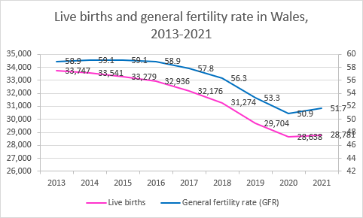
Recommendations
^{[1]} World Health Organization, Coronavirus disease (COVID-19) pandemic. Available from: https://www.who.int/europe/emergencies/situations/covid-19 Accessed 23.01.2024
^{[2]} Nomis. https://www.nomisweb.co.uk/query/construct/submit.asp?menuopt=201&subcomp Accessed 09.08.2023
^{[3]} Public Health Wales. Laboratory reports of Hepatitis B in Wales 2019-2022. Available from: https://public.tableau.com/app/profile/public.health.wales.health.protection/viz/LaboratoryreportsofHEPATITISBinWales2019-2022/Dashboard2
^{[4]} Public Health Wales. Public Health Wales Health Protection. Available from: https://public.tableau.com/app/profile/public.health.wales.health.protection/vizzes
Summary of results
2021 Reaudit
Fewer women had hepatitis B positive results in 2021 than 2017-2018 (25 and 59 respectively) Most women were previously known to have hepatitis B (68%). All pregnant women known to have hepatitis B (prior to the current pregnancy) received a repeat test in this pregnancy in the initial audit and reaudit. Only 1 of 17 women previously known to have hepatitis B had their viral load taken at booking. This should be offered to all women known to have hepatitis B. There is room for improvement in documentation of actions taken by the clinical team, for example, evidencing that midwives have been informed of results and that referrals have been made. As per the initial audit, no women with reactive results showed any evidence of HBV infection on confirmatory testing. In the 3 cases where HBIG was required-it was given on time 2 babies were out of the country when their vaccine schedule was due and no documentation recordd on whether these babies received their vaccines abroad 31% of babies did not receive serology after vaccination programme and hence remain undiagnosed. None of the babies born to mothers identified to be hepatitis B positive (either known from prior to pregnancy, or newly identified during this current pregnancy) seroconverted. Therefore, prevention of mother-to-child transmission (vertical transmission) was successful in 100% of cases where the baby had a serological test in the reaudit period.
2017-2018
The number of patients that had a confirmatory sample and/or a HBV DNA viral load sample was high. 65% - 85% of the follow-up samples were received within 6 weeks of the antenatal screening result being available. A high percentage (88%) of women had a review with Gastroenterology/ Hepatology, although a sub-optimal proportion were within 6 weeks of a positive antenatal screening result (42%). Barriers to following the appropriate clinical pathway include non-attendance of the appointment by the patient, late booking of the pregnancy, and women moving outside of the health board area. A high percentage of women with reactive antenatal screening results had a follow-up sample taken. No women with reactive results showed any evidence of HBV infection. Assessment: What overall observations can be drawn from your findings? Detail any key themes arising from the audit process, in terms of good practice, and areas for improvement. If this is a re-audit, have the implemented changes made a demonstrable improvement? This reaudit demonstrated the value of cross-disciplinary working, with collaboration between Screening, Health Protection, and Microbiology. We were able to audit the patient journey from booking bloods in early pregnancy, to demonstrating the child’s outcomes at 12 months of age. None of the babies born to mothers identified to be hepatitis B positive (either known from prior to pregnancy, or newly identified during this current pregnancy) seroconverted, where the baby received a serological test post vaccinations. Therefore, prevention of mother-to-child transmission (vertical transmission) was successful in 69% all of the cases in the reaudit period and 31% unknown. The reaudit period (1st January 2021-31st December 2021) was chosen at it represents the most up-to-date period, to allow for mothers to complete their pregnancy and for the child to be old enough for the serological test. This time period also encapsulates the COVID-19 pandemic (declared a pandemic by the World Health Organization on 11 March 2020, and declared no longer a Public Health Emergency of International Concern on 5 May 2023). The reaudit demonstrates areas of excellent practice despite the overarching context, as well as areas for improvement. Changes following the initial audit and outcomes can be found in the table below:
2017/18 audit recommendations | Outcome
Audit results to be shared with: Health Board Head of Midwifery, Antenatal Screening Coordinators and MAC Governance Leads Virology/microbiology laboratories in Wales All Wales Health Board Gastroenterology Leads. Audit results were presented and discussed at the joint screening co-ordinators and governance leads meeting in October 2019 by Sophie Jones (PHW microbiology). | 30 Dec 2019 Presented as a poster at PHW Annual Conference Oct 2019 30 Dec 2019
ASW, in conjunction with screening coordinators and MAC Governance Leads, have decided to develop a template/checklist for Hepatitis B positive women for use by health boards (in progress). Re audit following introduction of template/checklist. | Not conducted due to COVID-19 pandemic Completed Sept 2023 Aide Memoire HEP B - V1.docx (live.com) 2021 reaudit findings and interpretation Number of hepatitis B positive women Data from October 2017 – November 2018 demonstrated 59 women with hepatitis B positive samples. The reaudit (2021 data) identified 25 women. This may be reflective of the reduction in birth rate during this period; demographic changes in terms of risk factors for hepatitis B; or other reasons. Figure 1 . Live births and the general fertility rate in Wales, 2013-2021. Data from Nomis. Table 1. Notifications of hepatitis B in Wales, 2018-2022
Year | Total notifications | Rate per 100,000 population | % Female | Calculated number of females
2018 | 264 | 8.4 | 41.3 | 109
2019 | 227 | 7.2 | 37.4 | 85
2020 | 171 | 5.4 | 39.8 | 68
2021 | 188 | 6 | 37.2 | 70
2022 | 293 | 9.3 | 33.4 | 98 Test requesting Although high standard of practice was maintained regarding completion of demographic and sample details on test requests, there was still room for improvement in inclusion of clinical details. It is likely challenging for community midwives conducting booking bloods in the community as they work with pen and paper. Clinicians working in antenatal clinics would have access to electronic test requesting. Most women (92%) do not have a copy of the HBV DNA viral load requested to hepatology/gastroenterology. Note that this standard is less clinically significant currently that previously, as all results are now available to clinicians on Welsh Clinical Portal. In women known to have hepatitis B, HBV DNA viral load should be taken at the same time as the booking sample. The test is generally consented and requested by community midwife And taken in the hospital antenatal clinic at the same time as the early pregnancy dating scan. By 2026 the All Wales Maternity Record will be online with the functionality to add flags. For example, if women are known to have hepatitis B, a flag will pop up for the community midwife to take a HBV DNA sample at booking. N.B. This system is in the procurement process, so functionality is uncertain. Managing results There was a reduction in reporting of contacting a midwife with the results. It is likely actions have been completed but not documented. Current practice is to send an email to named screening coordinators. There is a failsafe whereby all screening results are sent to the antenatal screening coordinator (or deputy) and designated antenatal clinic staff via a generic email inbox. This is monitored on a daily basis (Monday-Friday) Referrals to gastroenterology / hepatology There was a reduction in the proportion of women with hepatitis B positive results referred to gastroenterology / hepatology compared to 2017/18. Review of data suggests that women were seen even though there was no evidence of a referral. It may be that women referred themselves. However, it is important to ensure that referrals are made and documented in order to align with standards and ensure the failsafes are adhered to. Reactive Hepatitis B results None of the reactive results became were positive for hepatitis B on retesting, implying no women were identified at the point of seroconversion. None of the confirmatory samples were “insufficient to test” which represents a huge improvement on 2017/18 (where 97% were insufficient). Neonatal management of babies born to hepatitis B positive mothers
[EC(G(R1]James - would you be happy to add postnatal findings
[EC(G(R2]Was this done? If so, is it possible to see a copy?
[EC(G(R3]Is this correct?
[EC(G(R4]I added this in for context but feel free to delete if not relevant
[EC(G(R5]James would you be happy to add in the additional findings?
Documentation and process
Health boards to use ASW hepatitis B Aide memoire for all cases
Hepatitis B positive results
Where hepatitis B positive status is known, HBV DNA viral load to be taken at the same time as screening
Neonatal management
Discuss with stakeholders regarding process to inform midwives of hepatitis B results
All health boards should have a process for ensuring that women who miscarriage complete the screening pathway
Where there is a positive Hepatitis B result, refer to Hepatology/gastroenterology, take HBV DNA and forward copy
Antenatal screening team to discuss with key stakeholders regarding updated UK HSA standards on recommended referral TAT
Consideration for improved follow-up of babies where there was no serology undertaken
Clarify roles and responsibilities of organisations involved to improve understanding of missed/late vaccination and actions required
Improving follow-up documentation of health protection database with clinical records for accurate status of vaccinations given early/late/not given
All women to receive a confirmatory test to rule out early infection
Hepatitis B reactive results
Reaudit once changes made
Notes:
Presentation + dissemination of findings
HEP B POSITIVE
Note that UKHSA have updated their standard to state that women should be seen within 6 weeks if they have:
a confirmed hepatitis B screen positive result for the first time in this pregnancy
a result with higher infectivity markers for a woman known to be living with hepatitis B
Higher infectivity markers are defined as:
HBsAg positive and HBeAg positive
HBsAg positive and anti-HBe negative
acute hepatitis B in pregnancy
HBsAg positive and known to have an HBV DNA level ≥2x10⁵ IU/ml
UK Government. Guidance Infectious diseases in pregnancy screening standards valid for data collected from 1 April 2023 Updated 7 February 2023. Available from: https://www.gov.uk/government/publications/infectious-diseases-in-pregnancy-screening-programme-standards/infectious-diseases-in-pregnancy-screening-standards-valid-for-data-collected-from-1-april-2018 Accessed 23.01.2024

Slide 24


Acknowledgements
Health Board Team for managing the women through their pregnancy and babies during their vaccination schedule
Specialist Registrar Programme, PHW
Virology UHW and ABHB
Health Protection, PHW
Antenatal Screening Wales, PHW
Thank you!
Any Questions?

Slide 26
Initial Audit (2017)
Audit of the management of hepatitis B in pregnancy against Antenatal Screening Wales (ASW) Policy, Standards and Protocols
  To specifically monitor outcome of a new addition to the pathway: hepatitis B DNA viral load when a diagnosis of hepatitis B has been made.

Slide 27
Hepatitis B reactive results

Slide 28
Identification of Hepatitis B reactive women
Total Hepatitis B reactive samples: 44
(2017: 38)
Request completed correctly: 44/44 (100%)
(2017: 37/38; 97%)
ANC contacted with result: 27/44 (61%)
(2017: 19/38; 50%)
Lost to follow up: 4/44 (9%)
(2017: 1/38; 3%)
Notes:
3 of the 4 LTFU did not need 2nd test (as primary test in this pregnancy was same result as a previous sample and verified as non-specific reactivity)
All results are sent to the generic email inbox for the antenatal screening coordinators. Recommendation: for antenatal screening teams and microbiology to discuss and decide regarding the best mechanism by which to inform of hepatitis B results. Should the processes be the same or different for positive and reactive results?

Slide 29
Turnaround times
Range: 2-48 days
30/44 (68%) within 5 days
2017: Mean: 6; range 1-16 days)
Range: 1-115 days (2017: mean 19, range 2-67 days)
Sample received within six weeks: 35/44 (80%) (2017: 32/38, 84%)
No sample received: 9/44 (20%) (2017: 3/38, 8%)
Notes:
ASW C16-Standard-The testing laboratory must aim to achieve a five working day turnaround from sample receipt to result reporting for non-urgent samples. Target 95%
Samples may be sent direct to the reporting lab, or may be forwarded on to another lab for analysis which should be no more than 1 working day from sample being taken, or no more than 2 working days if forwarded from the local lab onwards for analysis.
30 samples TAT within 5 days. NB may be more as audit used date of sample collection (not date received within the lab) to result date authorised and did not account for non working days (weekend days, eg).
14 samples TAT> 5 days
Recommend to look at TAT’s as a snapshot audit or as part of Performance Indicators
Regarding: informing ANC of reactive results → repeat samples
4 women should have received a 2nd sample and unclear why they di not
1 woman miscarried but repeat sample should have been sent to refute early infection. ASW standards state that the health board must have a process in place to manage results giving where the woman has miscarried.
4 women did not receive further test which was consistent with number of previous samples therefore likely to be non-specific reactivity +

Slide 30
Confirmatory samples
Notes:
None of the reactive results became positive for hepatitis B on retesting, implying no women were identified at the point of seroconversion.
1 woman who had a miscarriage did not have a second test. All health boards should have a process for ensuring that women who have a miscarriage complete the screening pathway.
Unclear why the others who did not have a confirmatory test did not have one sent.

