Slide 1







BBV in
Welsh Pharmacies
2030 elimination

Slide 2

1– Develop Joint Recovery Plans Health boards
2- Sufficient funding
3- Prevent Infection
4- Increase case finding
5- Improve testing models
6 - Improve testing in Community Pharmacies testing
7 - Improve testing in substance misuse services
8- Improve referral rates
9- Improve testing and treatment in Prisons
10 - Improve treatment times
11 - Increase number of patients successfully treated
12 - Deliver the national re-engagement programme
13 – Improve Data
Action 6
Improve testing in Community Pharmacies Testing is currently being delivered in a small number of community pharmacies.
Introducing new point-of-care tests is a key way of improving testing in this community setting.
Health boards must ensure point-of-care tests are available in at least 100 community pharmacies from those with the highest numbers of needle and syringe exchange and opioid substitution therapy service users by April 2024. Welsh Government will work with health boards to agree the priority pharmacies in each health board area.
WHC/2023/001

Slide 3

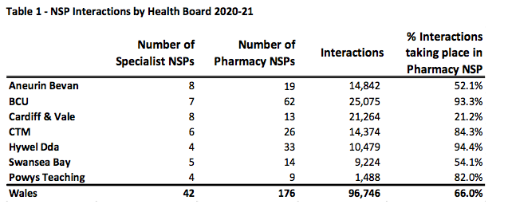
https://phw.nhs.wales/publications/publications1/harm-reduction-database-wales-prevention-and-detection-of-infectious-disease-amongst-people-accessing-substance-misuse-services-annual-report-2020-21/

Slide 4
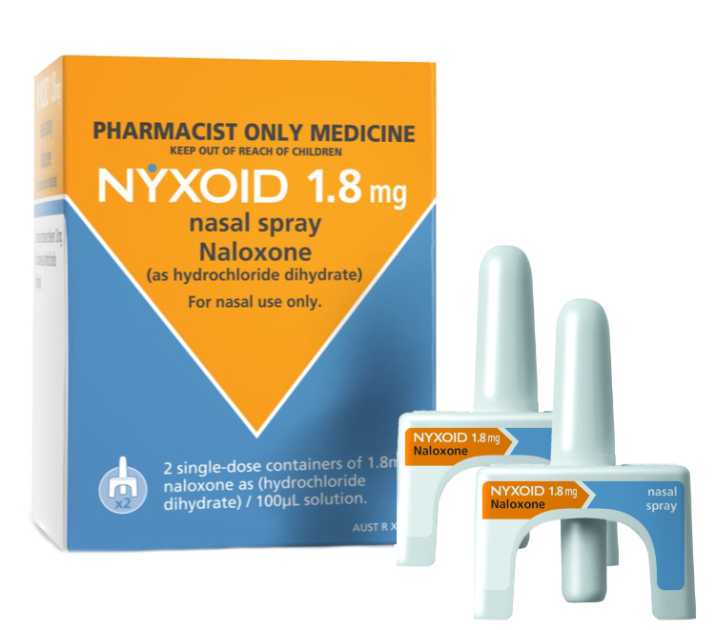
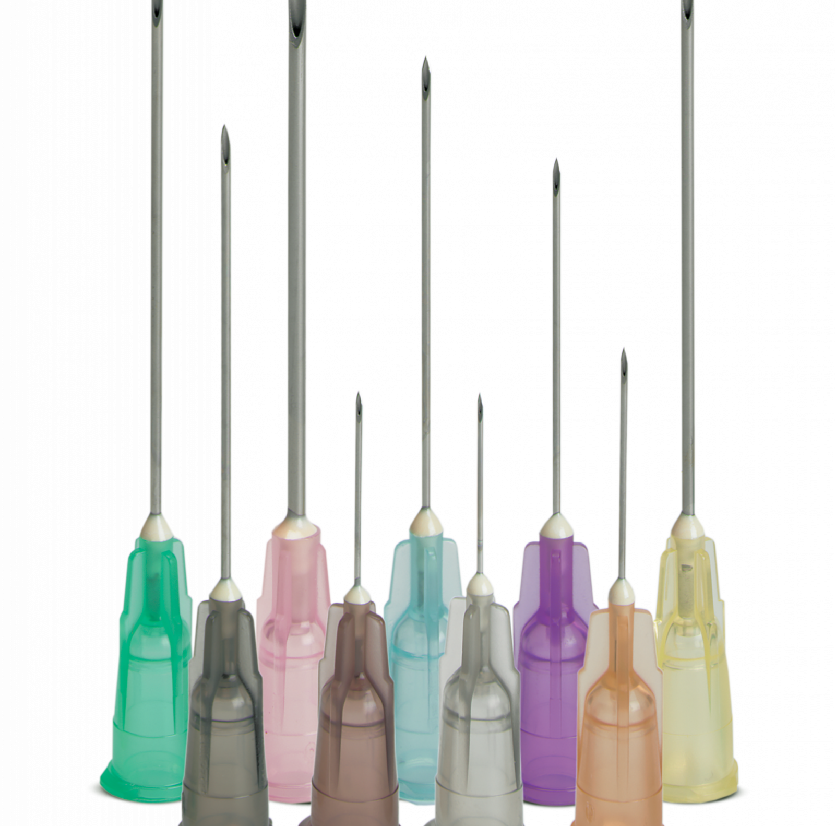
Needle and syringe programme
Level 1 – Supply only
Level 2 – Supply and proactive support (includes actively identifying individuals for BBV test)
Level 3 – Naloxone
National service specification signed by NESB and CPW.
Training module on HEIW
Blood borne virus testing

Slide 5


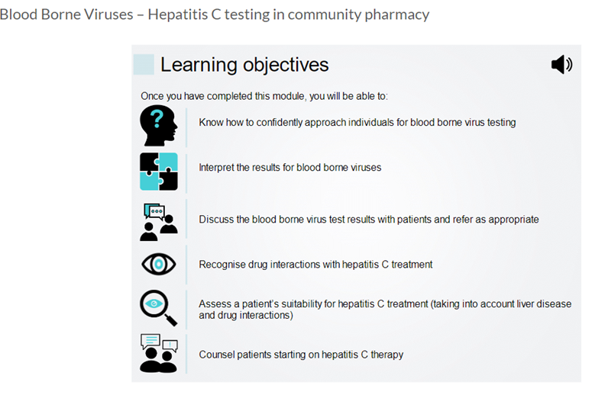
Notes:
We’ve got a live training module on health education and improvement wales which is the training platform for pharmacy staff to run services. Taking them through hiv, hep b and hep c. It has a good overview of all 3 bbvs but leans towards hep c as it concentrates on the testing methods, interpretation and engagement with cases studies which is interactive and takes around 40 minutes to complete.

Slide 6
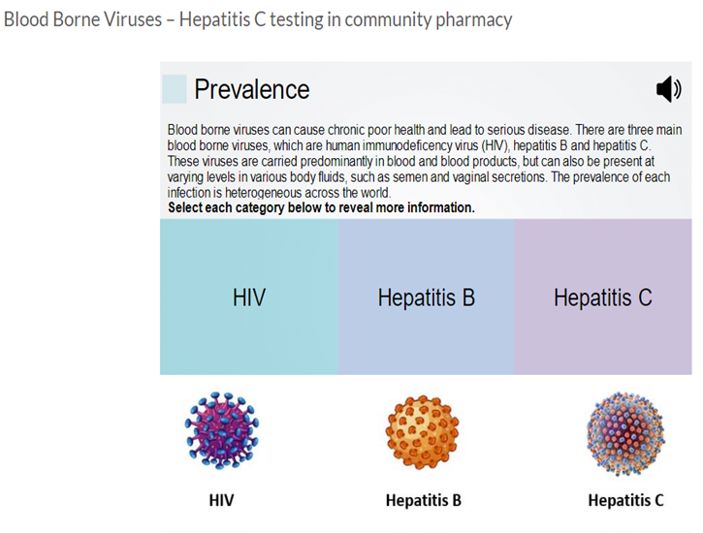
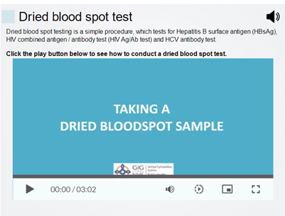
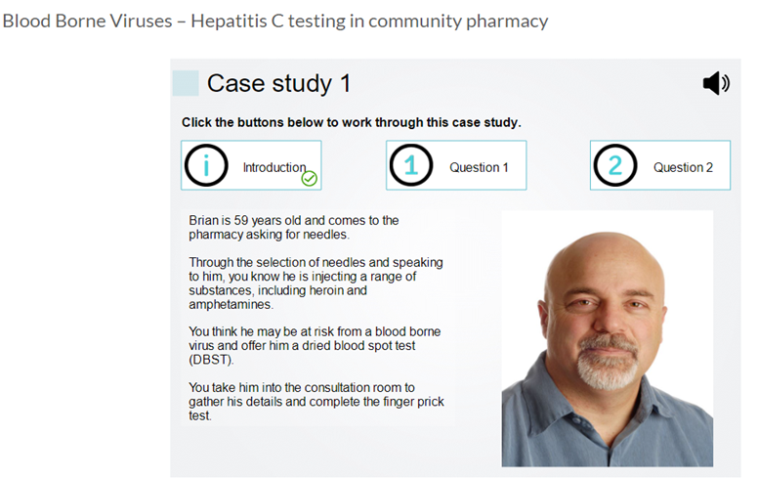

Slide 7
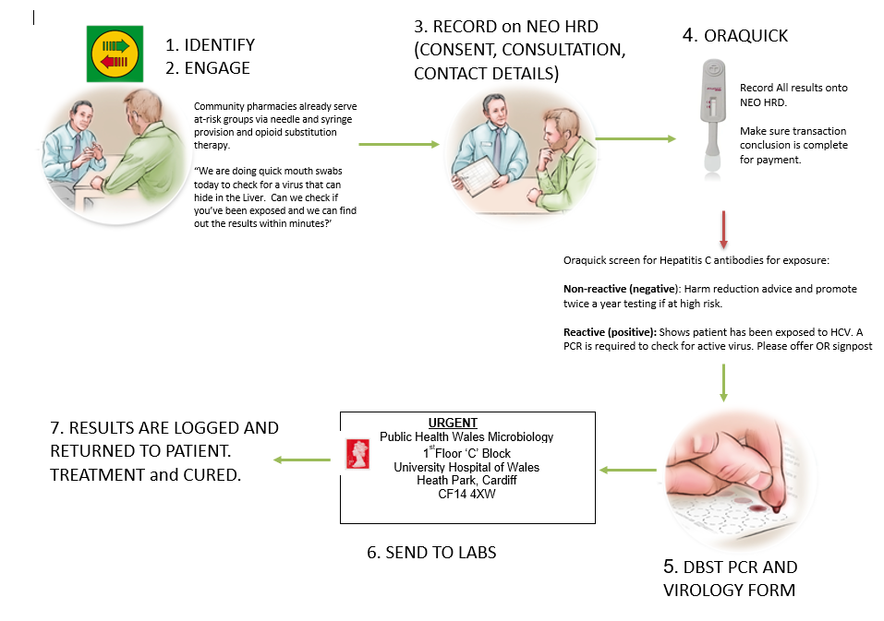
BBV PHARMACY
PROCESS

Slide 8
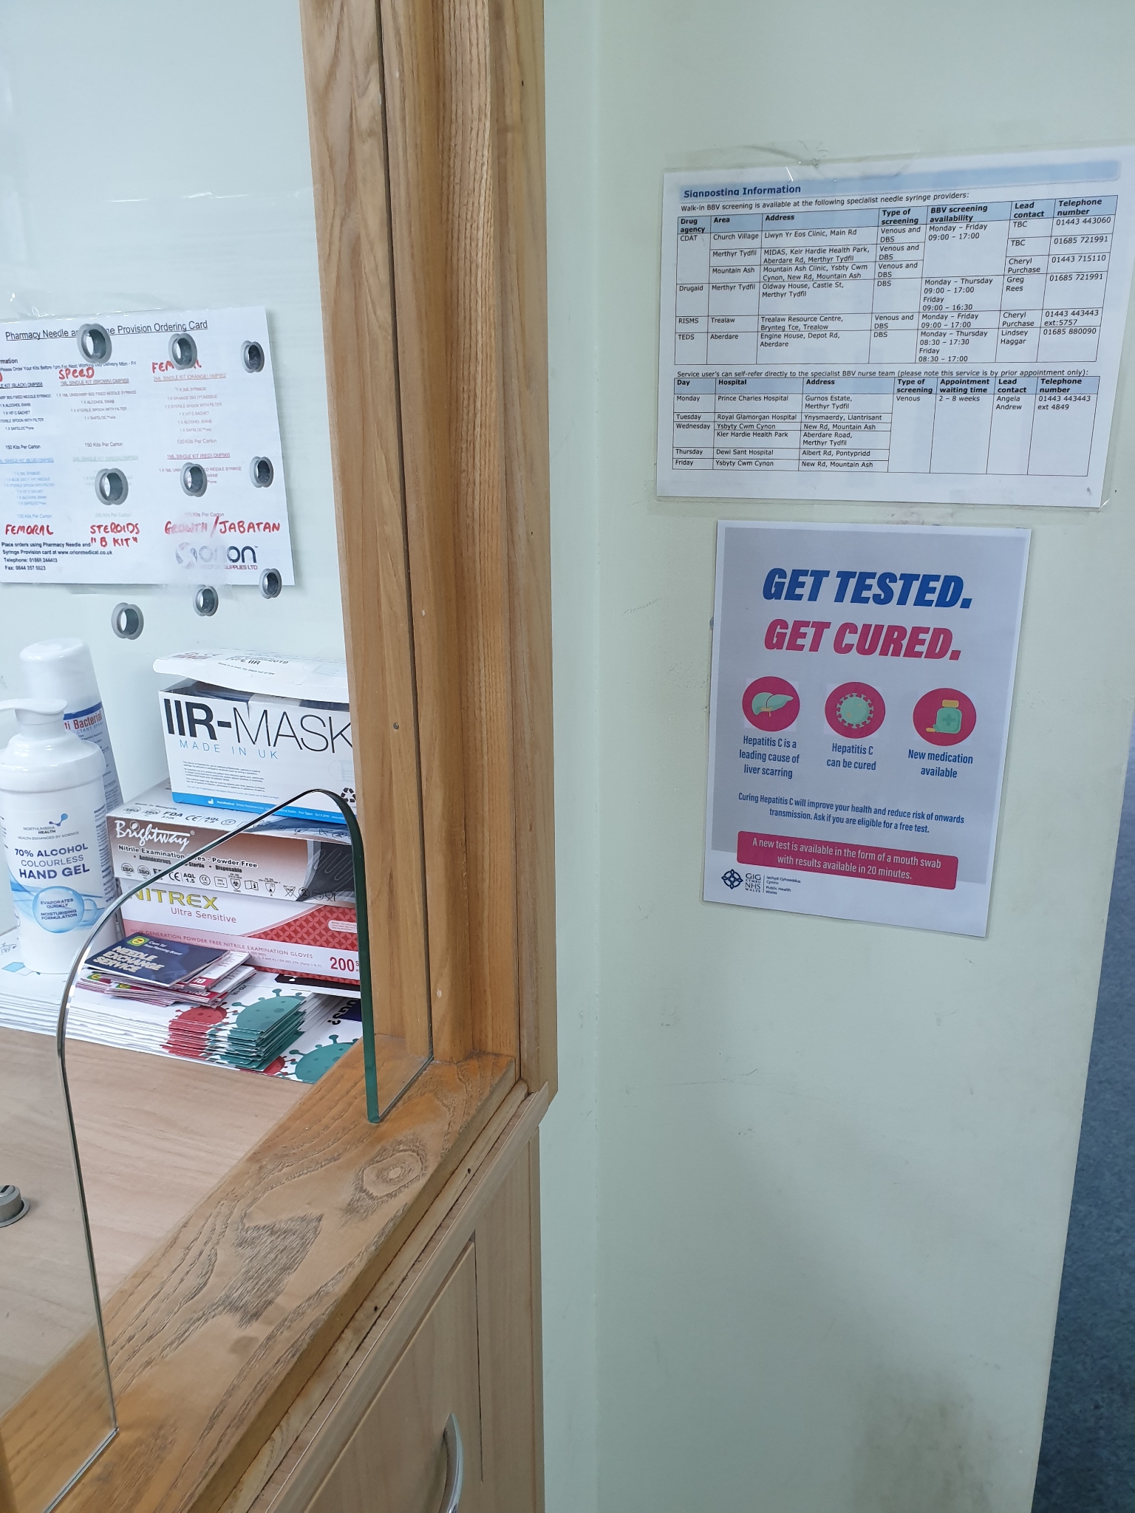
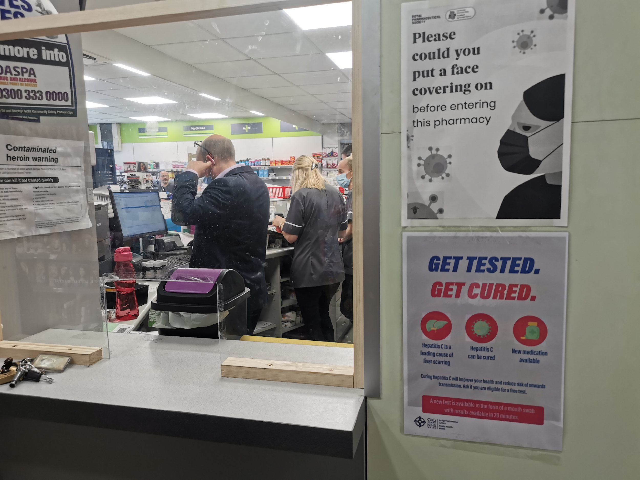
Notes:
In those SITE running so fair it as been accepted. We’ve completely tested all the OST patients in 3 pharmacies and additional walk in Needle exchange. We’ve brought treatment out to the ones prescribed. We’ve run extra engagement sessions, posters with also times and address of local clinics running in CDAT, DRUGAID, RISMS, and contact details should they wish to call myself or lead bbv nurse.

Slide 9


OUT OF 100?
Notes:
Currently 59 pharmacies are engaged with the BBV service
Rhyl, Wrexham, over to Slate quarries of Blaneau festinog, down to Newquay, Milford haven, Swansea valley, Port talbot, Merthyr, down the Rhondda valley and Cardiff. (Welsh road tripping)
Monthly testing rates are 20-25 tests and it is improving.
PCR positives 7 – All on Tx.

Slide 10


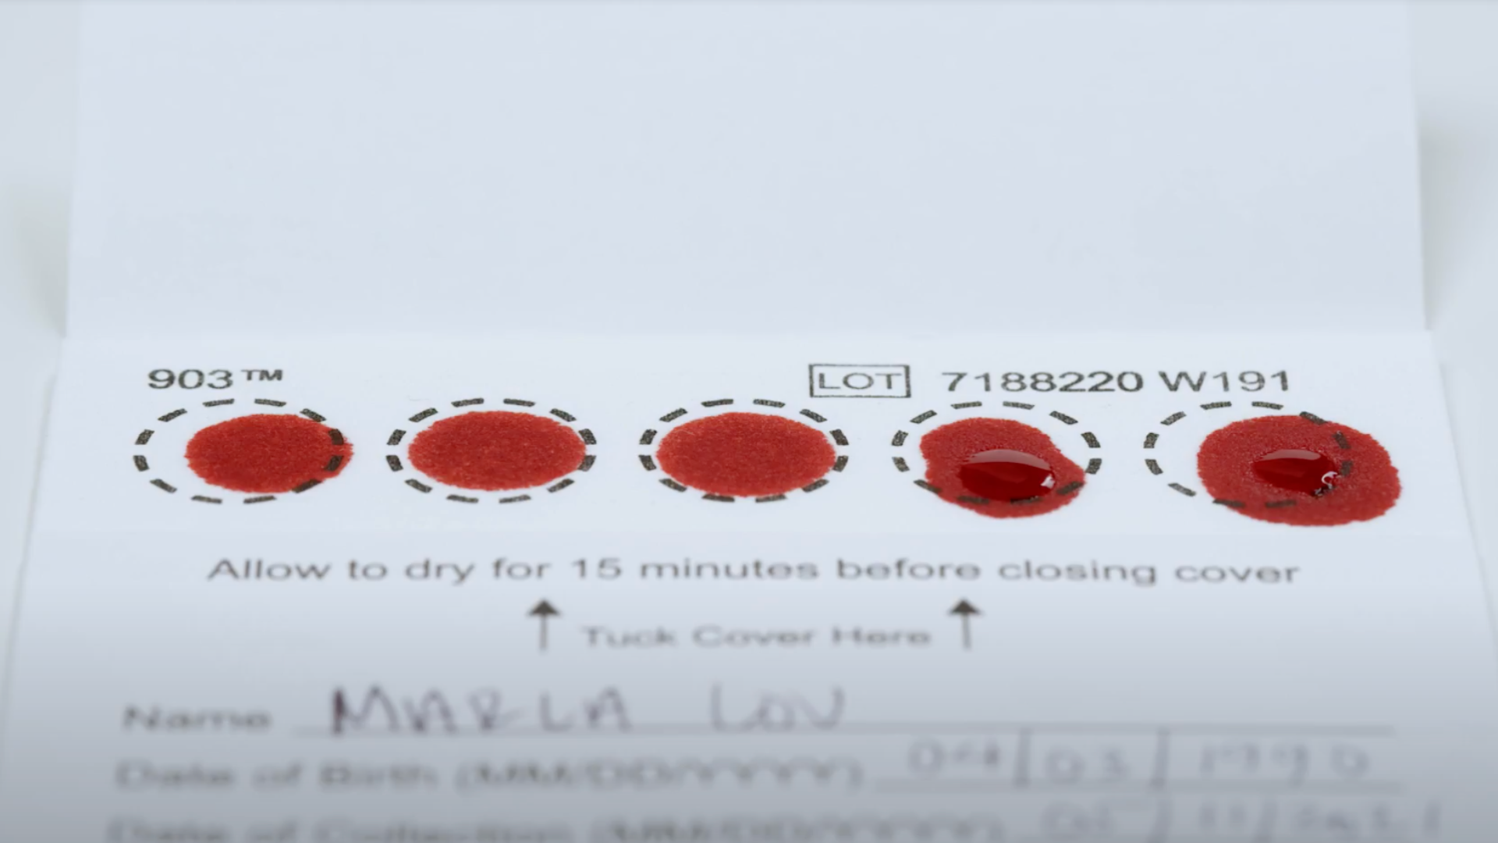

Wrexham February 2024
Notes:
55 patients tested
5 PCR positives

Slide 11
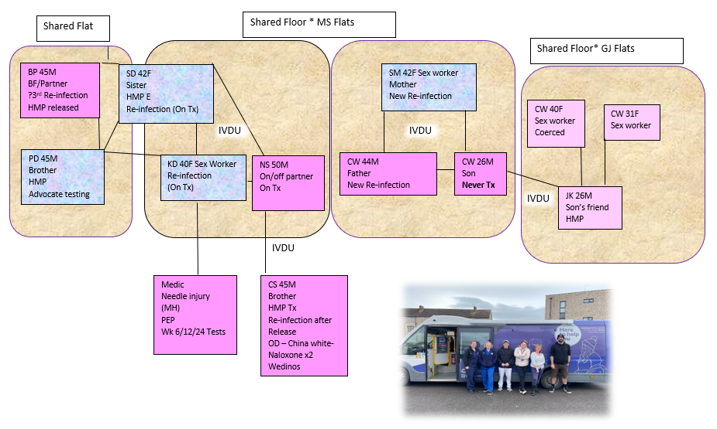
Collaboration
Testing and T&T

Slide 12
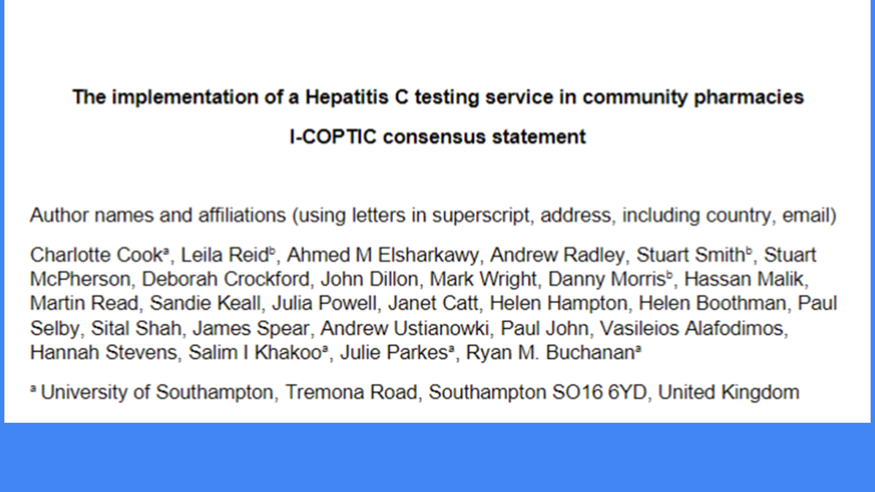
Notes:
I’ve collaborated with pharmacy leads around the uk to share best practice and learn from the different outcomes from the home nations

Slide 13
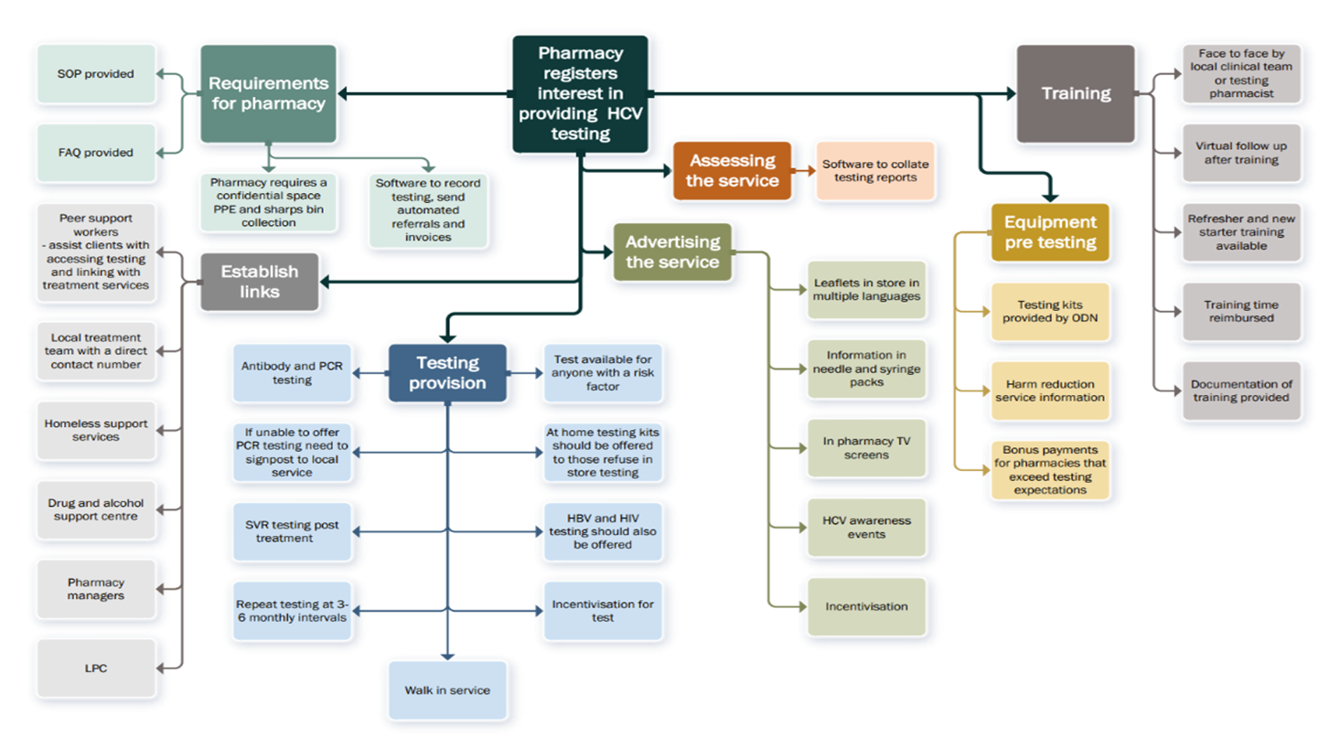

Slide 14
Barriers and solutions
Pharmacy service demand and Layout
Multiples
Stock
CAS, EHC, Flu, EMS (Main 4)
IP
STT
Referred and wait for room
NSP/BBV
Key sites critical
Same day cure
Solution
Solution
Solution
Generate demand
Support
Drop in visits
Monthly Newsletters
Understanding their direction
Working with HB
Key stock sites

Slide 15
THANKS
Do you have any questions?
Paul.john@wales.nhs.uk

