Slide 1
Reinvigorating the drive to eliminate Hepatitis B & C in Wales
March 2023
Notes:
Good morning, my name’s Liam Morgan and I work within the Policy and Priority Programmes division within the Health Protection directorate at the Welsh Government. We are responsible, amongst other things, for the WHO elimination targets relating to the elimination of hepatitis B & C.

Slide 2
Our Commitment
Eliminate hepatitis B and C as a public health threat by 2030 at the latest
The Minister for Health and Social Services recognises the need to reinvigorate the drive to eliminate hepatitis B and C
Scotland and England have committed to elimination by 2024 and 2025
Whilst we don’t rule out bringing the target forward the current target is already very challenging
Notes:
Our commitment; the Welsh Government have committed to eliminating hepatitis B & C as a public health threat by 2030 at the latest, in line with the WHO’s elimination targets. We know that Scotland and England have committed to elimination by 2024 and 2025 respectively, although for Wales, we recognise that the current 2030 elimination target will be challenging.

Slide 3
Challenges
Despite many successes to date and the dedication that continues to be shown by staff providing key services, elimination remains some way off
Updated modelling for hepatitis C suggests there could be another 8,000 people in Wales who we need to reach
Hepatitis B prevalence is not currently known but recent data suggests potentially higher rates in Wales than elsewhere in the UK
Notes:
In recent years, we have made some real progress towards these goals with roughly 4,000 people having been successfully treated for hepatitis C. Despite this, modelling estimates that there remains around 8,000 people in Wales living with hepatitis C to be identified, tested and treated. Thanks to the inclusion of hepatitis B screening in our antenatal screening programme and the inclusion of hepatitis B vaccination as part of the routine childhood immunisation programme, acute hepatitis B infection is now rare in children – however, it remains a problem among unvaccinated adults.

Slide 4
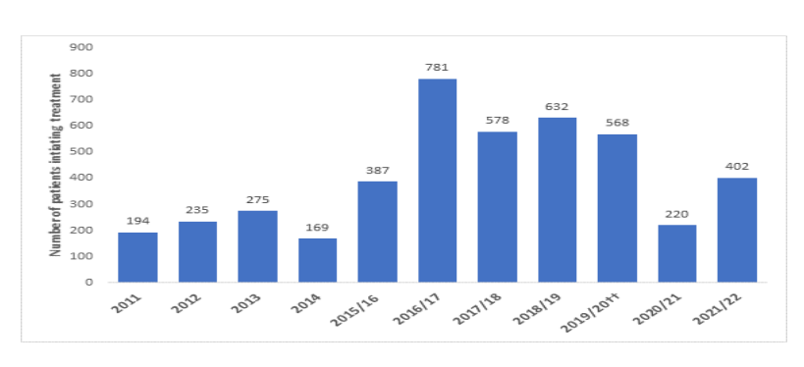
Challenges
Annual treatment numbers have reduced as those known to services have been treated and have never reached the 900 per year needed to achieve elimination
Notes:
The scale of the challenge ahead is clear; in order to achieve the 2030 elimination targets, we will need to treat a minimum of 900 people per year, with a focus on people who inject drugs. To achieve elimination by 2030 not only requires rapid recovery of services to pre-pandemic levels but a significant increase in individuals being tested and treated given the highest yearly treatment number to date were in 2016/17 where just under 800 people were treated. Without further action, elimination may not be achieved until at least 2040

Slide 5
Hepatitis B & C Elimination Programme Oversight Group
Will provide a renewed strategic focus on elimination
Has set out the roadmap to elimination, including specific actions and targets for key partners and will monitor progress
Chaired by the Welsh Government, membership includes Public Health Wales, clinical services within NHS Wales, specialist Substance Misuse Services and third sector organisations
Reports to the Chief Medical Officer and the Minister for Health and Social Services
Notes:
We have established the Hepatitis B & C elimination programme oversight group to reinvigorate the drive to eliminate hepatitis B & C as a public health threat in Wales. The group includes a range of policy leads from within the Welsh Government, in addition to representation from PHW, clinical services within the NHS, key services outside the NHS, associated networks and third sector organisations. The group meets quarterly with the first meeting of this group being held on 15 November 2022 where a refreshed roadmap for elimination was discussed and agreed.

Slide 6
Welsh Health Circular (WHC/2023/001)
The first meeting of the Oversight Group agreed a new Welsh Health Circular outlining the initial steps on our roadmap to achieving elimination in Wales
Welsh Health Circular was published in January 2023 and was supported by a written ministerial statement
Eliminating hepatitis (B and C) as a public health threat: actions for 2022 to 2023 and 2023 to 2024 (WHC/2023/001) | GOV.WALES
Written Statement: Eliminating hepatitis B and C as a public health threat (3 February 2023) | GOV.WALES
Notes:
As outlined on the slide, the Welsh Health Circular that was agreed by the oversight group outlines the initial steps on our road to achieving elimination in Wales. As we get closer towards our elimination target, the group will continue to refine the targets, and areas of focus required in order to drive towards elimination. The WHC contains 13 action points which the group will be monitoring. I won’t go through all the actions today, but I want to draw your attention to a few of the key targeted actions.

Slide 7
Action 1 – Develop Joint Recovery Plans
Health boards must lead the development of Joint Recovery Plans, working with the Area Planning
Boards and Public Health Wales
Outline plans to be submitted by 31 March 2023 and finalised plans by 30 June 2023
Recovery plans must cover the following actions;
A named corporate lead in the health board
A list of posts which are resourced to deliver elimination and provide evidence of new or planned investment
Actions to improve access to Needle and Syringe Programmes
Actions to improve outreach services including peer support services
Actions to improve testing in pharmacies, substance misuse services and prisons
Actions to ensure those referred for treatment are seen in an appropriate time frame and receive treatment in a setting suitable to their needs
Acknowledgement that the hepatitis C treatment targets set for 2023-24 are minimum targets to be exceeded wherever possible
Assurance on resource to support the national re-engagement programme
Assurance that the e-form will be used for data recording
Notes:
The first of these actions is the development of joint recovery plans, to be led by health boards, but working with APBs and PHW. It was initially stated that recovery plans were required to be submitted by 31 March 2023, however, this was later revised in light of the pressures that services are facing. The requirement to submit detailed recovery plans has been moved to 30 June 2023, and in the interim, by the original 31 March deadline, we ask that more strategic outline plans are submitted outlining how the recovery plans will be addressed. These recovery plans look to assess how each of the 12 remaining actions within the WHC will be addressed.

Slide 8
Action 2 – Provide sufficient funding to meet elimination targets
Welsh Government will seek to secure ongoing funding for key national coordination posts to assist and enable key delivery partners to deliver against the elimination agenda.
Health boards, Area Planning Boards and Public Health Wales must provide evidence of new investment in services to support the elimination agenda.
Notes:
Action 2. We are in the process of seeking to secure and ringfence ongoing funding for key national coordination posts through to the end of the current Senedd term. In addition to this, we ask that evidence of new or planned investment to support the elimination agenda is included, and this will be a key action which will be monitored by the oversight group.

Slide 9
Action 6 - Improve testing in Community Pharmacies
Rolling out testing is community pharmacies has been a real challenge and we need to change this
Health boards must ensure point-of-care tests are available in at least 100 community pharmacies by April 2024
Notes:
Action 6 relates to testing in community pharmacies, and the stretching target that point of care tests are to be made available in at least 100 community pharmacies by April 2024 given how important it is that testing is accessible as easily as possible. Welsh Government will provide support in identifying those pharmacies that are to be included.

Slide 10
Action 7 - Improve testing in substance misuse services
Key performance indicator (KPI) for Area Planning Boards has been reintroduced
For 2023/24, a minimum of 50% of service users should be tested, with the longer-term aim of 100% of service users tested routinely (in line with micro-elimination targets)
Notes:
The reintroduction of a 50% minimum target for service users to be tested within substance misuse services is the beginning of a longer term aim of 100% of service users being routinely tested. We have not set a specific date for the 100% aim to be formally adopted as a monitored target, however we want to stress that the 50% target for the upcoming year should be seen as an absolute minimum to be exceeded wherever possible.

Slide 11
Action 9 – Improve testing and treatment in Prisons
Micro-elimination of hepatitis C must be achieved and sustained in all Welsh prisons by March 2024
Notes:
Another key action on our road to achieving elimination will be micro-elimination in prison settings. We know that micro elimination has previously been achieved for a time at Swansea prison, and the target is extended and enhanced so that micro-elimination is to be achieved and maintained in all Welsh prisons by March 2024.

Slide 12
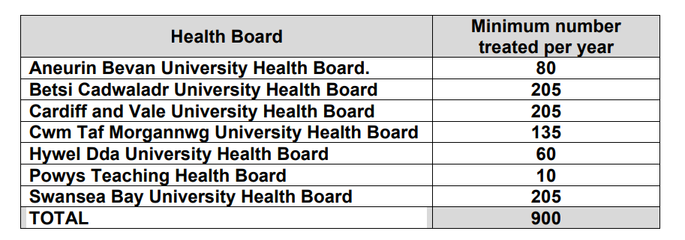
Action 11 – Increase number of patients successfully treated for hepatitis C
Minimum treatment targets for hepatitis C for 2023/24
Notes:
Action 11 sets out the individual targets in terms of minimum numbers that each health board is expected to treat per year, totalling 900 per year across Wales, which we need to sustain and exceed wherever possible in order to achieve the 2030 elimination target.

Slide 13
Questions/Observations
Notes:
As I mentioned at the start, the oversight group is in its infancy, and the WHC is the first communication issued in order to reinvigorate the drive to eliminate hepatitis B & C in Wales. In future meetings of the groups, we will continue to monitor progress and explore the areas of focus required to achieve elimination. I will be at the conference all day, and am happy to chat with anyone who has questions or observations. Thank you.

