Slide 1

Hepatitis National Meeting March 2023
Brendan Healy
Consultant in Infectious diseases and Microbiology and BBV lead for Wales and Cardiff

Slide 2
Why Eliminate Hepatitis C?
Welsh Health Circular
Current treatment rates by Health Board
Elimination Modelling
Elimination Oversight Group

Slide 3

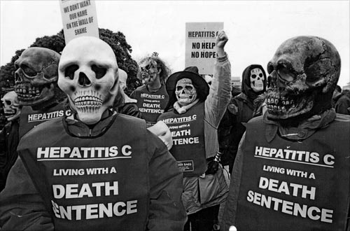
Why Eliminate Hepatitis C

Slide 4
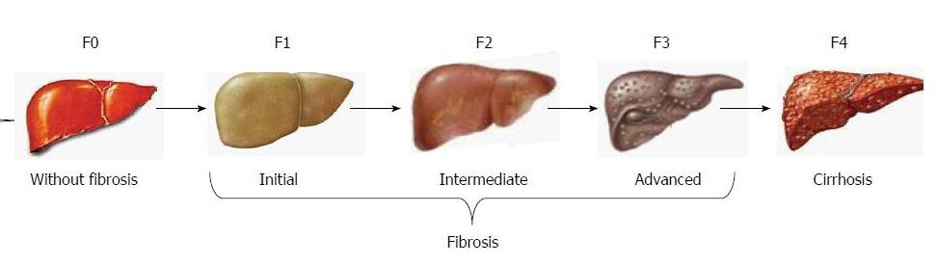
Natural history of hepatitis C infection
Chronic hepatitis Progressive fibrosis
Liver cirrhosis +/- HCC Death

Slide 5
Benefits of treatment - Individual
Prevents progression of disease
Prevents sequelae of chronic hepatitis
Eradicates systemic manifestations
Interrupts transmission
Positive psychological effects for patients
Return to “normality” – (no further hospital appointments)
Notes:
Puppet image

Slide 6


Treatment
1 – 3 tablets once per day
Extremely well tolerated
8 – 16 weeks
Just test and treat (no genotype testing)
No / Minimal monitoring required

Slide 7

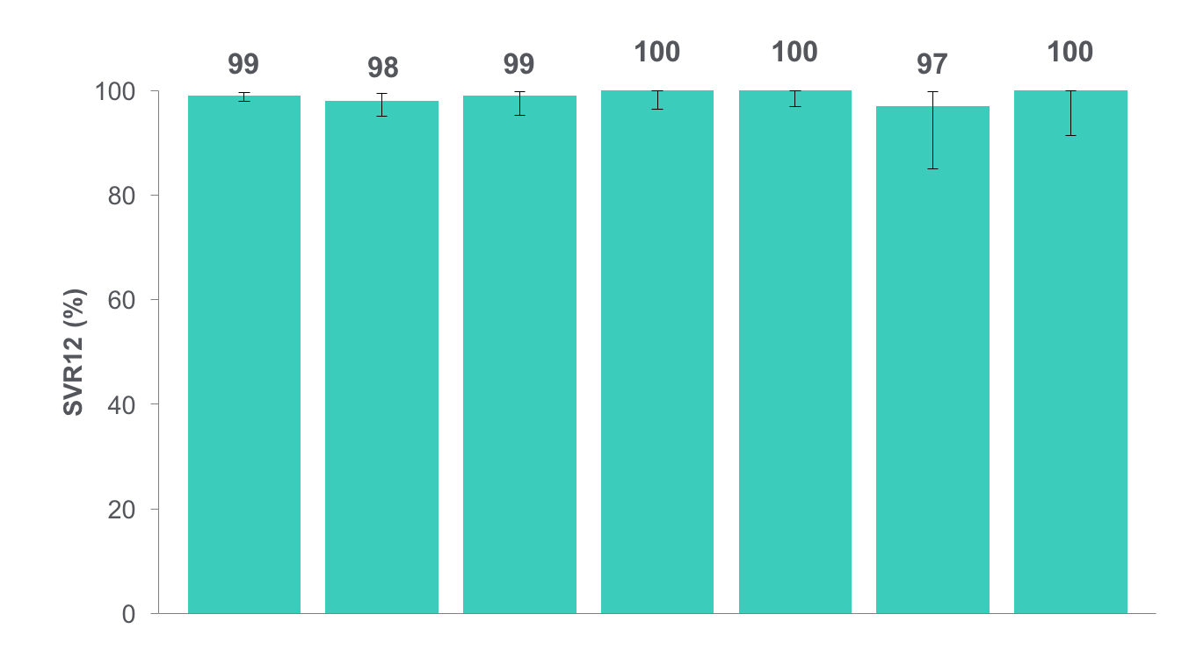
SVR12 by Genotype¹
ASTRAL-1
EPCLUSA: 12 weeks
1 relapse
2 LTFU*
1 WC^{ɫ}
1 relapse
1 death
618/624
206/210
117/118
104/104
116/116
34/35
41/41
Total
1a
1b
2
4
5
6
Genotype
Notes:
Transition
Here are the rates of SVR 12 weeks post-treatment (SVR12) results by genotype
Main Message
Overall, 99% (618/624) achieved SVR12
Statistically superior to pre-specified performance goal of 85%
None of the patients on placebo achieved SVR
Rates of SVR were similar irrespective of genotype
Background
Patients enrolled in the placebo arm from ASTRAL-1 were rolled over into the deferred treatment study where they received 12 weeks of SOF/VEL (n=111). Treatment with SOF/VEL for 12 weeks resulted in 97% (108/111) SVR12 rate in patients with HCV GT 1, 2, 4 or 6 (100% SVR12 in patients with cirrhosis; 100% SVR12 in patients with prior treatment failure). Presence of baseline NS5A did not impact SVR12. Treatment with SOF/VEL for 12 weeks was well tolerated.
2 relapses (<1%)
56 yo tx naïve white female, GT1a, no cirrhosis
58 yo black male, GT1b, with cirrhosis, previous PegRiba non responder
Both relapsed by week 4
2 LTFUs
Both Tx naïve males, GT1a, no cirrhosis
1 did not return after completing 45 days of tx
1 completed tx, SVR4, did not return for follow up week 12 visit.
1 D/C due to AE: 52 yo woman, GT1a, no cirrhosis, D/C due to anxiety attack at 4th day of treatment
1 death during follow up period: 55 yo white male, GT5a, dyslipidemia, was taking ezetimibe/simvastatin, died in his sleep 8 days after completion of treatment. Patient was not taking amiodarone.

Slide 8
Patients Listed for First Liver Transplant with a
Primary, Secondary and Tertiary Diagnosis of HCV 2008-2016
(UK Transplant Data)
Good for society

Slide 9
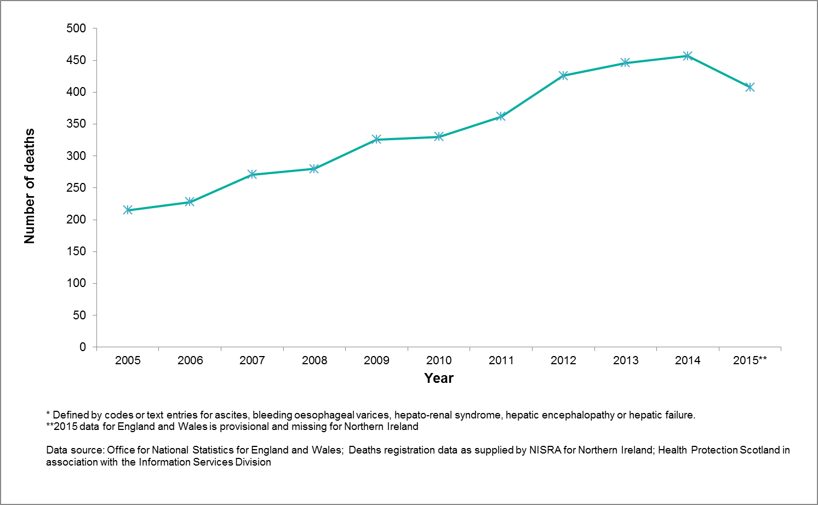
Death Certificates with HCV

Slide 14
Cost savings
Year | National Procurement (list price) | Home Care (VAT) | Prudent prescribing (cheapest option) | Prudent prescribing (waiting for cheaper options) | Total
2015/2016 | £6M | £2.5M | £5M |  | £13.5M
2016/2017 | £8.5M | £2.3M | £7M | £3.1M | £20.9M
Total | £14.5M | £4.8M | £12M | £3.1M | £34.4M

Slide 15
Why test for Hep C
Good for the individual (Cure (SVR 12) in almost everybody if treated early)
Good for society (Prevents onward transmission)
Highly cost effective (Good for society)
Reduces strain on valuable resource – liver transplant, hospital beds = Good for society
Can eliminate hepatitis C as a Public Health threat in Wales = Good for society
Identify Children at risk

Slide 16

Welsh Health Circular

Slide 17
Welsh Health Circular
Action 1 – Develop Joint Recovery Plans Health boards must lead the development of Joint Recovery
A named corporate lead for hepatitis B and C elimination in the health board.
A list of posts which are resourced to deliver hepatitis B and C elimination and provide evidence of new or planned investment in services to support the elimination agenda (Action 2 below).
Actions that will be taken to improve access to Needle and Syringe Programmes (Action 3 below).
Actions that will be taken to improve outreach services including peer support services
Actions that will be taken to improve testing in pharmacies, substance misuse services and prisons. Testing by GPs and testing in sexual health services should also be considered (Actions 5-9 below).
Actions that will be taken to ensure those referred for treatment are seen in an appropriate time frame and receive treatment in a setting suitable to their needs
Acknowledgement that the hepatitis C treatment targets set for 2023-24 are minimum targets to be exceeded wherever possible (Action 11 below).
Assurance on resource to support the national re-engagement programme (Action 12 below).
Assurance that the e-form will be used for data recording (Action 13 below).

Slide 18
Welsh Health Circular
Action 2 – Provide sufficient funding to meet elimination targets
Action 3 - Prevent Infection
Action 4 - Increase case finding
Action 5 - Improve testing models
Action 6 - Improve testing in Community Pharmacies
Action 7 - Improve testing in substance misuse services
Action 8 – Improve referral rates from substance misuse services
Action 9 – Improve testing and treatment in Prisons Micro-elimination of hepatitis C must be achieved and sustained in all Welsh prisons by March 2024.
Action 10 – Improve treatment times Health boards must ensure that individuals referred for further investigation and care should be seen expediently, preferably within days and in a setting suitable to their needs with provision being made for rapid access to therapy where required.
Action 11 – Increase number of patients successfully treated for hepatitis C
Action 12 – Deliver the national re-engagement programme Health boards
Action 13 – Improve our data From 1 April 2023, all data on treated patients will be gathered via the e-form, and any not entered via this system will not be counted.

Slide 19
Current treatment rates by Health Board

Slide 20
Health Board | Minimum number treated per year
Aneurin Bevan UHB | 80
Betsi Cadwaladr UHB | 205
Cardiff and Vale UHB | 205
Cwm Taf Morgannwg UHB | 135
Hywel Dda UHB | 60
Powys Teaching HB | 10
Swansea Bay UHB | 205
TOTAL | 900

Slide 21
Health Board | Minimum number treated per year | 2019-20 | 2021-22
Aneurin Bevan UHB | 80 | 74 | 58
Betsi Cadwaladr UHB | 205 | 105 | 95
Cardiff and Vale UHB | 205 | 116 | 72
Cwm Taf Morgannwg UHB | 135 | 45 | 14
Hywel Dda UHB | 60 | 39 | 19
Powys Teaching HB | 10 | 4 | 10
Swansea Bay UHB | 205 | 185 | 116
TOTAL | 900 | 568 | 384

Slide 22

Prevalence in the UK?
 | Prevalence | 90% target | 10% remaining
Wales | 12,000 | 10,800 | 1,200
UK | 210,000 | 189,000 | 21,000
England | 160,000 | 144,000 | 16,000
Scotland | 36,000 | 32,400 | 3,600
Northern Ireland | 4,000 | 3,600 | 400

Slide 25
Elimination Modelling

Slide 26
Modelling data - 8,300 patients
Treatments per year required to meet 2030 elimination goal
Treatment of PWID assumed to occur at random and aligned to proportion of PWID in the CHC population (~17% of patients)
Historic treatment numbers (2015-2020) derived from Public Health England. Hepatitis C in the UK, 2020: https://assets.publishing.service.gov.uk/government/uploads/system/uploads/attachment_data/file/943154/HCV_in_the_UK_2020.pdf Accessed 31/03/21
Current treatment target (900 per year) derived from Welsh Assembly Official Report: Oral Evidence from Public Health Wales to the Health Committee, July 2018: http://record.assembly.wales/Committee/4829#A44661 Accessed 31/03/21

Slide 27



Incidence of chronic HCV – 8,300 cases
Continuation of current treatment numbers will likely miss the WHO target of 2030, and will not achieve elimination until at least 2040.
Achieving the current target of 900 treatments per year but without focussing on PWID treatment will likely achieve elimination in around 2034.
An elimination strategy to meet the 2030 goal requires an increase in both treatment numbers and the proportion of PWID treated, but may be achievable within the current target of 900 treatments per year with a substantial focus on PWID treatment.
Current treatment numbers (estimated)
Elimination (WHO definition)
Analysis generated using the HCV DTM.
WHO elimination threshold equal to 90% reduction in 2015 incidence, equal to approximately 20 cases per year in this scenario (World Health Organization. Hepatitis C fact sheet. July 2020: https://www.who.int/news-room/fact-sheets/detail/hepatitis-c Accessed 31/03/21)

Slide 28
Modelling data – 12,000 patients
Treatments per year required to meet 2030 elimination goal
Historic treatment numbers (2015-2020) derived from Public Health England. Hepatitis C in the UK, 2020: https://assets.publishing.service.gov.uk/government/uploads/system/uploads/attachment_data/file/943154/HCV_in_the_UK_2020.pdf Accessed 31/03/21
Current treatment target (900 per year) derived from Welsh Assembly Official Report: Oral Evidence from Public Health Wales to the Health Committee, July 2018: http://record.assembly.wales/Committee/4829#A44661 Accessed 31/03/21

Slide 29


Incidence of chronic HCV, 12000 cases
Continuation of current treatment numbers will likely miss the WHO target of 2030.
Achieving the current target of 900 treatments per year while also focussing on PWID treatment will likely achieve elimination but miss the 2030 target. Achieving the target without focussing on PWID treatment may achieve elimination, but not until at least 2040.
An elimination strategy to meet the 2030 goal requires an increase in both treatment numbers and the proportion of PWID treated.
Current treatment numbers (estimated)
Elimination (WHO definition)
Analysis generated using the HCV DTM.
WHO elimination threshold equal to 90% reduction in 2015 incidence, equal to approximately 29 cases per year in this scenario (World Health Organization. Hepatitis C fact sheet. July 2020: https://www.who.int/news-room/fact-sheets/detail/hepatitis-c Accessed 31/03/21)

Slide 30
“To overcome the barriers to achieving viral hepatitis elimination, we must improve people’s access to treatment and care. To this end, all actors involved, including patient organisations, must work together and deliver care at the community level. In 2019, the major hepatology societies agreed that there is an urgent need to simplify viral hepatitis testing and linkage to care and today this remains a priority. Only by decentralizing viral hepatitis services to local level care and task-sharing care with primary care clinicians and other health care practitioners we can achieve our goal,” said Maria Buti, Chair of EU Policy and Public Health, European Association for the Study of the Liver (EASL).

Slide 31
Elimination Oversight Group

Slide 32
Summary

Slide 33
Summary
Save lives
Save money
Reduce inequity
Deliver prudent, transparent and equitable health care across Health Board boundaries
Deliver care to the disadvantaged and marginalised
Deliver care built around the patient / client
Deliver UK and National firsts
Deliver innovation
Deliver elimination

Slide 34




In partnership with

Slide 35
The End

