Slide 1
Elimination of hepatitis C in England
Now, and 2023/24 and beyond
Mark Gillyon-Powell
Head of the HCV Elimination Programme, NHS England

Slide 2

What we have delivered so far…
Major delivery mechanisms
24 Operational Delivery
Networks
Elimination initiatives
with pharma partners
Wide reaching
programme partnerships
Notes:
Intro
The program has been executed in three phases – the first focussed on people at imminent risk of dying, the second targeted those at greatest risk of passing on the virus and the final phase will involve engaging with people who are not at immediate risk and are unaware of their infection – more on that later.
Firstly, I am going to shine a spotlight on three areas which have been hugely impactful in ensuring the first two phases of the programme have been a huge success, and will continue to be important as we move into the third phase.
ODNs
The first is the creation of the Operational Delivery Networks.
If we cast out minds back – in 2015, when the HCV Elimination programme was established, leading clinicians across the country worked with NHS England to design 22 ‘operational delivery networks’ (ODNs), to help manage hepatitis C services and share expertise at a local level, including to regions that had never provided hepatitis C services before.​
ODNs have played a crucial role in implementing the HCV Elimination Programme, working alongside key partners such as drug and alcohol services
Since then, a further 2 ODNs have been established, including the worlds-first multidisciplinary paediatric ODN.
By launching a world-first hepatis C treatment pathway for children, the NHS has enabled hundreds of children and young people in England to be the first in the world to receive expert advice and treatment, wherever they live in England. The pathway, which launched last year, is led by world-leaders in the treatment of HCV in children.
The ODNs are instrumental in helping NHS England meet the global goal of elimination.
Pharma partnerships – prison HITTs
The second is the unprecedented collaboration between NHS England and the pharma companies Gilead, MSD and AbbVie have seen us deliver a series of jointly funded and highly successful ‘elimination initiatives’ that focussed on expanding testing and treatment.
At the start of this Programme, we knew that hepatitis C was prevalent in prisons – 13% of female prisoners and 7% of male prisoners are estimated to be affected, compared to 0.4% of the general population​.
It was therefore clear to us that we needed to focus on eliminating hepatitis C across the prison estate which is why we established treatment services in health and justice settings very early on.
The services have seen all new prisoners offered hepatitis C testing at reception
As a result of our collaborative efforts across health and justice settings, many prisons in England have achieved ‘micro-elimination’ status by testing over 95% of their population.
Programme partners – community mobile trucks
Hepatitis C is a condition of inequalities, disproportionately affecting marginalised groups. This includes people who inject drugs, immigrant populations and people who are homeless.
Reducing health inequality is a major focus of the NHS Long Term Plan, and the HCV Elimination Programme is providing services to isolated and seldom-heard communities.
One such way we have done this is through funding 12 mobile trucks which are focused on areas of high health inequality and where geographical location may make it difficult for some people to access hepatitis C services.
The NHS is a large organisation and for those communities who come less frequently into contact with its services, such as homeless people, access to support can be more difficult.
By working closely with the ODNs and the Hepatitis C Trust, these mobile trucks take testing and treatment to patients who would not usually visit healthcare settings. They can be found at GP practices, addiction services, food banks, sexual health clinics and homeless shelters and encourage the uptake of quick, non-invasive scans.
Due to the huge success these trucks have had in reaching underserved communities, NHS England has just announced a historic partnership between the hep c elimination programme and NHSE’s cancer programme – to use these mobile trucks to check for liver cancer, as well as hep C, in high risk communities as part of a major NHS drive to catch more cancers earlier and save lives.
The community checks are being offered to adults with long term alcohol consumption, a history of current or past viral hepatitis, or non-alcoholic fatty liver disease, as these factors increases the risk of developing liver cancer.
Those who are deemed high risk will be provided with information about their level of risk and where appropriate will be referred to their GP or straight into a six-month liver surveillance pathway.
Anyone referred for further surveillance will be partnered a person with lived experience of hepatitis C – from a network of peer support workers from the Hepatitis C Trust, who are expertly trained to support people in the community.
The roaming trucks are expected to visit hundreds of people over the next 12 months with a significant increase in liver cancer referrals expected within the first year, whilst maintain the numbers of people tested for HCV.
By making sure we reach the most marginalised people, we will ensure that no one is left behind and stop unnecessary deaths from hepatitis C and liver cancer.

Slide 3
Three Pronged Attack
Treat all people with cirrhosis and advanced liver disease
Targeted prison and drug service support
Extra testing, operational support, pathway mapping and peer support
Universal testing, and
finding people with previous risk factors in primary care

Slide 4
Justice System
Prison Reception Testing
Prison Intensive Test & Treat
PWIDS
Gilead Initiatives with Providers
Addiction Provider Treatment
Primary Care
MSD PSI Tool
Abnormal LFTs
Complementary
to existing work
ODNs
Probation
Approved Premises
Probation
Post-sentence Supervision
Probation
CSTR
Police Custody Testing
Testing & Diagnosis
Prevention
LDSS
Availability of Equipment
Interventions in NEX
Preventing Re-infection
NEX Comms
Antenatal
Sexual Health
Asylum Seekers
Homeless
Dental
GP-based Treatment
Community Van Programme
London
Find & Treat
Web Testing Portal
Emergency Departments
Liver Cancer Programme
South Asian Communities
Eastern European Comunities
Local Authority Planning & Commisisoning
Testing Technology in Needle Exchange
Performance & Image Enhancing Drugs
Community Pharmacy Testing and Treatment
PTPPS
Further, Faster Funding
Planning & Support
Maintaining Elimination / Sustainability
External review; England and ODNs
Network Treatment
Unknowns
Forensic Mental Health
Data
Data Quality
Understanding of prevalence
National data meeting
Understanding infection / reinfection
Evidencing elimination
Run rate
NSP Treatment Pathways
Reinfection Testing
EIs
Paediatric ODN
Local Authority Planning & Commissioning
Incidence Testing
IRCs
GRT testing
Large Employers / Migrant Workers
EMIS Pathway
Evaluating EIs

Slide 5
Primary care
Patient Search Identification Tool (PSI) usage as a choice
EMIS Pathway
GP Champion model
‘Inclusion Practices’
GP Prescribers
Directed Enhanced Service (DES)
Primary Care National Data Set – national search
Primary Care opt-out testing

Slide 6
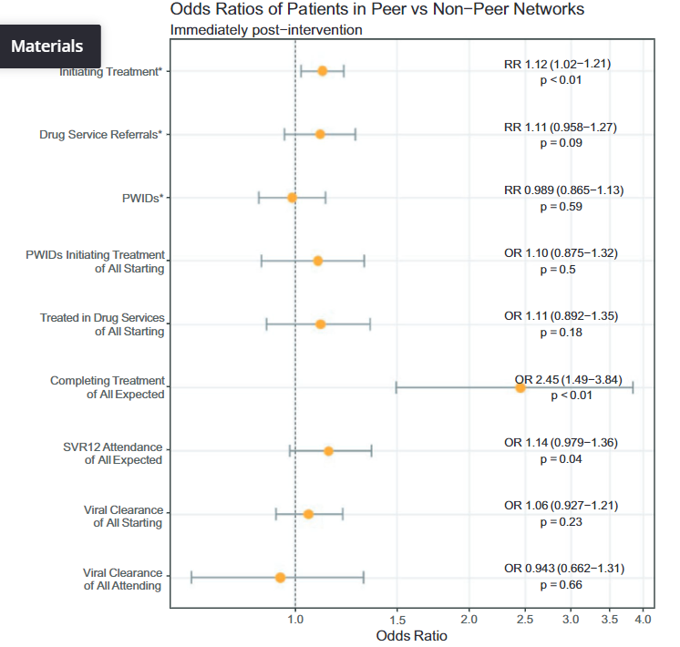
Peers
Peers associated with positive impact across a number of metrics
12% increase in people starting therapy in networks with Peers
Benefits maintained at 2 months post-intervention
Central to EI delivery in England; Prison & Community
Role of peer support in a hepatitis C elimination programme (wiley.com)

Slide 7

Community Vans
Picture of the Wessex Van
Currently 12 HCV Vans (plus 11 Liver Cancer vans based on the same model, also carrying out HCV testing)
Geographical reach
Focus on an area or cohort
Partnership delivery
Range of activities
  POCT
  Incentivisation
  Medicines delivery / support
  Info and peer support
  SVR testing
  Wound care / NEX
  Etc.

Slide 8
Health & Justice: Hep C
  The programme began with an extensive test and treat plan for the prison estate.
  Since then work has been undertaken to ensure all those in and around the criminal justice pathway are offered hep C testing.
Prisons
Through reception testing and High Intensity Test and Treat (HITT) across the entire English prison estate.
Approved Premises
Testing has restarted in Approved Premises – one third complete. Testing plans in place for additional cohorts
Probation
Offer of testing and treatment to those in Probation or on Community Sentence Treatment Requirement.
Immigration Removal Centres (IRCs)
22/23 is the first year we have an extensive programme in this setting.
Forensic Mental Health Units
Expanding the offer of hep C testing and providing engagement opportunities for staff.
‘Follow me’

Slide 9
Prisons background
People who are in prison in England have a disproportionately high prevalence of HCV infection
(~7% vs ~0.7% in general population)
35% of the UK prison population had a history of intravenous drug use and 18% were injecting prior to incarceration
Despite recent increases, there remains a large population who still require testing and treatment
BBV opt-out testing was introduced to English prisons in 2013 and fully implemented by 2018
Morey et al, J Viral Hep. 2019 Jan;26(1):101-108. doi: 10.1111/jvh.13017.
Harris et al, European Journal of Public Health, Volume 22, Issue 2, April 2012, Pages 187–192
Nakitanda et al. BMC Public Health (2020)20:1670

Slide 10
Commissioning & partnerships
NHSE
Hepatitis C Trust
Pharmaceutical companies
Prison Healthcare
ODNs
HMPPS
Prison Healthcare is commissioned by Heads of Health & Justice, which sit in each of the 7 NHSE regions.
It is a requirement to test for BBVs on reception. In prison, there are at least 2 receptions (first on arrival, second within 72hrs), and BBV testing may be done in either.
A variety of testing mechanisms might be used to test on reception, depending on many factors.
The Hep C Trust Prison Peers are central to testing and treating in the prison estate.

Slide 11

Overview of prison HITTs
High Intensity Test and Treat is offering HCV testing to an entire (static) prison population. The screening period is around 5 days, and involves rapid assessment and treatment initiation. HITTs are peer-led.
We aim to complete more than 20 HITTs across the estate each year.
All prisoners start treatment within 14 days of RNA+. This can be done in 24hr.
Over 40% of prisons have had a full HITT between 2019-2022 which has involved 29,490 prisoners.
Average prevalence was 1.7% (higher in female estate 3.7% than male estate 1.6%)

Slide 12
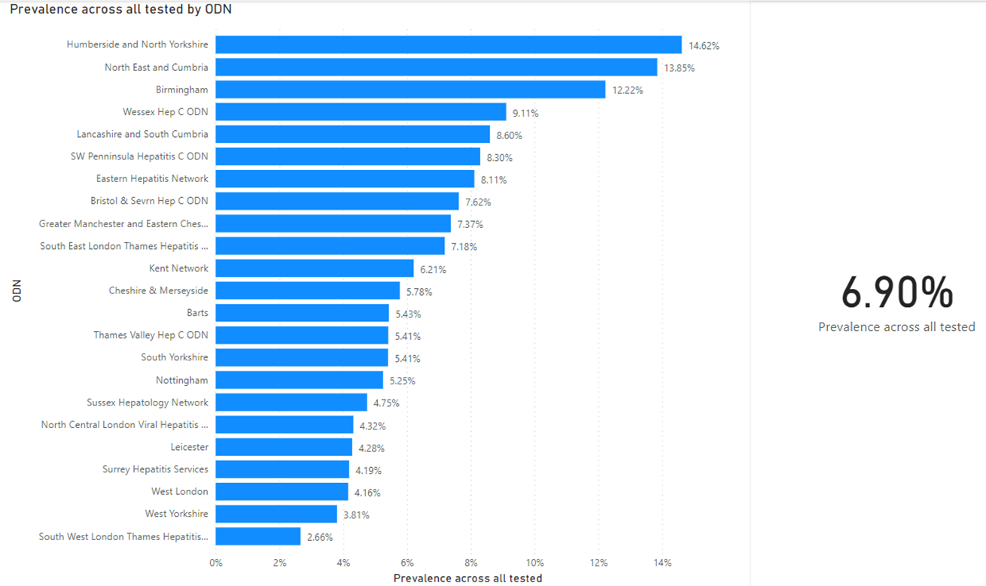
NHSE Needs assessment
Direct measurement of HCV in 11,000 people in addiction service

Slide 13
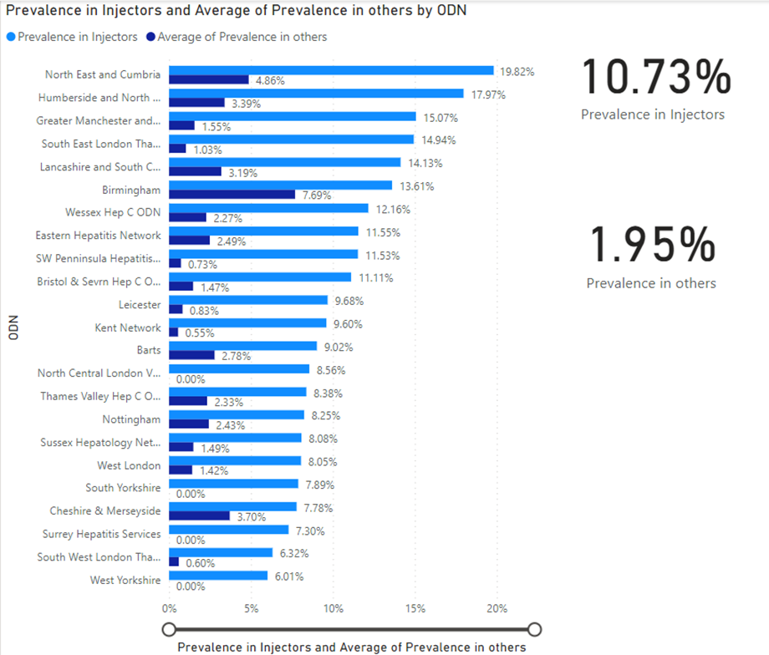
NHSE Needs assessment
Direct measurement of HCV in 11,000 people in addiction service

Slide 14
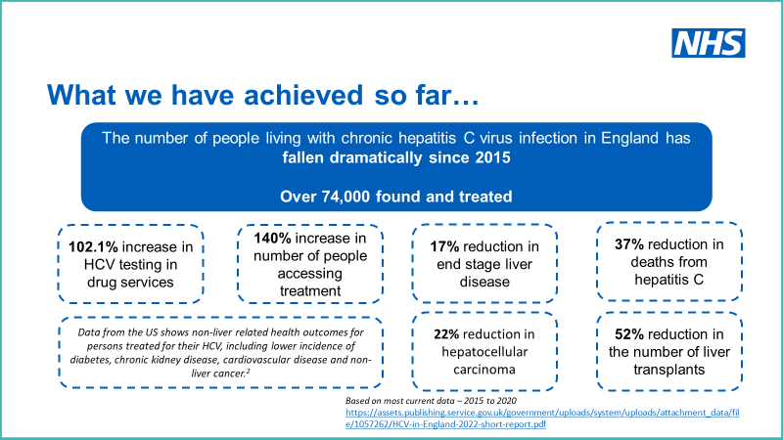

Slide 15
Treatment data
7,137 treatments in 10 months (7,284 including pending prescriptions)
182 retreatments with Epclusa (2.0%)
83% actual achievement against running target
Notes:
Under 70%: Humberside and North Yorkshire, Kent, Nottingham (lowest of all), Thames Valley and Wessex

Slide 16
HCV Elimination – treating advanced disease
Advanced
liver
disease
HCC
Based on most current data – 2015 to 2020
https://assets.publishing.service.gov.uk/government/uploads/system/uploads/attachment_data/file/1057262/HCV-in-England-2022-short-report.pdf

Slide 17

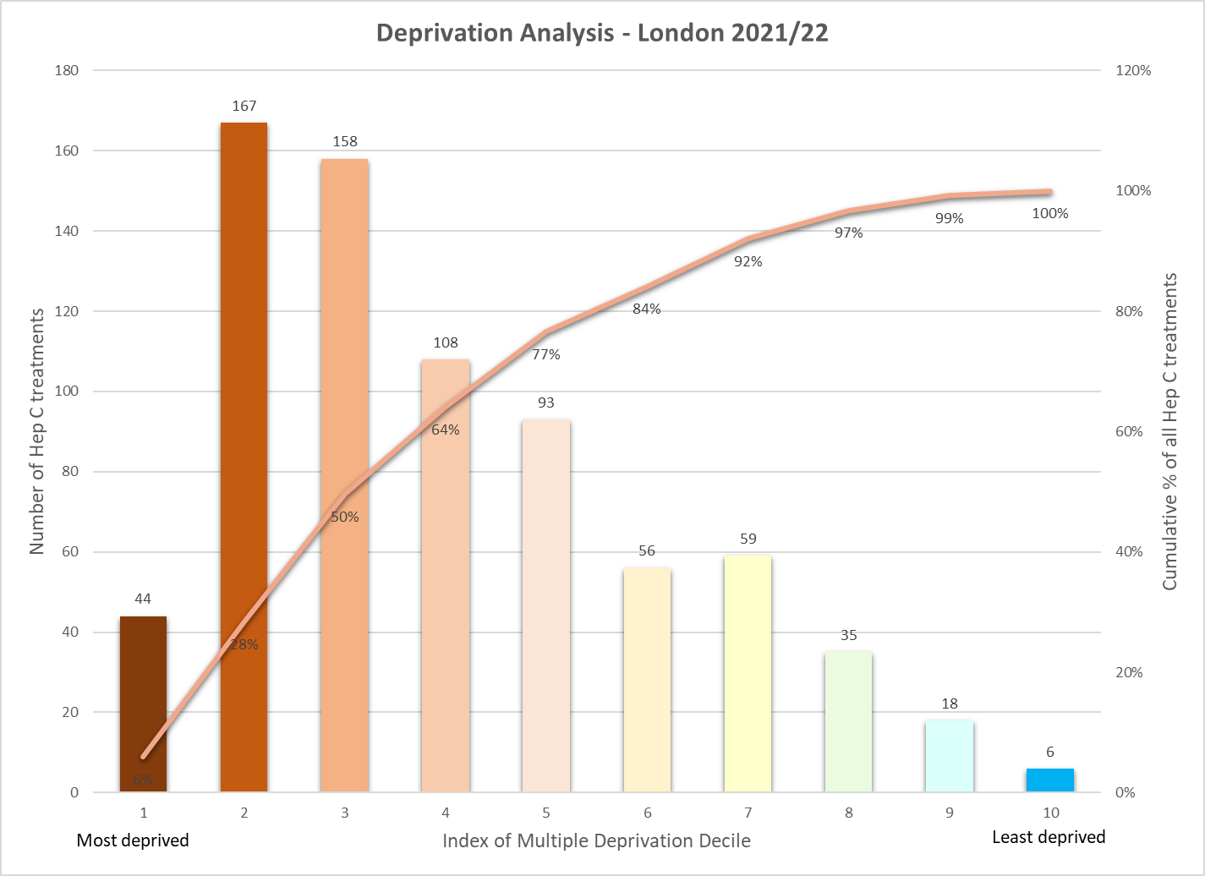
7,633 Hep C treatments in the most deprived half of the population
Last year (2021/22):
50% of Hep C treatments were given to the most deprived 30 per cent.
C.f. 80% of Hep C treatments were given to the most deprived half of the population.
B. Emmanouil – HCV Registry Data
Notes:
Data from Postcodes for 744 of the 1012 in the registry 73%. Overall 7,633 people have been treated from the most deprived areas in England across the duration of the programme.
Areas of deprivation. Equity of access. Where their resources could be directed.

Slide 18

What next…
To reach our goal of elimination ahead of 2030 we need to find people who are unaware of their risk and who may be asymptomatic
At home testing portal
Pivotal role of primary care
Antenatal screening
Emergency Department testing
Notes:
Mark
We are now moving to the final phase of the elimination programme which involves identifying people with a past history of exposure to risk factors.
To reach these people, later this year NHS England will launch a home testing website to enable the public to order a testing kit for hepatitis C which they can take in the comfort of their own home.
The home testing website will play a crucial role in the race to eliminate the virus as it will empower people who want to know their hepatitis C status to order and undergo a test quickly and discreetly, without even leaving their home.
Additionally, the programme recognises GPs are very well placed to find, test and treat at-risk patients as part of business-as-usual care.
We are therefore redoubling efforts to support GPs to play crucial role in finding undiagnosed patients by rolling out a ‘Patient Search Identification (PSI)’ tool which searches for coded hepatitis C virus risk factors in patient records in primary care settings.
The tool enables GP’s to search their caseload to identify patients with risk factors for infection who require testing.
Those identified as benefiting from hepatitis C testing will be contacted by the ODNs to arrange a free, simple test. The home testing portal will play a key role in ensuring those who wish to take this test at home, can.
We are also working closely with the United Kingdom National Screening Committee to enable them to review the evidence on screening pregnant women for hepatitis C. The review will help to understand whether antenatal screening should form part of the overall strategy to meet the World Health Organization’s target of hepatitis C elimination by 2030.
Finally, we have very recently launched a series of pilots which will see opportunistic opt-out HCV testing offered in emergency departments in the highest prevalence local authority areas.
To end new hepatitis C diagnoses and to cut transmission, routine hospital blood tests will help discreetly identify undiagnosed patients, especially in those population groups less likely to access to traditional health services. Routine opt out testing in hospital, including A&E, means an extra blood test as part of the routine bloods can detect and treat more people who maybe unaware they have the infection.
All London A&E departments are taking part in the pilot, meaning London may become the first major city able to declare elimination by 2025.

Slide 19
Antenatal
Opt-out antenatal testing
650,000 women per year not routinely tested
Current ‘risk-based’ in places (✗)
Some small pilots
Aiming for
Standardised
Opt-out
Everywhere

Slide 20
Web Testing Portal
An NHS-branded website
Universal and targeted promotion
Extensive Alpha and Beta testing
Sign off by Cabinet Office, DHSC, NHSD, NHSX
Operational in April 2023
Minimal registration data required
Simple self-sampling process, with support
Capillary blood test (AB), with reflex PCR
Minimal negative resulting
Positive resulting through ODN
Versions in English & Urdu; explanatory PDFs online in other languages
Personalisation of landing page
Expandable

Slide 21
HCV National Priorities 2023/24
Shorten and simplify the diagnostic and treatment pathway
Consolidation of targeted testing
  Micro-elimination in Prisons and other detained settings, drug and alcohol services, increase and enhance homeless and migrant testing
Primary Care
  Further roll out of systems (Patient Search, EMIS Pathway), progress GP prescribing, support from HCV GP Champions
Universal / population testing opportunities
  Increase and improve ED opt-out testing, commence antenatal testing, roll out national web testing portal
Lost to follow up
  Look-back exercise to find all those previously tested but not treated

Slide 22

Contact
Mark Gillyon-Powell
Head of Programme
HCV Elimination
Mark.Gillyon-Powell@nhs.net
@MarkHepNational
England.hepc-enquiries@nhs.net

