Slide 1

Surveillance of hepatitis C in Wales and challenges in monitoring progress to elimination
Daniel Thomas
Consultant Epidemiologist
Communicable Disease Surveillance Centre

Slide 2

Public Health Wales
Communicable Disease Surveillance Centre
Epidemiology and surveillance branch of PHW Health Protection Division
Multidisciplinary unit
Based in 2 Capital Quarter, Cardiff
Roles
  Surveillance
  Field epidemiology
  Education and training
  Policy development
  Research

Slide 3
Public health surveillance
  “The continued watchfulness over the distribution and trends of incidence through the systematic collection, consolidation and evaluation of morbidity and mortality reports and other relevant data” and regular dissemination of data to “all who need to know”
  (Alexander D. Langmuir 1963)
  “Information for action”

Slide 4
Why carry out surveillance of hepatitis C?
Relatively common - globally, 1% of population estimated to have chronic infection
High burden of disease - persistent infection can lead to cirrhosis, liver failure or cancer in 10-20% of chronic infections
Unequally distributed - affects some of most vulnerable populations in Wales
Preventable and treatable
WHO has set an elimination target for 2030 (validation)

Slide 5
Surveillance of hepatitis C
Trends in health outcomes – seroprevalence, new diagnoses of chronic infections, HCV-associated liver disease, cancer and mortality
Trends in risk behaviour – sharing injecting equipment
Uptake of prevention and treatment – needle exchange, testing and treatment rates

Slide 6
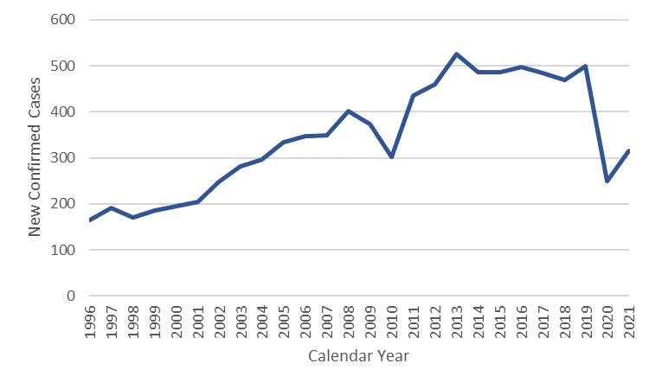
Laboratory notifications: New diagnoses of hepatitis C in Wales by year
Source: LIMS, as at 15/03/2023
New diagnoses defined as first positive PCR (therefore does not include reinfections)
Impact of COVID-19 pandemic on services?

Slide 7
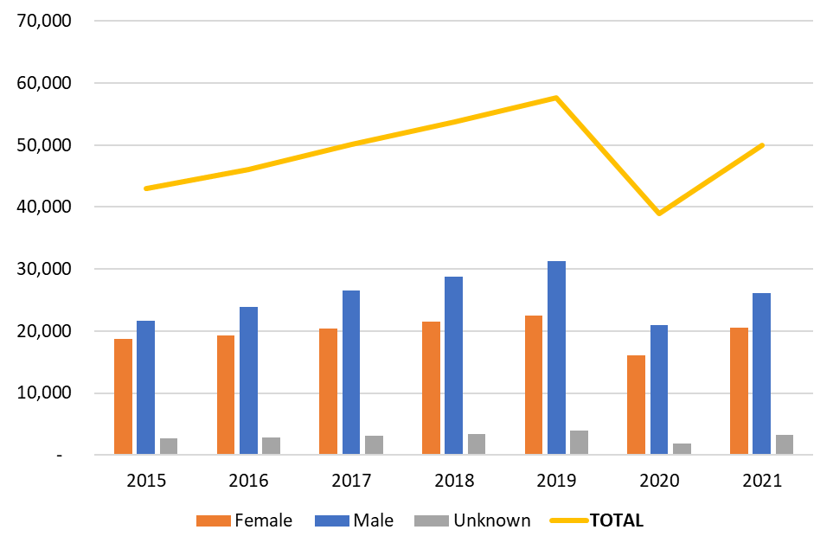
Individuals tested for Hepatitis C in Wales, 2015-2021
Source: LIMS, as at 15/03/2023

Slide 8
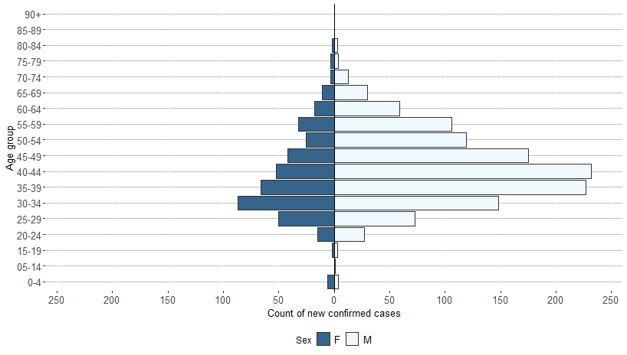
New diagnoses of hepatitis C in Wales by age/sex
Source: LIMS, as at 15/03/2023, 2017-21
3:1 ratio of male to female which is consistent over time
Median age = 39 years old (IQR: 16)

Slide 9
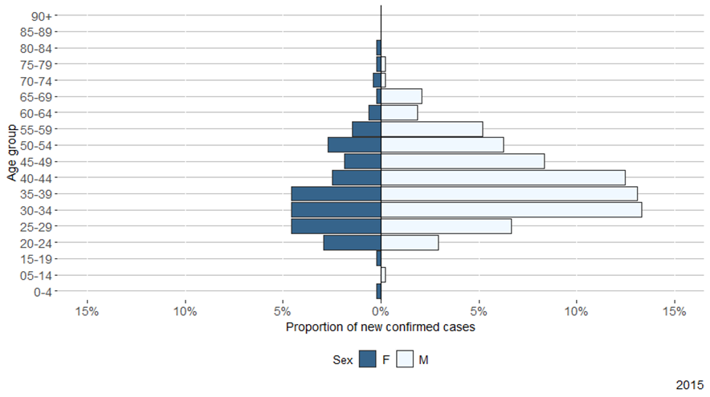
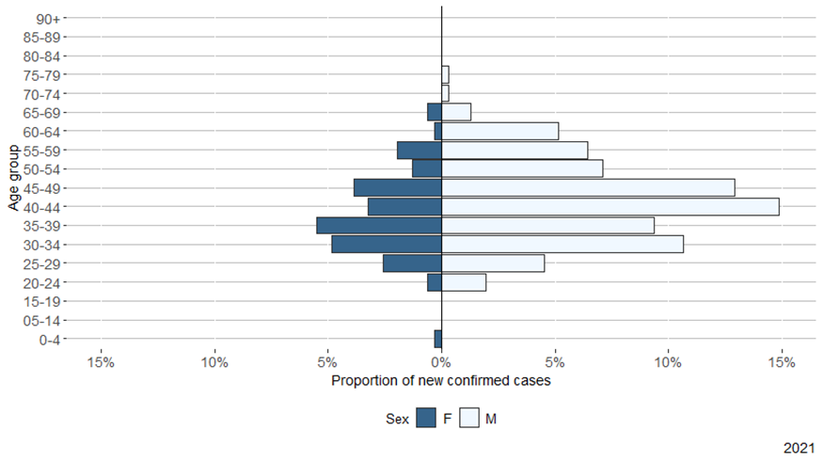
New diagnoses of hepatitis C in Wales by age/sex
Statistically significant increase in median age: 42 in 2021 v 38 in 2015

Slide 10
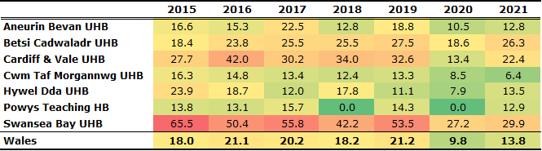
European age standardised rates of HCV new diagnoses per 100k population by Health Board

Slide 11
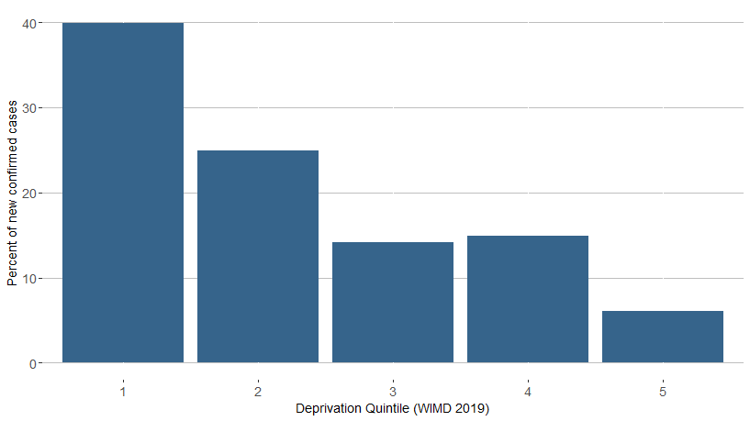
New diagnoses of hepatitis C in Wales, 2018-2022 (n=1077) by deprivation
Steep social gradient

Slide 12
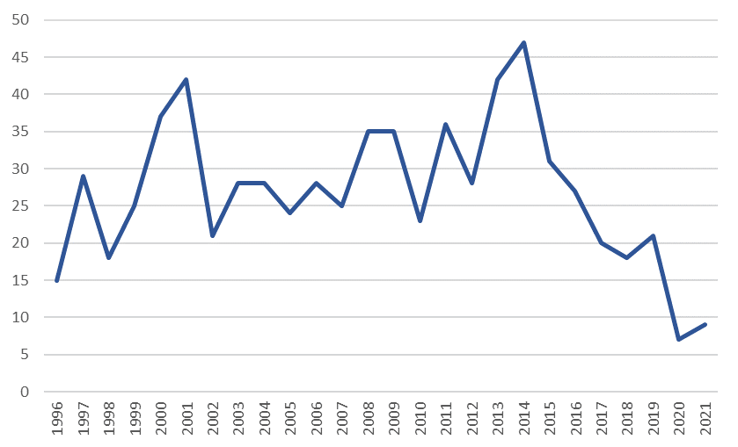
Laboratory notifications: New diagnoses of hepatitis C in Under 25s in Wales by year
Source: LIMS, as at 15/03/2023

Slide 13
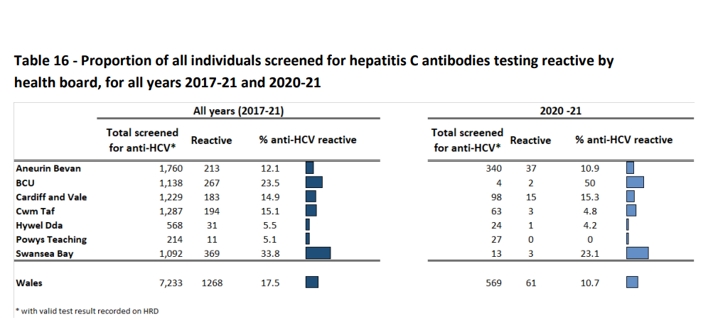
People attending substance misuse services: Harm reduction database
% of people who inject drugs screened in specialist drug services in Wales testing positive for chronic HCV infection
Source: Accompanying tables for ‘Shooting Up’

Slide 14
Hepatitis C screening in prisons in Wales

Slide 15
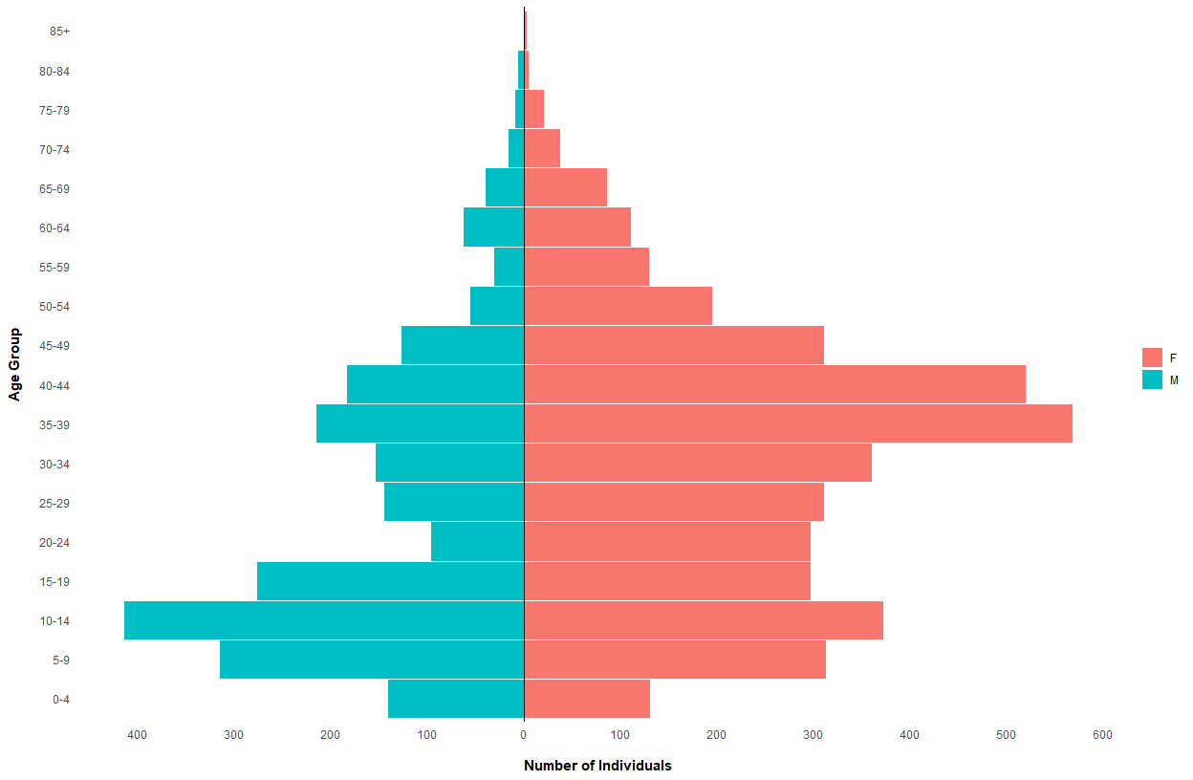
New entrants: Ukraine
Good quality data on arrivals
Since Feb 2022, majority of arrivals have been families comprising women and children
1,035 (15.4%) individuals have been screened for blood borne viruses
Small proportion with positive hepatitis C antibody test (0.8%) or hepatitis C antibody + PCR positive test (0.1%)
Data as at: 07/03/2023

Slide 16
Ethnic variation in HCV testing and proportion antibody positive using Onomap, a name-based ethnicity classifier
Positive tests per 100 000 population
Hepatitis A
Hepatitis B
Hepatitis C
Hepatitis E

Slide 17
Ethnic variation in HCV testing and proportion antibody positive using Onomap, a name-based ethnicity classifier
Positive tests per 100 000 population
Hepatitis A
Hepatitis B
Hepatitis C
Hepatitis E

Slide 18
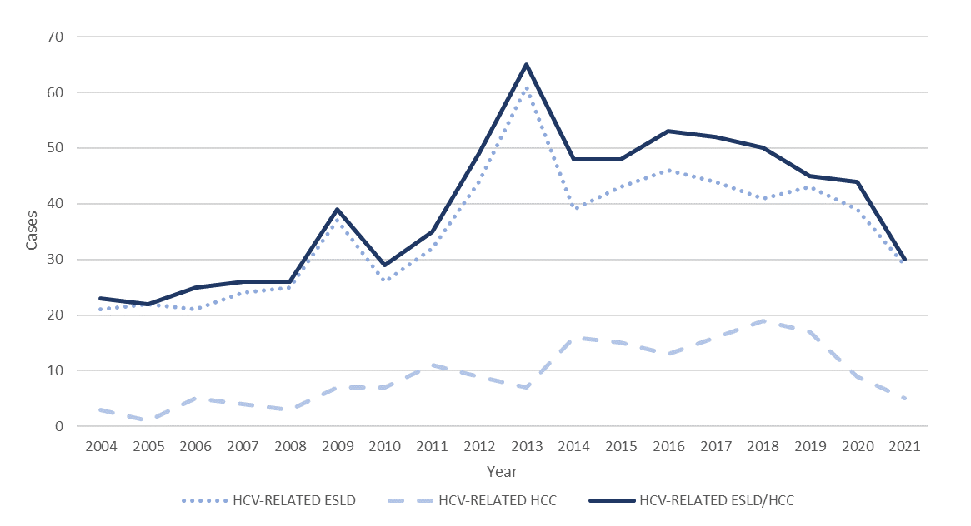
New diagnoses of hepatitis C-related end stage liver disease and hepatocellular carcinoma in Wales

Slide 19
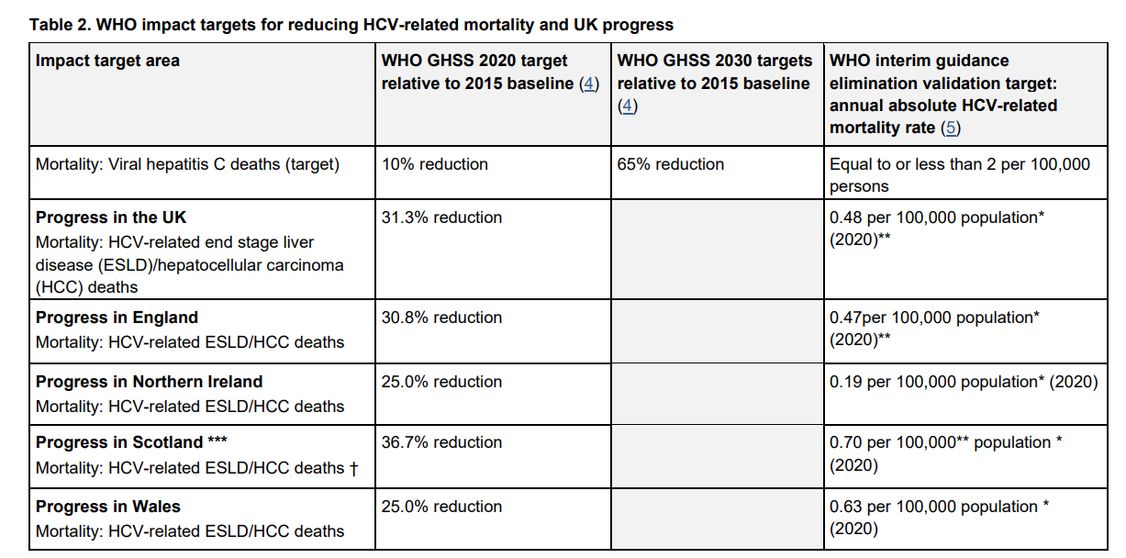
HCV-associated mortality
Hepatitis C in the UK 2023: working to eliminate hepatitis C as a public health threat (publishing.service.gov.uk)

Slide 20
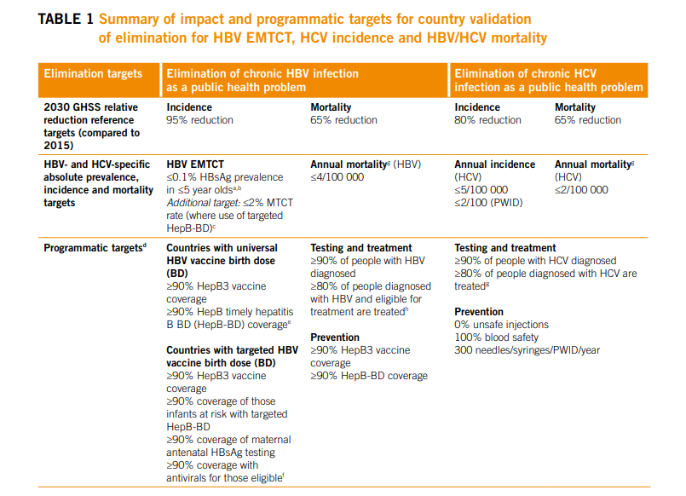
WHO targets for elimination of hepatitis C as a public health problem by 2030
Interim guidance for country validation of viral hepatitis elimination (who.int)

Slide 21
Challenges in monitoring progress to elimination
Proportion of those tested for clinical purposes or case finding who are positive does not necessarily equal population prevalence
Undiagnosed proportion?
Gaps in our knowledge of prevalence in medium and low-risk groups, e.g. new entrants, certain BME groups, ex-PWID, general population
Need to estimate number of prevalent chronic cases to monitor proportion diagnosed (WHO target)
Obtaining a good estimate of incidence is difficult (WHO target)
Monitoring re-infections will become increasingly important
How do we obtain repeated prevalence/incidence estimates to monitor progress to elimination?

Slide 22
CDSC role
Monitoring progress to elimination (Stakeholder involvement in development of information products)
Operational research and development
      ‘Workbook’ approach to estimating prevalent infections;
      New methods for estimating incidence and reinfection;
      Burden of disease/health inequalities;
      Treatment register (record linkage);
      HCV genomic surveillance (Northern Ireland cluster identified);
      Evaluating interventions, for example: find and treat initiatives,
      Qualitative research – who is not getting tested and treated and why?
Working with other UK countries to support validation

Slide 23
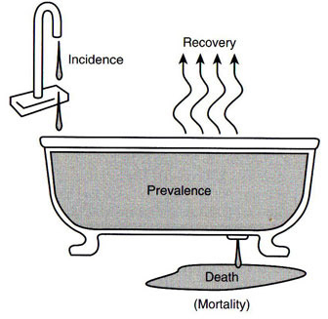
“ The Epidemiologist‘s bathtub“

Slide 24


Slide 25
Acknowledgements
CDSC - BBV, TB, STI and inequalities team:
George Ahearn, Sophie Harker, Craig Hogg, Savannah King, Matt Rumble, Josie Smith
CDSC – Data Science and statistics team:
Noel Craine, Jane Salmon
Communicable Disease Inclusion Health Programme
Rick Lines, Steph Perret
Microbiology
All colleagues providing data……..

