Slide 1
Hepatitis C re-engagement project – the next phase 2023 onwards
Dr Noel Craine

Slide 2
Phase one – 658 Letters sent to individuals with evidence suggestive of chronic HCV and registered with GP. 140 contacted BBV service, 76 started treatment, 62 completed
Phase two – Antibody positive or with evidence suggestive of chronic HCV with or without GP registration
Linking to information held on
  The harm reduction database
  Welsh Database for substance misuse
  GP registration
Resend final lists following HB feedback
Health boards to start re-engagement following local information governance sign off (DPIAs)

Slide 3
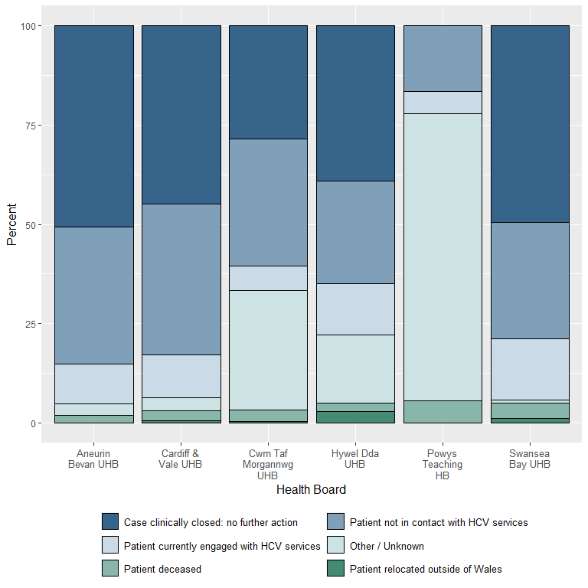
Summary of current clinical situation at initial data scrutiny, by health board.

Slide 4
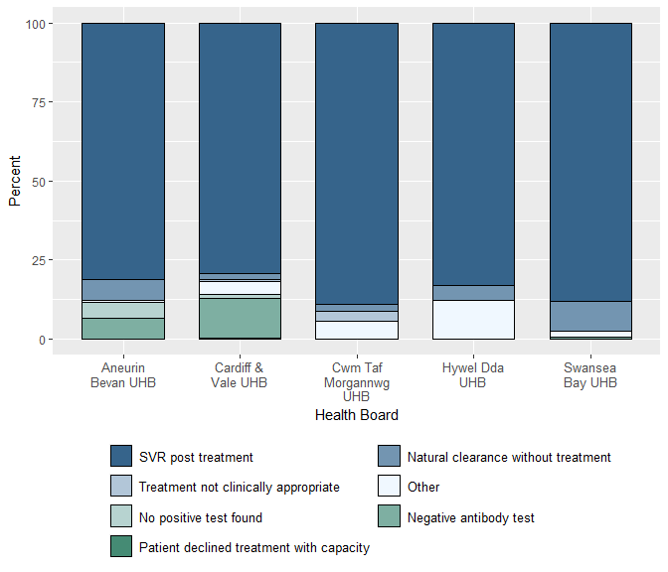
Reasons for closed cases as proportion of total number of closed cases, by health board.

Slide 5
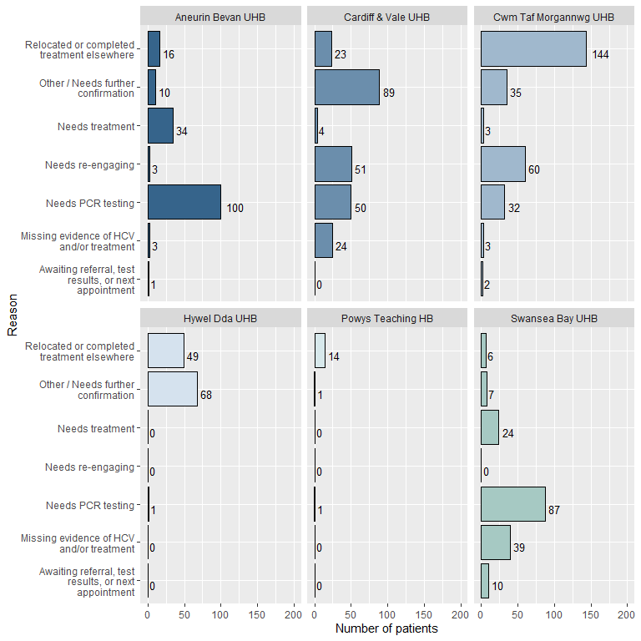
Summary of patients not currently engaging with HCV services.

Slide 6
Following feedback from HB - updated numbers for phase two
ABUHB – 203
BCUHB – 704 (703; no returns, could not remove closed cases)
CTMUHB – 316
CVUHB – 314
HDUHB – 160
PTHB – 17 (incomplete returns)
SBUHB – 266
Total – 1,980 (down from 3,054 following feedback)

Slide 7
Harm Reduction Database
Only 36 individuals in the health board lists were matched with HRD data.
Welsh National Database for Substance misuse
Awaiting matching
GP registration
91% registered with Welsh GP
8% no GP
1% registered with English GP
Small number of <18 year old cases approached via paediatric services

Slide 8
The future
Quality improvement phase
Consider writing to patients?
Ensure optimise opportunities for linking to care (e.g. flagging in GP systems, ICNET, System-one)

