Slide 1
BBV Pharmacy
2023
Paul John
Community Pharmacy Lead
Paul.john@wales.nhs.uk
07795274073

Slide 2


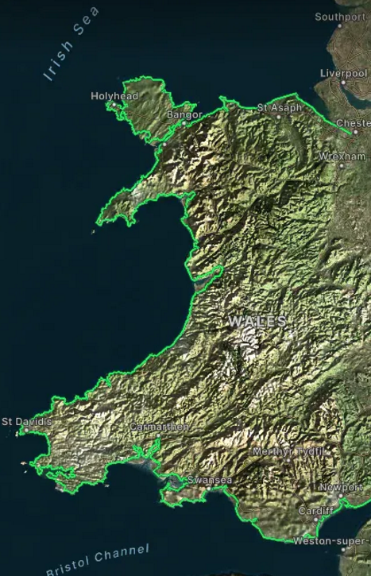
Four months flew past
OBJECTIVE: 8300 cHCV infection (Min. 7470)
STRATEGY: PREVENTION
EDUCATION
DIAGNOSIS
TREATMENT
TARGET HMP x 6
SITES: NSP SMS x 42
NSP PHARMACY x 220
PRIMARY CARE
GOVERNMENT CLEARANCE:
FUND MISSION

Slide 3
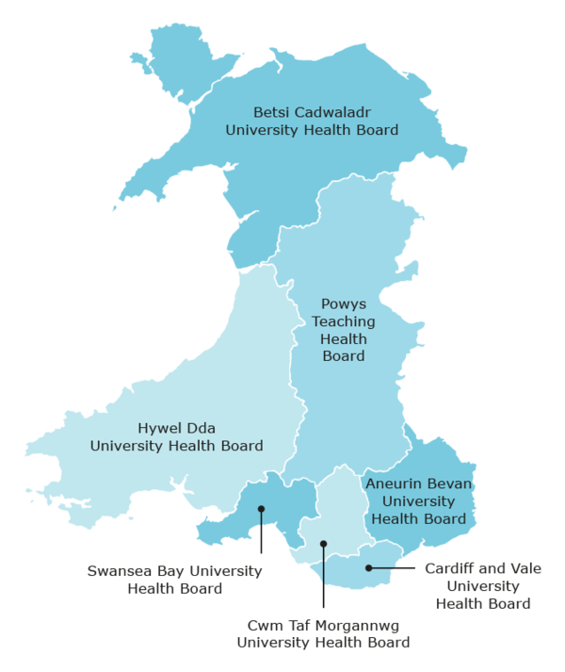
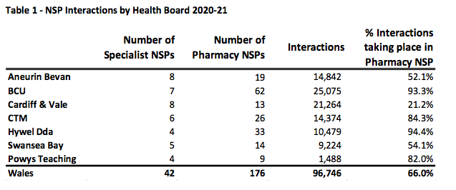

Slide 4

Highlighted in November
Multiples engagement is Key
Sustainable funding
- New LDIG (September)
Independents are engaged but most have staffing issues
WELL / BOOTS
Missing pieces
Chief Pharmaceutical Officer
Expand to all Health boards
Pharmacy BBV subgroup
Quarterly meetings: CPO, CPW
HB service leads and Hep C trust
April 2024
100 Pharmacies (220/715 NSP)
Uncapped No. of tests

Slide 5

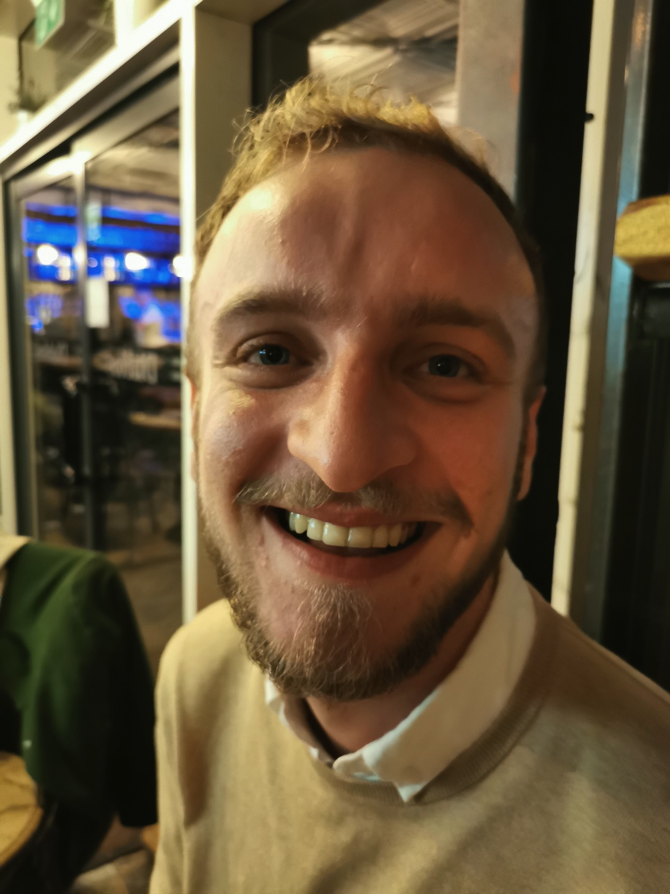
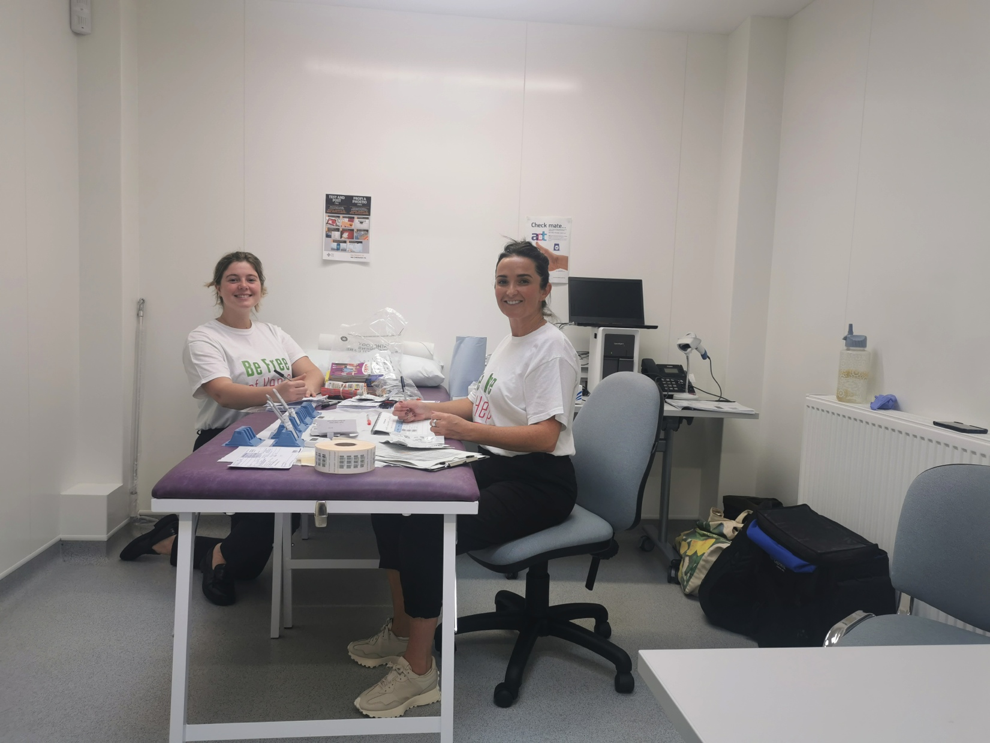

3 Techniques deployed
Hep C trust in Pharmacy
Incentive based
BBV/PHW HITT

Slide 6
Pharmacy Process
Inclusion
Engage
Method
Results
Enhanced service
NSP or
OST
Set
Dialogue
Oraquick +/- DBST
Neo
(+ LIMS)
Claim
.
Offering a quick lateral flow mouth swab
Checks for a hidden virus in your Liver
Find out today or we can
contact you if you leave
number
Option for staff
and patient
Manual submission
Monthly Data

Slide 7
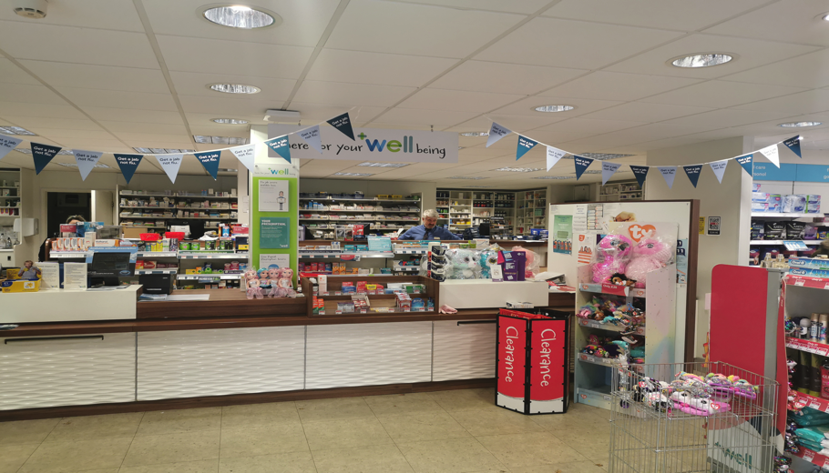
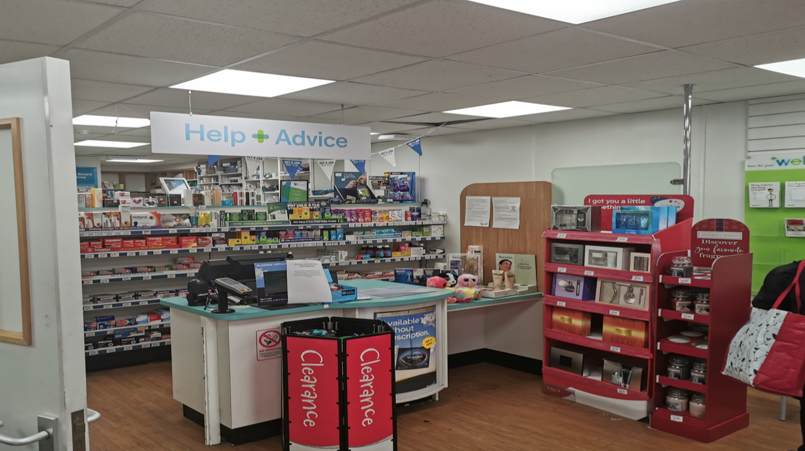
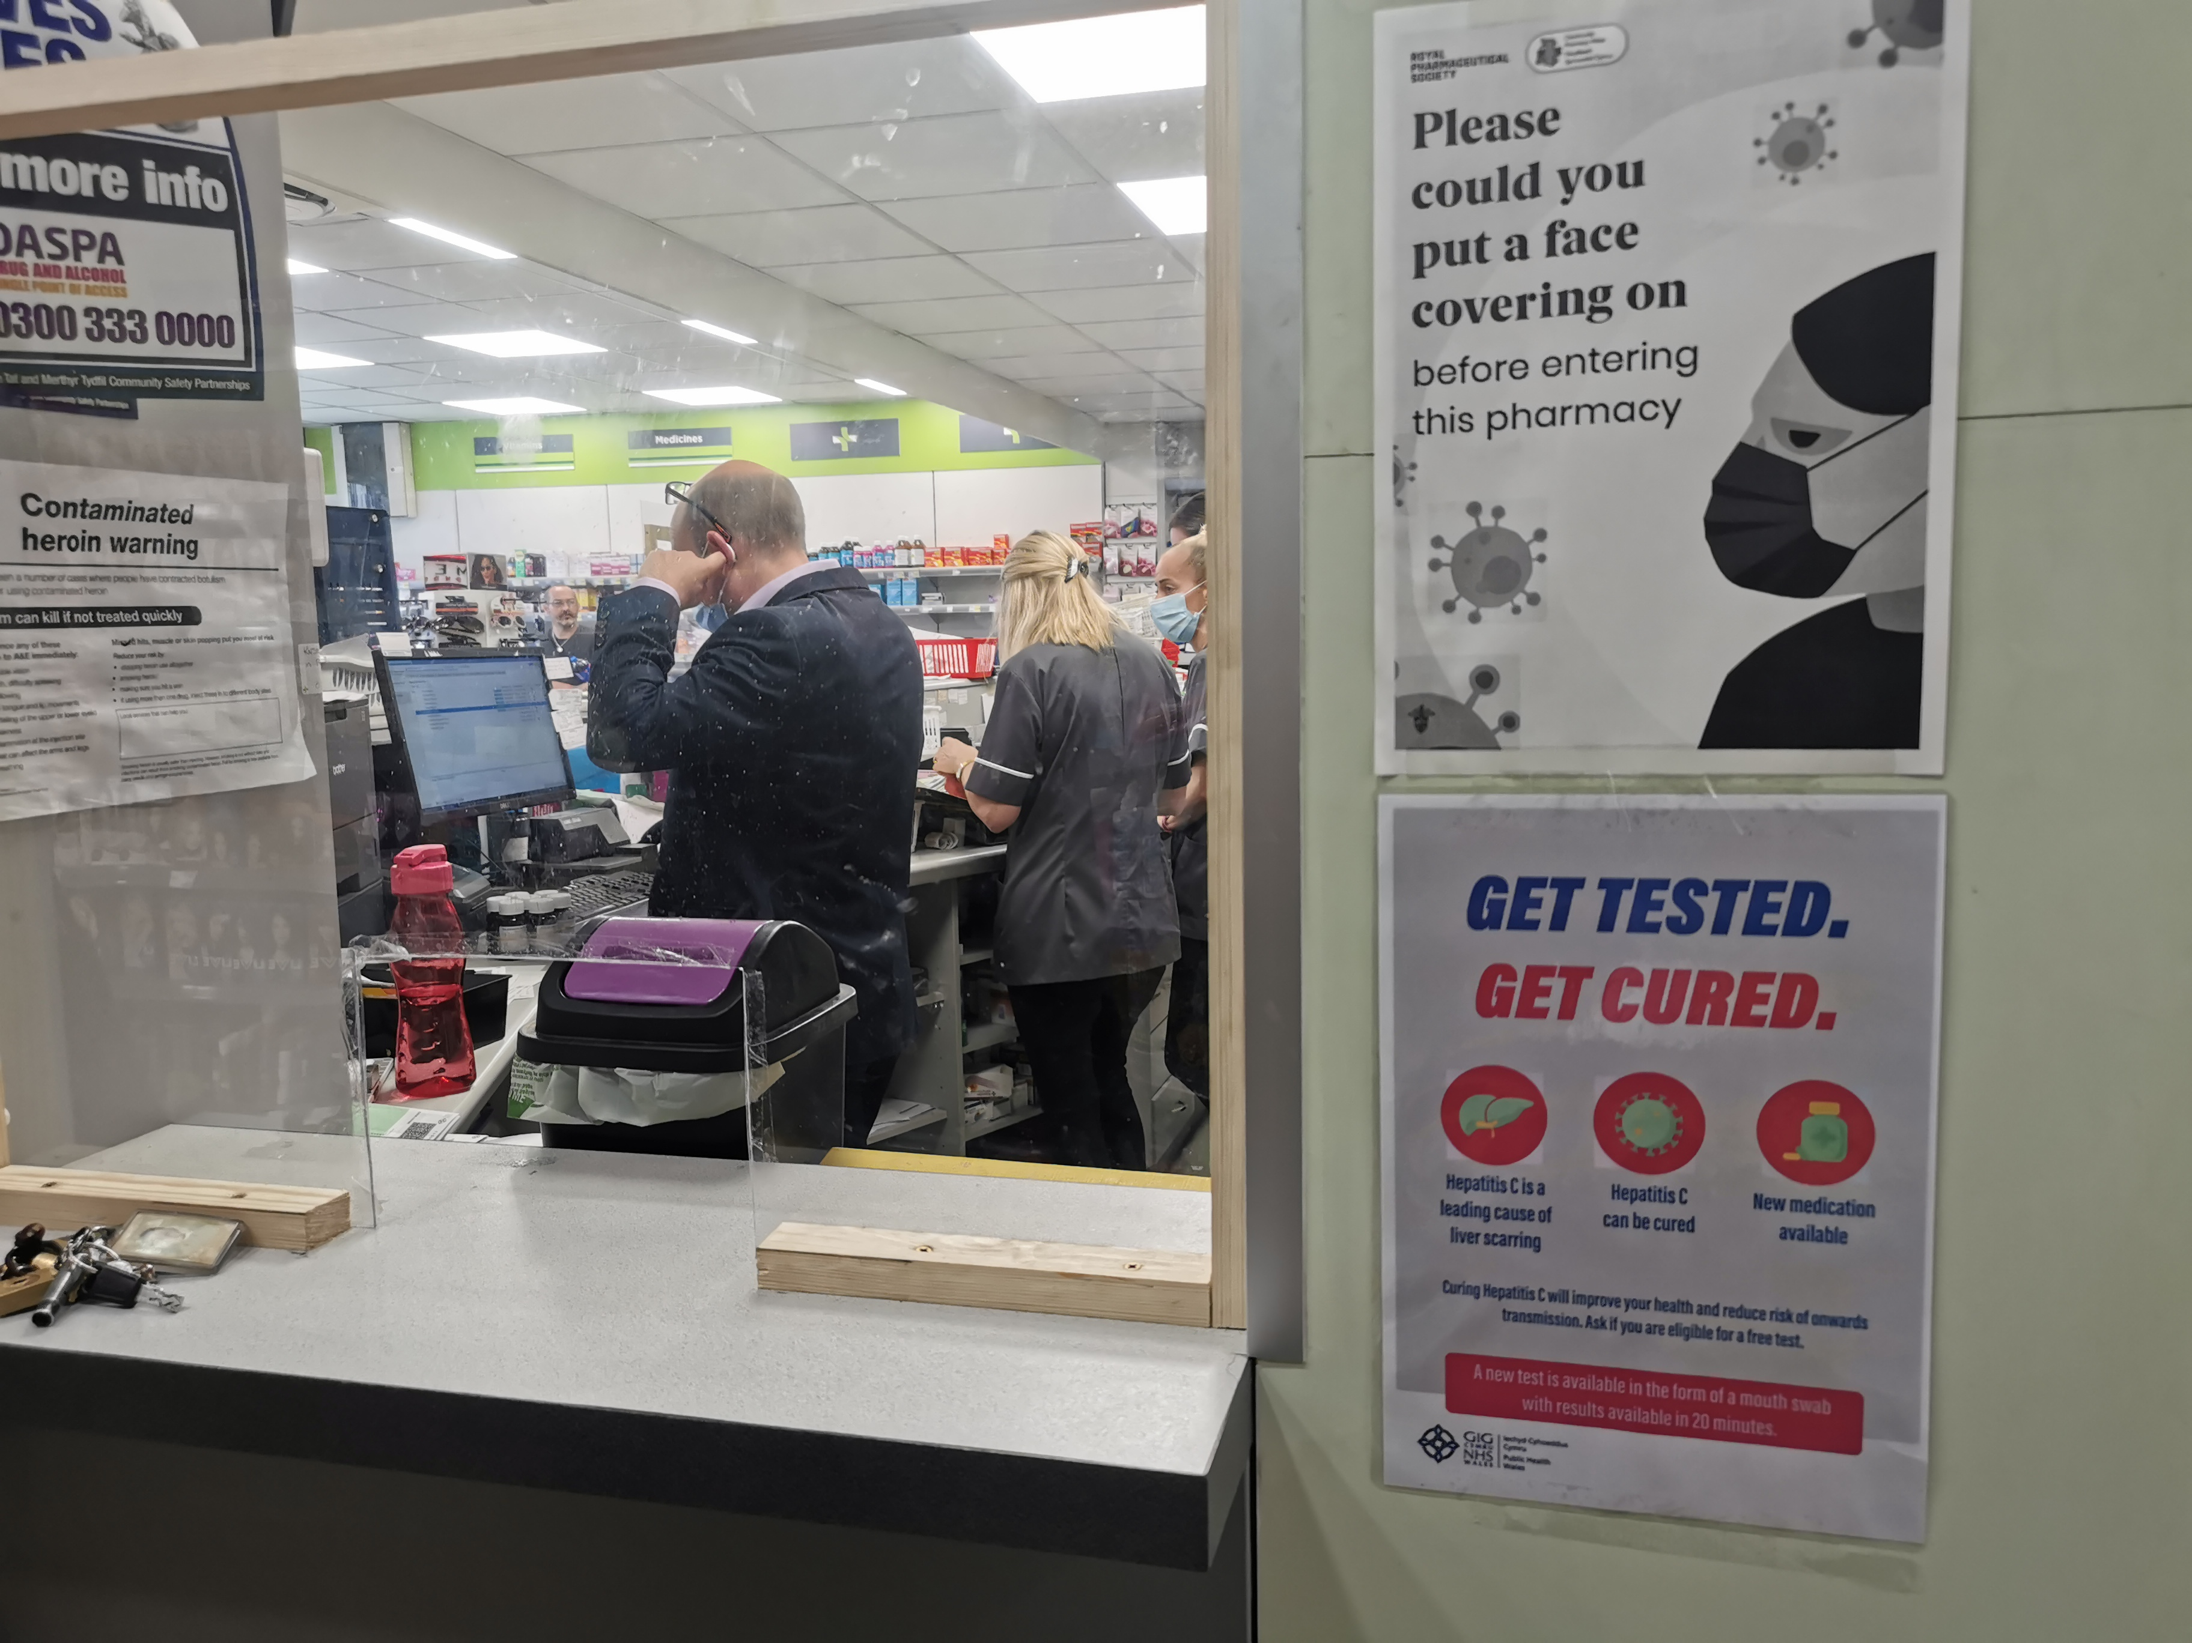

Slide 8
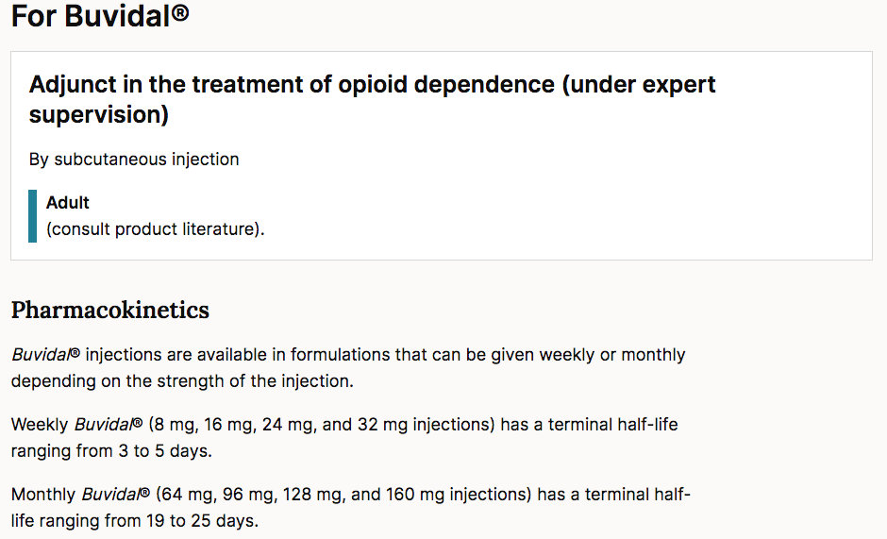

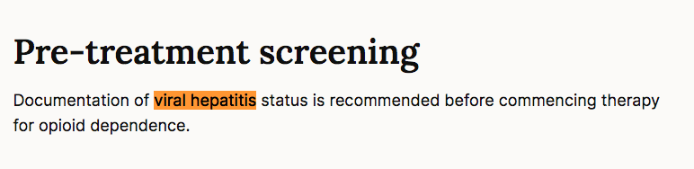
NB
For prescribers and administers.

Slide 9

BBV Pharmacy
Thank You

