Slide 1


Delivering hepatitis C elimination in Wales
Follow Me – HCV peer project
Hepatitis C National Workshop
Cardiff, 30th March 2023
Danny Morris – Regional Manager
Sean Cox - Director of Prison Services

Slide 2
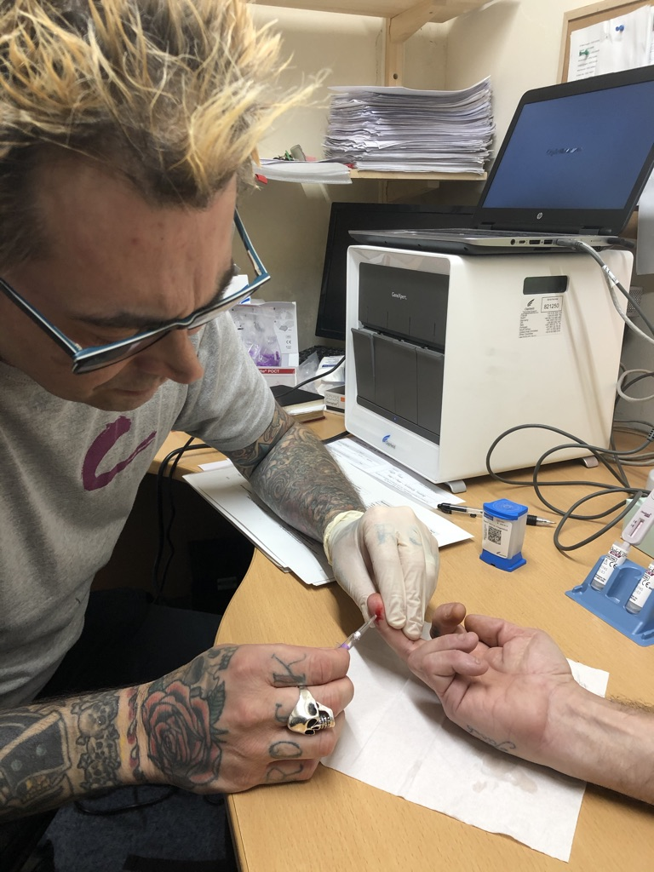

FOLLOW ME
Developed to provide support to people with little access to health care, or those who may find it difficult to navigate traditional HCV treatment pathways.
The core components are peer led:
Engagement and awareness raising
Testing and support to treatment
Prevention, advocacy & education
Notes:
The model is designed so that patients may ‘follow’ those with lived experience of HCV from initial testing through to completing treatment. Our staff are embedded within the clinical pathway, mainly have NHS honorary contracts and operate as part of the ODN delivery team, and work closely with partner organisations and settings such as hostels, drug services etc. This means they are uniquely placed to bridge the gap between hospital care and the community.
A Initial engagement, awareness and testing
We meet our potential clients through many channels: mobile outreach, peer-led testing events, awareness and education workshops, and referrals from NHS, drug services, and prison healthcare.
Our awareness workshops involve peer volunteers using their story – shaped to address common misconceptions about hep C, transmission, treatment and cure. We often offer testing at the same time. Workshops and/or testing events may be held in drug services, hostels, through street outreach, for example. We provide testing directly, with ODNs and./or on behalf of ODNs
B Peer support
Each client is connected with a peer worker (paid or volunteer) who will build a long-term support relationship. Peer workers have personal experience of hepatitis C and, often, injecting drug use and are well linked into local services. Peers make direct referrals into secondary care for HCV treatment. Reminders. Escort. Travel. Additional support is also offered, such as helping with accessing benefits and dealing with other health issues
C. Advocacy, education & prevention
Throughout this process, we help patients understand their rights and treatment options. We also provide harm reduction advice and sign post to services based on any additional needs that they may have.
As we work as part of the ODN, our staff also support changes to health systems to make them more accessible to patients, and we train staff across NHS and other partner organisations to raise awareness and understanding of hepatitis C.

Slide 3
Cardiff & vale Activity
1152 service users meaningfully engaged
HEP C awareness training, reducing stigma, harm reduction and prevention interventions, the importance of testing. Service users engaged via outreach, testing events, awareness raising events, and drop ins at local services used by those most at risk.
Resulting in 503 BBV tests
107 referrals for people testing positive for HCV with peer support for 70 treatment starts to date
Referrals from a variety of sources including harm reduction and treatment services, Welsh and English prisons, outreach events and C&V NHS clinical team..
Lost to follow up Many find it difficult to engage with traditional clinical pathways. Working closely with the local nursing team and National Consultant has led to adapting and developing bespoke pathways, allow for a more flexible approach to these patients, many with multiple needs and experiencing significant health inequalities 25 successfully initiated treatment

Slide 4
Cardiff & vale training & development
200 allied staff trained in Hep C & BBV Awareness
Delivered via HAT (Hepatitis Awareness Training) or a full day BBV Training to partner agencies across the statutory and third sectors (including Cardiff Addictions Unit (CAU); Vale Alcohol & Drug Team (VADT), Cardiff and Vale Drug and Alcohol Service (CAVDAS); Kaleidoscope; HMP Cardiff; HMP & YOI Parc; Dyfodol De Cymru; Cardiff Council Homeless MDT; Salvation Army; Pobl; Recovery Cymru; South Wales Police and National Probation Service, Cardiff)..
Over 300 staff engagements for ongoing support
Reinforcing confidence around Hep C awareness, supporting service users and positive patients through treatment, challenging stigma and the importance of the individual worker input in the journey to elimination – more staff taking care of their caseloads
7 active peers: Peers have varied responsibilities depending on competency and confidence. Peers support with testing, using lived experience to engage at risk individuals and provide ‘Follow Me’ support to service users.
Notes:
Thanks to both the professionalism and unique benefits our peers, Dyfodol and RAPS Cardiff have invited us to run a peer-led testing event in their service, running several sessions a week, increasing capacity to more effectively attract and target test those not currently engaged in existing hepatitis C care pathways.

Slide 5
Cardiff & vale developments
CAVDAS pathway Facilitated by Gilead with Del Tompkinson, Gareth Morgan, CAVDAS and Hep C Trust
‘BBV Hub’ @ CAU Newly created office space for nursing team where staff can drop in for HCV support and guidance
Dyfodol tracking system Supporting micro-elimination by tracking when clients due for test
Huggard homeless services Opt out referral mechanism post testing to reduce ‘lost to follow up’
Onward referral All Follow Me service users offered linkage to drug services and GP as standard practice
Regular testing at homeless hostels 200% increase in uptake at Adams Court Ty Ephraim
Assisted other LDIG funded programmes POCT at Adams Court and pharmacy testing

Slide 6
peer support in welsh prisons
Provided peer support, education and led on planning of a successful Parc HITT with community support from HCT Peer worker, NHSW, PHW and G4S:
  1588 tested - more than 95% of residents
  123 antibody positive, 23 PCR +ve and 17 treatment starts to date
Supporting HMP Usk and HMP Prescoed in reaching micro-elimination strategy, maintenance, and future training needs
Supporting HMP Cardiff embed rapid tests and access to treatment pathway, with staff and resident training
Full-time peer project running in HMP Berwyn alongside NHSW healthcare to eliminate hep C in next few months and embedding maintenance program.

Slide 7

PROGRESSING HEP C ELIMINATION
Hep C Trust committed to all Wales support -evolving the partnerships and increasing capacity
C&V APB committed to commissioning the project for 2 years – waiting for WG sign off
Peer development with individual progress to employment
Memberships of Hep B and C Elimination Project Oversight Group, HCV Re-engagement Implementation Group and LDIG
WELSH HEALTH CIRCULAR – eliminating Hep B & C – actions to prevent infection, increase case finding, improve testing and treatment access across community and prisons, improve successful treatment outcomes – highlighting success of our peer projects
Notes:
Other AHB - Betsi Cadwaladr University Health Board
Awareness raising
Finding the undiagnosed
Preventing re-infection
Initially planned wider training of volunteers
Experience suggesting local support needed to recruit and maintain volunteers
Cancer surveillance
Prison work
Prison follow me

Slide 8

Diolch
Thank you
Danny Morris danny.morris@hepctrust.org.uk
Sean Cox
sean.cox@hepctrust.org.uk

