Slide 1

POCT PROJECTS &
NATIONAL TESTING PATHWAYS
Louise Davies
Senior Biomedical Scientist
(National Point-of-Care Testing Lead)
Public Health Wales, Wales Specialist Virology Centre
Notes:
LOU

Slide 2
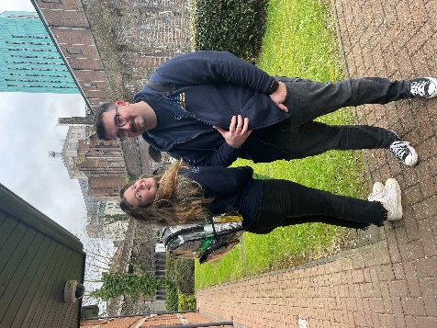
INTRODUCTION
NEW NATIONAL POCT PRACTITIONER POSTS
FUNDED BY LDIG/PHW(2022-2023)
Morgan Cutlan
Ryan Davies
RAPID POCT PATHWAYS ACROSS WALES
  Prison based POCT
  Community based POCT delivered by laboratory staff- not just a rapid test!
  What other factors that need to be in place for POCT to be effective.
  What next? Up coming projects
Notes:
LOU

Slide 3
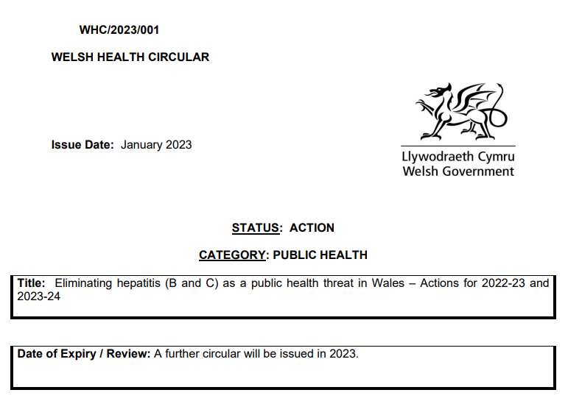
RAPID POCT PATHWAYS ACROSS WALES- Prison based
‘BBV opt-out testing has been introduced in prisons in Wales, in addition to community substance misuse and allied services’.
– This should change the way we offer testing
‘Action 9 – Improve testing and treatment in Prisons
Micro-elimination of hepatitis C must be achieved and sustained in all Welsh prisons by March 2024.
Micro-elimination is defined as:
• 100% of the prison population being offered a hepatitis C test.
• 90% of those having then been tested.
• 90% of those who been diagnosed with hepatitis C having started treatment.’
Notes:
The implementation of an innovative two-tiered POCT testing approach consisting of rapid Hep C antibody testing using the OraQuick mouth swab, followed by HCV RNA testing using the Cepheid GeneXpert Fingerstick PCR Platform in these prison settings has facilitated same day diagnosis and rapid access to treatment

Slide 4
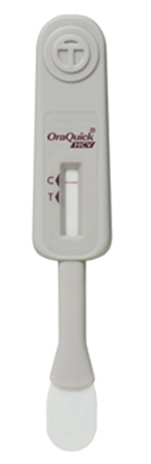
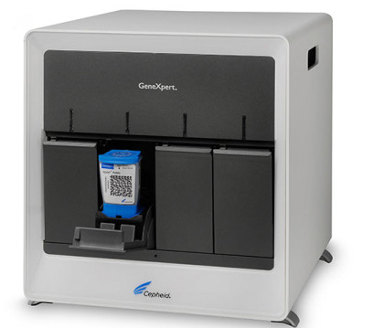
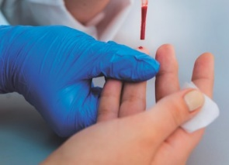
RAPID POCT PATHWAYS ACROSS WALES- Prison based
‘POCT facilitating same day Diagnosis and Rapid Access to Treatment’
Step 1.
OraSure, OraQuick HCV Antibody POCT
Identifies exposure
20-40 minutes
HITT (High intensity Test and Treat) POCT Services currently set up in:
HMP, SWANSEA
HMP, BERWYN
HMP, CARDIFF
Step 2.
Cepheid, GeneXpert HCV VL PCR POCT- 4 Module
Detects ACTIVE HCV infection in 60 Minutes
Finger stick sample collection
All new arrivals who enter the prison system are screened on arrival.
Stocks of treatment kept in the prison pharmacy.
Highly successful pathway- men often treated within the first week of entering the system.
PATHWAY 1.
Notes:
The implementation of an innovative two-tiered POCT testing approach consisting of rapid Hep C antibody testing using the OraQuick mouth swab, followed by HCV RNA testing using the Cepheid GeneXpert Fingerstick PCR Platform in these prison settings has facilitated same day diagnosis and rapid access to treatment

Slide 5
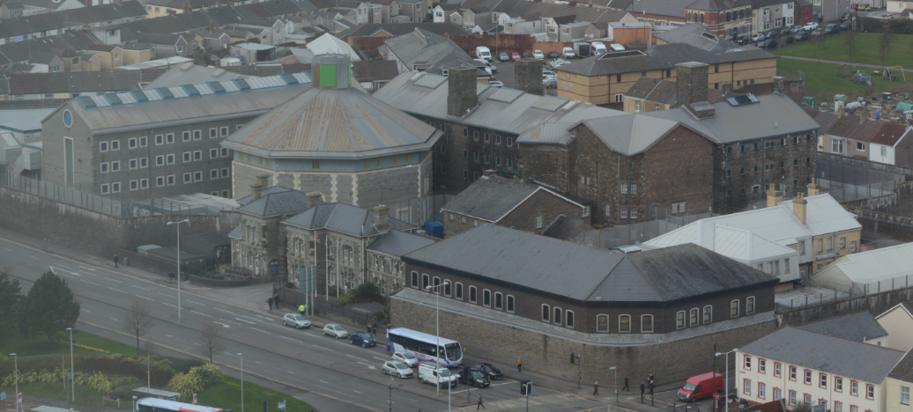
RAPID POCT PATHWAYS ACROSS WALES- Prison based (HMP, SWANSEA) (~450 men)
HMP, SWANSEA | NUMBER ANTIBODY MOUTH SWABS | NUMBER ANTIBODY POSITIVE MOUTH SWABS | NUMBER PCR TESTS DONE* | NUMBER OF PCR POSTIVE TESTS | NUMBERS TREATED
2022 | 839 | 89 | 70 | 16 | 15 1-Treated HMP, Cardiff
2023 | 47 | 3 | 12 | 1 | Patient released- being followed up by James Plant in Barod.
5th Sept 2021-Achieved micro-elimination using the POCT pathway
(5 months following service implementation)
More POCT training due to take place to make the service more robust.
1st April-James Plant (BBV Nurse) adding POCT/DBST results to NEO
PATHWAY 1.

Slide 6
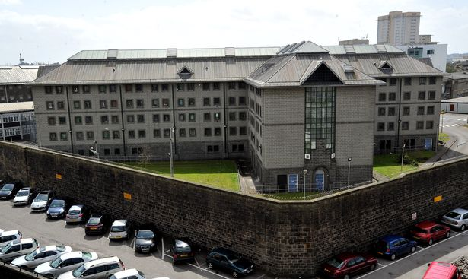
RAPID POCT PATHWAYS ACROSS WALES- Prison based (HMP, CARDIFF) (~780 men)
HMP, CARDIFF | NUMBER ANTIBODY MOUTH SWABS | NUMBER ANTIBODY POSITIVE MOUTH SWABS | NUMBER PCR TESTS DONE* | NUMBER OF PCR POSTIVE TESTS | NUMBERS TREATED
TOTAL (MAY 2021-JAN 2022) | 1151 | 64 | 89 | 23 | 22 Treated 1- Refused (believed to be his punishment from wrong doing)
MAY-OCT | 1097 |  | 80
NOV-JAN | 54 |  | 9
*Service set-up 16th May 2022
October 2021- Came very close to achieving micro-elimination
No tests performed since 17th Jan
Struggling with recruitment
Staffing issues raised
PATHWAY 1.

Slide 7
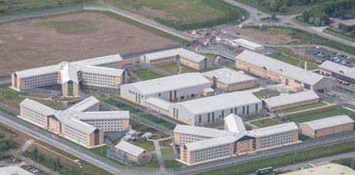
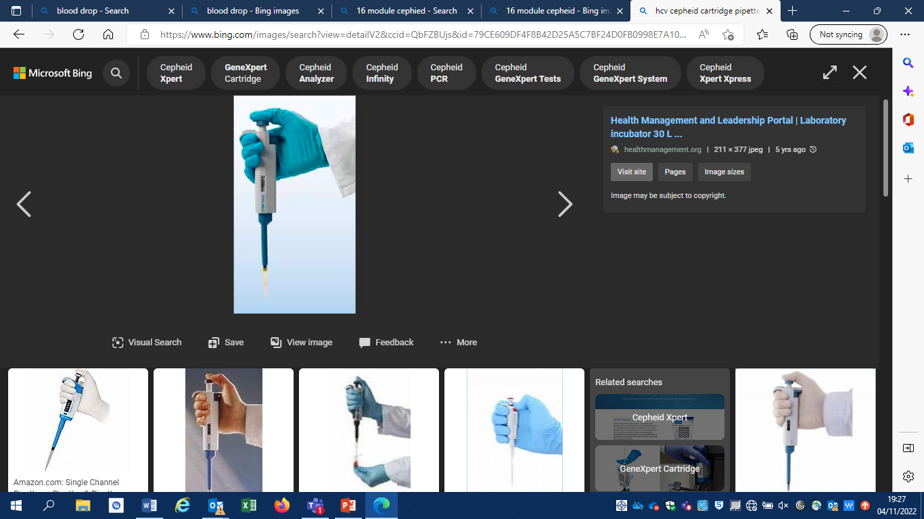
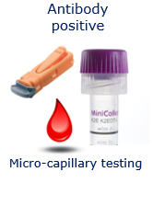

RAPID POCT PATHWAYS ACROSS WALES- Prison based (HMP, BERWYN) (~1800 Men)
STREAMLINED TESTING PATHWAY- NOT POCT’in everyone!
TRANFERS:
Primary care team DBST in primary reception via the ‘opt-out’ scheme.
Transfers from other prisons who have had DBST do not have a mouth swab.
Needle-phobic transfers who haven’t had a DBST will be offered a mouth swab.
Previous HCV positive transfer patients will get a rapid Cepheid PCR
NEW IN (Remanded and sentenced from court):
DBST & HCV antibody mouth swab
Cepheid PCR used to SVR difficult to bleed patients or if SVR result is needed before release date.
1st Feb 2023-MICRO-CAPILLARY SAMPLE PROCESSING TRAINING - pipette training to perform testing on Micro-capillary tubes.
Micro-capillary sample collection prior to Cepheid PCR helps to over-come barriers with prison logistics ‘making PCR more accessible’.
New sample collection option for PCR
PATHWAY 1.

Slide 8
RAPID POCT PATHWAYS ACROSS WALES- Prison based (HMP, BERWYN)
HMP, BERWYN | NUMBER ANTIBODY MOUTH SWABS | NUMBER ANTIBODY POSITIVE MOUTH SWABS | NUMBER PCR TESTS DONE* | NUMBER OF PCR POSTIVE TESTS | NUMBERS TREATED
2021 (July-Dec) | 767 | 67 | 67 | 17 | 12-Treated 3- Referred for community treatment
2022 | 1763 | 84 | 197 | 42 | 39-Treated 1-Treated in HMP, Cardiff 1- Short sentence, preferred to get treated in community 1- Released soon after PCR, referred to local clinic
2023 | 164 | 4 | 22 | 7 | 1- Started 2- Low viral load- monitoring 1- Acute Hep C, so not started yet 1- Issue around capacity to start yet 1-Hoping to start once other health issues have been dealt with 1- Hoping to start 28/03
Very close to achieving micro-elimination.
Small team of two POC testers (Anya Hughes, NHS & Janessa Turnbull, Hep C Trust) & dedicated pharmacy staff.
PATHWAY 1.

Slide 9
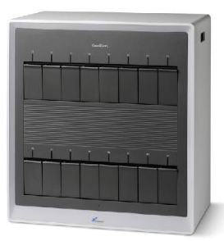
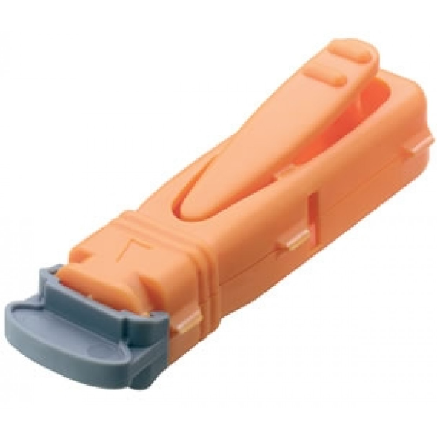
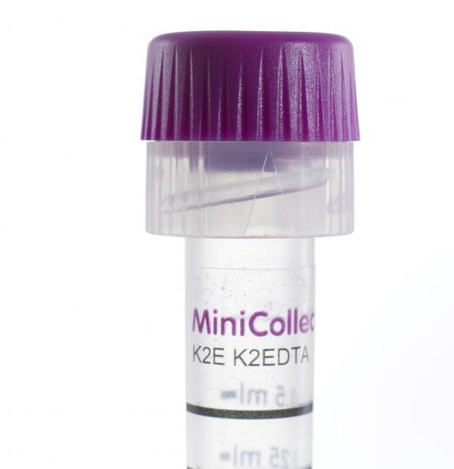
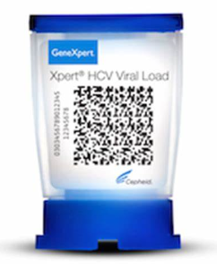
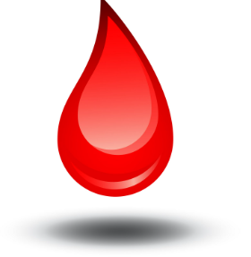
RAPID POCT PATHWAYS ACROSS WALES – Community/laboratory based (POCT Practitioner led)
Step 1.
Antibody positive
Sent to the laboratory for rapid PCR testing
Micro-capillary testing
Step 2.
16 module Cepheid in the microbiology dept.
Cepheid can be used for SVR (more sensitive than DBST).
Service is live in Cardiff.
Plans to expand this service to Swansea bay in the coming weeks.
FAST RESULTS: reported within two hours of receipt
PATHWAY 2.

Slide 10
RAPID POCT PATHWAYS ACROSS WALES - Community/laboratory based (POCT Practitioner led)
Antibody positive
Sent to the laboratory for rapid PCR testing
Micro-capillary testing
Only currently used as part of the POCT pathway
OR,
In exceptional situations
i.e. no venous access/extremely anxious/chaotic individuals (rapid result needed)
PATHWAY 2.

Slide 11
RAPID POCT PATHWAYS ACROSS WALES - Community/laboratory based (POCT Practitioner led)
High Intensity Test (HIT)- POCT Cwm Taf, Cardiff & Vale, Powys and Swansea Bay (2021-2022)
POC TESTING LOCATIONS | NUMBER ANTIBODY MOUTH SWABS | NUMBER ANTIBODY POSITIVE MOUTH SWABS | NUMBER PCR TESTS DONE* | NUMBER OF PCR POSTIVE TESTS | DBST | Numbers Treated
HMP, Parc – Cwm Taf Morgannwg UHB | 1588 | 117 | 117 | 21 | 21 | 13-Treated 7- Not competed
Hostels and Needle Exchanges (Huggard, CAU, Litchfield Court, Adams Court, Dyfodol) – Cardiff and Vale Health Board | 15 | 0 | 27 (DBST reactive follow up) | 13 | 128 | ?
Kaleidoscope drug and alcohol services in Welshpool and Newtown- Powys Health Board | 54 | 4 | 7 | 2 | 45 | All Treated
Hostels (St. Leonards, Ty Tom Jones, Paxton street, shoreline, YMCA) - Swansea Bay UHB | 31 | 7 | 9 | 4 | 26 | All Treated
Cross borders woman’s shelter, Birchgrove- Swansea Bay UHB. | 2 | 1 | 1 | 0 | 2 | N/A
Ambassador hotel, safe haven, Lewis Road, Beaufort house, Neath- Swansea Bay UHB | 78 | 8 | 20 | 3 | 86 | All Treated
Quay House - Swansea Bay UHB | 15 | 0 | 0 | 0 | 12 | N/A
Seafront Hotels (Swansea Bay Hotel, Tudor Court, South View) - Swansea Bay UHB | 16 | 0 | 10 (Inc. house visits) | 1 | 14 | All Treated
Keyworkers/security (trust established)
Swansea seafront hotel- same cohort as Wallich ‘high-risk’
OCT 2022
Mouth swabbing (AM) / rapid PCR testing in lab (PM). Known antibody positives- rapid PCR only.
Results from both POCT’s sent over to BBV specialist by end of the day.
Learning more and more what works well where!!
PATHWAY 2.
Treatment for all patients confirmed within 2 weeks.
3 patients treated within two weeks/1 patient treatment due to start by delayed by other therapy/3 starting treatment imminently/ 6 of the 7 patients will start within three weeks.

Slide 12
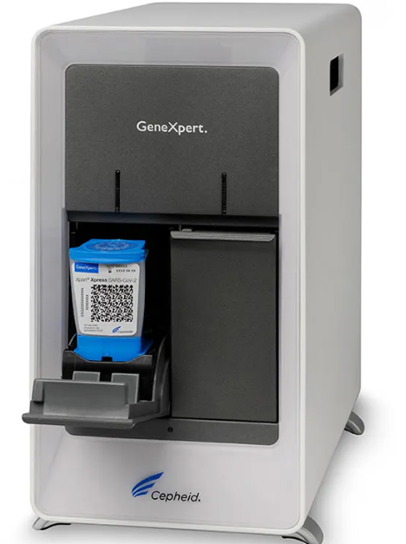
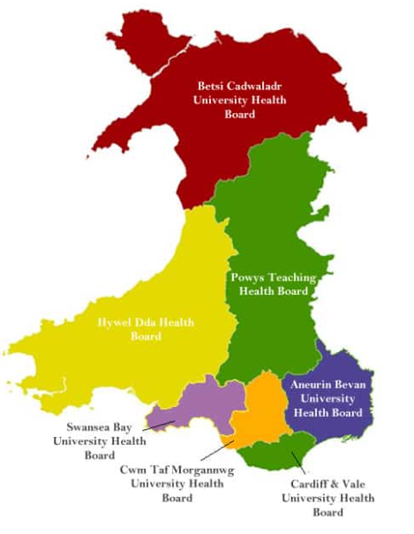
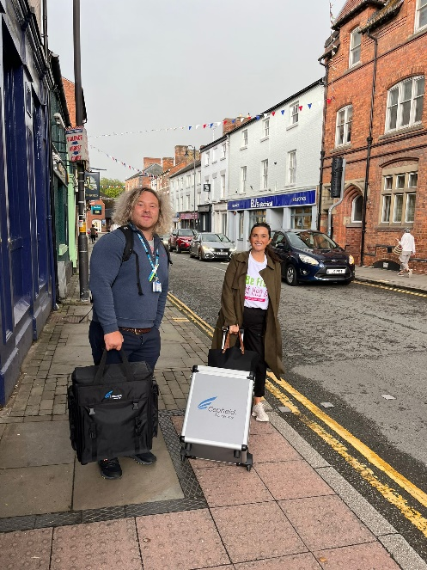
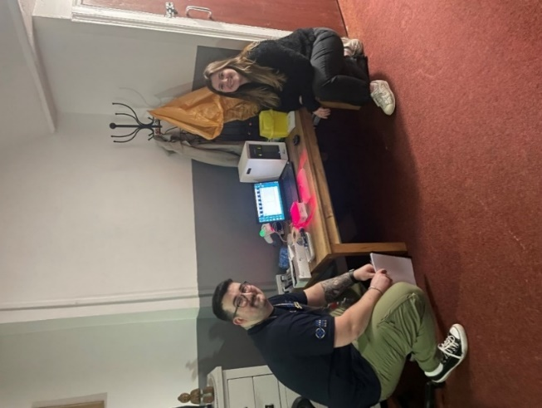
RAPID POCT PATHWAYS ACROSS WALES- Community based (POCT Practitioner led)
‘POCT facilitating same day Diagnosis and immediate referral to local BBV specialist teams for treatment’
OraSure, OraQuick HCV Antibody POCT
Cepheid, GeneXpert HCV VL PCR POCT- 2 Module
Great to use in rural locations- where accessibility to local laboratories is limited
Or
When doing small HITs- HCV antibody positivity rate not going to overwhelm the machines capacity
PATHWAY 3.
Notes:
The implementation of an innovative two-tiered POCT testing approach consisting of rapid Hep C antibody testing using the OraQuick mouth swab, followed by HCV RNA testing using the Cepheid GeneXpert Fingerstick PCR Platform in these prison settings has facilitated same day diagnosis and rapid access to treatment

Slide 13
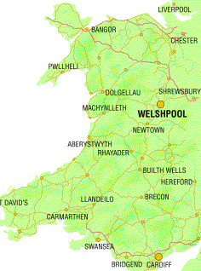
RAPID POCT PATHWAYS ACROSS WALES- Community based (POCT Practitioner led)
‘POCT facilitating same day Diagnosis and immediate referral to local BBV specialist teams for treatment’
High Intensity Test (HIT session)
2 Sessions (7th & 14th Sept):
54 mouth swabs
4 Ab mouth swab
positives
7 Rapid PCR’s
2 Active infections
45 DBST
2 Patients treated on 20th Sept
POCT in Powys
Kaleidoscope-Drug and Alcohol Clinic
Rural location- letters sent out to all clients to attend dedicated clinic slots.
Portable Cepheid/rapid PCR- highly effective in this setting as local laboratory is Shrewsbury.
PATHWAY 3.
Notes:
The implementation of an innovative two-tiered POCT testing approach consisting of rapid Hep C antibody testing using the OraQuick mouth swab, followed by HCV RNA testing using the Cepheid GeneXpert Fingerstick PCR Platform in these prison settings has facilitated same day diagnosis and rapid access to treatment

Slide 14
  What we’ve learnt for our community based POCT HIT sessions:
Ideally arrange two POCT screening sessions back to back- to inform patients of their results & to perform rapid PCR.
Schedule pre-planned BBV nurse lead clinics- for referrals to discuss treatment/treat soon after POCT sessions.
Ask patient if they’ve ever been exposed- fast-track to PCR/avoid over-use of mouth swabs.
2 module Cepheid can be overwhelmed- Often more suitable to collect micro-capillary bloods to be tested in the laboratory.
Advertising POCT session is key to testing success- print off client list (offer everyone a test!)

Slide 15
  What other factors that need to be in place for POCT to be effective.
Rapid access to BBV specialist clinics following POCT sessions.
-Ideally before results would be back via traditional lab tests (VP/DBST)
Connectivity of devices- In progress
Extra funding- For staff and tests

Slide 16
  What next?- Upcoming projects
Probation Swansea:
    Educational training event starting 20th April
    HITT - Mouth swab/Cepheid HCV PCR
    2300 men and women
    1/3 of these people have never been in prison
    POCT for one month period
    Exit plan- weekly DBST supported by Georgie, SBUHB BBV team
CDAT Cwm Taf:
    5 sites (Bridgend, Rhondda, Taff Ely, Cynon, Merthyr Tydfil)
    HITT - Mouth swab/Cepheid HCV PCR
    Average 200-300 patients accessing each site
Needle- exchange C&V CDAT
    Asess how POCT works in this environment
3 monthly HITT session in Ambassador Hotel, Neath (Swansea Bay UHB)
    High turn over/ works well in this setting because testing in encouraged by keyworkers.

Slide 17
  What next?- Upcoming projects
Implementing micro-cap Cepheid PCR testing in Singleton Hospital, Swansea Bay
Verification of blood sample collection method using OraSure, OraQuick POCT-
will enable us to rapidly test patients who’ve just eaten/ circumvent the ‘no food/no drink 15 minutes before oral sample collection’ limitation of the test.

Slide 18

Thank You For Listening
Any questions?
Email: Louise.Davies14@wales.nhs.uk
Tel: 02920 742178

Slide 19
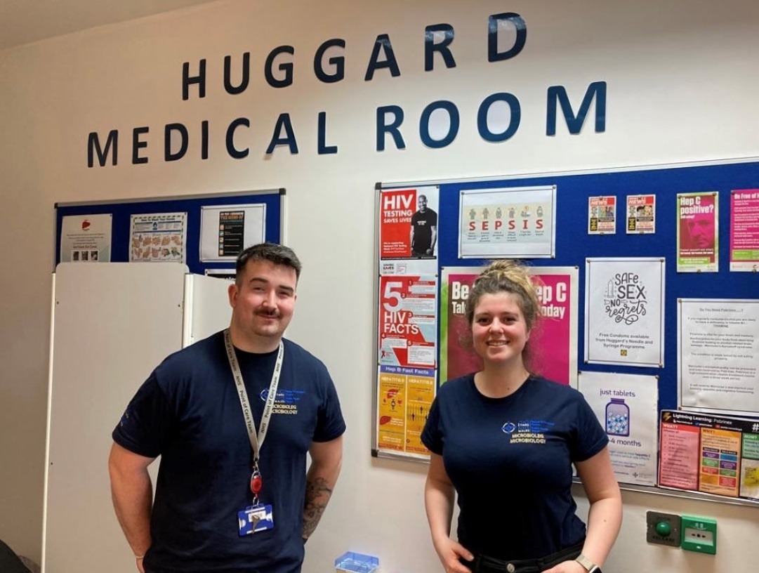
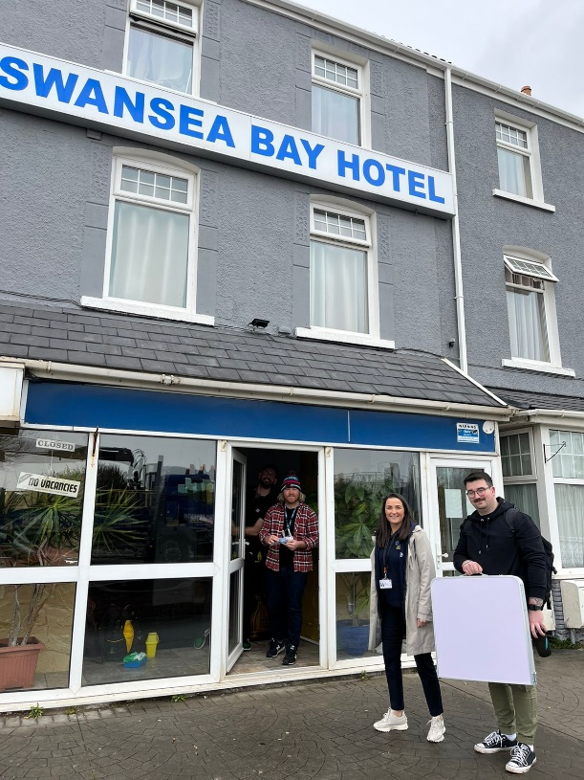

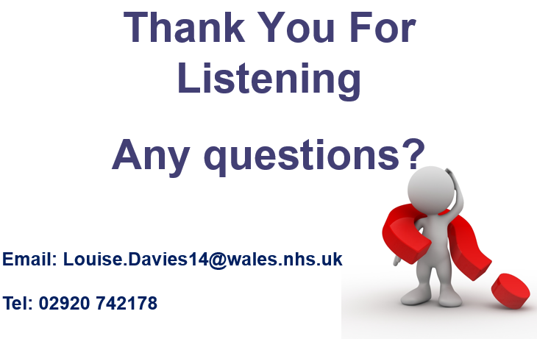
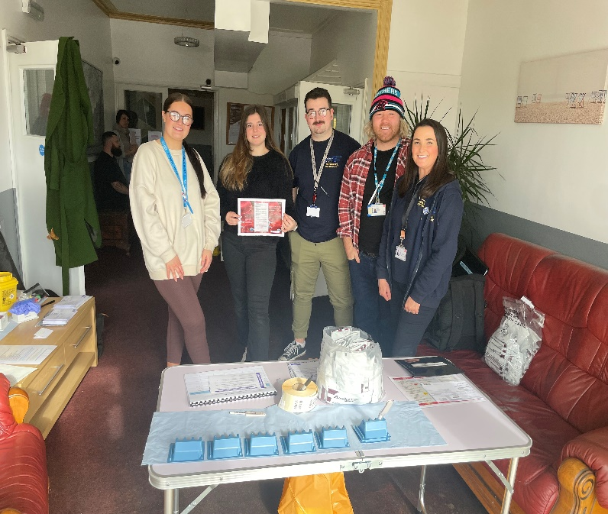
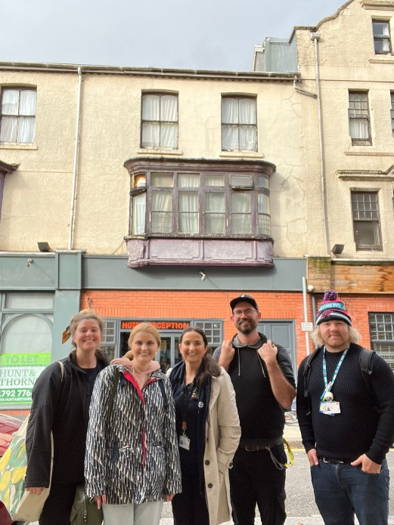
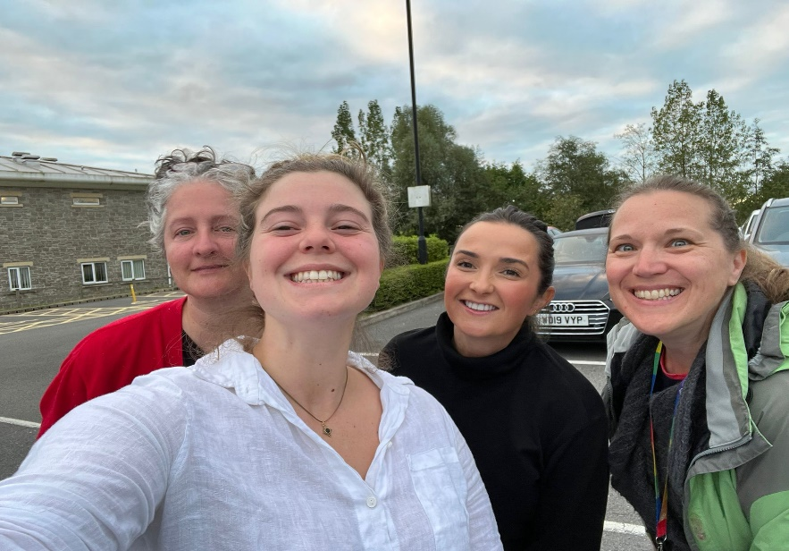
WE LOVE IT!

