Slide 1
Emergency Department Testing
in England
Mark Gillyon-Powell
Head of the HCV Elimination Programme, NHS England

Slide 2
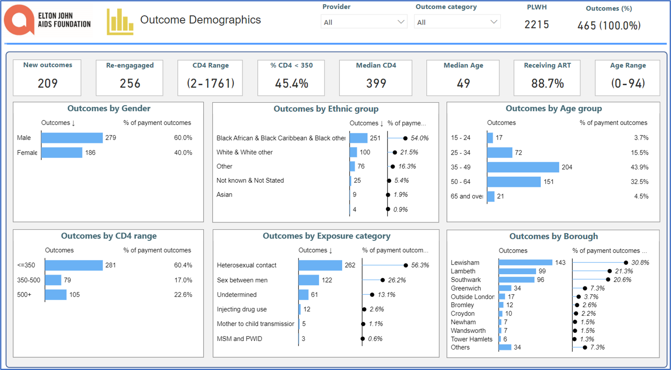



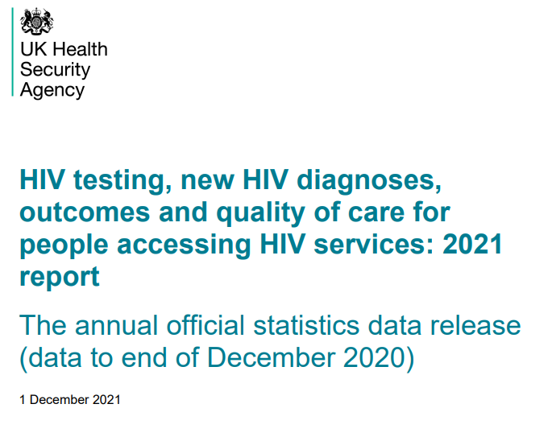
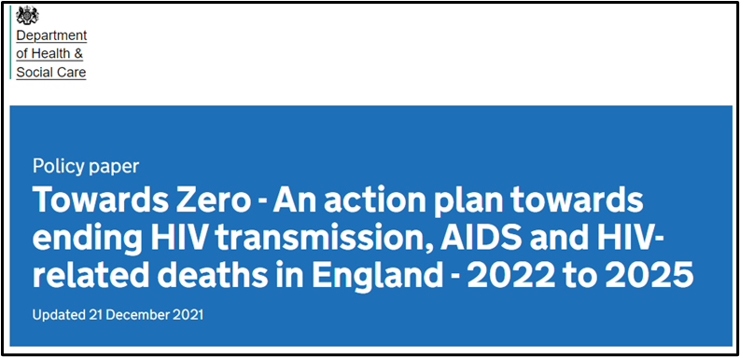
The ED BBV testing programme origins
British HIV Association/ British Association for Sexual Health and HIV/
British Infection Association
Adult HIV Testing Guidelines 2020

Slide 3

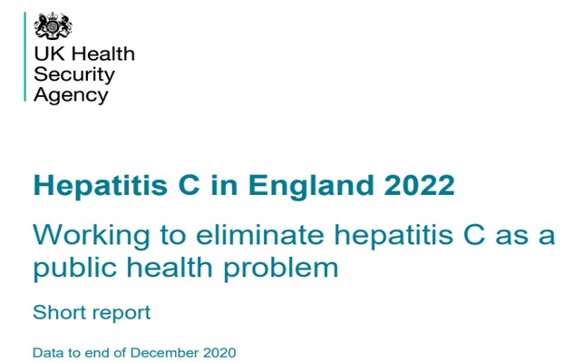
Inclusion of viral hepatitis testing
Used a ‘reverse engineering’ approach to explore maximum other blood borne virus testing possibilities from the same blood sample taken for HIV testing.
Strong partnership and funding from NHS England HCV Elimination programme.
Coordination and convening across the London ICSs, with champions driving local progress.

Slide 4
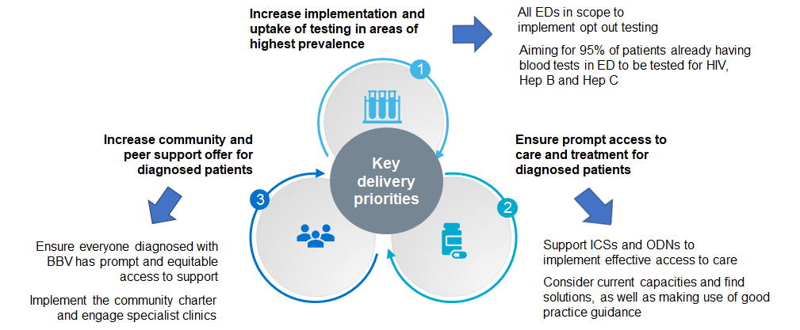
Dynamic commissioning approach

Slide 5
Local actors, London
34 Emergency Departments are taking part:
33 testing for HIV, and
21 additionally testing for HBV and 23 for HCV.
Some Trusts have been testing for HIV or for HIV, HBV, HCV in emergency departments for a number of years, and have generously shared their learning to facilitate progress.
ICSs offering leadership and coordinating local steering groups.
Community organisations are active partners, sharing their experience of providing community and peer support.

Slide 6
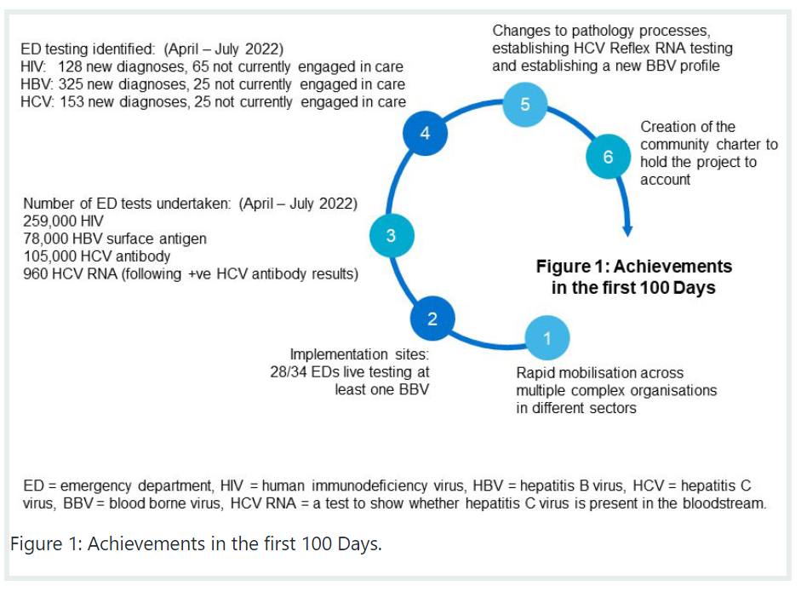
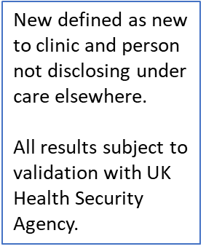
ED Results: April - August 2022, London
From NHS Publication Ref: PR1849 - Emergency department opt out testing for HIV, hepatitis B and hepatitis C: The first 100 days

Slide 7
ED BBV testing results: April 2022 – Jan 2023
Results | New | Disengaged | In care | Reinfection
HIV | 306 | 158 | 3,612 | n/a
HBV | 854 | 87 | 432 | n/a
HCV | 355 | 61 | 81 | 16
ED No. of attendees: 1,928,160
Attendees with blood drawn: 1,114,488
HIV tests: 705,633
HBV sAg tests: 255,646
HCV Ab tests: 335,334
HCV reflex RNA tests: 3,162 (of which 502 positive).
Subject to UKHSA validation. New defined as new to clinic and not disclosing under care.

Slide 8
What do people say?
‘When I felt unwell and went to the emergency department, it was a life saver – I got diagnosed with HIV and I wouldn’t have known otherwise. The opportunity to be tested meant that I got treatment and was able to carry on with my life. I think testing in A&E is a very proactive thing to do because having the opportunity to have the investigation could potentially save your life, I think it is something that should be offered to everyone.’ Male, 40s.
‘I attended A&E for a completely unrelated reason. I did not see the posters in the waiting room about HIV testing or I feel I may have opted out. I was initially angry about being tested as I felt I had control taken away from me, but after being diagnosed and speaking with the doctors and learning HIV is just a long term manageable condition and with treatment it does not reduce life expectancy, I now feel very grateful I have been diagnosed as I don’t think it’s something I would have been tested for in the near future.’ Male, 50s.

Slide 9
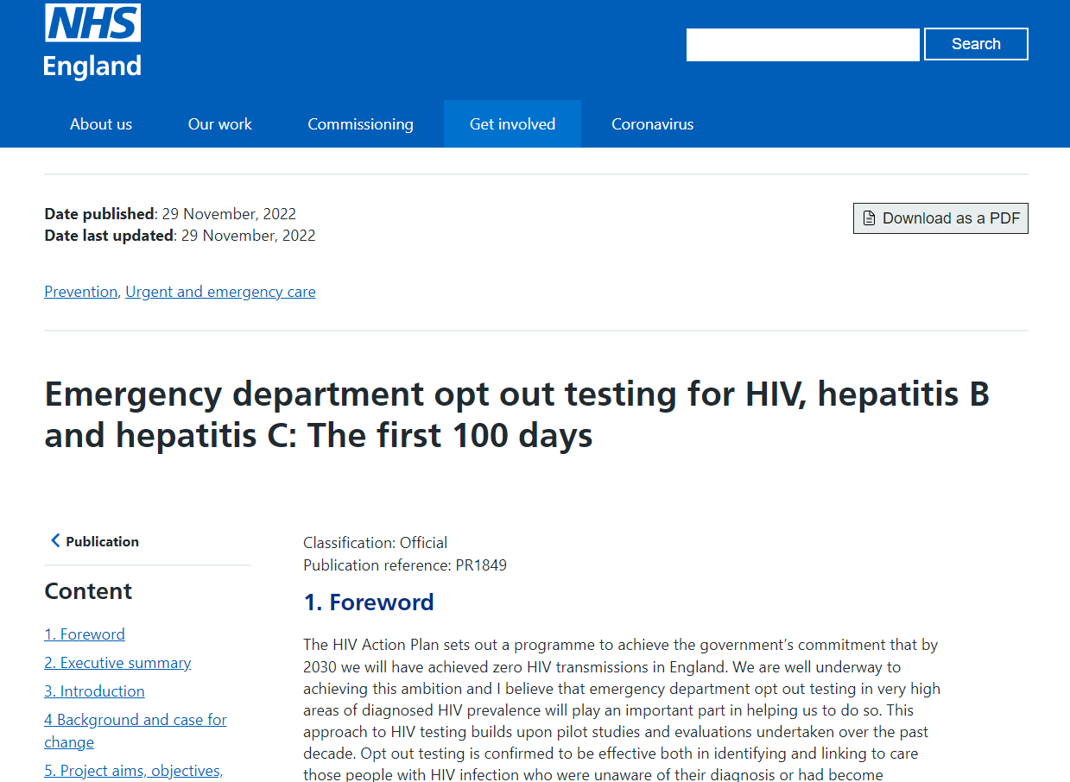
Launch of the First 100 Days report
Extensive press coverage of the ED BBV testing programme, including The Times, The Guardian, The Evening Standard.
Great coverage across BBC radio and BBC TV stations, including interviews on BBC TV London News on World AIDS Day.
Discussions in Parliament on BBV testing , including Penny Mordaunt MP, Leader of the House saying that ED HIV testing should become the norm.
https://www.england.nhs.uk/publication/emergency-department-opt-out-testing-for-hiv-hepatitis-b-and-hepatitis-c-the-first-100-days/

Slide 10

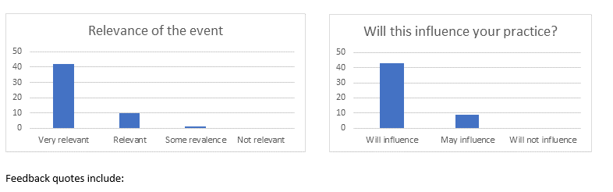



Sharing learning and best practice
National Learn and Share event Sept 2022
140 people attended - plenaries and workshops format.
Honest reflections and discussions by implementers
Feedback included:

Slide 11
Critical success factors
Dedicated HIV / Hepatitis / ED clinicians passionate about ED BBV testing, building on existing testing experience.
NICE guidance, British HIV Association & British Association for Sexual Health and HIV guidelines recommend ED HIV testing in areas of very high/high diagnosed HIV prevalence.
Pan London approach led by Ian Jackson, Director of Commissioning, Specialist Commissioning, NHS England – London.
Partnership with Hepatitis C Elimination programme team to bring BBV approach.
Coproduction with vibrant and influential community sector.
Fast Track City initiative partnership already in place.
Strong focus on sharing learning, challenges and success.
London BI team allocating resource to support data collection and presentation.

Slide 12


Slide 13
What’s next?
Implement full ED BBV opt-out testing in remaining Trusts, ensuring appropriate referral pathways in place.
Increase uptake of testing to 95% and increase number of ED sites ‘blocking’ those who have already HIV/HCV/HBV tested previously (recently).
Ensure culturally appropriate community support offered to all.
Roll out webform data collection for data reporting and develop new dashboard.
UK Health Security Agency developing a twelve month evaluation report due summer 2023.
BHIVA developing a Rapid Guidance statement on ‘Assumed consent’.
Learn and share event being planned for June 2023.

