Slide 1

Joint Peer/Doctor Team Outreach Work in the Big Smoke
Hepatitis C National Workshop
John Gibbons and Indrajit Ghosh
Notes:
Introduction
Indrajit and John

Slide 2
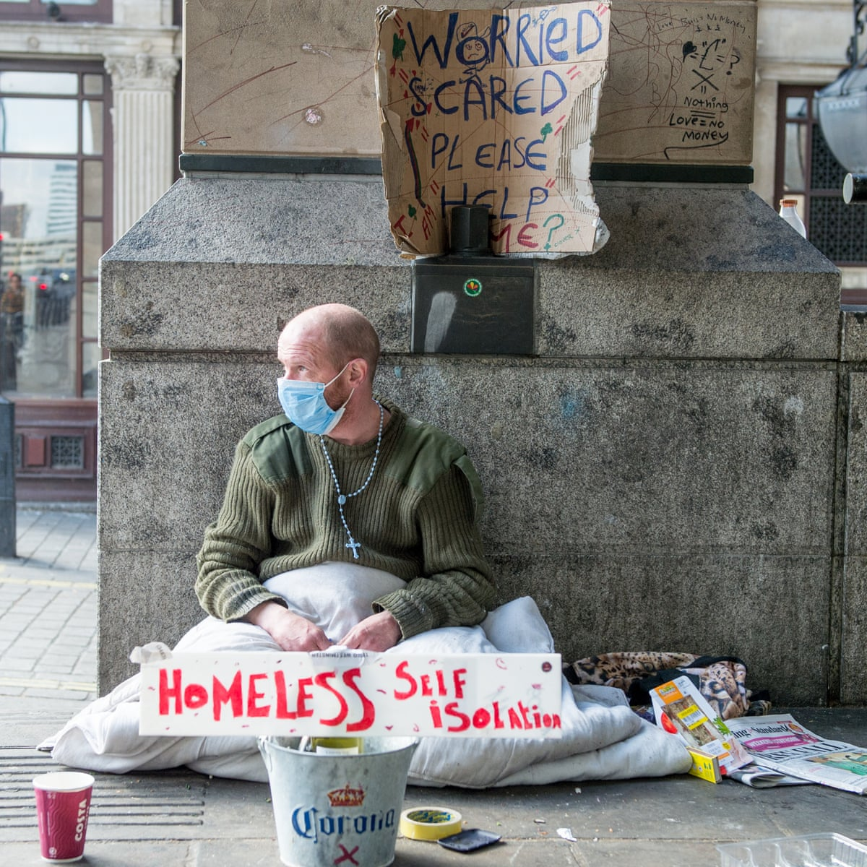
Background
24th March 2020 1st COVID lockdown
“Everyone In”
All DDU’s stopped providing F2F
Patients on BBV treatment had to continue
BBV testing in homeless hotels from May 2020
July 2020 start of the home/hostel visit clinic (John Gibbons & Indrajit Ghosh – JGIG)
July 2021 DDUs started reopening for F2F with limited access
September – November 2022 most DDUs restarting BBV screening
Notes:
Indrajit

Slide 3
BBV testing results May 2020 to February 2023
5540 people screened for BBV’s by Find & Treat
HCV Ab 5021
Positive 800 (15.9%)
Negative 4221 (84.1%)
HCV PCR 742
Positive 309 (41.6%)
Negative 433 (58.4%)
HIV Ab 5011
Positive 96 (1.9%)
Negative 4915 (98.1%)
HBsAg 4395
positive 67
(1.5%)
negative 4328 (98.5%)

Slide 4
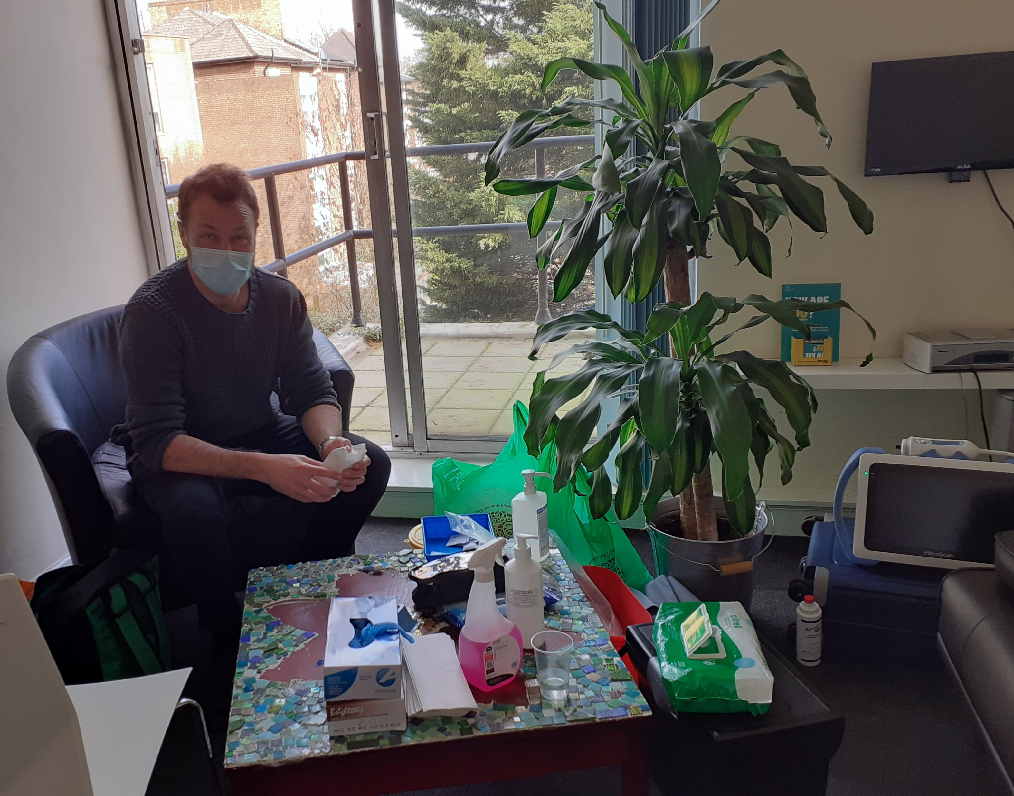
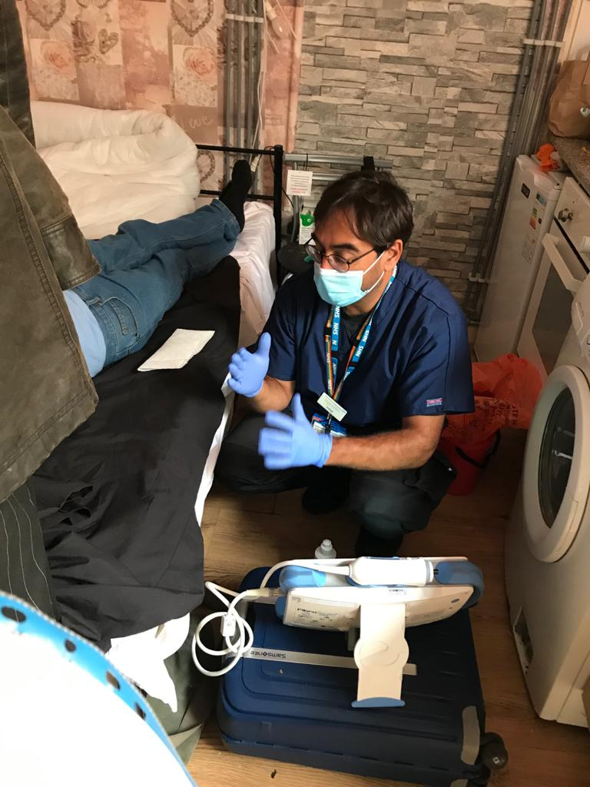
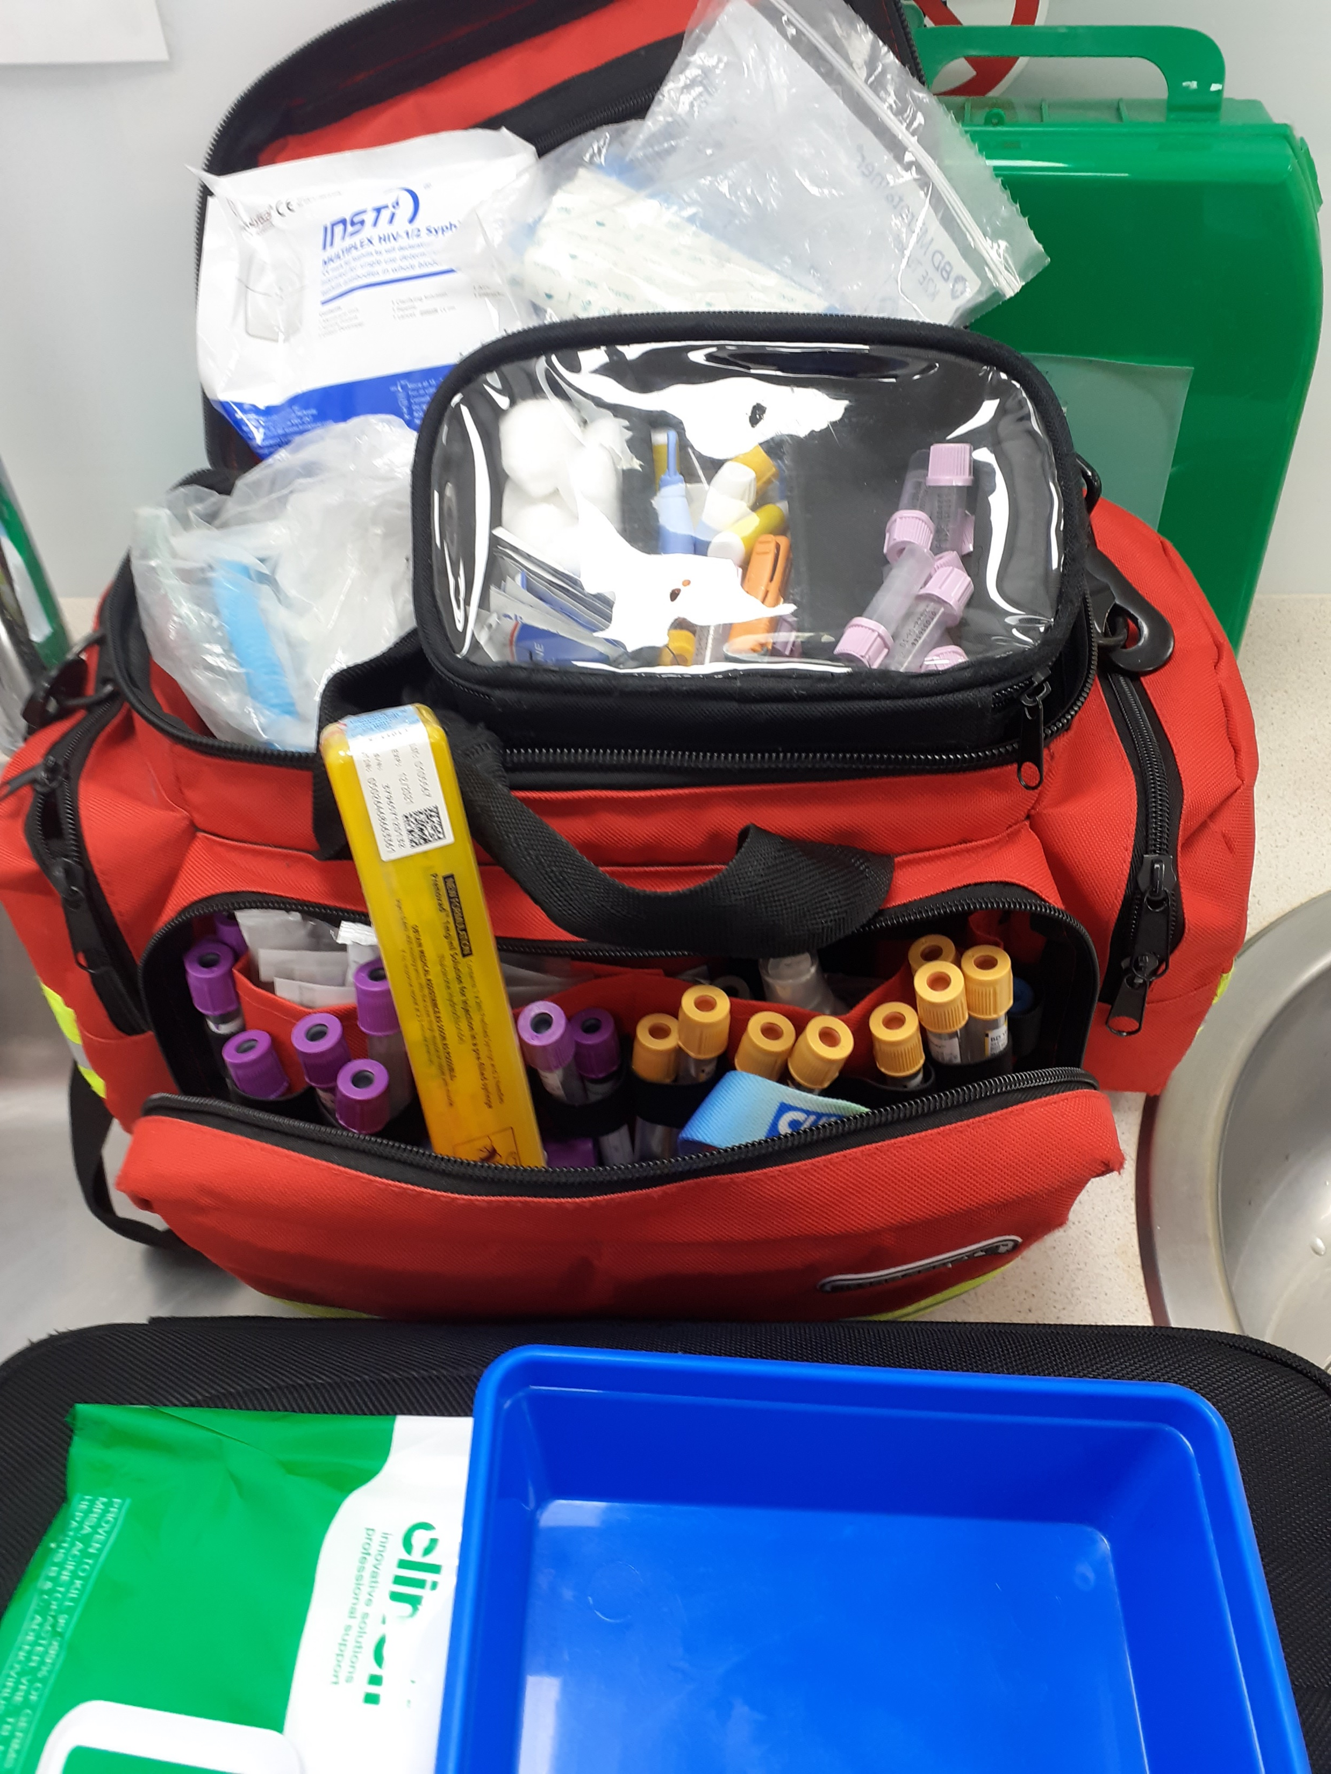

Skill set: peer worker/doctor team
Notes:
Introduction – prev history, clinical skills, LTFU project and JGIG.
I think the combined skill set of an inclusion health Dr and a peer compliments each other well. The peers engage the patients, we make the calls and plan the visits and arrange at a time to suit the patients lives and not ours.
Why I think peers make the difference
Patience, as peers we know that it's not going to be easy and patients might not engage on the first attempt. We've been there before and understand why you miss an appointment. We'll reassure you and try again, without judgement. For me at least, I felt a lot of shame when I missed an appointment or upset anyone, I would just ignore you until you stop calling me. I always remember that and text patients that it's fine, Let's try again next week. I think it's really important that we never discharge anyone. All people go through waves of highs and lows. We can't wait around for people to engage. We have to support them to do it.
We understand what you're going through, we've spent a day in your shoes. and we may be able to share a bit of our story to help relate, inspire and motivate. We build relationships through listening and supporting you in an inclusive way based on what we hear.
Nuances- Fuck off – you've got to get used to this. you are going to be told this at some point and you have to look past it. It's not what it means. It's years of trauma and trudging through a system that isn't very kind. To me, fuck off translates to " could you ever so kindly call me back later" and I will. Let's look at what you need and make it happen.
Calling. Most people should know this already but I think there's a lot of people NOT in Inclusion health that don’t. Don't call from a private number. If you called me from a private number back then, I'm not answering it, I might owe you money and you are not getting it. Even if you don't hide your number, I'm likely still not answering it. Text me, let me know who you are, make me feel comfortable and that you're hear to help.
F2F – We have to listen more. We can help people in a more effective way if we know the whole story and can direct our support accordingly. I think we need more time with each person we work with and be less specific about what we help with first.
Flexibility – I think we need to move away from rigid timed appointment slots for this group, we need to build our clinics to suit the patients lives and not ours.

Slide 5
Tour
Referrals / Contact
Medication
Check equipment
Create tour on app
Notes:
Indrajit

Slide 6
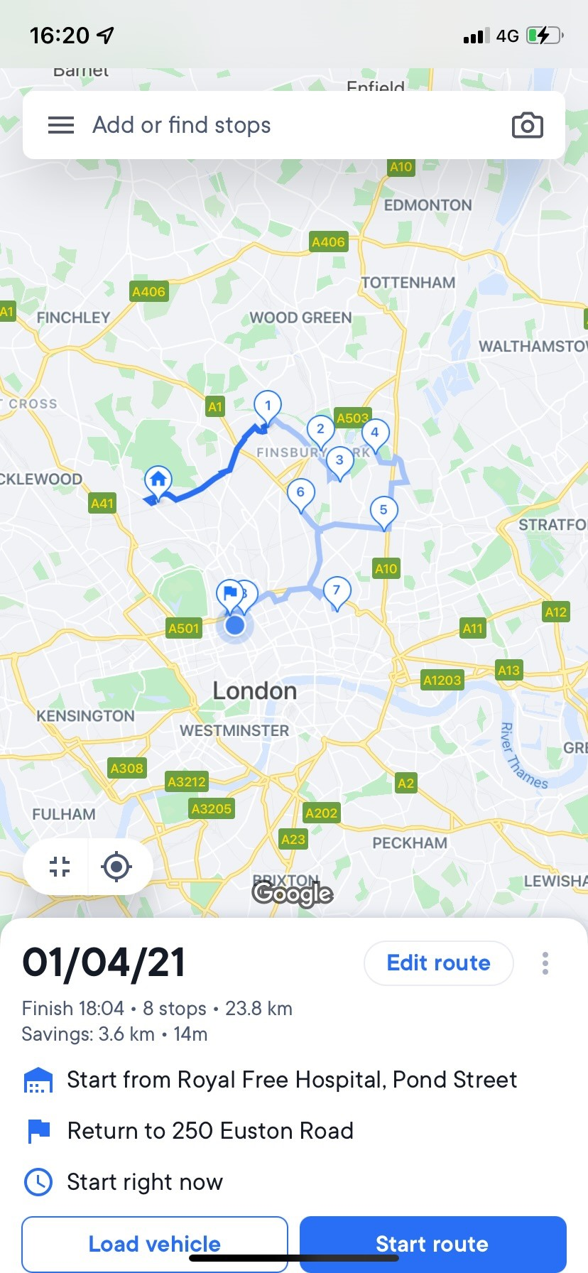
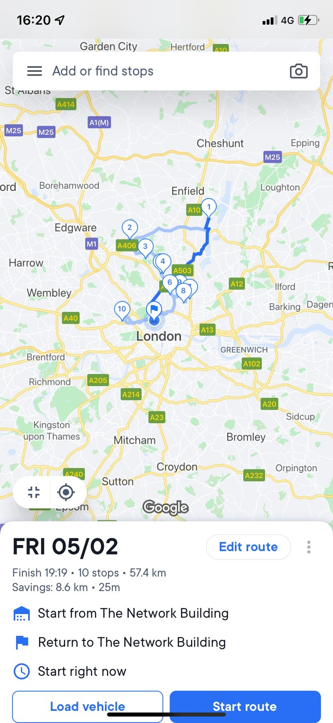
Circuit example
Notes:
John / Indrajit
This is an example of the amount of patients we can see on an average day in patients homes. Medications and bloods can be done using a bicycle Home visits are an excellent example of cutting down on missed appointments. It’s rare that a patient doesn’t want you to come around to their house and they’re always pleased it’s a time that suits them and they don’t have to travel

Slide 7
Assess-ment
Phlebotomy
Treat-ment
Lab contact
Linkage
Documentation across several trusts
Moni-toring
Peer support
Small volume
POCT/ STI
Liverelastography
Observation
PMH/DH
Keyworker / Recovery
VOT
Phone / text / WhatsApp
ODN referral / approval
Blue-teq scripts
FP10
Sick notes
PIP / ESR / Housing support letter / GP reg.
Network of DDU / GP’s / hospitals
Network of local authorities / homeless teams
Peer groups
Incentives
Referral to imaging / OPD
HMP
GP records
Cepheid PCR
Reminders
Notes:
Indrajit

Slide 8
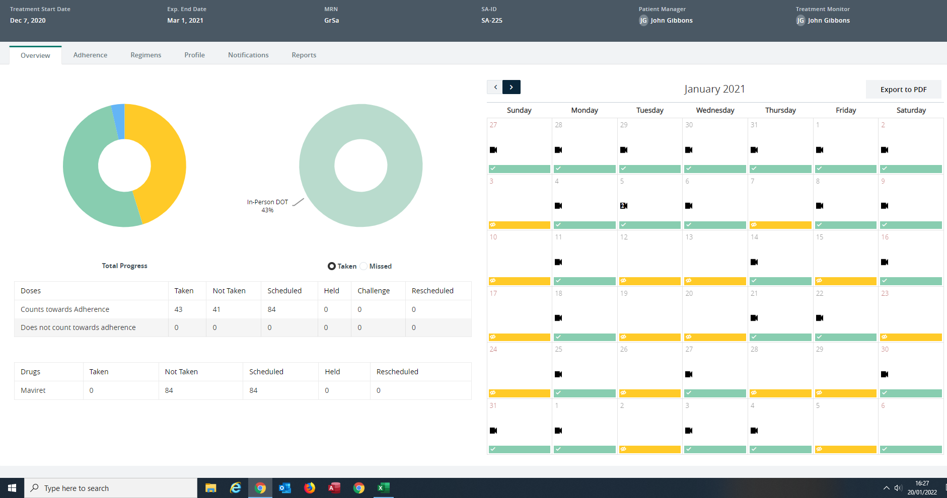
7 patient on VOT
Notes:
Breakdown of VOT -history – TB / HCV
What it’s good for - retreatment HCV – last line treatment , Vosevi
It works at varying degrees – very well with TB patients, there’s generally less drug use or chaos with TB patients and HCV is wildly variable. Originally , we intended to get the phones back once treatment has finished but to this date we have never received one back. Phones get lost, stolen and broken once treatment is finished, sometimes during. All patients get daily reminders regardless of the lost phone and extra support is given.

Slide 9
Cases
Notes:
In the next few slides, we will talk about 4 cases. We will highlight some of the complexities and barriers that stopped the patients being linked into care and the reasons why home visits are key. The guys referred to us are the patients that hardly ever attend appointments.

Slide 10


Case 1
Coinfected Couple HCV/HIV
Liver Cirrhosis
Street homeless Westminster / Unstable housing SE London
Cognitive issues
Unstable OST
DV Case
Both cured of HCV
1 undetectable HIV VL with support of HIV community nurse and Solace Women’s Aid
Notes:
Home visits
Key - Liasing with other organisations
Detox/rehab
Peer support

Slide 11
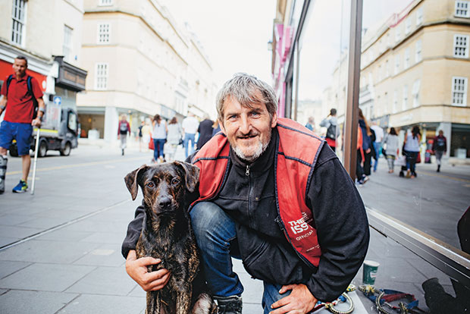
Case 2
Coinfected HCV/HIV
History of low adherence to ART and difficulties with engagement.
Got own council flat
Lower GI issues, incontinence – (limiting factor for engagement)
Severe COPD
Pets
Begging spot
Stabilised with ART
Successful HCV treatment
Admission to hospital
Lost flat due to flooding – hostel
Readmission to hospital
Pets in care
Own council flat
Notes:
G S. This person was known to us for many years, I tried to get him to clinic since I was a volunteer in 2017 without success. He was unable to manage all of his health issues on his own

Slide 12

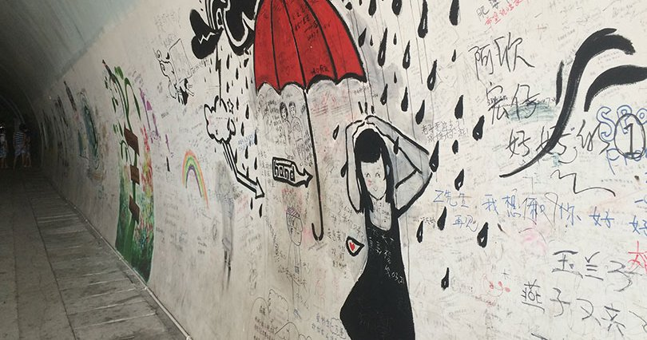
Case 3
Sex worker, screened on F&T SWOT bus - Poor proximity to treatment services in NCL
Body dysmorphia syndrome
Assaulted with knife on street while sex working
PTSD
Seen at flat of relative and changes in location
Good engagement
SVR 12 on F&T SWOT bus.
Notes:
M.B – I think the main point as to this person not being treated would be the poor location, unsettled location and due to her job was working unsociable hours.

Slide 13
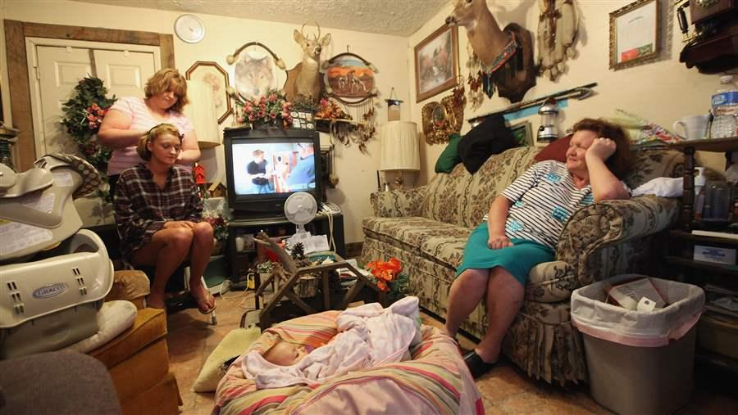
Case 4
2 known HCV positive brothers, visited home which gave us access to the rest of the family
Diagnosed further HCV in the family context
Tightly knitted family network around mother, who was diagnosed with F4 for the first time and HCV although under care for other conditions for 30 years – RIP which caused a lot of disturbance in the family
1 member rough sleeping, xRFP with malignancy
1 member moved to own council flat
Contact remains very difficult
Notes:
Fs – This case was a special one because we originally went to see two brother but managed to engage 2 other family members and test another close contact.
This was probably the most intense clinic I’ve been in. Trying to screen 4 people at once, all talking over one another and with the telly on full blast. There was even a tiny Kitten, which was nice.
John

Slide 14
Advantages and Challenges for home visits
Notes:
Indrajit - interactive

Slide 15
 | Advantages |  | Challenges
Patient view | Removes anxiety of clinic settings or hospitals Flexible time slots to suit peoples lives Geographical issues and travel expenses removed Frequent patient to peer contact and Doctor Advice Being in a comfortable environment |  | Confidentiality Poor living conditions Invasion of privacy Shame or embarrassment
HP view | Hostel visits - many patients in a short space of time Opportunistic testing of Individuals (Friends, Partners or Family of patients) Insight to living conditions and social aspects Counting / checking medication |  | Traffic! Parking! Safe Spaces – needle stick Injuries, dogs, flatmates Drugs and paraphernalia, alcohol Safeguarding issues
Notes:
John – patient view – from my own experience, and from chats with patients.
Indrajit – HP view

Slide 16
Data
07/2020 to 03/2023, weekly, sometimes twice weekly
Total number of patients = 200
10 patients RIP (5%)
Median age – 51 years (26-79y)
HCV (179)
HBV (6)
HIV (25)
9
3
1
Notes:
No transgender
John

Slide 17
Referral pathways
N=200
Notes:
Indrajit

Slide 18
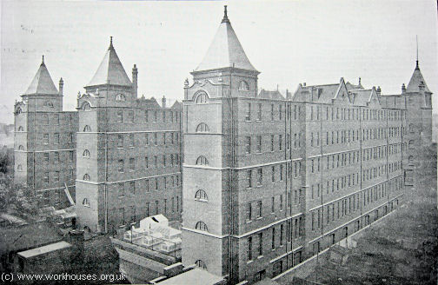
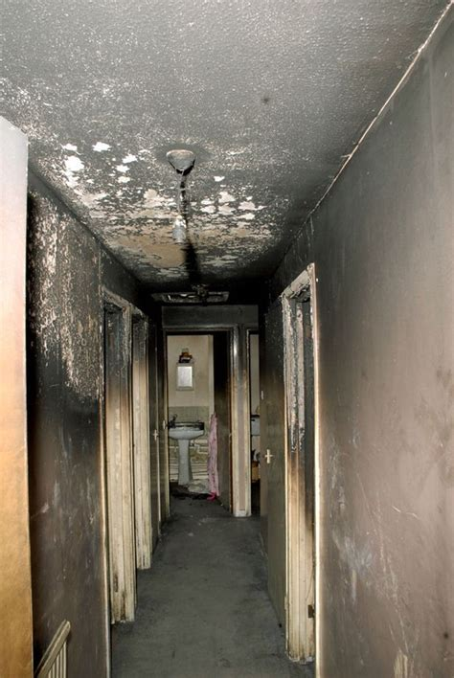
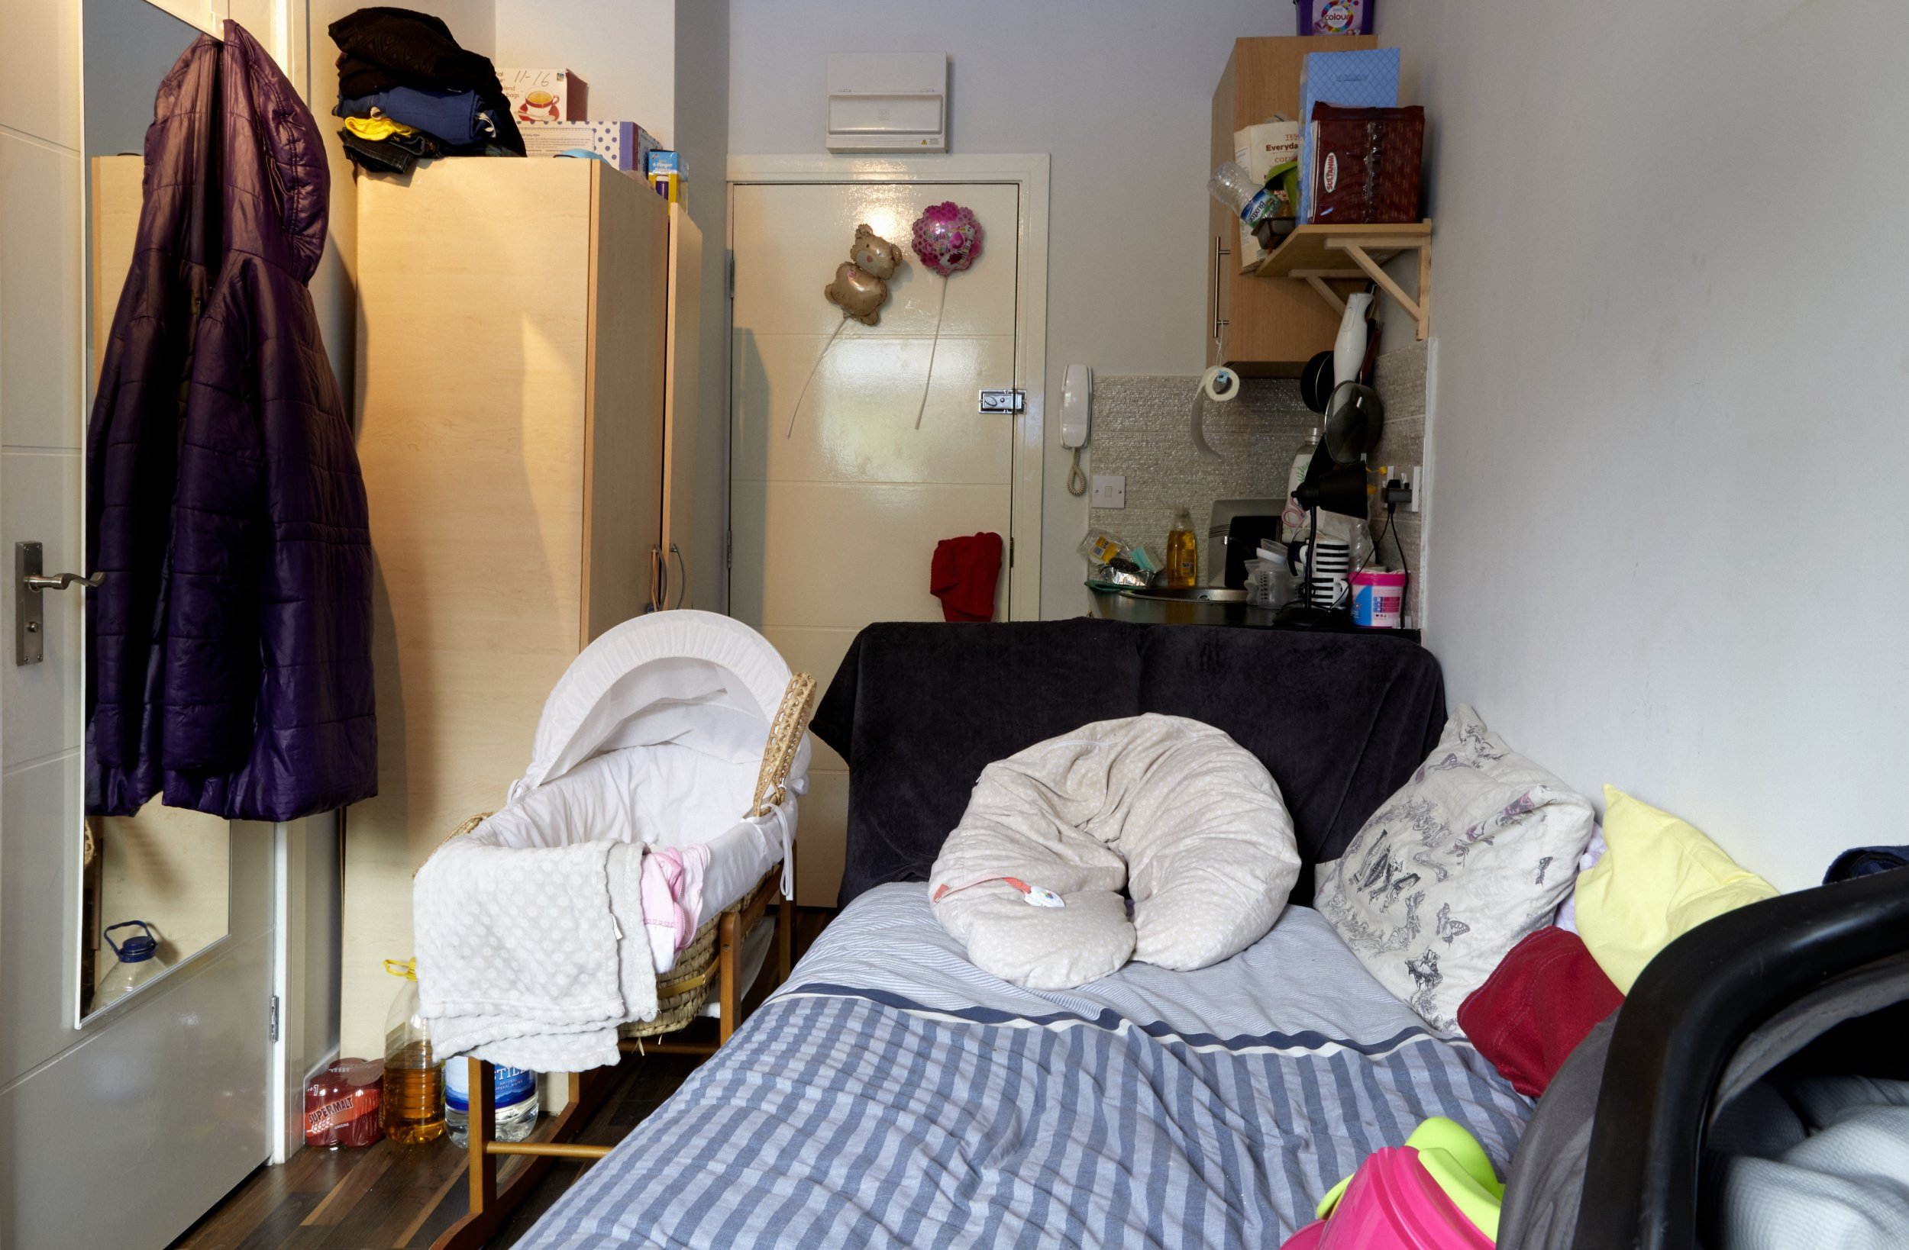
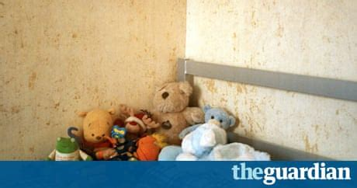
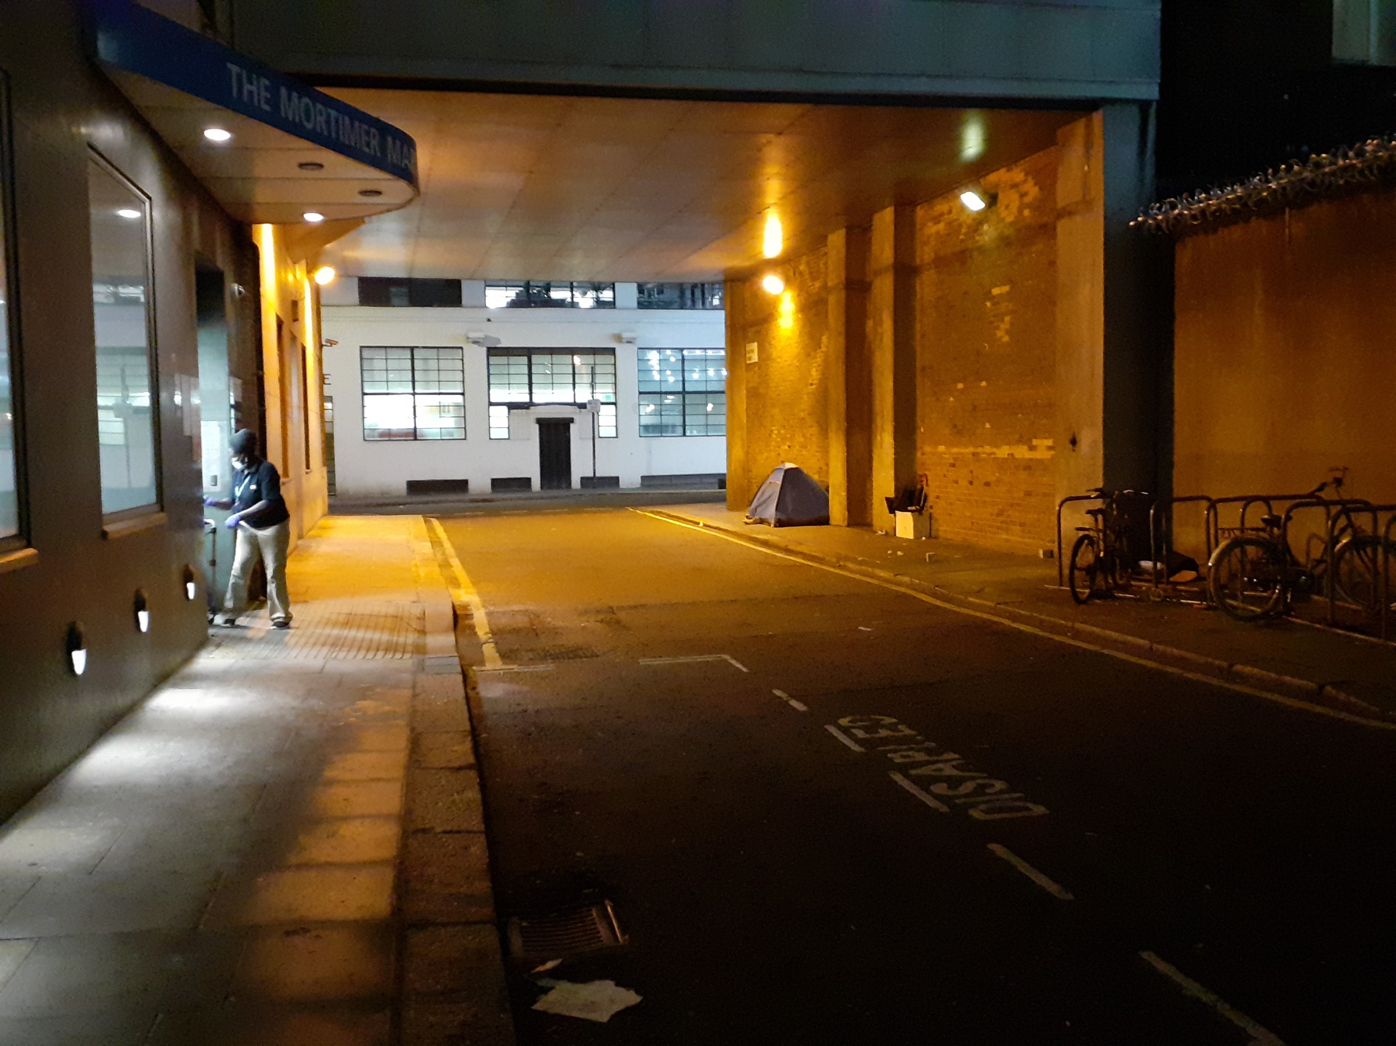
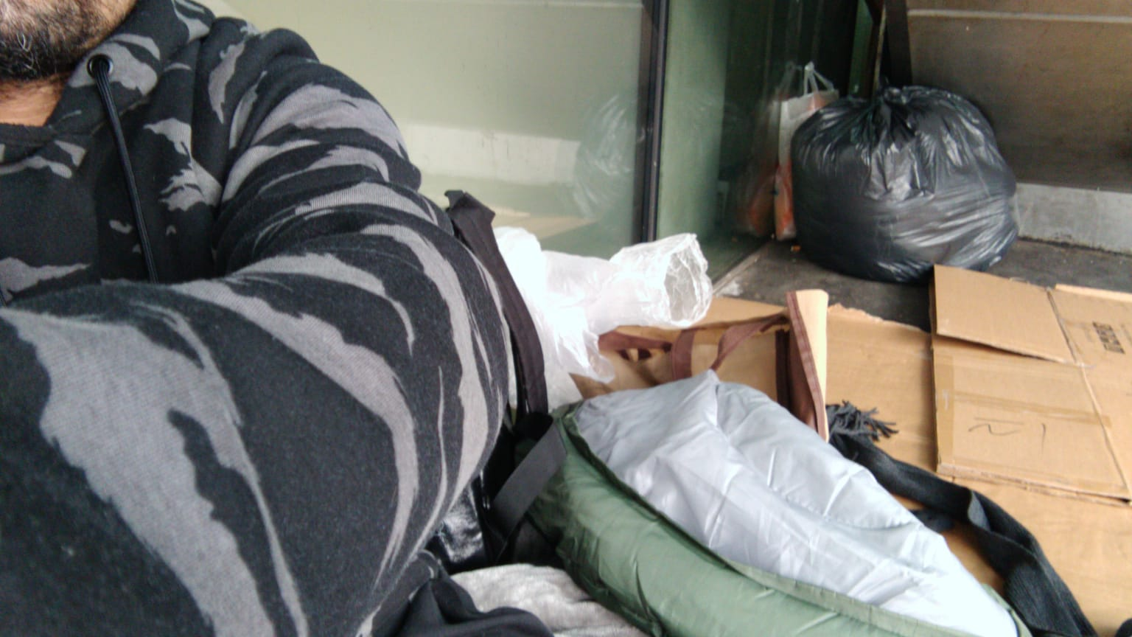
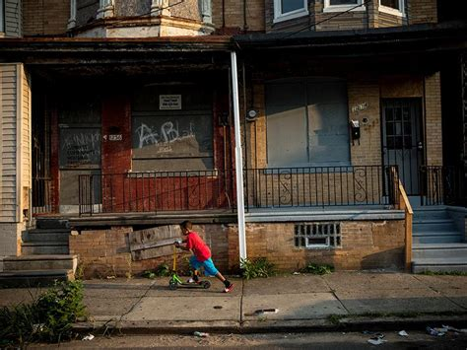

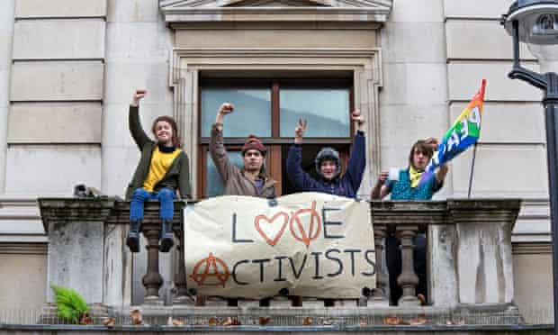
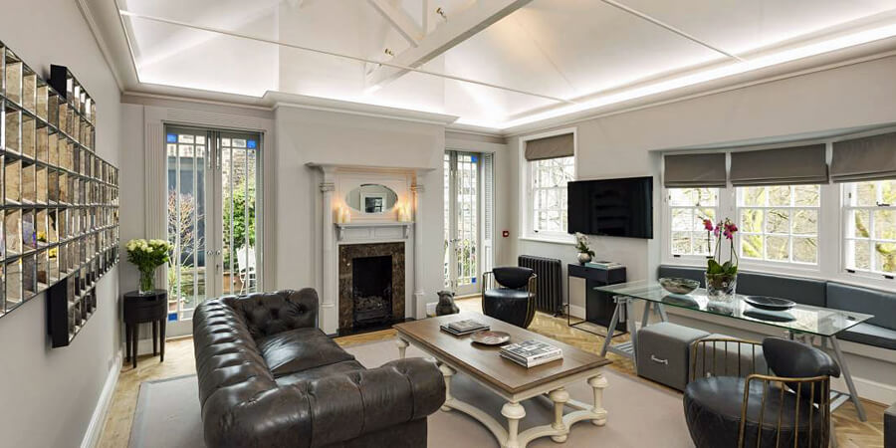
HOMES
Notes:
Indrajit

Slide 19
Visiting locations
Council flat, private flat
Home
SHP, St Mungos, One housing…
Hostel
Nursing home, street, HMO
Other
GLA or LA funded hotels
Temp. Hotel
44%
37%
13%
6%
Notes:
John
67/200 Hostel
99/200 Home
10/200 temp Hotel
24/200 Other

Slide 20
Hepatitis C

Slide 21
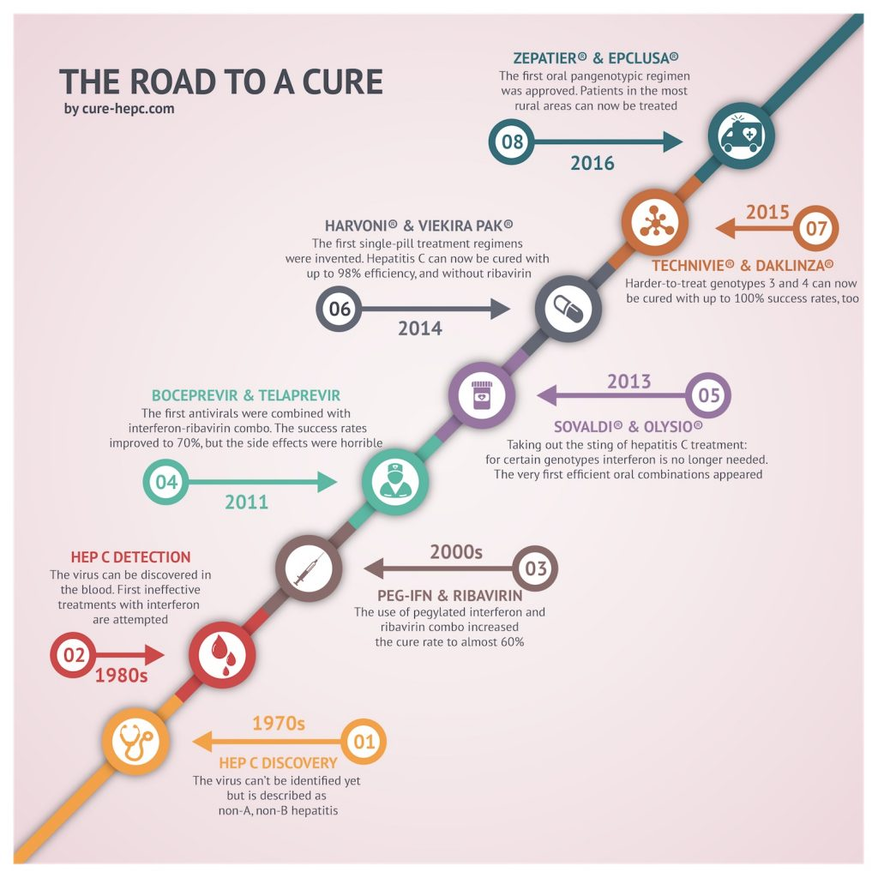



Slide 22
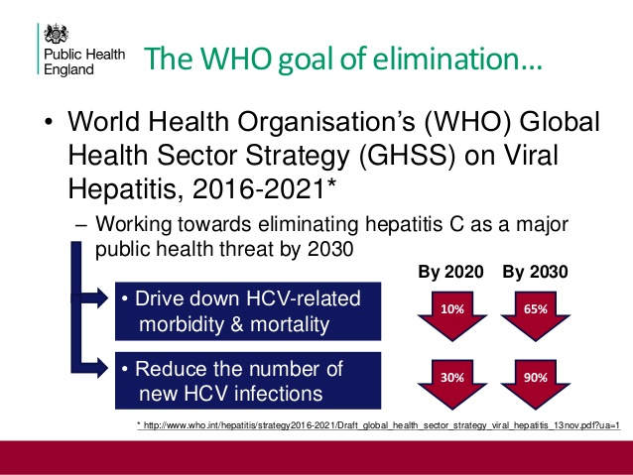

Slide 23
Notes:
Indrajit
13 / 179 HCV RNA neg
166 HCV RNA pos

Slide 24
Notes:
Indrajit 2020-2021 data

Slide 25
HCV Genotype
7 known genotypes
UK – dominant 1a and 3
Genotype specific Rx to pan-genotypic Rx
Notes:
Indrajit
Pro and cons of slim diagnostics
2020-2021 data

Slide 26
Liver disease (n=143)
No liver fibrosis
Advanced liver fibrosis / cirrhosis
Notes:
IDU cohorts = 20% F3/F4

Slide 27
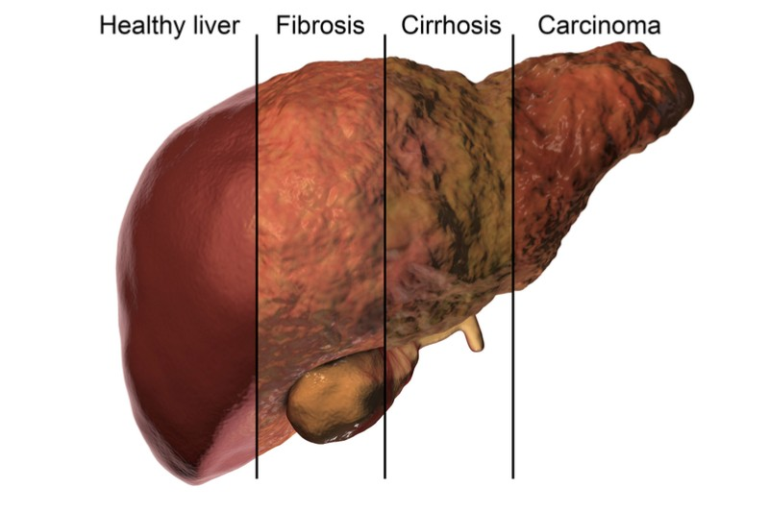
Patients with F4 (N=27)
CHILD-P: A – 14; B – 10; C – 3
HCC, Malignancies, COPD, CKD, COVID
6 RIP (22%)
Age range 33-75 years
Female / Male: 7 / 20
FS range: 12.1 – 75 kPa
IDU history: 22
EtOH: 15 (all IDU hx)

Slide 28
Mental Health
Anxiety
Depression
Psychosis
Schizophrenia
PTSD
Victims of DV ad sexual abuse
Personality disorder
Notes:
Indrajit

Slide 29
Number of contacts / patient
Start of engagement
3-4 calls/texts
1-2 F2F
On Treatment
10-12 calls/texts
2-4 F2F
SVR12
3-4 calls/text
1-2 F2F
Addition:
Daily test reminders / VOT / calls or text from patient
Calls / email to keyworkers or support workers
Notes:
John
>2000 contacts / 115 pts

Slide 30
Joint home visits and DDU appt
DDU Grove
DDU BLI and SCDS
“Everyone In” ended
2nd lock down, ITU deployment

Slide 31
Plans for the future
To be continued
Support from admin and data management
Add further POCT and other bed side examination methods
Vascular / abdominal USS
Qualitative research
Cycle clinic
Replicate in other regions / specialities
Build stronger linkage to existing community nurses / homeless teams / GPs
Expand to other at risk groups or individuals not currently supported
Networking
Notes:
Indrajit

Slide 32
Plans for the future
To be continued
Support from admin and data management
Add further POCT and other bed side examination methods
Vascular / abdominal USS
Qualitative research
Cycle clinic
Replicate in other regions / specialities
Build stronger linkage to existing community nurses / homeless teams / GPs
Expand to other at risk groups or individuals not currently supported
Networking
Notes:
Indrajit

Slide 33
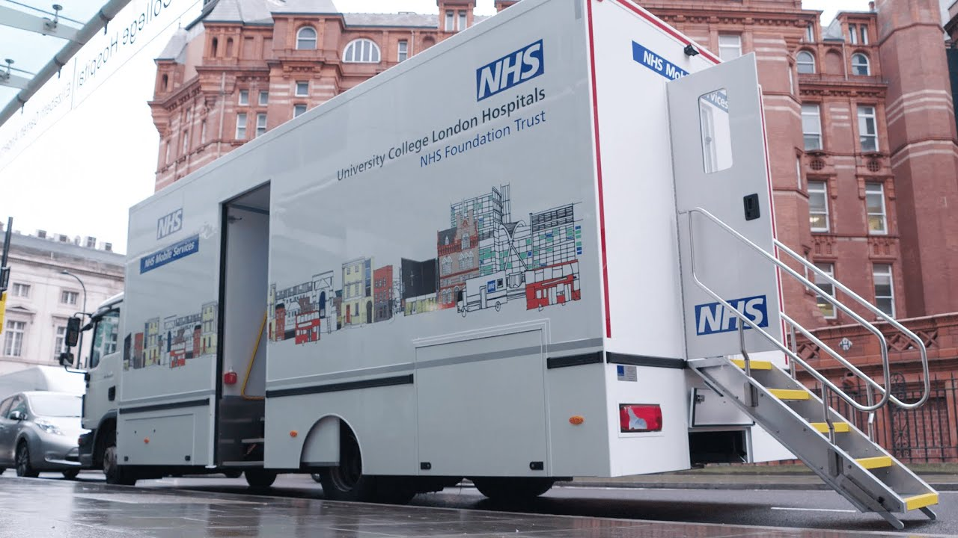
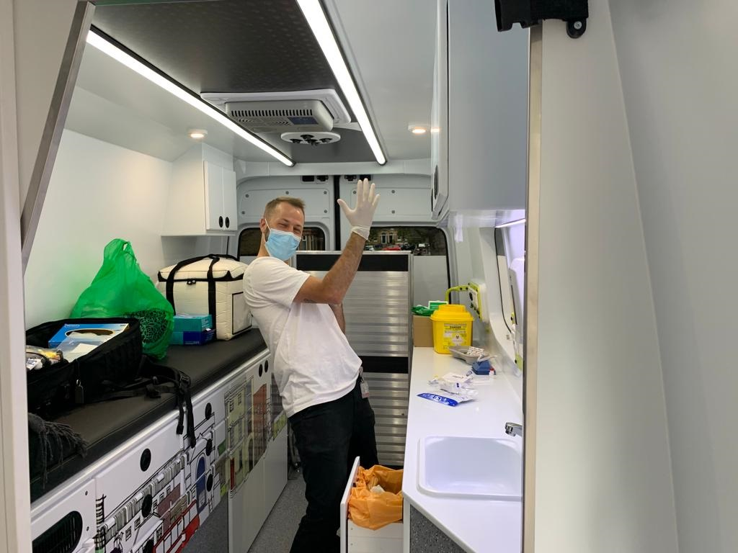
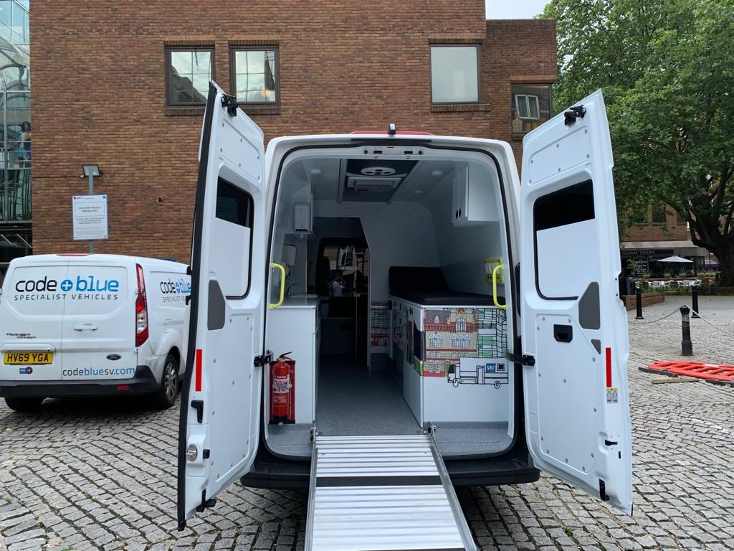
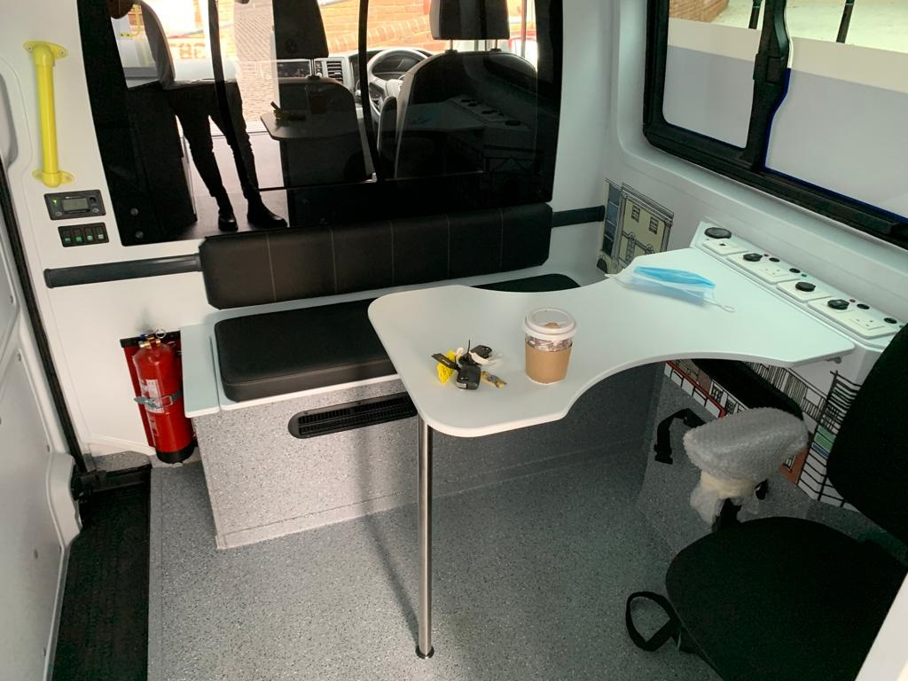
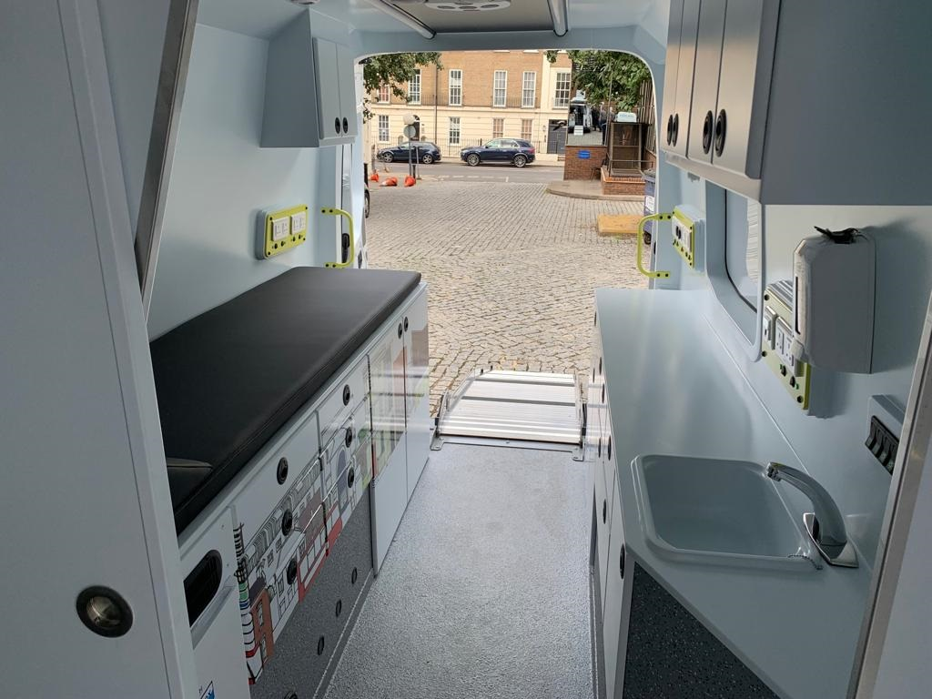

Slide 34
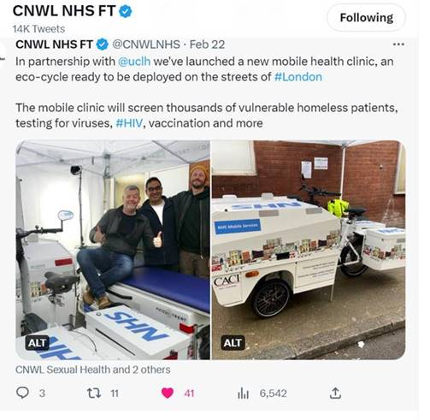
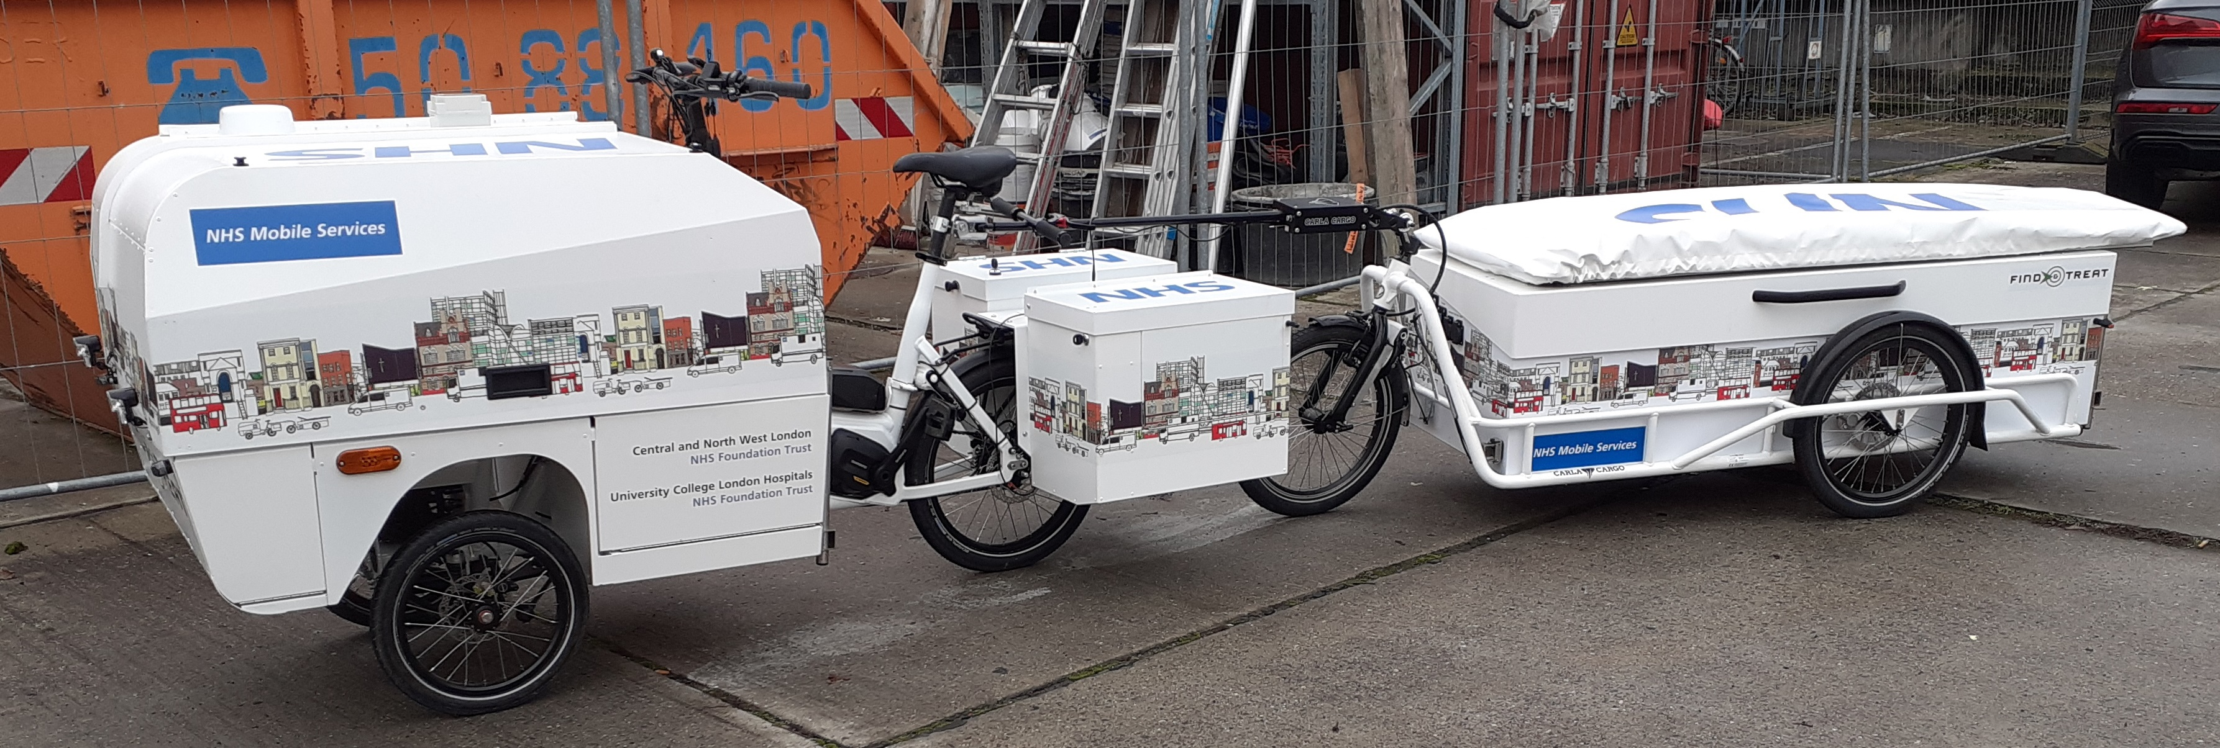
Clinic tricycle / pop up clinic
https://www.uclh.nhs.uk/news/new-health-clinic-built-eco-tricycle-treat-homeless-patients
Launched on 22nd February
https://www.standard.co.uk/news/health/doctors-treat-homeless-london-fold-out-clinic-bike-b1063774.html

Slide 35
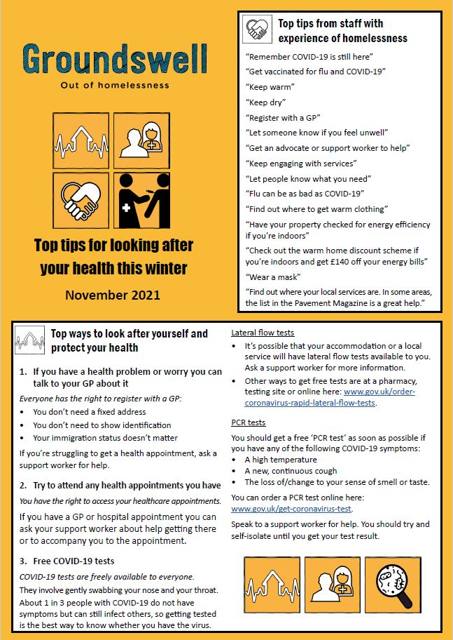
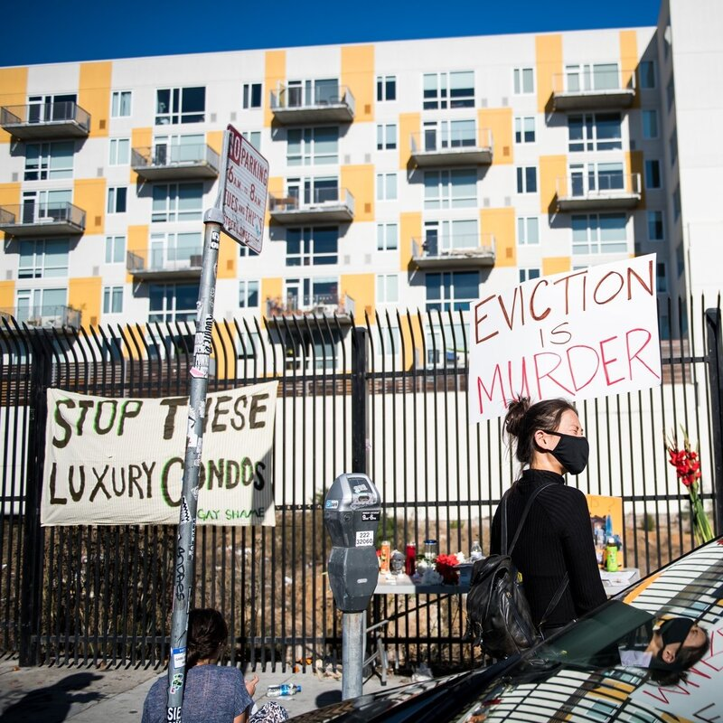
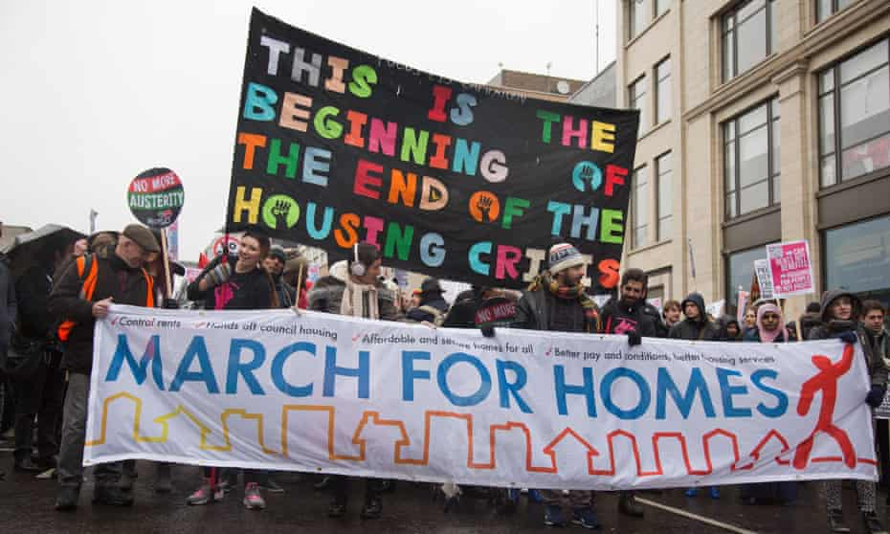
Thank YOU!
uclh.bbv@nhs.net
john.gibbons@nhs.net
Indrajit.ghosh@nhs.net

