Slide 1
Blood Borne Virus screening and diagnosis in substance misuse (SM) and allied community services
BBV screening overview
Demographics and risk factor characteristics of all individuals receiving BBV screening
Diagnosis and treatment
Hepatitis C treatment

Slide 2
BBV overview of testing and diagnosis
BBV testing breakdown within substance misuse and allied community services 2021-22
3.4%
Of all individuals screened were HCV-RNA
<1%
HBsAg detected
Hepatitis B
2370
Individuals screened
232 (10%)
Individuals reactive for anti-HCV
173 (75%)
Received confirmatory HCV-RNA
2401
Individuals screened for anti-HCV*
84 (30% of HCV-PCR tested)
Individuals HCV-RNA positive
2458
Individuals screened for BBVs
Hepatitis C
2455
Individuals screened
112
Received direct HCV-RNA testing*
HIV
2361
Individuals screened
<1%
Anti-HIV detected
* Includes only valid tests recorded on the Harm Reduction Database Wales: Blood Borne Virus Module.
† Where recorded on Harm Reduction Database Wales: Blood Borne Virus Module

Slide 3
BBV screening and diagnosis in SM and allied services
BBV Screening Overview
Following implementation of the HRD: Blood Borne Virus module, between 1 April 2018 and 31 March 2022, a total of 9,291 BBV tests with valid results, were completed by Substance Misuse and community services involving 7,930 individuals. During the 2021-22 reporting period:
2458 unique individuals were screened for at least one blood borne virus (HBV, HCV, HIV), an increase of 209 per cent on the previous year.
The highest levels of screening were recorded in Cardiff & Vale Health Board and the lowest proportional decrease in testing has been observed in Hywel Dda Health Board (see Table 13).
All of the health boards reported an increase in BBV screening, again this is likely due to the reintroduction of testing due to the effects of the Covid-19 epidemic (see Table 19).
A total of 369 individuals were offered and declined testing, with 38 per cent of these recorded in CTM University Health Board area.
Hepatitis C was the most commonly screened for blood borne virus, with 99 per cent of all individuals screened.
Table 19: Number of individuals receiving a blood borne virus test by virus type, health board and year (% change on previous year)

Slide 4
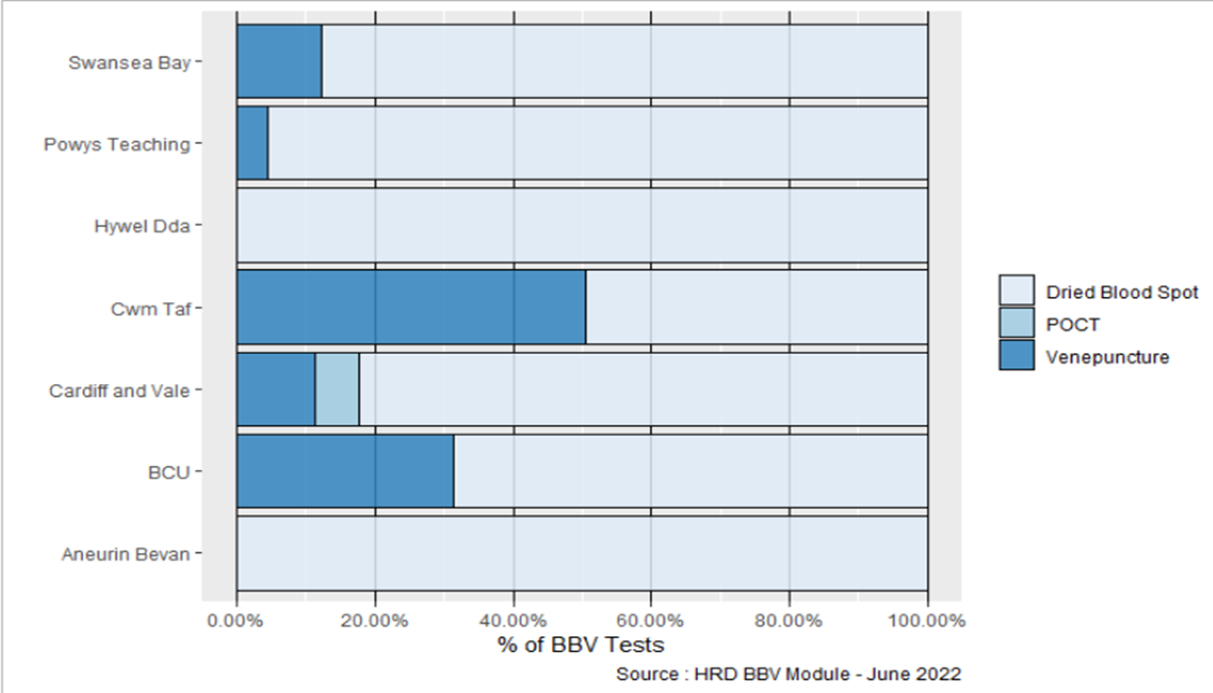
BBV screening and diagnosis in SM and allied services
BBV Screening Overview
Table 20: Number of individuals receiving a blood borne virus test by virus type, health board and year.
Whilst nationally the most common sample collection method was Dried Blood Spot Test (DBST), accounting for 76 per cent of all tests undertaken, regional variances occurred between health board regions (see Figure 15).
During this period 234 POCT – Oral Swab samples (HCV only) were collected by Public Health Wales Microbiology Laboratory Service in targeted settings and recorded on the Harm Reduction Database.
Venepuncture remains the ‘gold standard’ test for blood borne viruses, but is not always possible or available within the range of community settings currently providing screening.
Figure 15: Proportion of BBV sample collection methods used by Health Board

Slide 5
BBV screening and diagnosis in SM and allied services
BBV screening coverage
Screening and diagnosis coverage amongst individuals accessing substance misuse or harm reduction services remains low.
Data from the Welsh National Database for Substance Misuse (WNDSM) recorded 18,184 individuals assessed by specialist substance misuse services during 2019-20, of which 8,874 were assessed for problematic drug use, and 9,310 for problematic alcohol use. In addition, as indicated earlier in this report (see NSP activity overview), there were 9,658 unique PWIDs regularly attending NSP services during the same reporting period as screening was undertaken, a proportion of whom will not be in contact with substance misuse treatment services.
The introduction of the BBV Key Performance Indicator(KPI) in April 2019 aimed to facilitate the continued upscale of BBV screening across Wales, so that all individuals at risk of BBV infection are routinely tested, and where required, provided with treatment. It is hoped that improvements in routine screening seen pre-COVID can be sustained in 2021-22 and beyond.
Demographics and risk factor characteristics of all individuals receiving BBV screening
The HRD: BBV Module enables the recording of demographics and risk factor characteristics. In order to support ongoing upscale and roll out of BBV screening within non-clinical settings and amongst those not engaged in substance misuse treatment services,¹⁷ these questions are non-mandatory. As such a table of data completeness related to this can be found in Section 5 – Data Quality.
Demographic and risk factor characteristics for all individuals where data was collected is summarised in Table 26.
17 Including; homelessness services, community pharmacy services, sex worker support projects

Slide 6
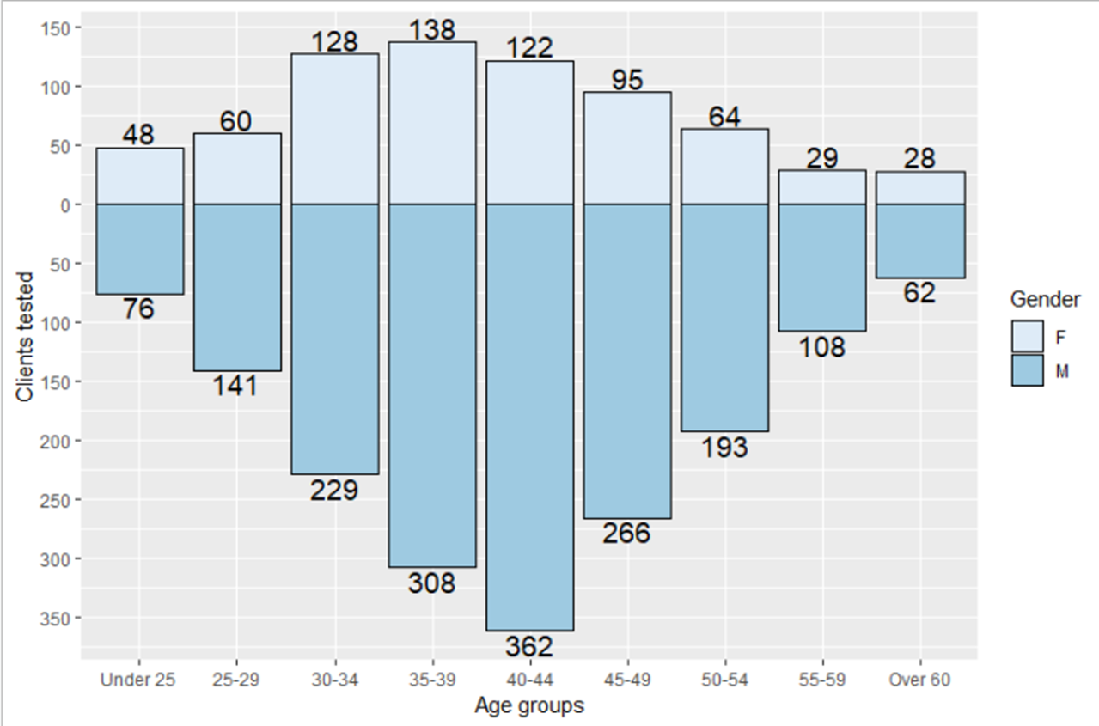
BBV screening and diagnosis in SM and allied services
Demographics and risk factor characteristics
Median age of individuals receiving screening remains consistent with the previous year at 40 years (range 11-76). The most common age group was 40-44 year olds (see Figure 16).
The median age of females offered screening was slightly younger than that of males (39 years compared to 41 years). The most common age group for females was 35-39 years.
Sex distribution has remained relatively stable over the last 3 years with between 29 and 32 per cent of those tested reported as female, as shown in figure 16.
Unemployment was reported amongst 68 per cent (n=888) of individuals.¹⁸
Sex working (i.e. receiving money, goods, or drugs in exchange for sex) was reported by 1 per cent of individuals.
Non-secure housing (e.g. hostel, friend’s home) or having no fixed abode (NFA) was reported by 30 per cent (n=372) of individuals. Having NFA often results in higher risk and non-sterile injecting practices.
In 2021-22, 53 per cent of individuals tested did not have an employment status recorded and 50 per cent did not have a housing status recorded.
Age and gender profile of individuals receiving BBV screening across Wales, 2020-21
18 Not reported for 1520 individuals

Slide 7
BBV screening and diagnosis in SM and allied services
Demographics and risk factor characteristics in substance misuse services
Median no. of risk factors:
2
(range: 0-7)
in individuals screened during 2021-22
One or more risk factors:
100%
(n=2458)
in individuals screened during 2021-22
Most common risk recorded:
Ever Used Drugs
(91%)
in individuals screened during 2021-22
Ever been assaulted:
(involving blood contact or human bite)
17%
(n=174)
of individuals screened during 2021-22
Ever been in Prison:
44%
(n=520)
of individuals screened during 2021-22
Ever Injected Drugs:
53%
(n=715)
of individuals screened during 2021-22

Slide 8
BBV screening and diagnosis in SM and allied services
Diagnosis
Table 21: Hepatitis C screening outcomes by health board, and type of test, 2021-22.
Table 22: Hepatitis C screening outcomes by health board, and type of test, 2018-22.
HealthBoard | Total screened for anti-HCV* | Total anti-HCV reactive | Total anti-HCV reactive receiving confirmatory PCR* | % anti-HCV reactive receiving confirmatory PCR | Total HCV PCR/RNA positive | % HCV PCR/RNA positive
Aneurin Bevan | 1924 | 220 | 190 | 86.4% | 96 | 50.5%
BCU | 1132 | 258 | 176 | 68.2% | 108 | 61.4%
Cardiff and Vale | 1803 | 248 | 160 | 64.5% | 83 | 51.9%
CTM | 1146 | 133 | 84 | 63.2% | 42 | 50.0%
Hywel Dda | 720 | 28 | 7 | 25.0% | <5 | ‡
Powys Teaching | 514 | 12 | 3 | 25.0% | <5 | ‡
Swansea Bay | 1099 | 333 | 254 | 76.3% | 127 | 50.0%
Wales | 8,263 | 1,218 | 862 | 70.8% | 453 | 52.6%

Slide 9
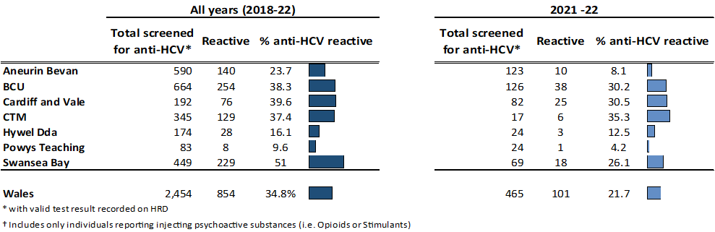
BBV screening and diagnosis in SM and allied services
Diagnosis
Number and proportion of all individuals screened for hepatitis C antibodies testing reactive by health board, for all years 2018-22 and 2021-22.
Proportion of current and recent ex-PWID (injected in last 12 months) injecting psychoactive drugs, screened for hepatitis C antibodies testing reactive by health board, for all years 2018-22 and 2021-22.
21 Where valid results were recorded on the HRD
22 Public Health Wales (2017), Enhanced surveillance of blood borne viruses in drug users in Wales: Annual report 2016. https://www.wales.nhs.uk/sites3/page.cfm?orgid=457&pid=62269

Slide 10
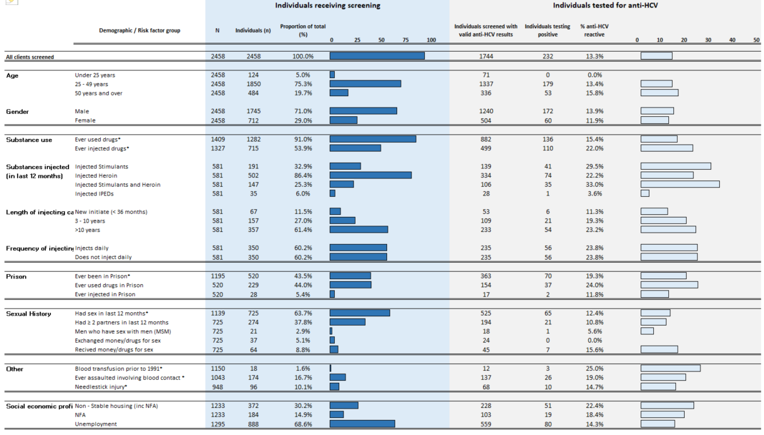
BBV screening and diagnosis in SM and allied services
Screening and diagnosis anti-HCV
Proportion of individuals receiving BBV screening alongside proportion of individuals that tested reactive for anti-HCV by demographics and risk factor characteristics, 2021-22.

Slide 11
BBV screening and diagnosis in SM and allied services
Diagnosis
Hepatitis C confirmed cases
Between 1 April 2021 and 31 March 2022, 285 individuals received a PCR test for HCV in community substance misuse services, of which 84 individuals (30% of those tested by PCR) were identified as having a confirmed chronic infection and requiring treatment. These included 173 individuals identified following a reactive anti-HCV test during the reporting period. In addition, there have
been:
415 individuals identified as reactive anti-HCV since April 2017 but prior to 1 April 2021.
84 individuals identified following direct confirmatory PCR (i.e. anti-HCV reactivity was identified prior to implementation of the HRD)
Table 26: Year of first anti-HCV reactive test result for individuals with a confirmatory PCR test for HCV, by health board, 2021-22.

Slide 12
BBV referrals to treatment from SM and allied services
Hepatitis C referral to treatment
Individuals referred to clinical specialist services
According to data recorded on the HRD, over the period 2021-22 a total of 110 individuals were referred into HCV clinical specialist services by SMS and associated services in Wales (see Table 27). Of which:
n=23 were referred following a reactive anti-HCV test
n=84 were referred following a confirmatory PCR/RNA test
n=2 were referred following a POCT.
The HRD: BBV module automatically generates a referral to HCV clinical specialist treatment services once the test result has been given to the client, thereby eliminating loss to follow-up. In addition to the HCV screening process, the HRD also enables the recording of referral outcomes and treatment milestones by clinical specialist services following referral. This feature has been
designed to support joint working partnerships between SMS and Clinical Nurse Specialists/Teams post-referral and to support engagement with individuals during treatment.
Table 27: Number of individuals screened for hepatitis C within SMS in Wales and referred into clinical specialist services, by type of test and health board, 2021-22

Slide 13
BBV referrals to treatment from SM and allied services
Referral to Hepatitis C treatment
For individuals referred into clinical specialist services by SMS, an initial referral outcome was recorded for 70 individuals (64 per cent, see Table 28). Since 2018, of all those referred to treatment, no outcome data is available for 240 referrals (33 per cent, see Table 29).
Initial outcomes following referral of individuals tested for hepatitis C into hepatitis C clinical specialist services, 2021-22
Initial outcomes following referral of individuals tested for hepatitis C into clinical specialist services, 2018-22

Slide 14
BBV referrals to treatment from SM and allied services
Hepatitis C treatment
Since 2018, some 97 individuals have been recorded on the Harm Reduction Database, by the BBV clinical teams, as having commenced HCV treatment following referral from SMS and associated services across Wales (see Table 30). Of these, 43 were recorded as successful completing treatment. This figure does not accurately reflect the level of treatment provision following
referral for HCV treatment from SMS services. Improvements in access to and analysis of treatment data is underway.
According to treatment commencement data held centrally by the Lead Consultant for Blood Borne Virus Action, matching analysis would indicate that for the periods 2019-20 and 2020-21, a total of 362 individuals were referred from substance misuse services to BBV clinical teams for treatment. Of these, 126 (34.8 per cent) were present on the Treatment commencement dataset. Further
analysis is required to confirm this and future development and streamlining of the HRD with external data sources is ongoing.
Table 30: Treatment outcomes for individuals referred and accepted into clinical specialist services 2018-22
Table 31: Treatment outcomes for individuals referred and accepted into clinical specialist services 2021-22

Slide 15
Summary
  Since 2017 recorded testing for hepatitis C in high risk populations in contact with specialist services has increased by 53 per cent, however, testing coverage levels remain relatively low, with one third of all those in contact with services tested
  Prevalence of anti-HCV amongst all those tested within specialist substance misuse has decreased, from 18.4% to 13.2% over the last five years, however, rates vary by risk group:
Risk | 2017-18 | 2021-22 | Proportional change
Ever injected drugs | 31.3% | 22% | -9.3%
New initiates (injecting <36 months) | 14.4% | 11.3% | -3.1%
Injecting heroin and stimulants | 42.5% | 33% | -9.5%
- Of those anti-HCV reactive in 2021-22, 75% received HCV-RNA test
  Prevalence of HCV-RNA infection in all those tested in substance misuse services has halved over the last five years from 6.9% to 3.4%
  However, amongst those at highest risk, current/recent people who inject drugs (PWID), data from the HRD indicate that in 2021-22 prevalence of HCV-RNA infection was higher than 2017-18. This may also reflect more targeted tested and improved quality in risk factor data collection
  Data from the Unlinked Anonymous Monitoring (UAM) programme with current people who inject drugs in Wales reported a prevalence of anti-HCV of 48.4% and HCV-RNA amongst those anti-HCV reactive of 25.8%. It should be noted that small numbers were recruited in 2020-21 due to Covid restrictions

