Slide 1
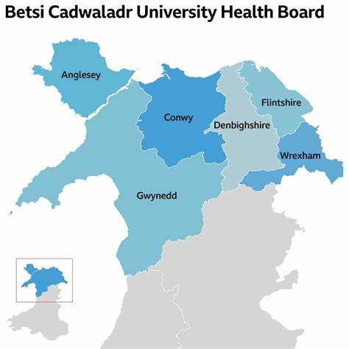

Successful Hepatitis C Projects
Sarah Hulse
BBV Lead Pharmacist

Slide 2
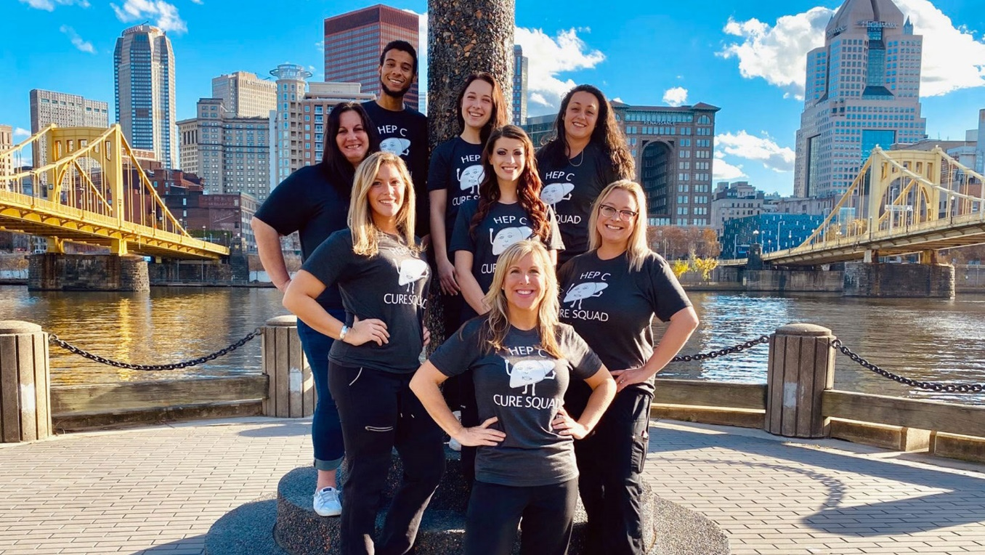
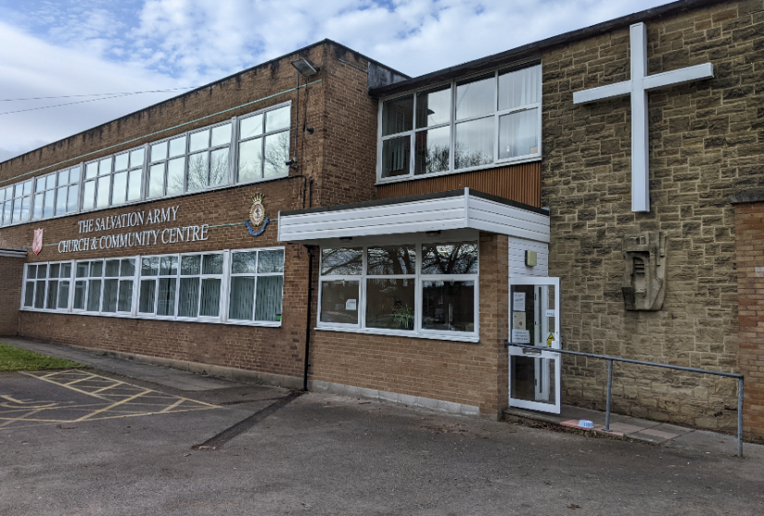
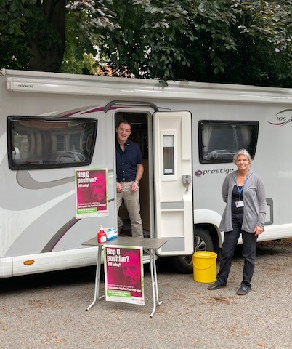
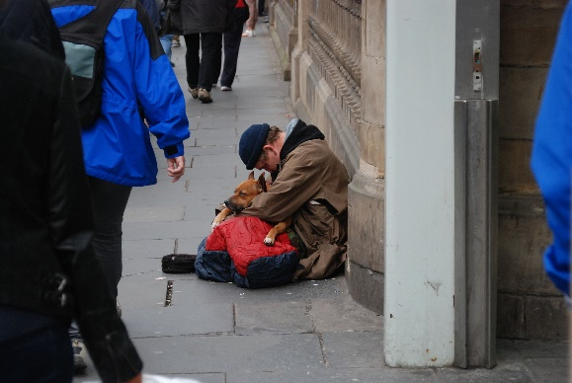
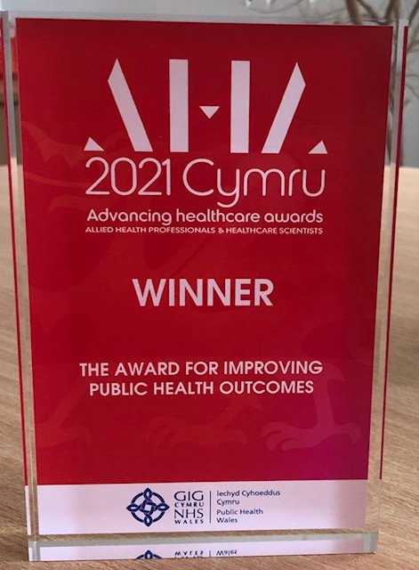
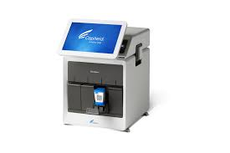



Hepatitis C Rapid Test and Treat in BCUHB
Notes:
Reduced DNAs for secondary care clinics.
Pathway reduced from over 6 months to 2 weeks
Rapid & simplified pathway welcomed by homeless– ease of access & engagement cf. to previously experienced barriers to treatment
PCR week 3-4
32 vulnerably housed
Majority homeless or vulnerably housed, 25 men and 7 women.
mean 5 years ( range 1.5 – 17 years) and hadn’t been able to access care through usual pathways

Slide 3
Wrexham Community Care Hub Hepatitis C Rapid test and treat project
Impact and feedback
“I feel like a new person, I have so much more energy”.
“I would never have been able to successfully be treated via the hospital route; I have always been terrified of hospitals”
“Because of treatment I have gained my life back, I now have my driving licence and for the first time in many years, I am working again”
“I no longer feel dirty and ashamed”
“I am interested in becoming peer for testing and treatment, this could be the way for me to access further training and continue my recovery!”

Slide 4
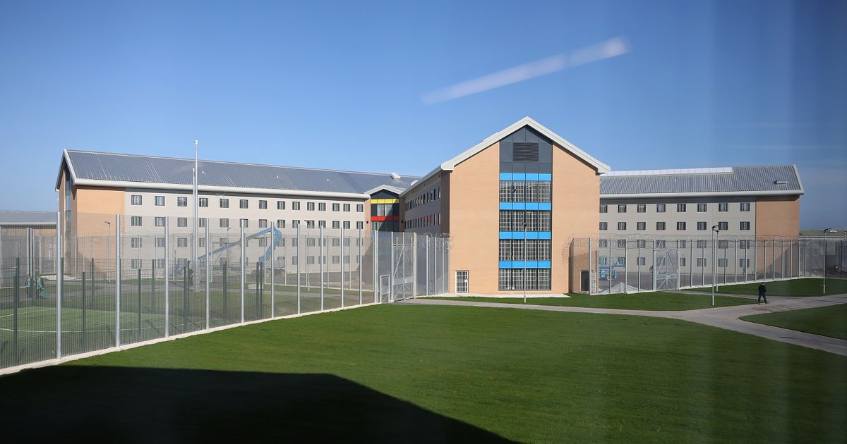



HMP Berwyn
Notes:
Collaborative working
One team – treating difficult patients who are bouncing between community and prison. Sometimes given 2-3 courses worth of tablets to get them through treatment

Slide 5
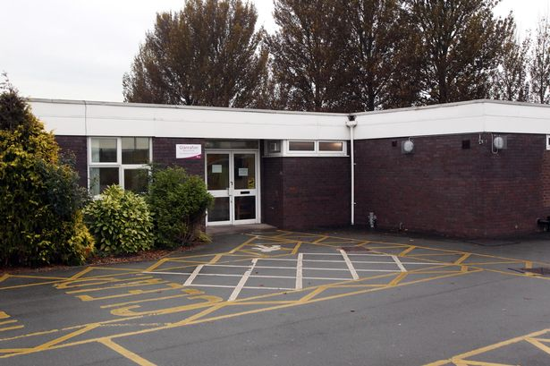
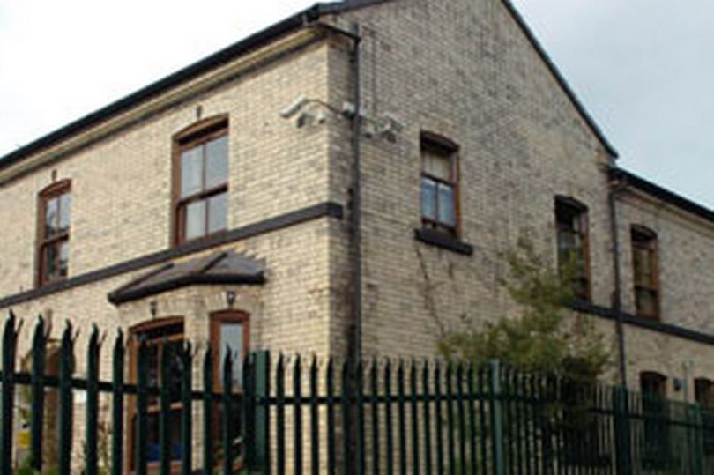
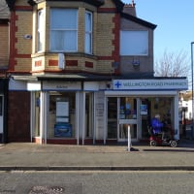
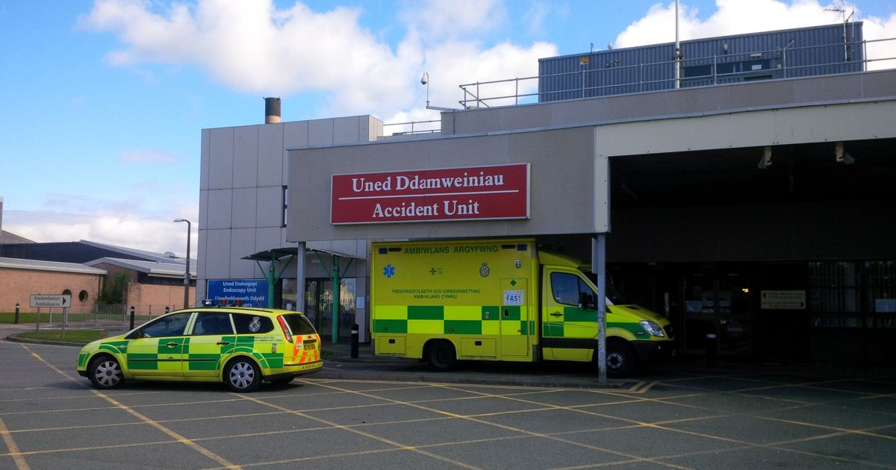
Wrexham Community Care Hub Hepatitis C Rapid test and treat project
Other HCV Test and Treat Settings
Notes:
Glanrafon
8 week project
19 patients offered testing
4 refused, 11 HCV PCR negative & 4 HCV PCR positive
Out of 4 needing treatment 3 were successfully treated during the project
Other patient got sent to prison the week after testing but has now successfully completed treatment in the community

Slide 6
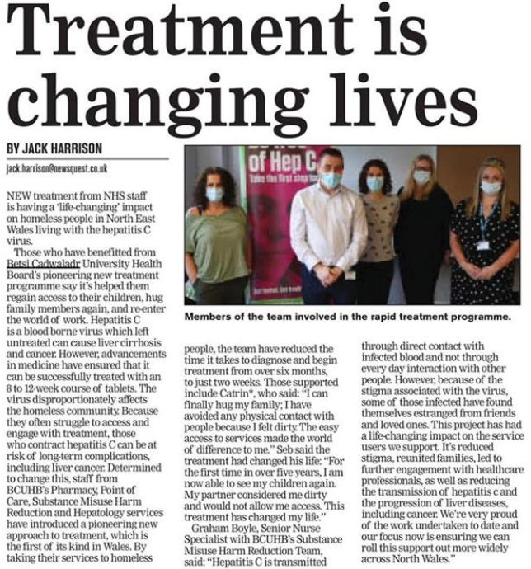

Successful Hepatitis C Projects
Access and Health Equity
Groups Around the World Work to Eliminate Hepatitis C by Meeting People Where They Are
Stories@Gilead.com - March 02, 2023
Notes:
Meeting people where they are

