Slide 1
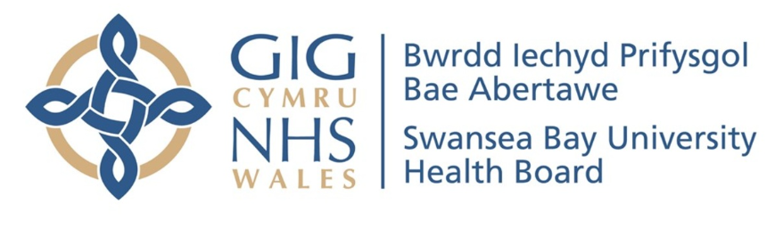
Successes in Swansea Bay UHB 2022 - 2023
James Plant
Swansea Bay University Health Board

Slide 2
The numbers
119
People treated
>1300
Number of BBV tests done in community
11
Regular clinic locations monthly
88
Discharged with SVR and normal fibroscan

Slide 3
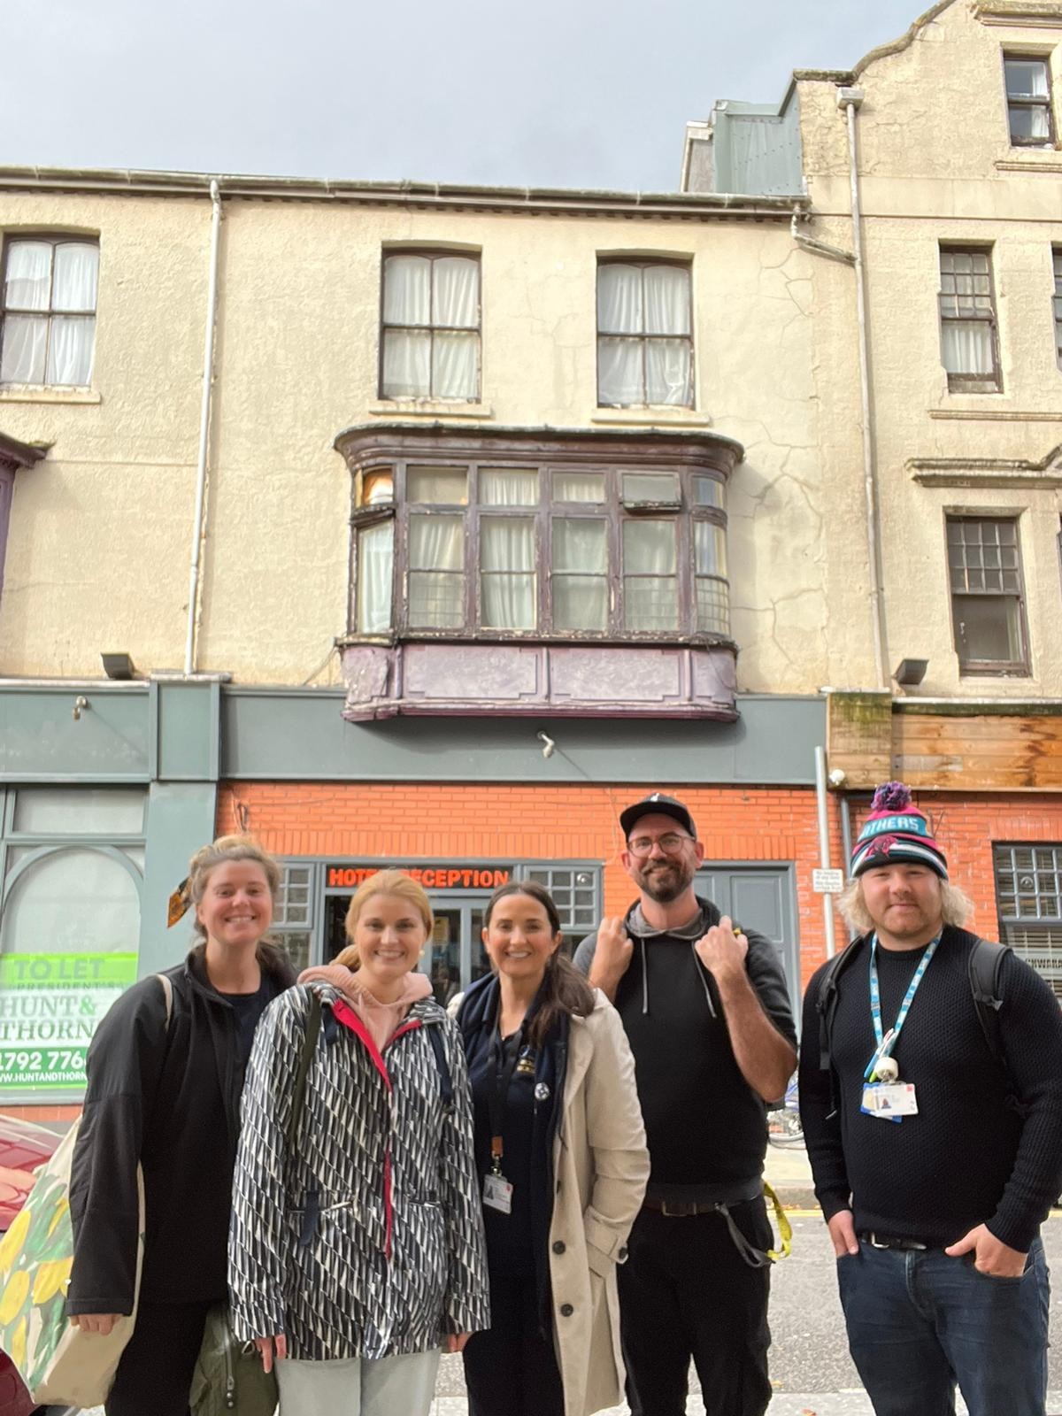
HITting the streets: Neath
9 venues
12 practitioners
74 individuals tested
127 tests conducted (POCT, DBST, venous sample)
All PCR positive cases reviewed by BBV specialist and treatment decision made <7/7
2 new peer workers engaged to deliver DBST
7 new venues developed for DBS screening

Slide 4
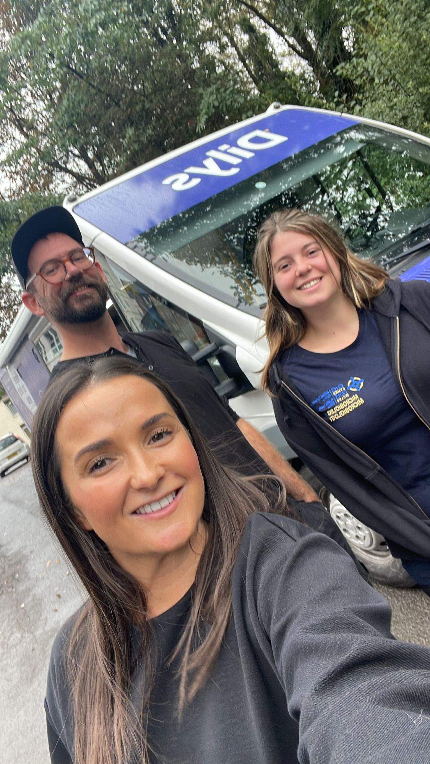
BBV on the road
Development of collaborative drop-in service between:
  SBUHB BBV specialist service
  The Wallich
  Homeless Health adult nurse practitioner & mental health nurse
  Rapid Access to Prescribing Service
  Swansea Council
  Rough Sleepers Intervention Team
  APB harm reduction
  Barod Swansea
  NSP delivery
  Currently in action at Griffith John St – Swansea
  197 units of accommodation
  3 fatal/ 7 non-fatal OD 2021/2022
  High incidence of drug-taking paraphernalia local litter

Slide 5
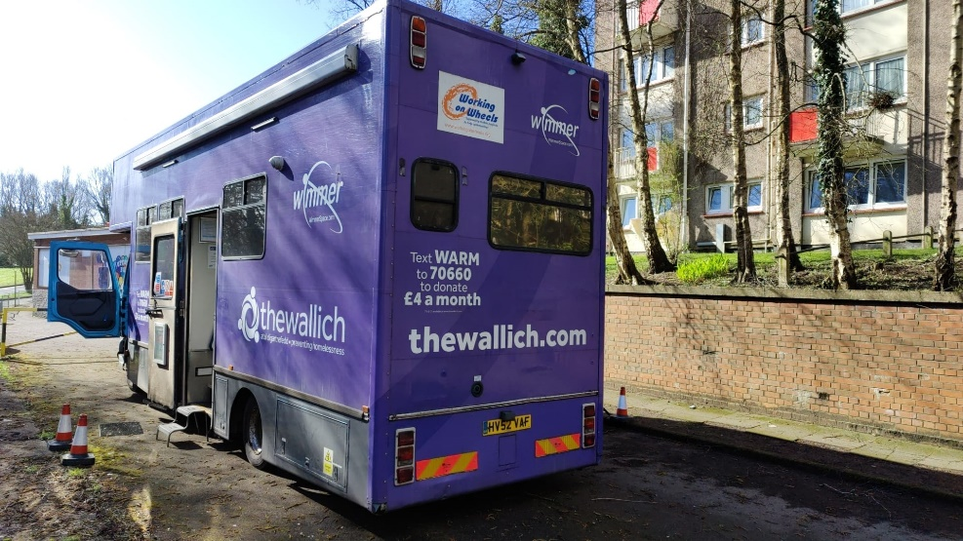
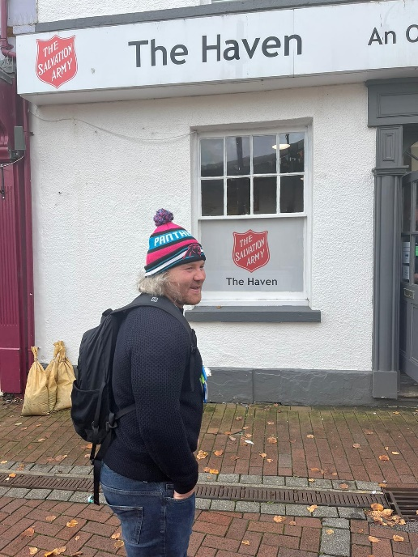
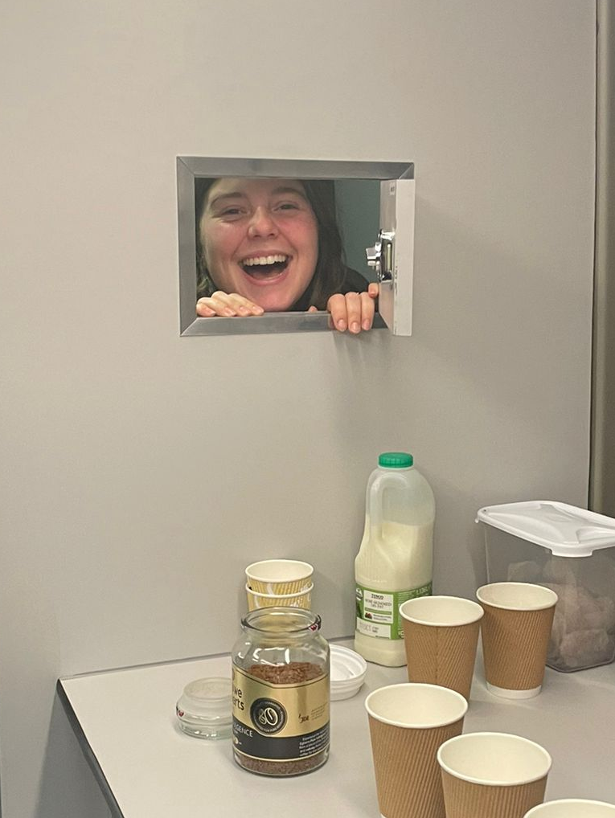
Community POCT Projects
Translation of prison successes with POCT into community settings
Appropriate HITs identified in community including large units of temporary accommodation, high-intensity short-stay drop-in centres
Scoping of POCT to support urgent results for those at high risk of disengagement and onward transmission
Potential for use in those with needlephobia to support treatment access and SVR
Increased familiarity with ease and suitability for testing
Broad scale overt opt-out testing destigmatises routine screening
Strengthening of collaboration between POCT practitioners and BBV specialist team
Dates agreed to begin first opt-out screening and referral service via a probation point of contact centre in Wales

Slide 6



The Streamlined Swansea Model
All community routine testing responsible to BBV team with exception of CDAT & HMP Swansea
All results returned in name of one BBV specialist clinician
All testing conducted alongside a NEO entry
All positive PCR results given to service users with a specific date for review by specialist clinician – within two weeks
Treatment decision discussed at initial review alongside fibroscan and next appointment made for two weeks later to start treatment
Promotion of close collaboration between testers/ key workers and BBV specialists
Supports assurance that service users will receive results
Delivery of high-quality BBV risk, testing, pathway, and outcome training from BBV team
Train/ Test/ Treat package being rolled out across services including hostels, drug agencies, support services, drop-in sites
15 sites currently adding tests to NEO – 3 more to commence in April

Slide 7
Additional successes
Launch of third year student nurse BBV placement to support BBV education of nurses and delivery of testing projects in community
Collaboration with Swansea University to conduct BBV testing amongst homeless & vulnerably housed to gauge state of play post-Covid & develop impact assessment
Development of opt-out testing strategy in inpatient psychiatric settings to establish BBV prevalence
Development of screening service in SBUHB has led to rates this year exceeding the cumulative total of the previous five years

Slide 8
Questions?
James Plant – clinical nurse specialist, blood-borne viruses
james.plant@wales.nhs.uk
07813 409443

