Slide 1

HCV Elimination in England – a view from an ODN
Ben Stone
Consultant in Infectious Diseases,
Sheffield Teaching Hospitals NHS Foundation Trust
Clinical Lead,
South Yorkshire, Bassetlaw &
North Derbyshire HCV ODN

Slide 2

Outline
HCV Operational Delivery Network (ODN): organisation, staff & other resources
Successes
Current challenges and future priorities
Closing remarks
Questions

Slide 3
Outline
HCV Operational Delivery Network (ODN): organisation, staff & other resources
Successes
Current challenges and future priorities
Closing remarks
Questions

Slide 4
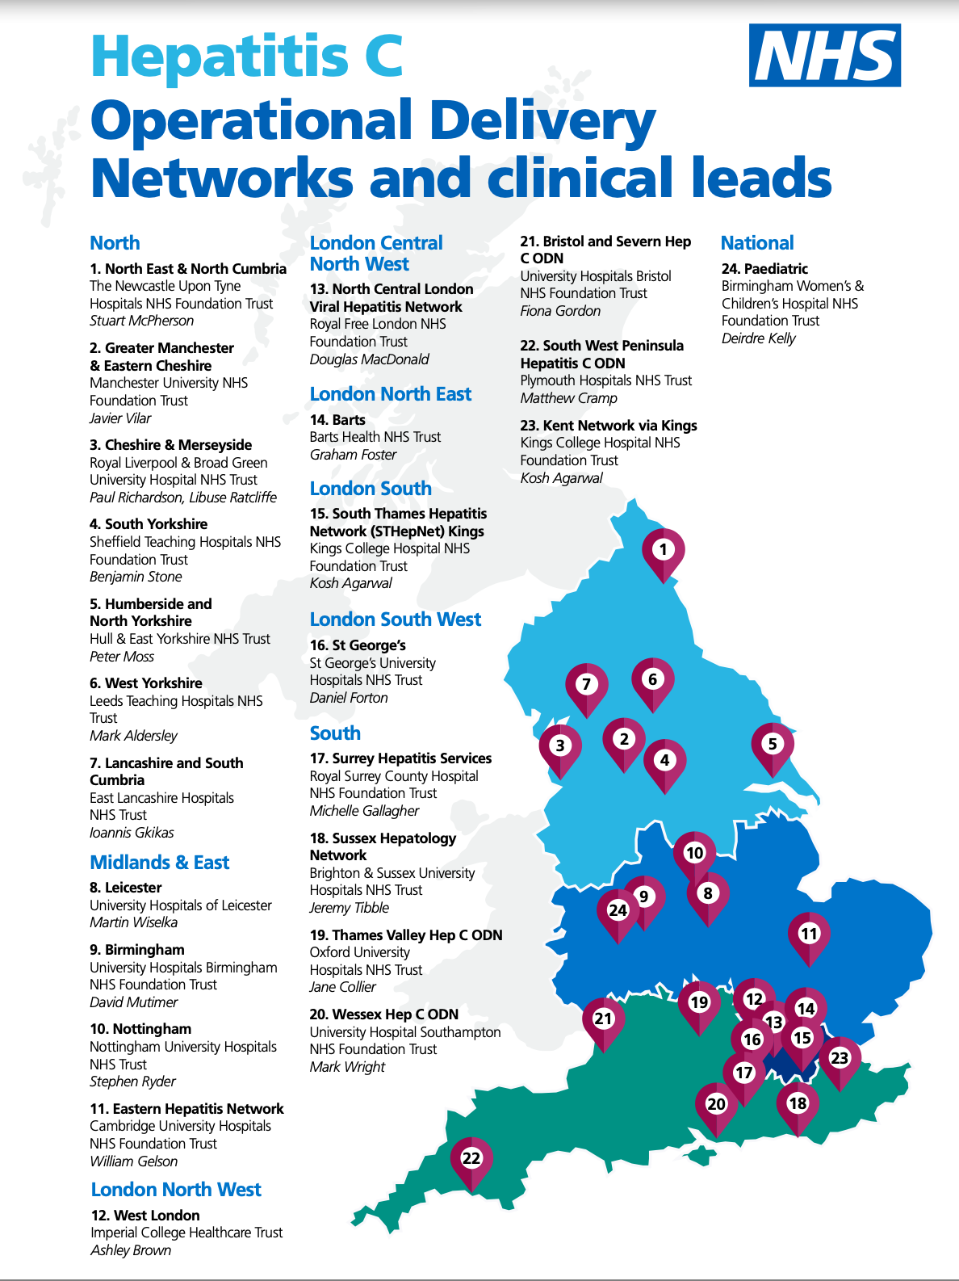
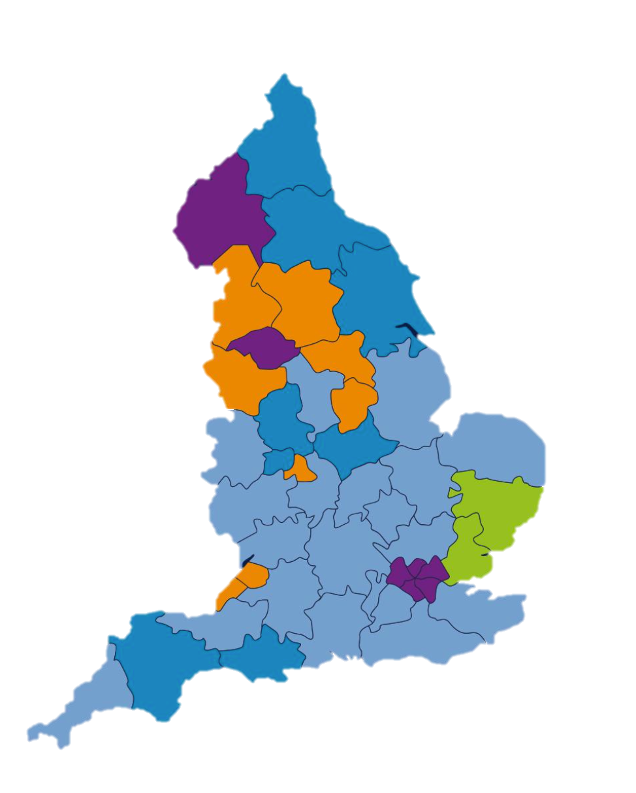
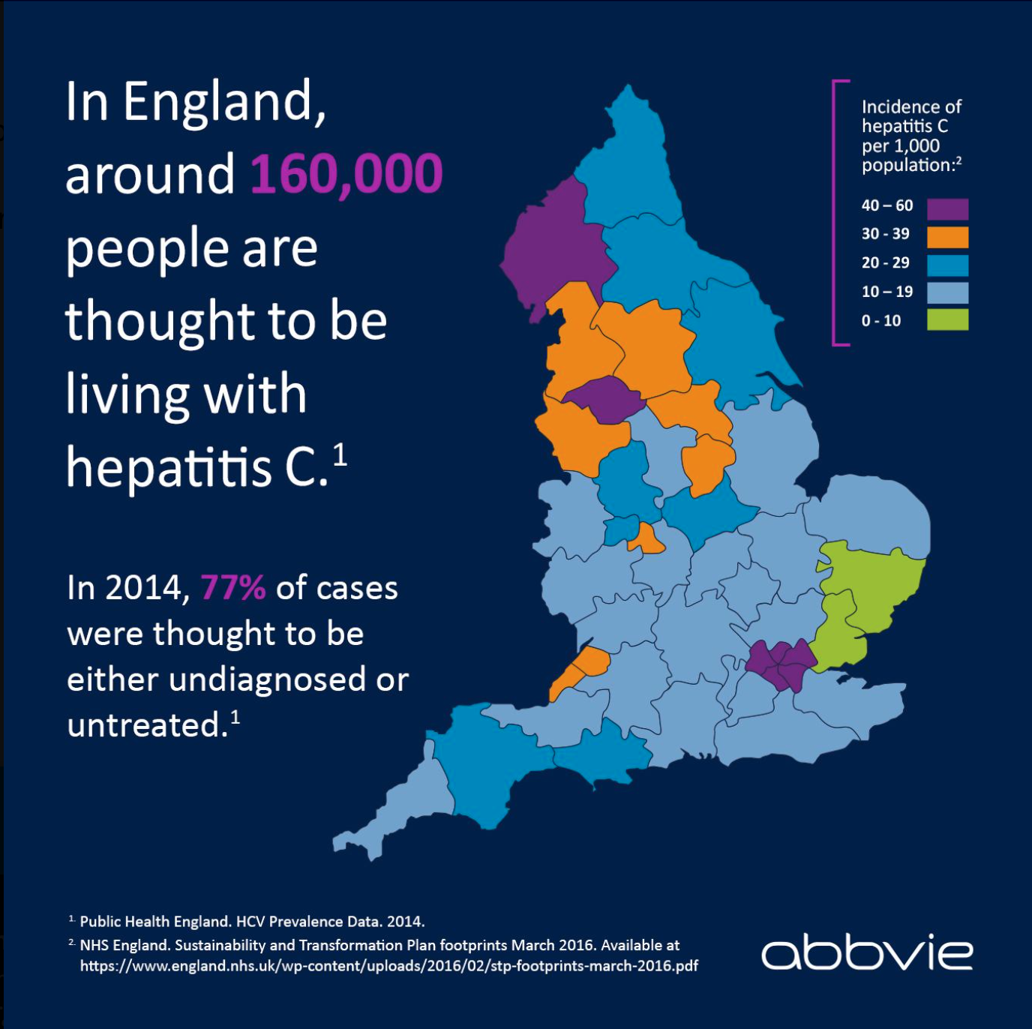
24 ODNs in England
Established 2016
North: 7
Midlands: 4
South: 7
London: 4
National: 1
  Paediatric

Slide 5
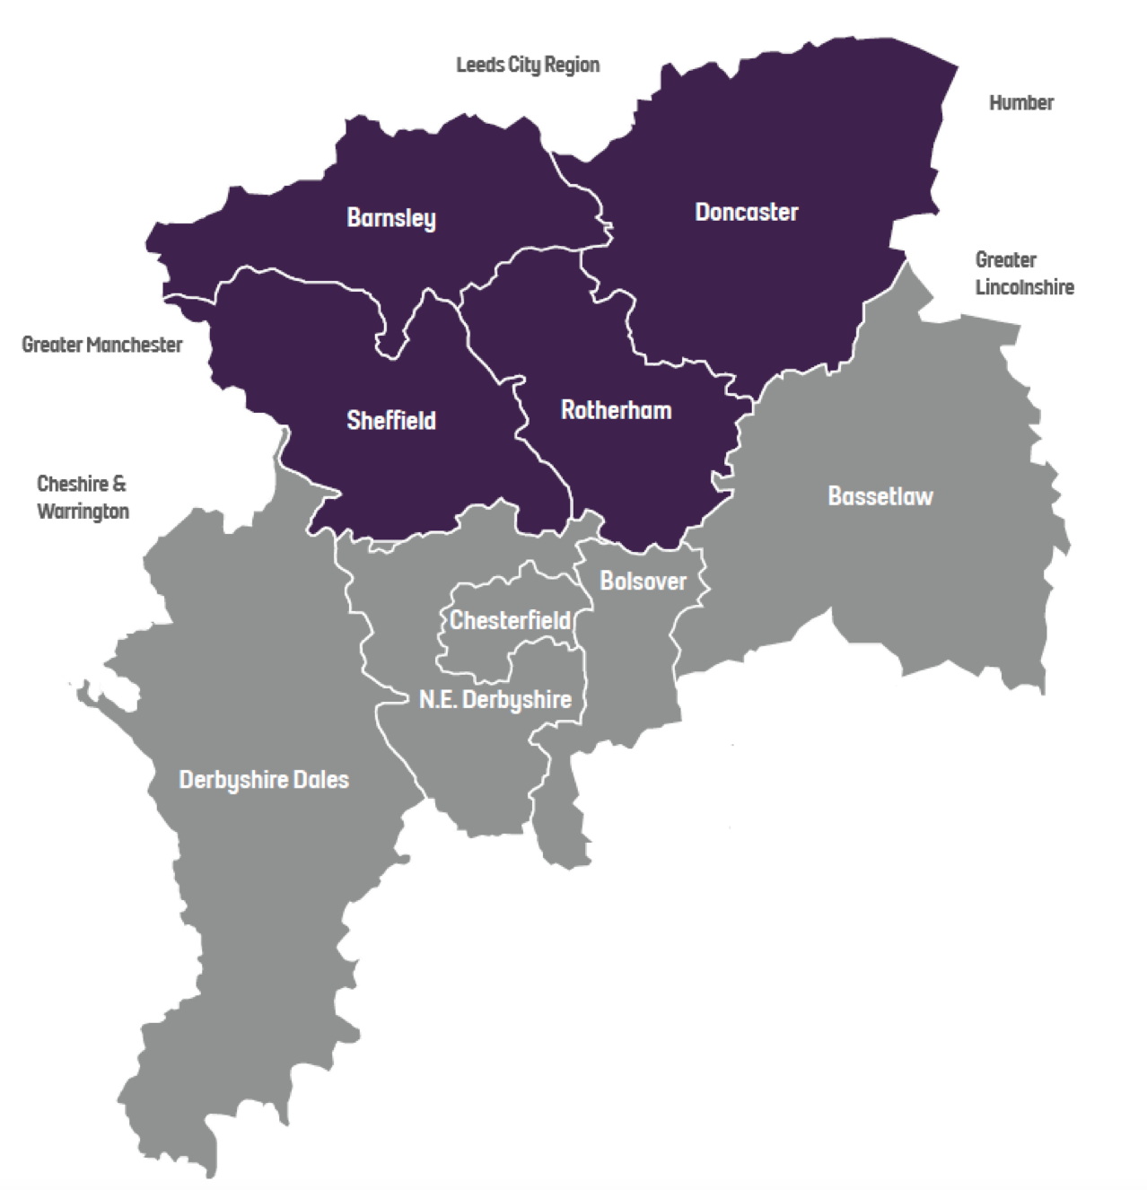


South Yorkshire, North Derbyshire & Bassetlaw HCV ODN (estimated population 1.88 million - 2023)
South Yorkshire prisons
(max. capacity 3,488)
HMP Doncaster (B - remand)
HMP Lindholme (C)
HMP & YOI Moorland (C)
HMP Hatfield & The Lakes (D)
Barnsley
Doncaster
Rotherham
Sheffield
Chesterfield
Worksop

Slide 6
South Yorkshire, North Derbyshire & Bassetlaw HCV ODN (estimated population 1.88 million - 2023)
Doncaster
Royal Infirmary
Barnsley DGH
Rotherham DGH
Sheffield
Teaching Hospitals
NHS FT
ID & Hepatology
Chesterfield
Royal Hospital
Bassetlaw Hospital

Slide 7


South Yorkshire, North Derbyshire &
Bassetlaw HCV ODN: organisation, staff, resources
Doncaster
Royal Infirmary
Barnsley DGH
Sheffield
Hepatology
Sheffield
Infectious Diseases
Rotherham DGH
Sheffield
Teaching Hospitals
NHS FT
Viral hepatitis activity only
ID & Hepatology
Nurse Consultant
CNS/NP
Medical
Consultant
Chesterfield
Royal Hospital
Bassetlaw Hospital

Slide 8
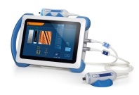
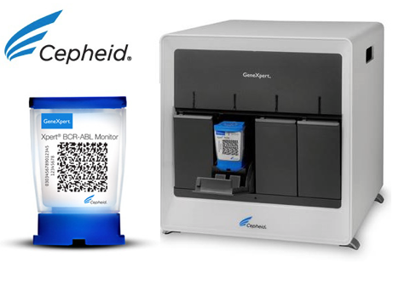
South Yorkshire, North Derbyshire &
Bassetlaw HCV ODN: organisation, staff, resources
ODN management & support staff (CQUIN funded):
Sheffield
Hepatology
Band 7 ODN Manager
Band 5 ODN
Case Finder &
Van Co-ordinator
Band 4 ODN
Administrator &
Data Manager
ODN
Clinical Lead
1 PA per week
Sheffield
Infectious Diseases
Hepatitis C Trust Peer Workers:
Other:
Peer
Co-ordinator
Peer
Support
Leads
Community
Health &
Justice Peer
Van
Peer
Van
Driver
NSP
Peer
Viral hepatitis activity only
Other clinical staff:
+ Prison Peer Support Leads
+ Peer volunteers
1 x Van
Band 8a Pharmacist
0.6wte
Virology
Consultant
1 PA per week
x 6 portable
x 3 static
x 3
Nurse Consultant
CNS/NP
Medical
Consultant

Slide 9

ODN additional HCV financial and other support
NHS England
  CQUIN
    Governance payment (now discontinued)
    Stewardship payment (based on CQUIN target performance)
  Elimination initiatives
    £500 per treated patient payment scheme (PTPPS) (linked to data reporting quality)
    Prison high intensity test and treat (HITT) programme
    Prison reception Cepheid GeneXpert point of care HCV RNA testing
Pharmaceutical companies
Gilead:
  Project management support
    Prisons
    Drug Services
AbbVie:
  2 x Peer Support Leads
  Project management support (drug services)
MSD:
  GP search tool

Slide 10
ODN function and roles
Hub and spoke model
Clinical leadership, advice and support
Specialist nurse provision
Pharmacy support
Complex treatment MDTs (weekly)
Interface between ODN and NHSE
Management of elimination initiatives & finances
Service level agreements, contracts and governance
Data collation & reporting and performance monitoring
Case-finding
  UKHSA look back
  Real-time
Virology support
Quarterly meetings
Quarterly reports

Slide 11
Outline
HCV Operational Delivery Network (ODN): organisation, staff & other resources
Successes
Current and future challenges
Closing remarks
Questions

Slide 12

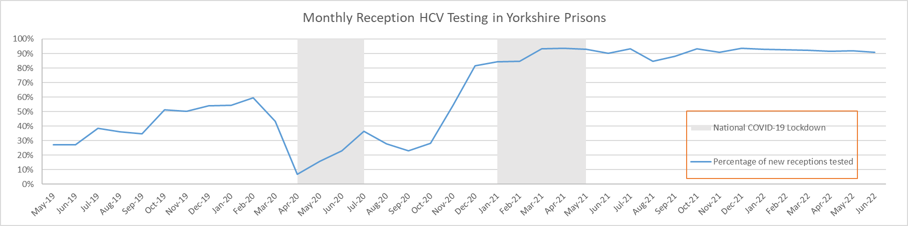
Improved prison reception testing
Relatively high HCV prevalence
High turnover
“Captive audience” - opportunity for HCV diagnosis, assessment and treatment – “kidney” of the ODN
Historically low BBV testing rates
Gilead-funded regional BBV lead nurses for Practice Plus Group prison healthcare + project management
Hep C Trust prison peer co-ordinators – education of staff and prisoners
Marked improvement in offer and uptake of reception BBV testing
Monthly prison reception HCV testing rates
South Yorkshire prisons
(max. capacity 3,488)
HMP Doncaster (B - remand)
  All receptions
HMP Lindholme (C)
HMP & YOI Moorland (C)
HMP Hatfield & The Lakes (D)
2019
2020
2021
2022
Royal, N. et al. INHSU 2022 PE-032
Notes:
HCT Peers – raise awareness, reduce stigma

Slide 13

Prisons high-intensity test and treat “HITTs”
Aim: to test and treat pre-existing prisoners
  Missed reception testing
  Newly infected within prison since reception
Delayed until reception testing rates >90%
ODN + Practice Plus Group + Hep C Trust + NHSE; bespoke NHSE funding
HITTs in all 4 South Yorkshire prisons 2020-21 – several days to weeks
All achieved (and have maintained) prison micro-elimination* status
Hep C Trust Peer pre-HITT education & training
ODN, Prison Healthcare (Practice Plus Group), Hep C Trust & NHSE planning
Whole prison testing day(s): capillary blood HCV Ab POCT
Same day CNS assessment of HCV Ab+: capillary bloods* + FibroScanTM
Pan-genotypic treatment delivery and treatment start within 5 working days
*HCV RNA + genotype, HIV Ag/Ab, HBsAg, FBC, U&E, extended LFTs
Notes:
Plus presence of a robust system to review ongoing testing and treatment performance to ensure these targets are maintained

Slide 14


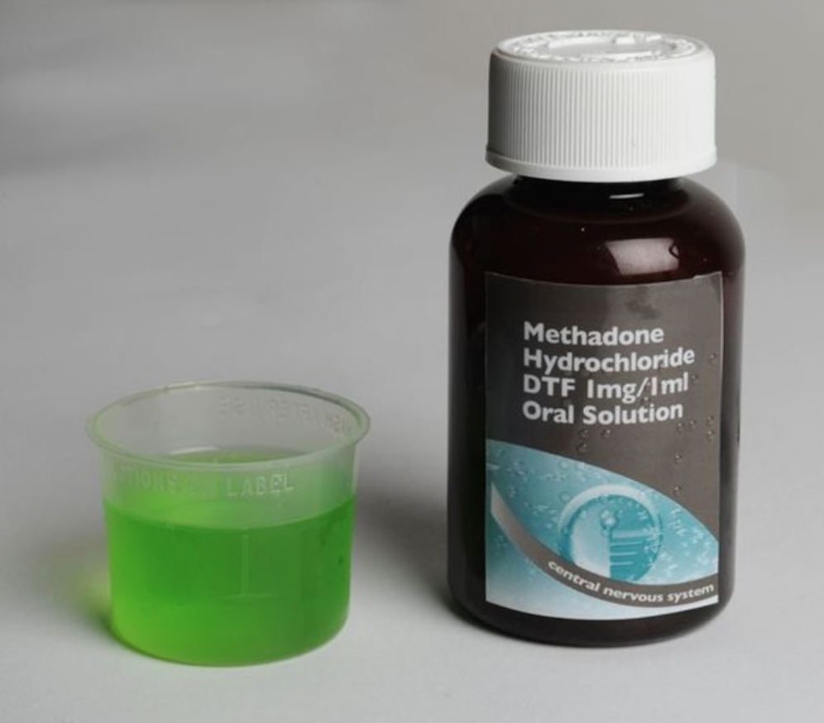




Peer supported care
*Peer delivered testing: dried-blood spots, capillary, point of care (Matrix BBV serology +/- Cepheid GeneXpert HCV RNA)
Deliver education & promote awareness
Prison Peer Co-ordinators (Yorkshire-wide) x 2
  Gilead funded
Through Care Peer Coordinator (Health & Justice)
  NHSE Community Health & Justice funding
Peer Co-Ordinator
  AbbVie funded
Peer Support Leads x 2
  1 x AbbVie funded; 1 x ODN funded (PTPPS)
Mobile Clinic Van Peer Lead
  ODN funded (PTPPS)
Needle Syringe Pharmacy Testing Pilot Peer Lead
  NHSE funded 12-month pilot
Support & deliver testing*
Employed by:
Support engagement with HCV care
Honorary contracts
with Sheffield Teaching Hospitals
Support post treatment repeat PCR testing*

Slide 15

Taking HCV care to the patient
2016 ODN baseline
2018 to 2019

Slide 16
Co-locating HCV care in place and time
Baseline:
Hospital outpatient HCV clinic
80% referral from one single drug service
 | Number of referrals (N) | Number attending for assessment (% N) | Number initiating treatment (% N)
Baseline (12 mo) | 194 | 83 (42.8) | 44 (22.7)
Cassell, M. et al. INHSU 2019 Poster 127
Notes:
From August 2016 to July 2017, of 194 new referrals into the hospital outpatient clinic:
111 (57.2%) failed to attend for their first appointment
83 (42.8%) attended their first appointment only
44 (22.7%) engaged and commenced treatment
80% of referrals originated from one single local drug service

Slide 17
Co-locating HCV care in place and time
Baseline:
Hospital outpatient HCV clinic
80% referral from one single drug service
 | Number of referrals (N) | Number attending for assessment (% of N) | Number initiating treatment (% of N)
Baseline (12 mo) | 194 | 83 (42.8) | 44 (22.7)
Phase 1 (3 mo) | 59 | 33 (56.0) | 26 (44.0)
Phase 1:
Drug treatment service clinic
Hospital CNS delivered HCV outreach clinic
Co-located HCV assessment and treatment clinics
Cassell, M. et al. INHSU 2019 Poster 127
Notes:
From August 2016 to July 2017, of 194 new referrals into the hospital outpatient clinic:
111 (57.2%) failed to attend for their first appointment
83 (42.8%) attended their first appointment only
44 (22.7%) engaged and commenced treatment
80% of referrals originated from one single local drug service

Slide 18
Co-locating HCV care in place and time
Baseline:
Hospital outpatient HCV clinic
80% referral from one single drug service
 | Number of referrals (N) | Number attending for assessment (% N) | Number initiating treatment (% N)
Baseline (12 mo) | 194 | 83 (42.8) | 44 (22.7)
Phase 1 (3 mo) | 59 | 33 (56.0) | 26 (44.0)
Phase 2 (12 mo) | 86 | 76 (88.3) | 75 (87.2)
Phase 1:
Drug treatment service clinic
Hospital CNS delivered HCV outreach clinic
Co-located HCV assessment and treatment clinics
90/101 (89.1%) patients who started treatment at Drug Service completed treatment:
67 (66.3%) attended for SVR assessment
  64/67 (95.5%) achieved SVR12
  3 re-infections
Phase 2:
Joint HCV-OST clinic appointments
Extended joint HCV and OST appointments
Linked OST and HCV DAA scripts every 4 weeks
Cassell, M. et al. INHSU 2019 Poster 127
Notes:
From August 2016 to July 2017, of 194 new referrals into the hospital outpatient clinic:
111 (57.2%) failed to attend for their first appointment
83 (42.8%) attended their first appointment only
44 (22.7%) engaged and commenced treatment
80% of referrals originated from one single local drug service

Slide 19
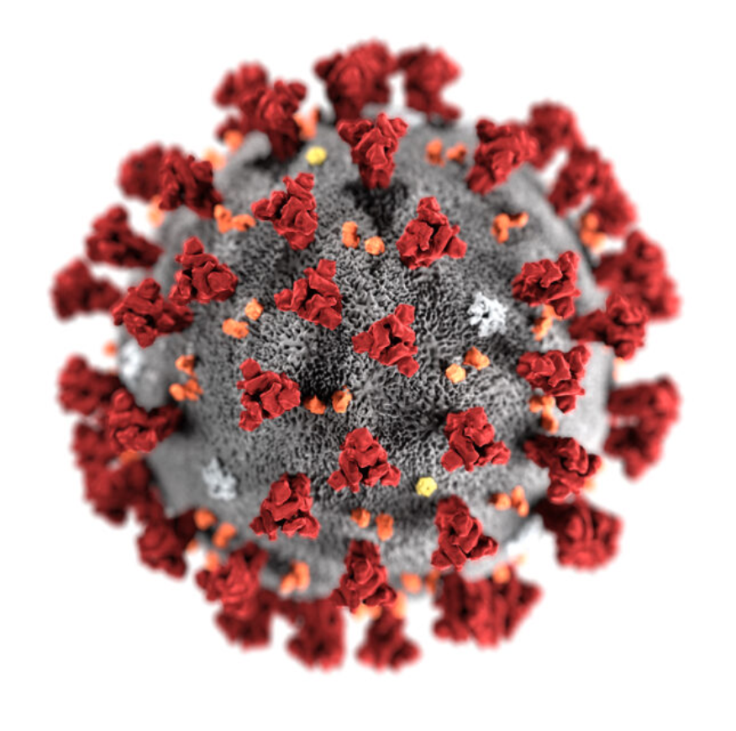
Taking HCV care to the patient
Drug service and community
Love2Shop voucher incentives:
Testing (£5); assessment (£10), treatment start & visits (£10) & SVR12 assessment follow up (£20)
2016 ODN baseline
2018 to 2019
2020 to 2023

Slide 20
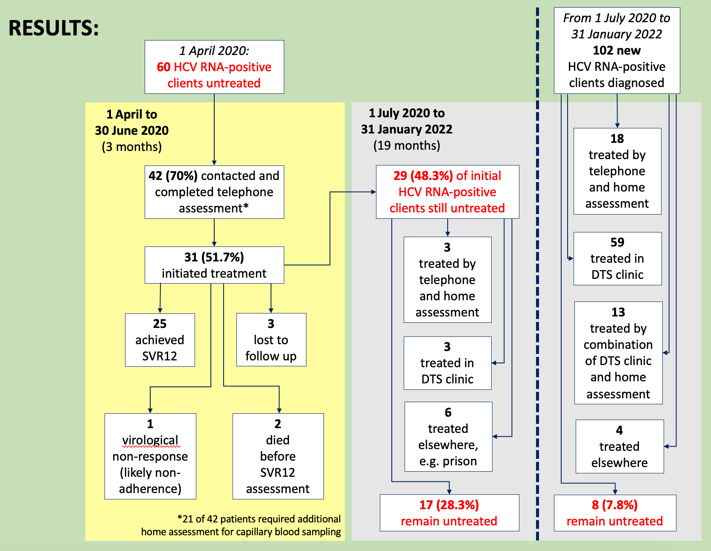
Homecare
Further 12/60 treated since pilot
3 by telephone and home assessment
July 20 to Jan 22:
102 new RNA+
31 treated using telephone and home assessment
March 2020:
60 HCV RNA+ to treat in 1 x drug service
April to end May 2020:
Telephone +/- home assessment pilot
Historic bloods ± FIB-4 calculation
± capillary bloods ± FibroScanTM
Remote local MDT + DAA home delivery
Telephone + home visit* follow up
42 (70%) assessed
31 (52%) treated: 25 achieved SVR12
Baker, N. et al. EASL Viral Hepatitis Elimination 2022 Poster
*2 nurses, appropriate PPE and infection control precautions; FibroScanTM performed retrospectively if indicated

Slide 21

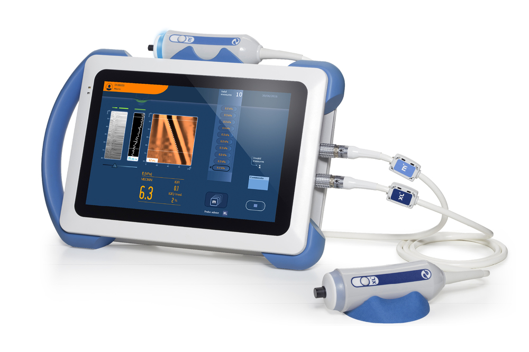


Simplifying the care pathway: “Hep STAT” pilot
Hepatitis C Single Appointment Test Assess and Treat
Clinical Nurse Specialist
Informed; FU appt:
bloods & AUSS
F3-4
HCV RNA DETECTED
Peer
F0-2
HCV RNA not detected
Informed, counselled, issued with pan-genotypic
Also offered HIV RNA testing
Informed, counselled & discharged
Current or past IDU and/or Sex Worker
Weekly single afternoon drop-in clinic, March to July 2019
IDU = injecting drug use; AUSS = abdominal ultrasound scan
Stone, B.. et al. INHSU 2021 Oral Presentation
Notes:
At risk patients identified by Clinical Nurse Specialists and Peers from Homeless Hostels, Drug Services & other community services for PWIDs in Doncaster and Bassetlaw (Worksop) areas

Slide 22
Simplifying the care pathway: “Hep STAT” pilot
Hepatitis C Single Appointment Test Assess and Treat
Results:
27 assessed in 12 clinics
9 HCV RNA+ (33%)
  No HIV
3 F3-4 (33% of RNA+)
Median time: 113 minutes
  Range: 75 to 195
Shortest time from arrival to treatment issue: 90 minutes
Clinical Nurse Specialist
Informed; FU appt:
bloods & AUSS
F3-4
HCV RNA DETECTED
F0-2
HCV RNA not detected
Informed, counselled, issued with pan-genotypic
Also offered HIV RNA testing
Informed, counselled & discharged
Weekly single afternoon drop-in clinic, March to July 2019
IDU = injecting drug use; AUSS = abdominal ultrasound scan
Stone, B.. et al. INHSU 2021 Oral Presentation
Notes:
At risk patients identified by Clinical Nurse Specialists and Peers from Homeless Hostels, Drug Services & other community services for PWIDs in Doncaster and Bassetlaw (Worksop) areas

Slide 23
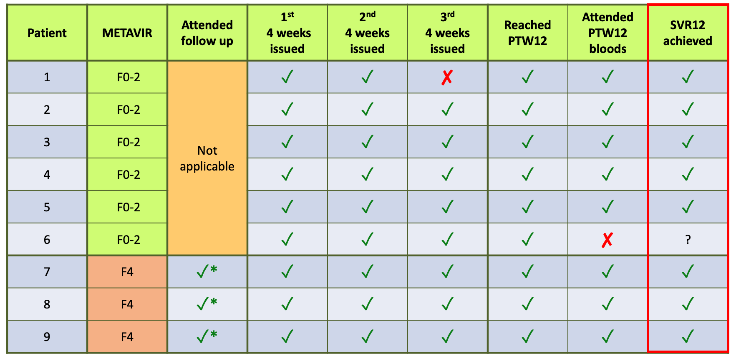
“Hep STAT” pilot treatment outcomes
*All Child Pugh A(5); 1/3 attended for AUSS (no focal lesions); 2 x G3a, 1 x unable to genotype; all commenced Epclusa
‡Treatment re-initiated after interruption after week 4
PTW12 = post-treatment week 12

Slide 24
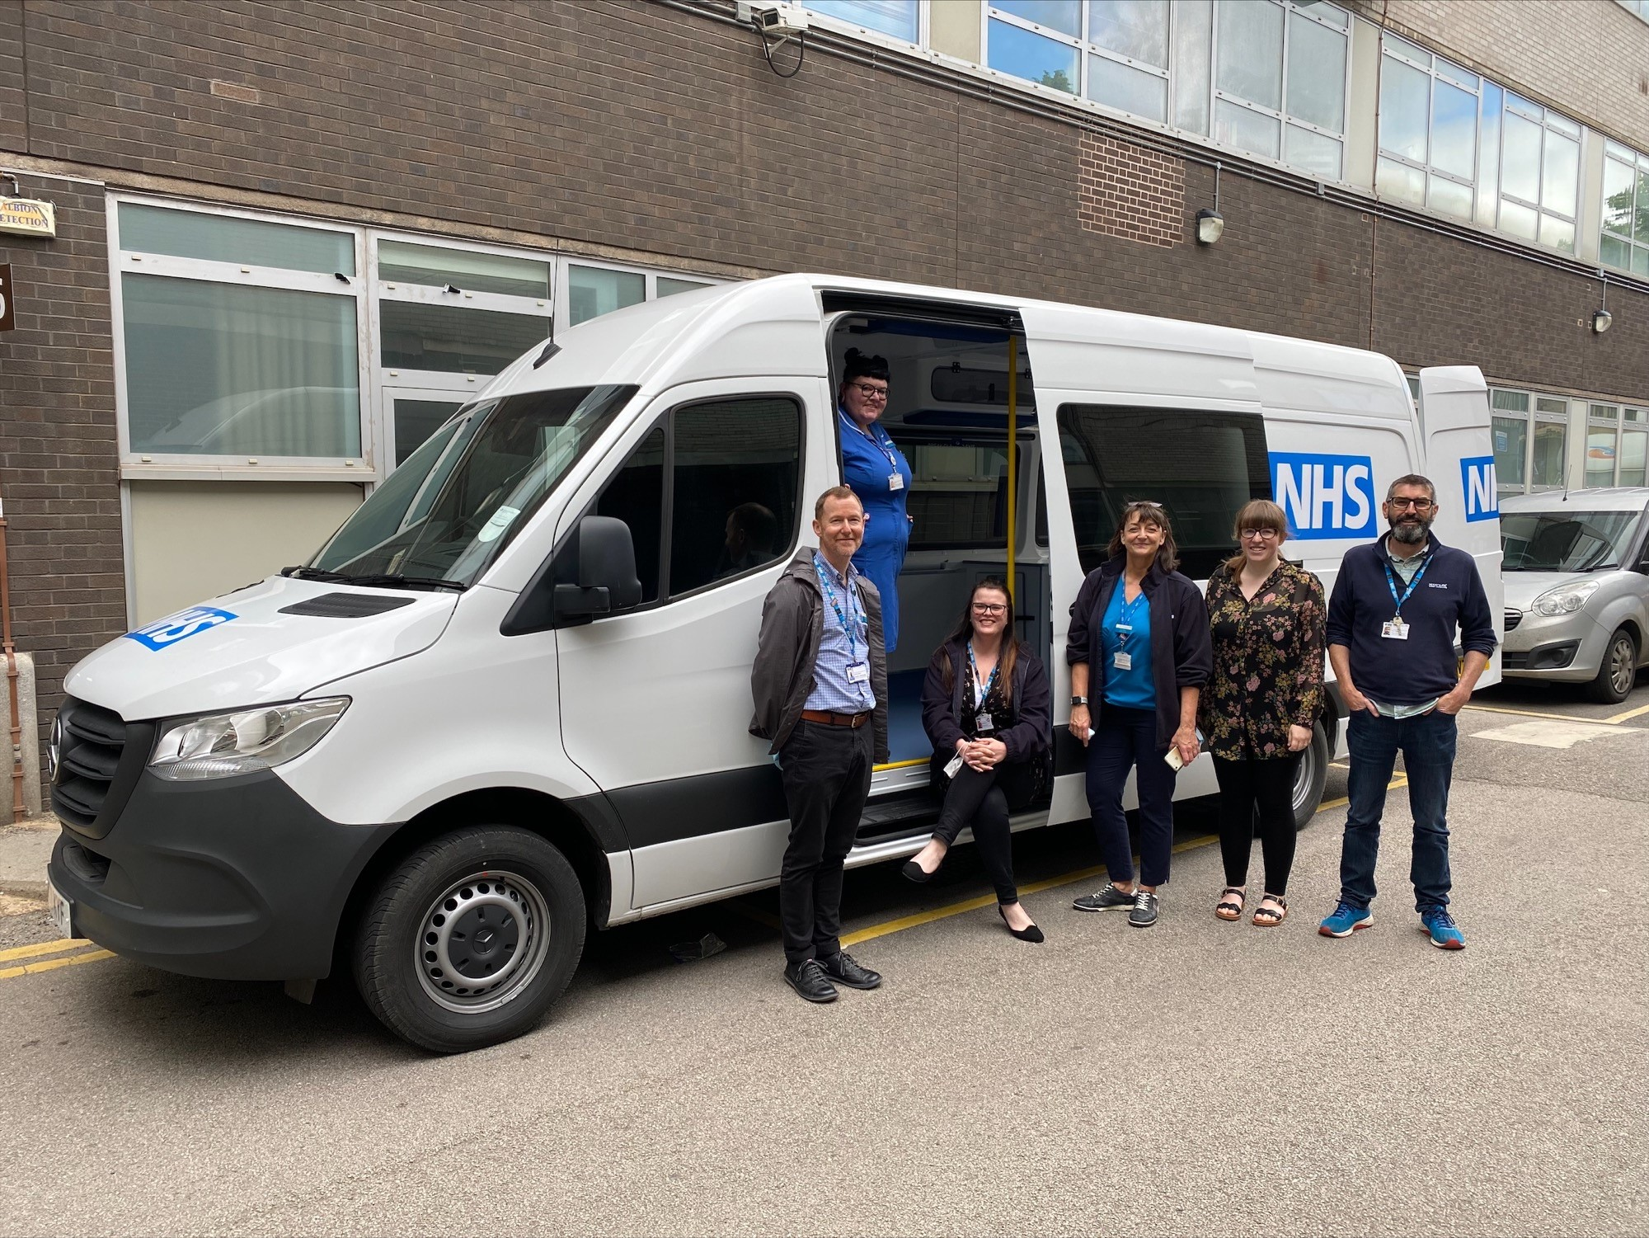

Slide 25
“Hep STAT” mobile
Hepatitis C Single Appointment Test Assess and Treat
Driver
Peer
CNS
Also: needle-syringe exchange, wound care; etc.
Informed; FU appt:
bloods & AUSS
F4
HCV RNA DETECTED
Matrix BBV
Point of Care
Serology
Test
F0-2
F3
HCV RNA not detected
Informed, counselled, issued with stocked DAAs
Person at risk of or know to have HCV infection
HCV Ab DETECTED
Informed, counselled & discharged
HCV Ab not detected
IDU = injecting drug use; AUSS = abdominal ultrasound scan
Notes:
At risk patients identified by Clinical Nurse Specialists and Peers from Homeless Hostels, Drug Services & other community services for PWIDs in Doncaster and Bassetlaw (Worksop) areas

Slide 26
“Hep STAT” mobile: first six months
Hepatitis C Single Appointment Test Assess and Treat
Driver
Peer
CNS
Also: needle-syringe exchange, wound care; etc.
Informed; FU appt:
bloods & AUSS
June to Dec 22:
756 contacts
535 individuals
135 HCV RNA+
116 treatment starts
  41 previously known
  75 new diagnoses
F4
HCV RNA DETECTED
Matrix BBV
Point of Care
Serology
Test
F0-2
F3
HCV RNA not detected
Informed, counselled, issued with stocked DAAs
HCV Ab DETECTED
Informed, counselled & discharged
HCV Ab not detected
IDU = injecting drug use; AUSS = abdominal ultrasound scan
Notes:
At risk patients identified by Clinical Nurse Specialists and Peers from Homeless Hostels, Drug Services & other community services for PWIDs in Doncaster and Bassetlaw (Worksop) areas

Slide 27
Prisons: rapid diagnosis & treatment
Former pathway
Prison
Nurse
Prison reception
Prisoner
Peer
Dried blood spot
HCV RNA testing
Matrix BBV
Point of Care
Serology
Test
ODN CNS Prison in-reach clinic
Further assessment
Pan-genotypic treatment
Informed, counselled & discharged
HCV Ab not detected
HCV RNA DETECTED
Rhodes, A. et al. INHSU 2022 PE-033

Slide 28
Prisons: rapid diagnosis & treatment
New pathway
Prison
Nurse
Prison reception
Remote virtual assessment
Prisoner
Peer
Same day referral to ODN
Prison in-reach CNS team
Review previous history and results
Review co-medications & DDIs
Prospective MDT
ODN
CNS
HCV RNA DETECTED
Matrix BBV
Point of Care
Serology
Test
ODN CNS Prison in-reach clinic
HCV RNA not detected
HCV Ab DETECTED
Further assessment
Pan-genotypic treatment
Informed, counselled & discharged
HCV Ab not detected
Rhodes, A. et al. INHSU 2022 PE-033

Slide 29
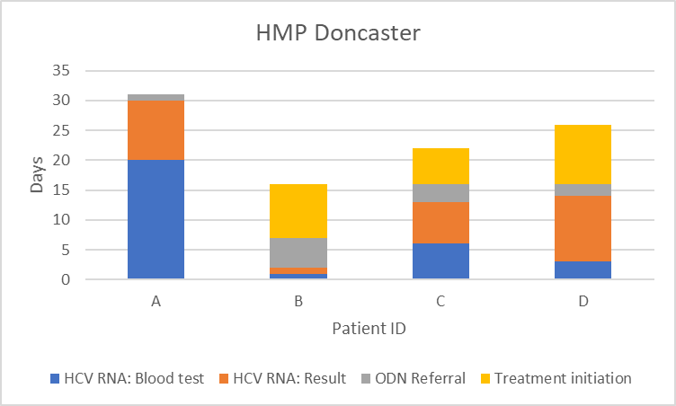
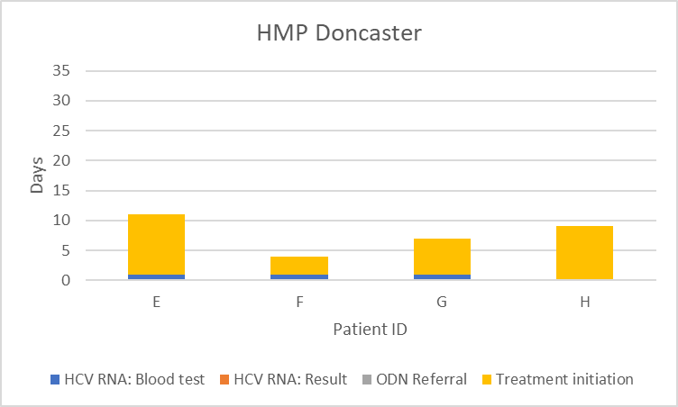
Prisons: rapid diagnosis & treatment: outcomes
HCV a/b PoC; Virology Lab HCV RNA
HCV a/b PoC; Cepheid HCV RNA
Day 0 = day of HCV a/b PoC test
Average time from HCV a/b PoC test to treatment initiation
24 days
8 days
Virology Labs
Cepheid
Rhodes, A. et al. INHSU 2022 PE-033

Slide 30
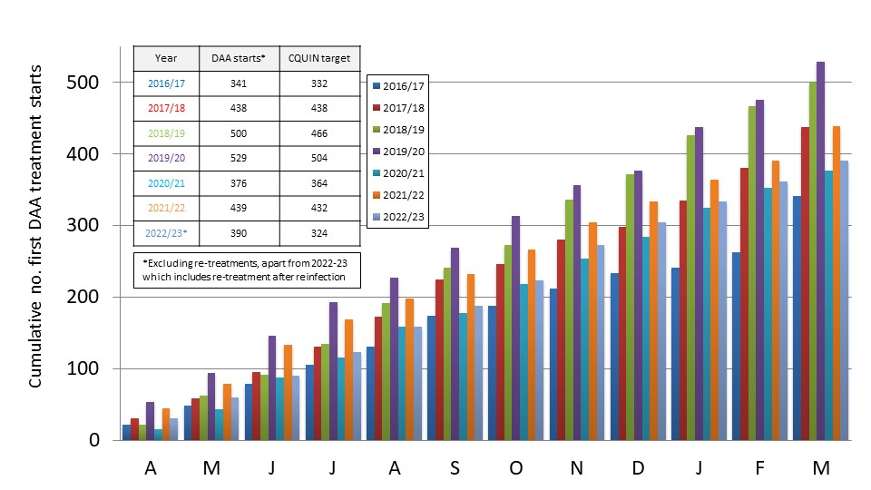
High treatment numbers 2016-23 (∼3,000)…..
Universal DAA access March 2017
78 new DAA starts in 1 month
2,965 individual patients treated since April 2016
101 re-infections treated since April 2019
81 re-treatments for virological failure since June 2018 (2.64% of first DAA treatment courses)
CQUIN targets met each year – full NHSE payments received
Peak treatment numbers in 2019/20
Reduced treatment numbers in 2020/21 (COVID-19) and 2022/23 (more complex patients left to treat)
Data up to 26th March 2023. Re-infection re-treatment starts included for 2022/23 only

Slide 31
…..large numbers still to treat (old + new)
ODN-wide
Prevalence ⇩ 10.2% (567 to 509)
Numbers to treat ⇩ 28.5% (239 to 171)
Incidence: 34 per month average, ⬄

Slide 32
Differing rates of progression in different areas…
Sheffield
Pop: 746,000
Rotherham
Pop: 267,000
Prevalence ⇩ 26.1% (218 to 161)
Numbers to treat ⇩ 26.5% (102 to 75)
Incidence: 7 per month average, ⇧
Prevalence ⇧ 17.3% (75 to 88)
Numbers to treat ⇩ 37.8% (37 to 23)
Incidence: 3 per month average, ⇩

Slide 33
…some with very low prevalence and incidence
N Derbyshire
Pop: 200,000
Bassetlaw
Pop: 118,000
Prevalence ⇩ 40.0% (35 to 21)
Numbers to treat ⇩ 33.3% (6 to 4)
Incidence: 2 per month average, ⇩
Prevalence ⇩ 46.6% (13 to 7)
Numbers to treat ⇩ 33.3% (3 to 1)
Incidence: 0.5 per month average, ⇩

Slide 34
Outline
HCV Operational Delivery Network (ODN): organisation, staff & other resources
Successes
Current challenges and future priorities
Closing remarks
Questions

Slide 35
Treating remaining people living with HCV
…if they want treatment! (encouragement vs. coercion)
Further simplification of treatment pathways?
Greater pragmatism
Multi-agency working and enhanced support
More time required per patient
…whilst keeping on top of new cases too!
+ 34 new RNA+ per month

Slide 36
Shortening time from diagnosis to treatment
New NHSE CQUIN target for 2023/24
  ≤4 weeks referral to treatment start for new referrals (≥75%)
Earlier and simpler assessment
Increased use of pan-genotypics
Faster genotype turnaround
Earlier MDT treatment decision (retrospective, none?)
DAA delivery options
+ 34 new RNA+ per month

Slide 37
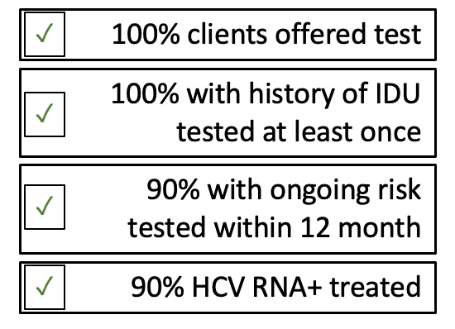
Finding the undiagnosed: in drug services
Variable BBV testing rates across 6 ODN drug services:
The Good…
…the Bad…
…and the Unknown
1 x drug service has just achieved micro-elimination
Poor testing levels at largest drug service (∼2,000 clients)
Fluctuant testing levels of new and pre-existing clients
40% with history of IDU never tested – no change
Reduced footfall since COVID-19
Telephone appointments of more stable clients
Increase face-to-face visits?
Home testing?
Second largest drug service not fully engaged with ODN
No data sharing
Unknown testing rates
Low referral rates to ODN
Lots of untested and undiagnosed clients?
Gilead-funded project lead
Dedicated BBV nurse
Close working with ODN CNS
BBV = blood-borne viruses, i.e. hepatitis C, hepatitis B and HIV; IDU = injecting drug use

Slide 38
Finding the undiagnosed: elsewhere
Barriers to primary care testing:
“Not funded” – no financial incentive
Additional cost
Understaffing / increased workload – no time
Variable patient access – often poor
Ongoing or recent risk
  Injecting networks (incentives)
  Needle syringe exchange pharmacy testing pilot
Historic risk
  Primary Care***
    At risk & never tested / tested but never referred
    GP patient list HCV risk factor search tool (MSD)
  Re-attempt contact of lost to follow up
Unknown risk (population opt-out testing)
  Antenatal opt-out testing (BBV + syphilis)
  Emergency department opt-out testing (BBV)
    Focus on areas with HIV prevalence ≥2/1,000
      Sheffield: 1.9/1,000
Solutions to primary care testing:
National testing portal (HCV only)
New national GP HCV lead
GP champions
ODN-supported administration and testing for high prevalence practices?
BBV = blood-borne viruses, i.e. hepatitis C, hepatitis B and HIV

Slide 39
Outline
HCV Operational Delivery Network (ODN): organisation, staff & other resources
Successes
Current challenges and future priorities
Closing remarks
Questions

Slide 40
In summary…..
Lots of reasons to be cheerful:
  Nearly 3,000 people treated since 2016
  Good management and support structures in place
  Good levels of staffing with flexibility
  Ongoing high-level national funding and support for ≥1 year (2 to 3 years?)
  Multiple options for patient co-located diagnosis, assessment and treatment
  Simplified care pathways
  A well functioning kidney (prisons)
  Elimination achieved in some areas
Focus for 2023/24 and beyond:
  Testing, testing, testing
    Drug treatment services
    Needle syringe pharmacies
    Injecting networks
    Primary Care***
    Antenatal +/- ED opt out testing
  Faster assessment and treatment for new diagnoses
  Enhanced treatment support for complex patients
  Transition to maintenance
    Continued testing in low prevalence settings

Slide 41
Questions?
HCV Operational Delivery Network (ODN): organisation, staff & other resources
Successes
Current challenges and future priorities
Closing remarks
Questions

