Slide 1
Cardiff Hepatitis C event 31st March 2023
What we’ve learnt about inclusion health (IH) patients
A brief overview of 12 months of patient data from University College Hospital in London (Euston)
IH/general internal medicine (GIM) locum consultant James Norman
Work mobile: 07773 664 367
Email: JamesNorman1@NHS.Net
Appointed: 4th October 2021

Slide 2
Disclaimer
Some of what follows may be upsetting for those in the audience with lived experience of Inclusion Health issues
This talk is meant to be a dry, objective look at numerical data in terms of percentages of people with, or without, certain issues, but this can be difficult to hear for those who have lived through these challenges themselves
I apologise in advance if any of this is upsetting to any of you, and completely understand if any of you need or want to pop out during the talk, or miss it altogether

Slide 3

About inclusion health (IH)
IH is an effort to provide better quality healthcare to people who may have been excluded from this in the past, due to:
  Stigma
  Personality clashes
  Late presentations to GP/hospital
  And numerous other reasons
This group typically, but not exclusively, includes:
  People who use class A drugs
  People who persistently drink too much alcohol
  Homeless people
  Undocumented migrants
  2 or more of the above
In essence: everyone is an inclusion health patient (potentially)
  It’s defined by its inclusivity!
https://www.nice.org.uk/guidance/ng214

Slide 4


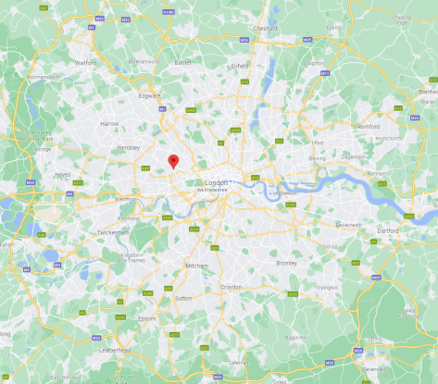


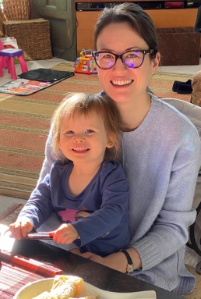

About me
London born and raised
  Chelsea (& England rugby) supporter (please don’t laugh)
Graduate entry medic (GEM) at Nottingham
  FY1 in 2010
  In Midlands for foundation years and core medical training
Arrived (back) in London 2014
  Training number in infectious diseases (ID) and general internal medicine (GIM)
  Worked in various West London hospitals
Initial locum ID/GIM consultant job at Imperial
  15/11/20 to 3/10/21
Joined UCLH as a locum in IH/GIM (5 PAs each) 4/10/21
Non-medical: married with a 3 year old daughter and a wonderful mortgage…!
  Thank you Vladimir Putin for making interest rates so wonderfully high…… ☹

Slide 5

Why did I take this job?
For the glory!
In reality:
  As an ID/GIM doctor I have looked after many young (and not so young) patients who’ve come in very unwell with complications related to their social situations, including:
    Deep vein thrombosis/pulmonary embolus
    Bacterial blood infections such as infective endocarditis
    Advanced liver cirrhosis
    And more
  Many have recovered to an incredible degree during their hospital admission…
  …Only to be discharged back to the exact same social situation that led to that attendance
    On the streets/other accommodation with a high potential for harm
    No/minimal follow up for mental health/other chronic issues
    Hospital and GP follow up there is a strong sense they won’t attend (for a variety of reasons)
  Is there a better way of doing this? This job seemed like a great opportunity to find out!

Slide 6
Inpatient IH at UCH since October 2021
Two main approaches:
  Inpatients: development, use, amendment, and analysis via:
    The Holistic Inclusion health Patient Assessment (HIPA)
  Attempt to provide a way in to hospital for IH patients, in conjuncture with community HCPs, that bypasses the Emergency Department (ED)
    The 987 initiative

Slide 7
UCH OP IH resources: focus on the ‘big three’
Find & Treat team
  Focus on Tuberculosis and Hepatitis C virus
  Switched focus to COVID vaccination in homeless population during the pandemic
Camden Adult Pathway Partnership (CAPP) team
  Expert, nurse-led outreach to clients in IH facing hostels
  Provide access to health care interventions with some stunning successes
Homeless Intermediate Care (HIC) team
  Multi-disciplinary team engaging with clients to aid the transition back to the community at discharge from hospital
  Help with housing authority, accessing benefits, registering with a GP, etc.
  Have had a major impact on attendance in many cases, including High Intensity Users of our ED

Slide 8
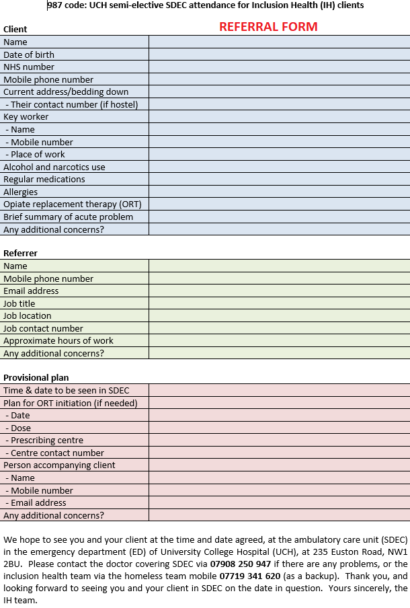
987 initiative
So called purely because ‘987’ should be in the email referral line
  This makes it easier to search for referrals
This is an attempt to allow IH patients to bypass ED and be seen in ambulatory care
  ‘A&E level for access to tests without the time pressure and waits of A&E’
It tends to be for people who refuse to attend ED, or who do so frequently but don’t stay for investigations
14 people seen thus far (~50% rate of non-attendance)
  Thorough IH assessment (HIPA) and screening tests for each
  Plus assessment regarding their presenting complaint

Slide 9

The HIPA
Holistic Inclusion health Patient Assessment

Slide 10
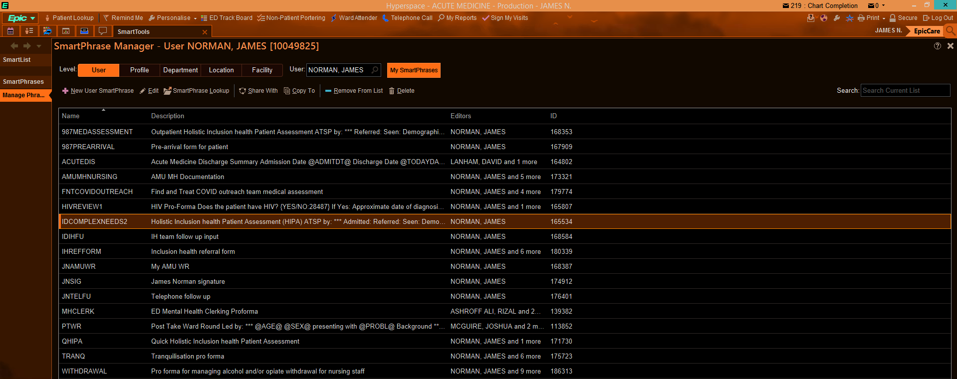
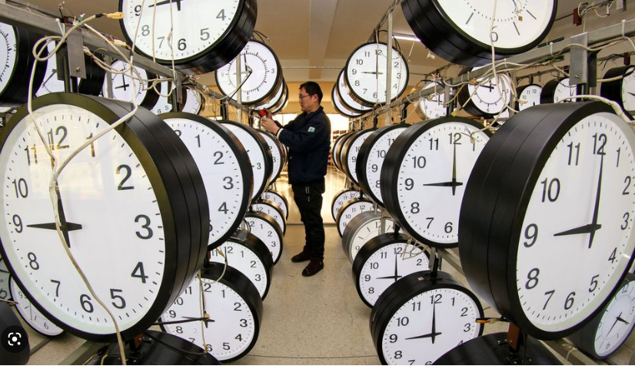
HIPA
Epic (UCLH electronic records system) smart phrase
  Mixture of auto-populating data from Epic (some)
  And free-text typed responses (most)
  Updating the auto-populating data with correct info (quite a lot, sadly)
Takes about 30-45 minutes to fill in bits and pieces that don’t auto-populate pre-review
After that person reviewed, using HIPA cheat sheet to remind HCP of the main questions
  Takes ~0-120+ minutes, depending on interviewee
  If compliant is usually ~60-90 minutes
Has evolved over time into it’s current form

Slide 11
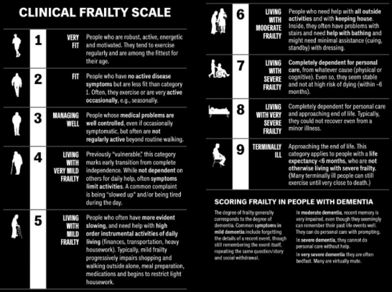
Has a lot in common with frailty assessment
Biographical details
  5 years of addresses
  Up to date mobile phones
  National insurance
  Proof of address
  Benefits
Significant relationships
  NOK
  GP
  Key worker
Why they’re in hospital
  Presenting complaint
  Issues list
  Background
  Medication and allergy history
    Comparing acute versus pre-admission
IH specific questions
  Communicable infections
  GP screening
  Eye and ear care
  Mobility
  Bowels and urinary issues
Self-rating health /10
  Physical, mental, and overall
Vaccination
  COVID and HBV
Sexual history
Capacity assessment
Mental health history
Safeguarding
  Used to delay discharge if unsafe living situation

Slide 12
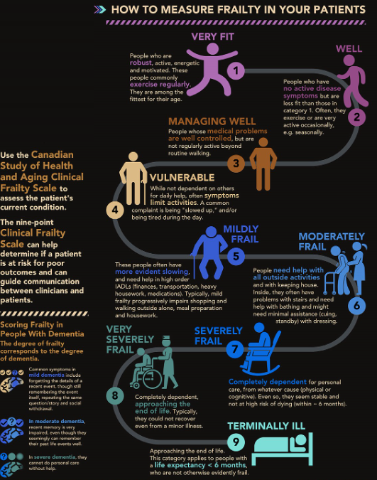
Plus
Dependency
  Smoking
    Nicotine replacement therapy
  Alcohol
  Class A drugs
    Opiate replacement therapy
Living situation
  What is it?
  Are they happy there?
  Are they safe there?
Verbal consent to share with GP, key workers, and other HCPs
Feedback on HIPA and consent to flag as ‘IH patient’
Hospital investigations
  Bloods
  Imaging and ECG
AMT /10
Examination
Scoring systems
  Qrisk3, FRAX, and FIB-4 as standard
  Hepatitis, pancreatitis, and AF if appropriate
Conclusions
  Impressions
  IH issues list
  IH plan
    Divided between things for us to do (add on tests, EPIC referrals), and things for team

Slide 13
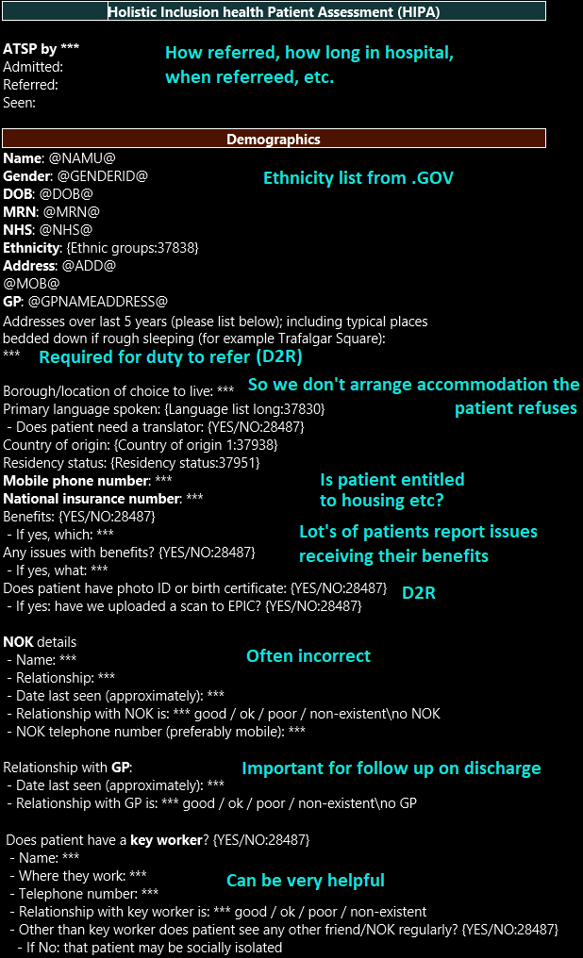
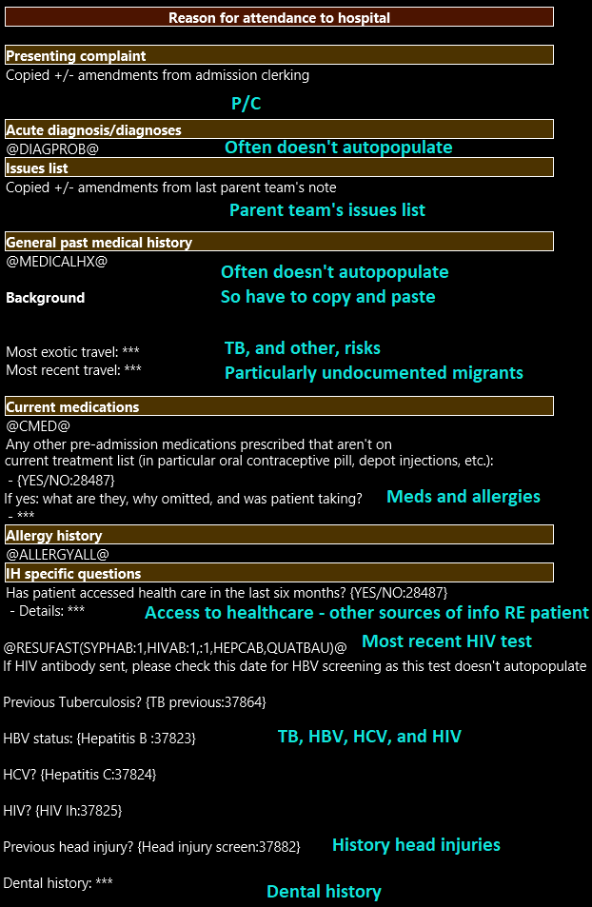
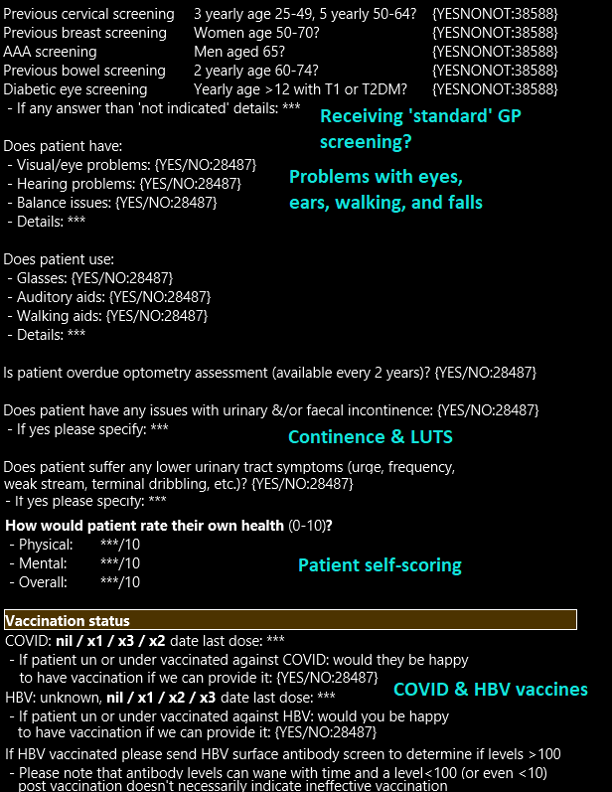
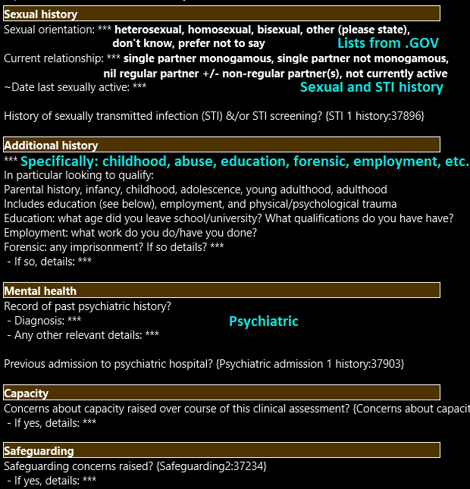
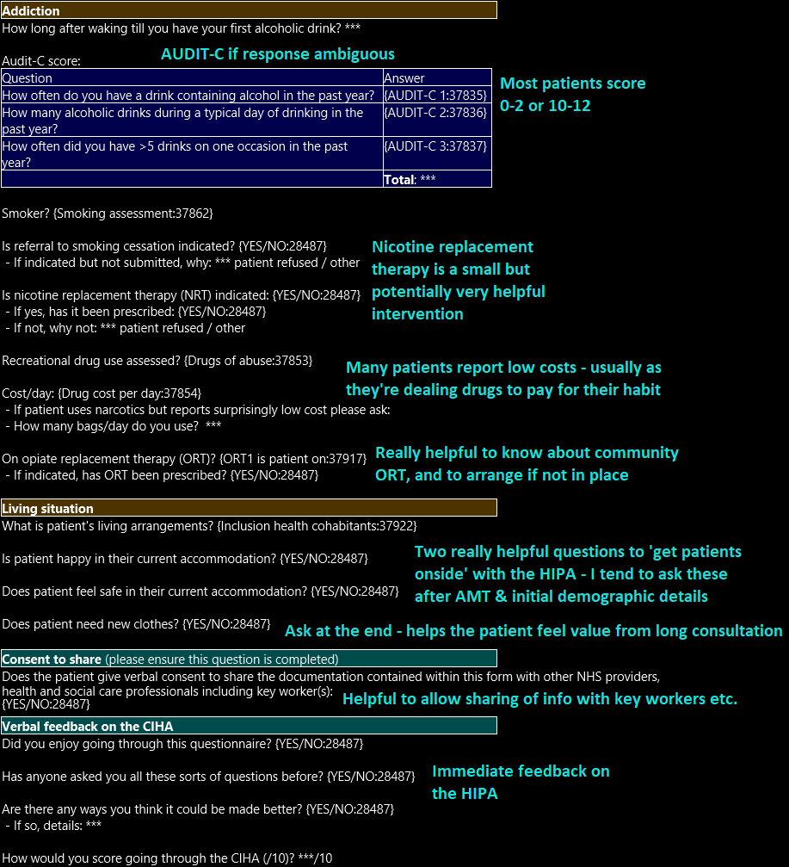
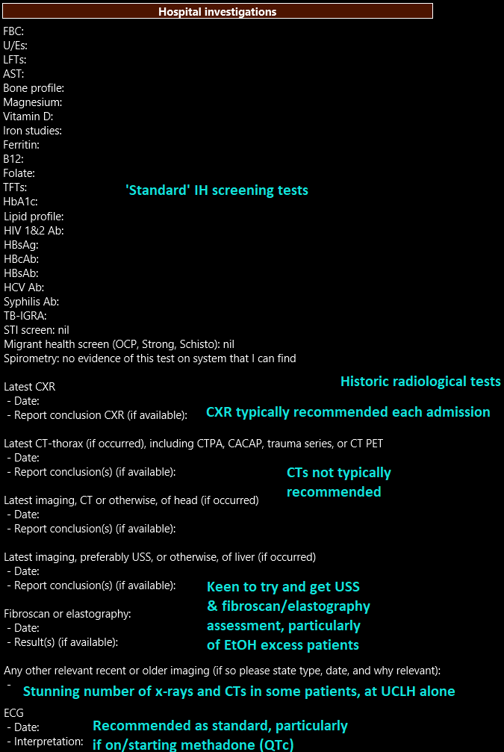
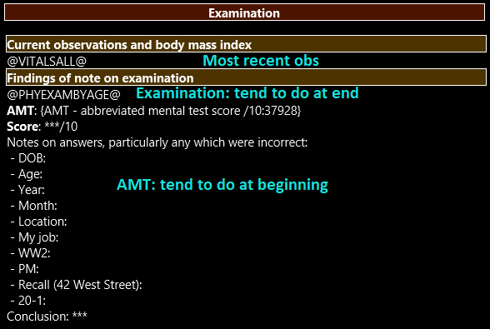
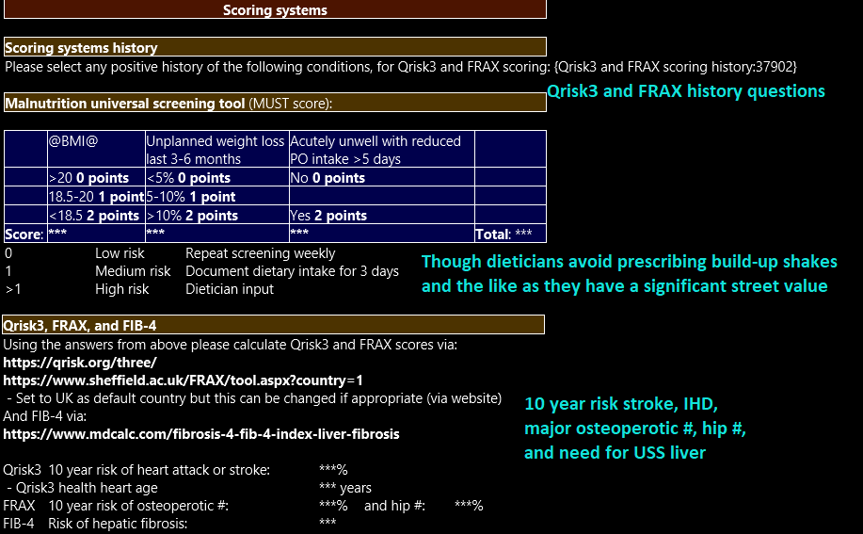
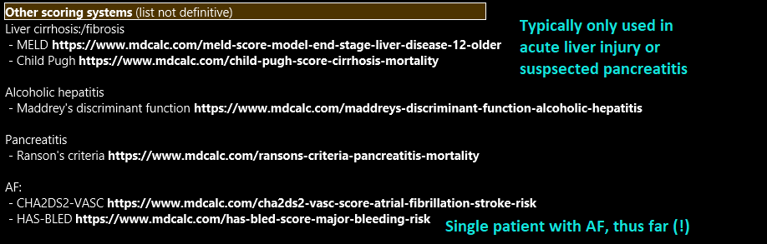
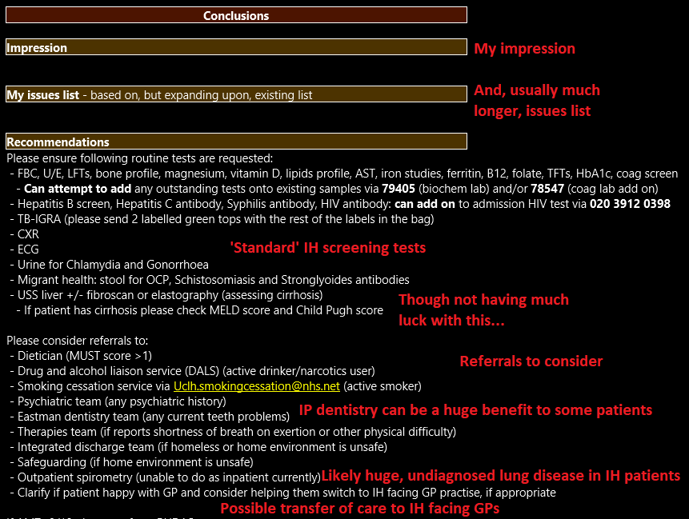
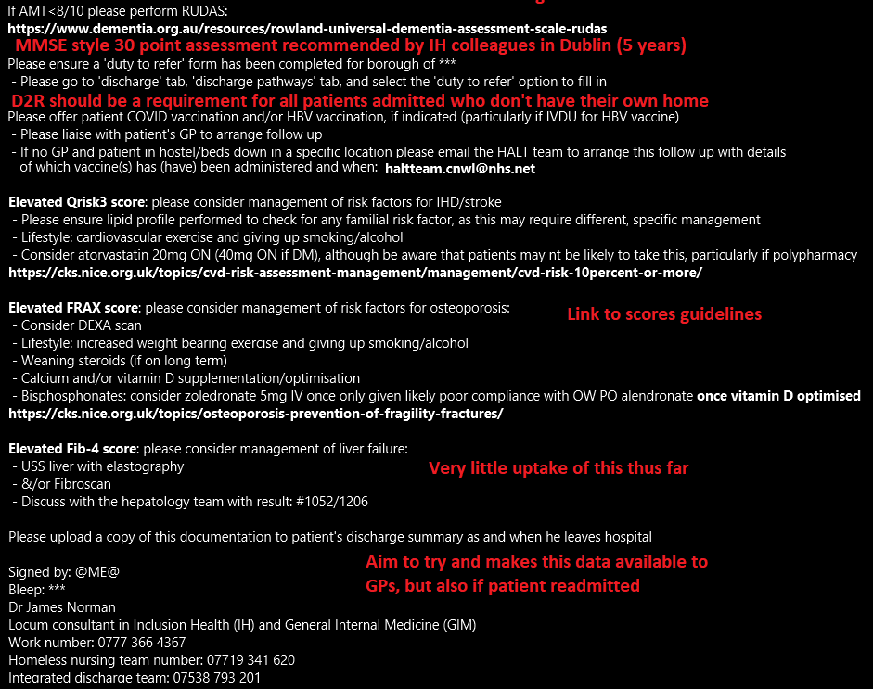
Notes:
List of ethnicities is paraphrased from .GOV website
List of sexuality options was from .GOV website

Slide 14
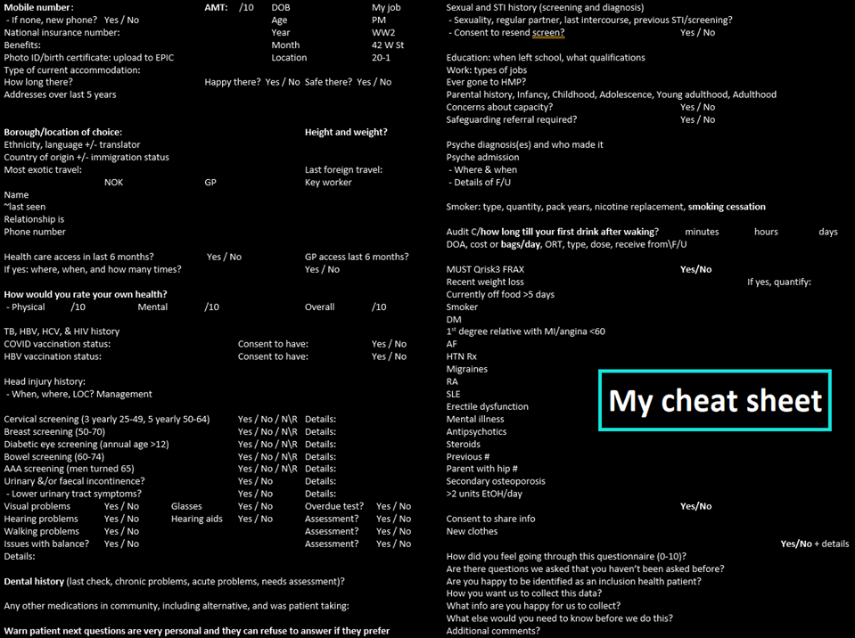

Slide 15

Results
Results of note are in a red box
I have attempted to focus the results on areas of likeliest relevance to this audience
There are a lot more potentially interesting results that the HIPA has revealed… as well as quite a lot of less interesting things!

Slide 16
Biographics, relationships, and clothing
Average: 49.0, UK born, Caucasian male (~4:1 M:F)
Only 40% have a good relationship with NOK &/or GP
  80% have this with key worker, but only 50% have key worker
60% needed new clothes, 10% given new phone

Slide 17
State money
75% on benefits
70% know NI number, or have it available at bedside
50% have no issue with their benefits
40% do have issues
  Or should be on benefits but aren’t

Slide 18
Eyes, ears, legs, bowels, and bladders
75% have some issue with their vision
  This includes people with resolved issues, such as those with new glasses
  80% overdue or never had an eye test
20% report issues with their hearing
35% have balance/mobility issues
25% need visual correction, meaning glasses (ignores the 40% with glasses)
30% may need hearing aids
10% may need mobility aids
25% report urinary issues
20% report bowel issues
  Range of problems described:
    Mild pain passing urine to full blown, uncontrollable bowel and urinary incontinence

Slide 19
Simple recommended interventions
Many of the peoples we’ve seen only have old, often soiled clothes
  A new pair of socks or underpants can make a huge difference to them
People in receipt of certain benefits, and with certain medical conditions, are entitled to subsidised, even free vision and hearing checks
  With similar subsidisation for glasses and hearing aids
  A lot of clients aren’t aware of their right to these interventions (potentially) for free
It is extremely challenging to access services, such as with the local authority, without some online capacity and a viable telephone number
  This is doubly challenging if the person’s contact details provided by the NHS are incorrect
  The Pathway charity provide a limited number of smartphones for people
  As do many key workers and social workers
  Though I’m not sure of services available outside of London
Please consider asking if a person is having any problems with their benefits, as this is a common, and potentially challenging, issue

Slide 20
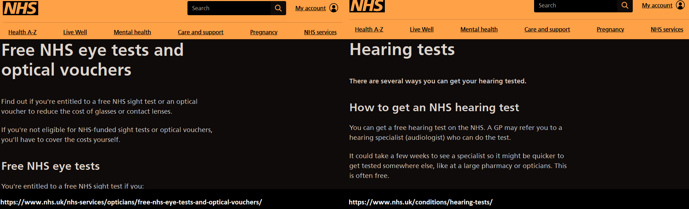
https://www.nhs.uk/nhs-services/opticians/free-nhs-eye-tests-and-optical-vouchers/ https://www.nhs.uk/conditions/hearing-tests

Slide 21
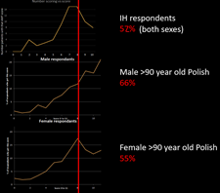
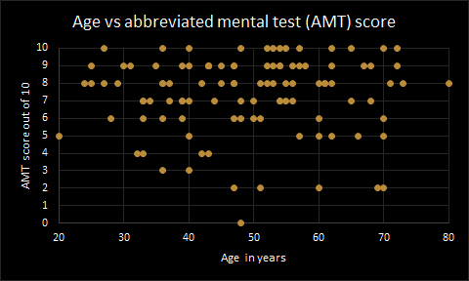
Abbreviated mental test (AMT) and capacity
55% scored ≥8
  Wide range of scores per age
No difference M vs F
Equivalent to 90 year old Polish people
Some of the questions may not be ‘fair’
  WW2, UK PM
Score <8/10 consider RUDAS (like the MMSE)
20% people were found to lack capacity*
  All documented on IH review only
Reasons were typically low AMT &/or mental health concerns (~50:50 distribution, or combination of both)
Notes:
* = acknowledging that you need a specific question to ‘lack capacity’ to answer
Polish study: Gender gap in health condition and quality of life at advance age
Dorota Rackiewicz, Przemyslaw Bejga
Annals of agricultural and environmental medicine: AAEM 27 (4)
2020 study based on data from 2015-18
870 female patients, 264 men, aged 90 or over
https://www.researchgate.net/publication/344088188_Gender_gap_in_health_condition_and_quality_of_life_at_advanced_age

Slide 22
Mental health
65% had historic MH issues
  Included if documented in the notes despite denial by interviewee
30% had been in a MH institution
  Again included if in notes but denied
  Did not assess whether attendance voluntary or under section
Acute MH concerns 35% of people
  50% on assessment by IH team
3 people sectioned from IP during IH admission
  2 due to concerns raised by IH team
Like cognition and capacity, acute MH is a significant issue with IH inpatients

Slide 23
Recommendations
Assessment of cognitive ability
And acute mental health state
Consideration of person’s capacity
  This would be of particular importance when initiating a new treatment
    Such as treatment of Hepatitis C virus

Slide 24
Accommodation
65% in non-permanent, ‘unreliable’ accommodation
  On the streets, in a hostel/hotel/ B&B, or sofa surfing
65% unhappy in their accommodation
55% feel unsafe
These individuals are unlikely to improve or remain abstinent if we return them to the same, unreliable accommodation from whence they came

Slide 25

Duty to refer (D2R)
Homeless reduction act 2017
“A duty on specified public authorities to refer service users who they think may be homeless or threatened with homelessness to local authority homelessness/housing options teams”
  “Hospitals in their function of providing inpatient care”
  Includes people who are “homeless but not roofless”
The individual must consent to D2R and can chose their local authority
  But more likely to gain traction if they have a “local connection”
  In practise: we tend to refer to the authority the person has been living in most out of the past 5 years, including several patients who have been referred to other cities
  But this is not a requirement for completing the D2R
This is a duty, meaning something we are required to do as standard with these people
https://www.gov.uk/government/publications/homelessness-duty-to-refer/a-guide-to-the-duty-to-refer

Slide 26
Dependence
65% active smokers
  Pack year estimates unreliable
35% not on NRT who might’ve benefited
  Equivalent number of patients were prescribed NRT
  High rates of refusal
    Including to smoking cessation
People either drank from the moment of waking (40%) or denied completely (40%)
  Predominantly ++++ alcohol each day, or none at all
Similar for class A drug use (CADU)
  40% active versus 50% never used
    Like with smoking and alcohol there is likely significant under reporting of active/ex-use
Significant underuse of OST in the hospital
  40% of people not on appropriate OST
  Only one of these had a valid reason (nil by mouth)

Slide 27
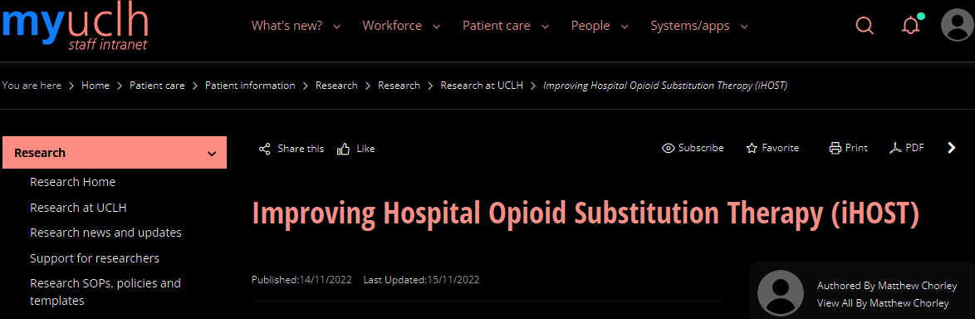
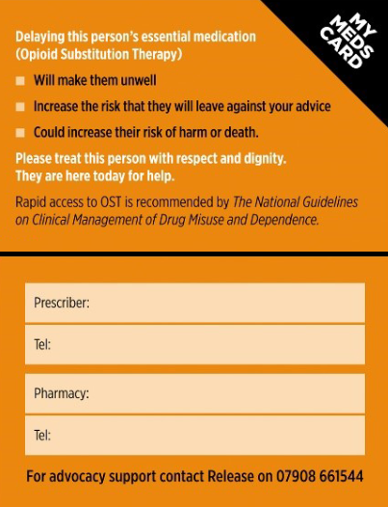
Improving hospital opiate substitution therapy (OST)
Research on initiation and use of OST in hospital has shown:
  Wide range of different practises across the NHS
    Including a great deal of judgemental, even discriminatory, language and terminology
  The time on discharge from hospital is high risk for potentially lethal overdose
    Equivalent to release from prison
The iHOST project is an attempt to change this
  New guidelines, now in place and in use at UCH
    Emphasis on early prescription of OST (typically methadone)
    Removal of barriers to this (need for urine toxicology)
    Encouragement of higher, but still safe, initial dosing if OST naive
  Cards to make it easier to confirm community dosing
    These give telephone numbers to contact; they are not proof of dose
Notes:
Professor Magdalena Harris
Dr Dan Lewer
Fatal opioid overdoses during and shortly after hospital admissions in England: A case-crossover study
Dan Lewer ,
Published: October 5, 2021
https://doi.org/10.1371/journal.pmed.1003759

Slide 28
UCH guidelines on OST before and after iHOST
Pre iHOST guidelines
Post iHOST guidelines
Title: Managing Drug Misusers
Requirement for urine toxicology result prior to commencement
  Turnover of ~24 hours
10mg twice daily starting dose
  5-10mg 4 hourly as needed (maximum 20mg in 24 hours)
  Alternative provision for continuation of community dosing
    After urine toxicology result & confirmation of dose with community team
No provision for dose adjustment within initial admission
No provision for continuation in the community
Title: prevention and treatment of opioid withdrawal in hospital
Nil requirement for urine toxicology (at all)
20mg once a day starting dose
  10mg 4 hourly as needed (maximum 20mg in 24 hours)
  Provision for more if ‘senior decision maker’ approves (SpR/cons)
  Alternative provision for continuation of community dosing
    Once confirmation of dose with community team
Add starting dose to PRN doses and increase from day two
  Provision for further increased during admission (alt. days)
Must ensure continuation of OST in the community
  Including provision for staying in hospital if not arranged
  Or discharging with ‘bridging doses’ to cover till take over of prescription in community

Slide 29
Outcomes post iHOST
Still too early to say for sure
But we are seeing a noticeable uptick in OST prescription
  Up by ~50% compared to pre-iHOST levels
The problems we are seeing are predictable:
  Downtick after junior doctors change jobs
    Need for regular repeat teaching
  Over-reliance on drug and alcohol liaison service (DALS) to initiate
    Particularly in surgical specialties
  Poor provision for arrangement of community of OST on discharge
    In absence of DALS, or ward pharmacy, efforts in this area
It is still very early days so all these are rough opinions based on analysis of three months’ worth of patients since iHOST initiated

Slide 30

Blood tests
60% male people and 45% female people anaemic
  20% folate deficient
  Likely high rates of iron deficiency
    Hard to assess in acutely unwell people as acute illness can alter iron levels
Sodium, potassium, phosphate and other salts low
  Like anaemia, this is most likely due to diet for the most part
80% people tested are vitamin D deplete
  Almost 50% of interviewees have history of fractures
4 people diagnosed as diabetic, and 16 as pre-diabetic

Slide 31
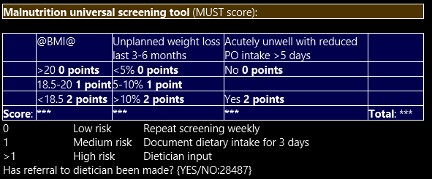
Malnutrition
Assessed via the Malnutrition Universal Scoring Tool (MUST)
  Use estimate for height & weight if none done
IH request dietician review if indicated (45%)
But: build-up shakes have high re-sale value on the street
  Dietetics team therefore reluctant to discharge IH individuals with these treatments
  Which may explain review rate
Overall IH individuals seemed disinterested in nutrition, ‘Not bothered’ about dietician input

Slide 32
Hepatitis C virus
30% of people tested were positive for HCV Ab
25% of these (8 in total) had a detectable viral load
For the most part these were known HCV positive, but lost to follow up
  UCLH has a fantastic community team who are able to follow these people up on the streets, going to their homes/where they bed down, performing fibroscans and blood tests, consenting for treatment, distributing meds, and following them up
  Very low rate of referral to this team by UCH itself (increased 800% by IH team!)
  This will hopefully change with the adoption of opt-out HCV (& HBV) testing in UCH ED, complimenting our existing opt-out HIV testing
    London’s rate of HIV is >2/1,000, meaning opt-out testing for HIV is recommended by BHIVA
FIB-4 score can offer a potential alternative to a fibroscan/elastography
  https://www.hepatitisc.uw.edu/page/clinical-calculators/fib-4
Notes:
BHIVA = British HIV Association
BASHH = British Association for Sexual Health and HIV

Slide 33
Other scoring systems
Scoring system
In our patients
Qrisk3
  https://qrisk.org/three/
  10 year risk of heart attack and/or stroke
FRAX
  https://www.sheffield.ac.uk/FRAX/tool.aspx?country=1
  10 year risk of hip fracture or major osteoporotic fracture
ACE (new addition to the HIPA)
  https://www.cdc.gov/violenceprevention/aces/index.html
  Adverse Childhood Experiences
Average patient age 49.0
  Qrisk3 predicted patient age 62.7
  Average odds ratio 14.2% vs 5.1% (~x3 risk)
National Osteoporosis Guidelines Group recommend intervention in 80% of patients tested by IH team
  DEXA scan &/or treatment (vitamin D optimisation then bisphosphonates) &/or specialist referral
Higher the score the higher the chance of medical, psychological, and substance misuse issues

Slide 34
Recommendations
Prevention of fractures, and appropriate management when they occur, is very important, as is taking what opportunities we can to improve nutrition and housing
  Very difficult to stop taking class A drugs if you have chronic pain from a vertebral insufficiency fracture, or nerve damage from folate deficiency
Long term management, of nutrition and cardiovascular risk for example, is a little harder
  IH individuals are often not interested in managing a 10 year risk profile
But interventions with discernible benefit, such as for HCV, are often very welcome, provided we can work around the individual’s needs and limitations
  UCH’s find & treat blood borne virus team are a great example of this

Slide 35
Repeat disclaimer
For those in the audience with lived experience of Inclusion Health issues the next section may be particularly upsetting
We apologise in advance if any of this is upsetting to any of you, and completely understand if any of you need or want to pop out during this part

Slide 36
How did they end up in this life?
Three main routes
  Challenging childhood with high rates of physical, mental, and sexual abuse
    Leads to ‘falling in with the wrong crowd,’ reduced attendance at education, and potential progressive use of alcohol and/or street drugs leads to addiction
      Escaping a difficult homelife, but cannot leave it completely
    Or attempts to blunt resulting physical and emotional trauma with alcohol and/or street drugs leads to the development of addiction
      Numbing a difficult homelife, as cannot escape it
  Single major trauma, often psychological or major head injury
    ‘My life changed for the worst after that event’
  ‘Routine’ consumption, often starting in youth, led to a slow descent into dependence
    This is the route predominantly reported by non-UK EU nationals who have been seen
Of these a challenging childhood appears to be the predominant cause, particularly in class A drug users

Slide 37
Evidence
70% problematic childhood
  Likely underestimated
Limited schooling
Minimal qualifications
Childhood abuse
Taken into care
HMP
Employment

Slide 38

When seeing the adult…
…remember the child
It is difficult to imagine the impact of sustained abuse in in childhood on the chances for achieving a happy, healthy, ‘productive’ life
The adult in front of us has a high chance of having been brought up in a psychologically devastating environment, possibly even prior to birth
While we don’t argue that this forgives socially challenging behaviour, whether in hospital, on the streets, or in other walks of life…
…We would strongly urge you to consider the Adverse Childhood Experiences test, once establishing a rapport with your client, to ascertain how circumstances might have been loaded against them from a young age
  There is a physical as well as mental burden from a challenging childhood
https://www.cdc.gov/violenceprevention/aces/index.html

Slide 39
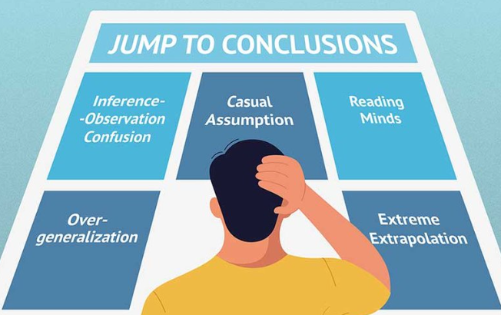
Conclusions

Slide 40

The ‘actual’ UCH IH patient
50 year old Caucasian male from the UK
Only 50:50 chance of good engagement with NOK and/or GP
High risk of acute mental health problems &/or lacking capacity to consent for medical interventions
Doesn’t typically pass away from ‘IH things’
  VTE, TB, IE, overdose, or exposure
Tends to pass away from the same things our frail, older population do
  Heart attack, stroke, end stage lung disease, and malignancy
  But on average 21 years earlier: 12 of 146 people seen have passed away, all within a year of review
  Average age was 60, oldest was 72, youngest was just 28; UK average age of death is 81 (2022)
Presents late, often with advanced illness
  When they can’t function adequately to access alcohol/narcotics in the community
Really does not want to be in hospital
  Aware that they won’t get alcohol or narcotics, and may well not get prescribed OST
  Really does not want to go into withdrawal on top of acute illness
Can change with the right kind of holistic support, and the desire to do so
  But this is seldom a priority during forced, acute attendance to ED/hospital
  “People seldom come to hospital specifically to stop using heroin”

Slide 41
Take home messages
New clothes – quite a small thing, makes a big difference
New phones – more challenging, but very important
  Ability to access the internet and knowledge of which sites to use is hugely helpful to this group
Fractures – very high rate of historic, and acute, fractures
Capacity – 20% of people considered to lack capacity for moderate or complex decision making on their medical management
MH – very high rate of chronic, acute, & acute on chronic MH issues
  With very high rate of historic admission to IP MH
Withdrawal prevention – lots of people not on nicotine or opiate substitution therapy who might benefit
  Latter improving since the implementation of iHOST
Housing – 65% in unreliable accommodation
  65% unhappy in their accommodation, 55% unsafe
  These people are unlikely to continue to improve after discharge if we discharge them back to these places
Anaemia
Risk of diabetes – likely a result of chronic pancreatitis
Routine screening – there appears to be a benefit to testing for vitamin D, HIV, (HBV), and HCV
MUST – recommend screening for malnutrition
Qrisk3 – odds ratio ~3.0 for IH cohort
FRAX – IH group are high risk for future #’s; also evidenced by ~50% with history of fracture
Safeguarding and duty to refer
OP optometry and audiometry input

Slide 42

In summary
We are hopefully on the cusp of publishing some good quality data on best practise when it comes to the IH population in north central London
  And will (again hopefully) come up with some simple interventions that may reduce the overall need, within the cohort, to come to hospital
    This is of financial advantage to the NHS
    But, most importantly, is of significant benefit to the IH population who, as a group, do not wish to be in hospital and are actively fearful of going into withdrawal as a result of admission, with the related stigma, broken down relationships, missed appointments, and other consequences of this
The goal is to create an evidence based ‘quick-HIPA’ that anyone can do as standard during a 15-30 minute consultation, with high impact
UCLH is leading the way in the NHS
  Thanks to the Trust’s increasing focus and commitment to the IH population, both in and out of hospital, in keeping with NICE: in particular our commitment to ‘safe discharge’
But the biggest conclusion we have come to is that these patients need a great deal of the most precious resource available to the NHS...

Slide 43

The most important resource in the NHS
Time
IH patients are typically standoffish, fearful, undereducated, stigmatised, and generally believe they get treated (at best) as second class citizens in the NHS
Our findings suggest they have complex, underappreciated health needs, particularly related to mental health issues, and the desire to avoid going into withdrawal, which is a huge concern for them
  They often ‘kick off’ quite quickly due to a combination of these factors
A busy ED is the last place they want to be
The greatest thing the UCH IH team has to offer is being able to take the time to sit down, get to know, and learn all about these patients as individuals, often identifying numerous problems in the process, particularly related to housing and mental health
Identifying and helping with these problems allows us to begin to regain these patients’ trust, get them out of unsafe living environments, and helps prevent further admissions, ultimately saving them and us the most important thing for everyone...
Time And bed days: 12% reduction in usage at 6 months & 15% at 12 months after IH review (52 patients)

Slide 44
Thank you all for listening
Are there any questions?
I’d be delighted to hear your thoughts on what you’ve just heard, and answer any questions in the time available Apologies if I’ve overrun
07773 664 367
JamesNorman1@NHS.Net
With thanks to so many people, too many to count, but particularly:
Tim, Josie, and Flo of the UCH homeless team
Al, Julian, John, Indrajit, and colleagues from the Find & Treat teams
Lauren, Jubily, Lucy, Selene, and the CAPP team
Sainab and colleagues in the HIC team
Debra and the whole safe discharge team – I’m sorry for all the safeguarding referrals and delayed discharges
Ben K and the GIM consultant team, plus the AMU & SDEC nursing, OT, PT, pharmacy, and all other services on the two units
Mel, Hannah and other members of the management team who work tirelessly in the face of ever mounting challenges to UCLH, AMU, & the NHS
Dr Smith and the MHLT – thank you for seeing so many people so quickly!
Prof Harris, Marisha, and everyone else involved in iHOST
Tim, Marc, and Annie from ED
Alex Bax and the Pathway charity, without whom the concept of IH would likely not even exist
Mike Brown, without whose support, patience, judgement, and drive (not to mention attention to detail) the IP IH service would’ve progressed at ¼ of the speed, if at all
& everyone else who’s had to meet and put up with me over the past 18 months!
Massive apologies to anyone I’ve left out!

