Slide 1

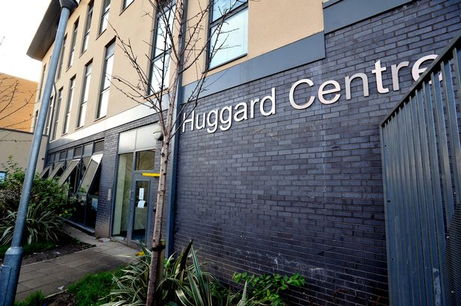

POCT PROJECT:
CARDIFF AND VALE
MORGAN CUTLAN
POINT OF CARE TESTING (POCT) PRACTITIONER
Notes:
Hello, my name is Morgan Cutlan and I am a point of care testing practitioner - today I will be presenting on how POCT was used to rapidly identify active HCV infections so pt. could be referred to the BBV nurses in order to start treatment soon as possible

Slide 2
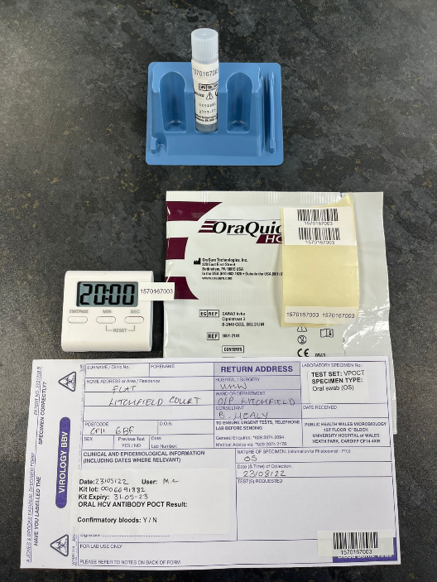
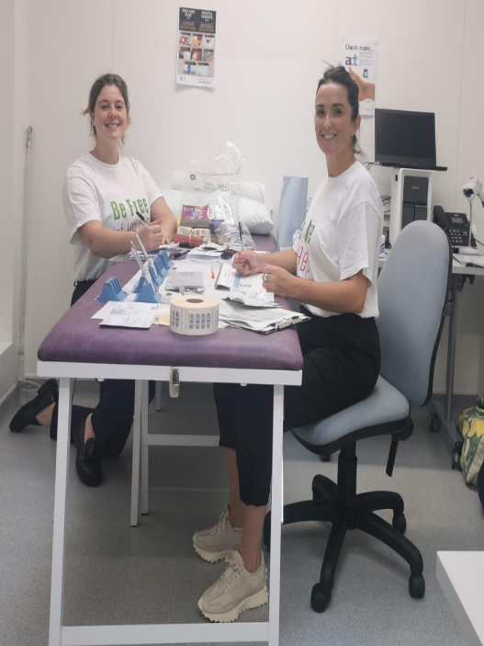
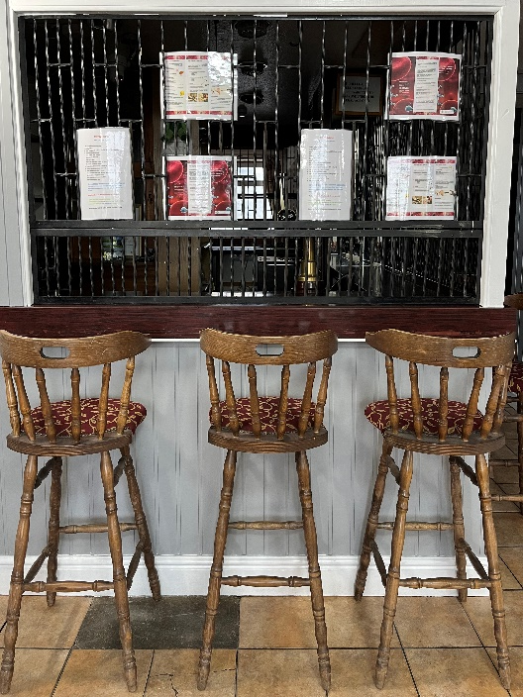
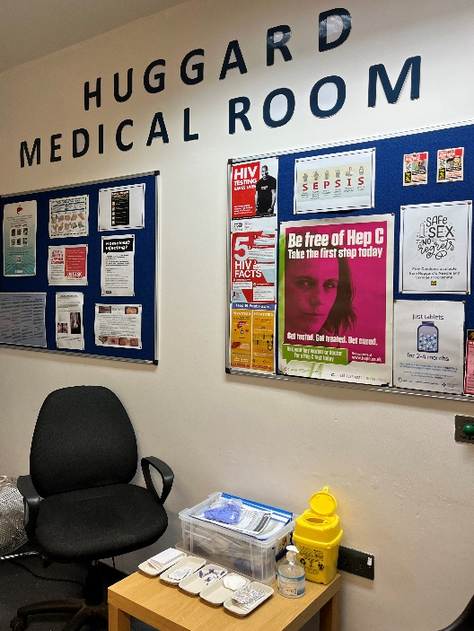
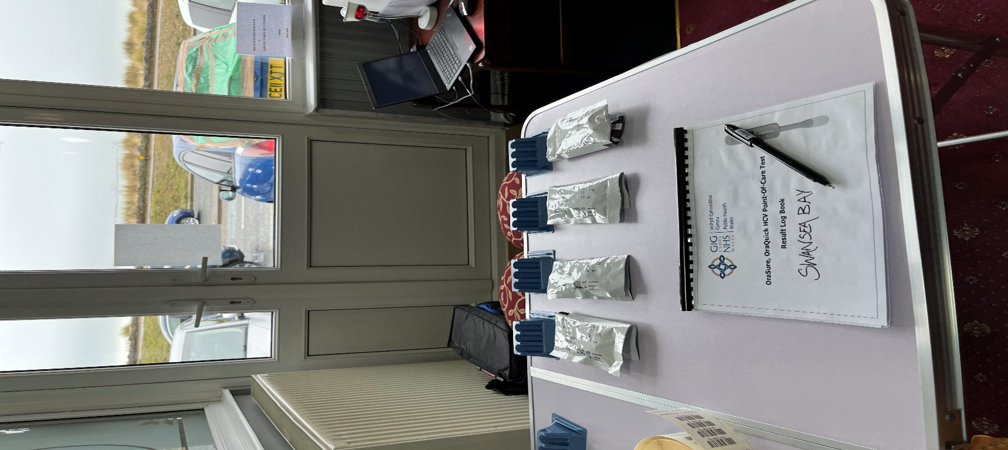
Point of Care Testing (POCT)
Diagnostic testing that is performed by or near to the patient – in this case the OraQuick OraSure Mouth swab was used

Slide 3
BACKGROUND
BBV Specialist Nurses Lorraine Wall and Sarah Nicholas have run weekly BBV clinics at Huggard since 2017
Observation: learning best clinical practise from BBV nurses and DBST training
POCT mouth swabs and micro-caps brought into the BBV clinics
Micro-cap HCVPCR results ready Thursday morning – next Huggard clinic not until the following Wednesday
POCT’ing the day prior to the nurses clinic would allow for rapid result turn around – thus the POCT Xpress Pathway was born..!
Notes:
BBV Nurses Lorraine Wall and Sarah Nicholas have run BBV clinics at Huggard on alternating Wednesdays since
As part of my POCT training I spent time learning best clinical practise and how to perform DBSTs with the BBV nurses
POCT was introduced during these clinics
Inspiration of running b2b BBV clinics days
Day one = testing and day two more of a follow-up/treatment orientated clinic
Huggard Key workers trained to do DBST independently

Slide 4

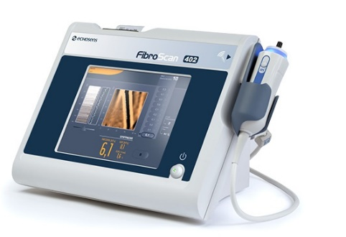
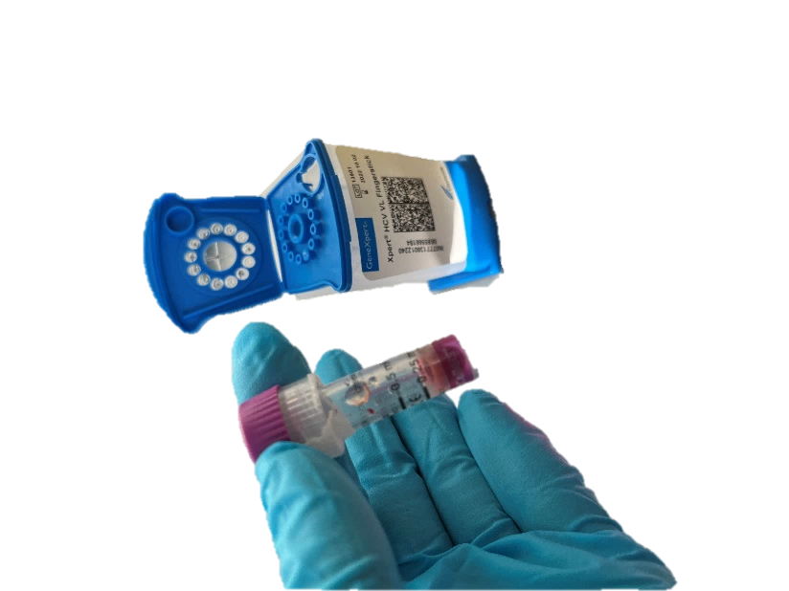
FRAMEWORK: POCT Xpress Pathway
DAY ONE (Tues): Testing (OraSure, DBST and HCVPCR micro-capillary)
DAY TWO (Weds): Referral of Patient to BBV Nurses
DAY FOUR (Fri): Fibroscan and Treatment Plan
Day 7/Day 1 of new cycle: Results back from DBST performed previous week; any co-infections highlighted and the process is repeated.
Notes:
this is the framework of the pathway:
With Day one consisting of testing
Tests offered:
Dried Blood Spot Test (DBST)
OraSure Oral Swab
20-40 min – results given to pt. that day
Hepatitis C Antibody result
Micro-container
Results ready same day as taken –given to pt. following morn (next slide)
Hepatitis C active infection result – viral load
Two tests were offered:
Dried blood Spot test (DBST)
And the POCT orasure mouth swab
The OraSure oral mouth is a game changer for a rapid 20-40min result turn around time which made it much easier to call pt back for further confirmatory tests
Reactive oral swabs were followed up with a micro-container which would then be put on the Cepheid for a rapid HCVPCR within 1 hour
Meal voucher incentives !!
Day two being a hand-over day / consultation with the BBV nurses Lol and Sarah
Day two acted as referral day with any new HCV infections picked up from the previous day were highlighted to the BBV nurses Sarah Nicholas and Lorraine wall as well as any other findings from the day prior – pt who’s microcap came back with an RNA not detected result.
During this consultation, the pt would be informed of their HCV status, and introduced to key workers for support as well as booked in for a fibroscan at DATT that friday
Referral of RNA detected pts to Lol W and Sarah N for tx
Diagnosis given
Education about possible exposure risks
Fibroscan appointment booked for that Friday
Sign posting to support groups
Introduction to Hep C Peer/CAVDAS key worker Huw Rowles
Day four “Fibroscan Friday”
Pick up by Key worker at Huggard
Huw Rowles (Huggard/CAVDAS)
Hep C Trust peer
Escorted to DATT for Fibroscan appointment with Specialist BBV Nurse: Sarah Nicholas or Lorraine Wall
Fibroscan performed to assess liver damage
Help determine most appropriate treatment plan
LFT or any other additional bloods performed
Help determine most appropriate treatment plan
Patient would be picked up at Huggard by key worker – usually Huw Rowles or Kieran Olds – and escorted to DATT for their Fibroscan appointment.
This was a helpful tool for ensuring pt attended their appointment - I particularly like aspect of the pathway as there’s often a lot of anxiety surrounding new diagnosis and I found this allowed pt to feel supported during what could be a scary time.
finally day 7 where DBST’s from previous testing day were given back to pt and the cycle refreshed

Slide 5
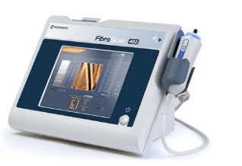
FRAMEWORK: POCT Xpress Pathway
OraQuick, OraSure Mouth Swab (HCV ANTIBODIES)
NON-REACTIVE
No Hepatitis C Exposure
REACTIVE
Hepatitis C Exposure
No Further Action Required
Retest 3-6 Months Time
Follow up HCVPCR
RNA DETECTED
Active HCV Infection
RNA NOT DETECTED
No Active HCV Infection
No Further Action Required
Retest 3-6 Months Time
Fibroscan/Treatment
Signposting to Support

Slide 6
FRAMEWORK: POCT Xpress Pathway
DAY ONE (Tues): Testing (OraSure, DBST and HCVPCR micro-capillary)
DAY TWO (Weds): Referral of Patient to BBV Nurses
DAY FOUR (Fri): Fibroscan and Treatment Plan
Day 7/Day 1 of new cycle: Results back from DBST performed previous week; any co-infections highlighted and the process is repeated.
Notes:
this is the framework of the pathway:
With Day one consisting of testing
Tests offered:
Dried Blood Spot Test (DBST)
OraSure Oral Swab
20-40 min – results given to pt. that day
Hepatitis C Antibody result
Micro-container
Results ready same day as taken –given to pt. following morn (next slide)
Hepatitis C active infection result – viral load
Two tests were offered:
Dried blood Spot test (DBST)
And the POCT orasure mouth swab
The OraSure oral mouth is a game changer for a rapid 20-40min result turn around time which made it much easier to call pt back for further confirmatory tests
Reactive oral swabs were followed up with a micro-container which would then be put on the Cepheid for a rapid HCVPCR within 1 hour
Meal voucher incentives !!
Day two being a hand-over day / consultation with the BBV nurses Lol and Sarah
Day two acted as referral day with any new HCV infections picked up from the previous day were highlighted to the BBV nurses Sarah Nicholas and Lorraine wall as well as any other findings from the day prior – pt who’s microcap came back with an RNA not detected result.
During this consultation, the pt would be informed of their HCV status, and introduced to key workers for support as well as booked in for a fibroscan at DATT that friday
Referral of RNA detected pts to Lol W and Sarah N for tx
Diagnosis given
Education about possible exposure risks
Fibroscan appointment booked for that Friday
Sign posting to support groups
Introduction to Hep C Peer/CAVDAS key worker Huw Rowles
Day four “Fibroscan Friday”
Pick up by Key worker at Huggard
Huw Rowles (Huggard/CAVDAS)
Hep C Trust peer
Escorted to DATT for Fibroscan appointment with Specialist BBV Nurse: Sarah Nicholas or Lorraine Wall
Fibroscan performed to assess liver damage
Help determine most appropriate treatment plan
LFT or any other additional bloods performed
Help determine most appropriate treatment plan
Patient would be picked up at Huggard by key worker – usually Huw Rowles or Kieran Olds – and escorted to DATT for their Fibroscan appointment.
This was a helpful tool for ensuring pt attended their appointment - I particularly like aspect of the pathway as there’s often a lot of anxiety surrounding new diagnosis and I found this allowed pt to feel supported during what could be a scary time.
finally day 7 where DBST’s from previous testing day were given back to pt and the cycle refreshed

Slide 7
FINDINGS
107
Tests Performed
58
People Tested
5
RNA Detected
4
On Treatment
Notes:
We ran 5 clinics over 7 weeks and
OVERALL A TOTAL OF …. TESTS WERE PERFORMED WITH … DBSTS …. OS AND …. HCVPCR
We new …. New HCV infections

Slide 8
41% oral swab
10% microcap
= 51% POCT (49% DBST)
All RNA detected were scanned same week as being told HCV status – this is with particular thanks to Lol and Kieran
Key workers and BBV nurses continued to test during this time
Reactives caught in a shorter time frame = less likely to transmit virus

Slide 9
EVALUATION
  Rapid output (Result) of POCT = Rapid outcome (treatment or peace of mind to vulnerable individuals) and is also complimentary to transient nature of pt. demographic
  Weekly service worked – massive participation encouragement from meal vouchers
  Resource Heavy – what’s needed for continuation and expansion to other services/health-boards?
  This pathway could not have existed without the hard work of the BBV nurses, Hep C trust peers and Huggard Harm reduction team
Notes:
Rapid nature of test/treat is complimentary to pt. lifestyle
Pt. demographic = transient
Rapid results = more likely to relocate and inform pt. of results
Reduced turn around time of results
Allows pt. who haven’t put themselves at risk to have peace of mind
Reduced spread
The faster pt. starts treatment the smaller the window that they can transmit virus if they continue to share personal items with other people.
POCT was crucial here for rapid result due to transient nature of pt.
What’s needed for continuation
Resource heavy
Full-team needed each week
Implementation in other services/health-boards
Weekly service necessary to due high turnover

Slide 10

POCT Tales
Pt. 1: Resourceful Chappy
Notes:
BBV Nurses Lorraine Wall and Sarah Nicholas have run BBV clinics at Huggard on alternating Wednesdays since
As part of my POCT training I spent time learning best clinical practise and how to perform DBSTs with the BBV nurses
POCT was introduced during these clinics
Inspiration of running b2b BBV clinics days
Day one = testing and day two more of a follow-up/treatment orientated clinic
Huggard Key workers trained to do DBST independently

Slide 11


MASSIVE THANK YOU TO…
Sarah Nicholas
Lorraine Wall
Lab staff at Wales Specialist Virology Centre (WSVC)
Huggard Harm Reduction Team
Huw Rowles (CAVDAS)
Hep C trust (KIERAN OLDS, JAMES BOLTON)
Louise Davies
Ryan Davies

Slide 12
Thank you for listening – Questions?

Slide 13
POCT Xpress Pathway: Summary
Overview:
POCT pathway with rapid HCVPCR to rapidly identify active HCV infections
Method:
OraSure mouth swabs Anti-HCV
DBST for HIV/HBV co-infections
HCVPCR via microcap* with follow up Fibroscan.
Novel equipment:
OraSure, OraQuick HCV POCT Rapid Antibody Test (mouth swab)
Cepheid GeneXpert Xpress RT HCVPCR
Started: 07/02/23 (5 clinics run; totalling 15 sessions)
Notes:
In my presentation today I will discuss how the poct pathway was introduced in a local homeless shelter called Huggard
The purpose of this pathway was to rapidly identify active HCV infections so pt. could be referred to the BBV nurses in order to start treatment soon as possible.
This was done with the use of novel equipment such as the orasure mouth swabs and Cepheid HCVPCR – which allowed me to perform the point of care testing.

