Slide 1

BBV
LDIG showcase event
Brendan Healy
Consultant in Infectious diseases and Microbiology and BBV lead for Wales and Cardiff

Slide 2
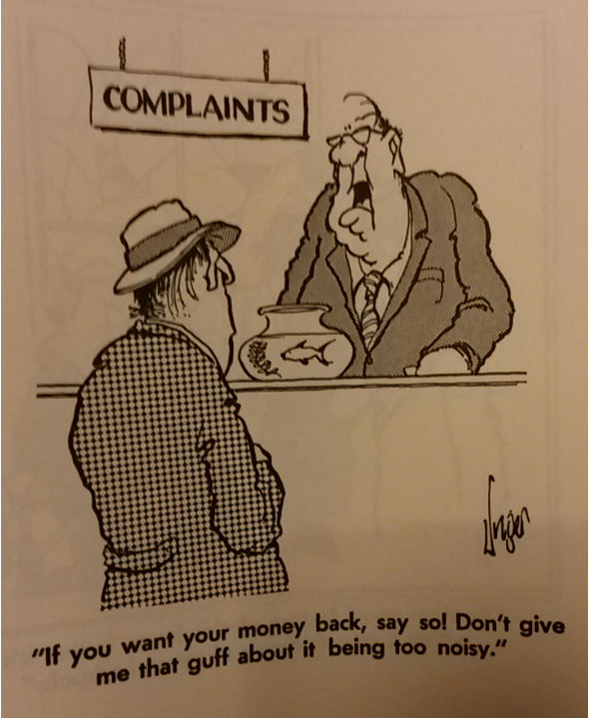

Slide 3

Achievements
National roles
BBV Network
Welsh Health Circular
Key performance indicators
Hepatitis C e form
No waiting lists for treatment
Medication – free to choose
Prudent healthcare
Equitable and transparent access
Vision for elimination#
ICNet
Rapid treatment pathways
Savings > £60M
Testing pathways
Pharmacy pathway
Prisons
Smart phone assisted video observed therapy
Peer workers
Street worker, Mosque, IPED projects
Asylum seeker
Harm reduction
Look back and reengagement exercise
Children and young people pathway

Slide 4
National roles – supported by LDIG
Brendan Healy – clinical BBV lead
Nicola Palmer – Project lead
Paul John – Pharmacy Lead
Louise Davies – POCT lead

Slide 5
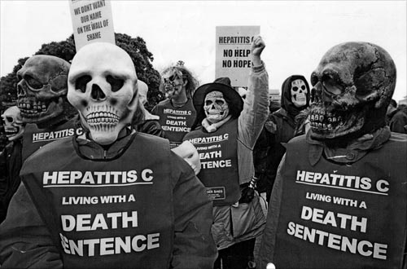

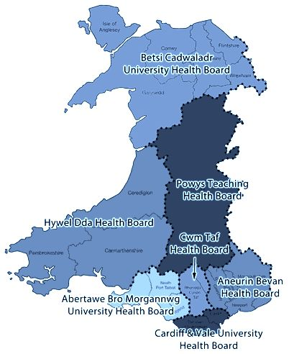


BBV Network

Slide 6
Money Saved

Slide 7
Cost savings
Year | National Procurement (list price) | Home Care (VAT) | Prudent prescribing (cheapest option) | Prudent prescribing (waiting for cheaper options) | Total
2015/2016 | £6M | £2.5M | £5M |  | £13.5M
2016/2017 | £8.5M | £2.3M | £7M | £3.1M | £20.9M
Total | £14.5M | £4.8M | £12M | £3.1M | £34.4M

Slide 8
Numbers treated

Slide 10
Numbers Cured

Slide 12
Projects

Slide 13
Successful projects (supported by LDIG)
2 POCT practitioners
Orasure testing
Microtubule testing
Street-workers
Community links
Community HITT projects
Video observed therapy
ICNet
Kidney transplants (first in UK)
Peer workers Cardiff

Slide 14
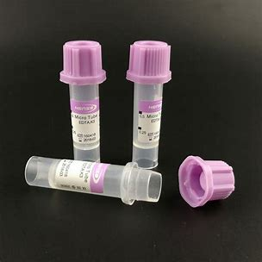
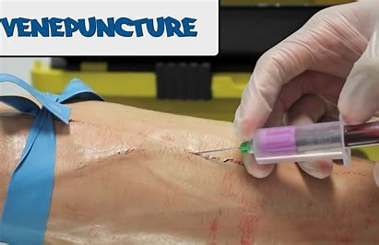
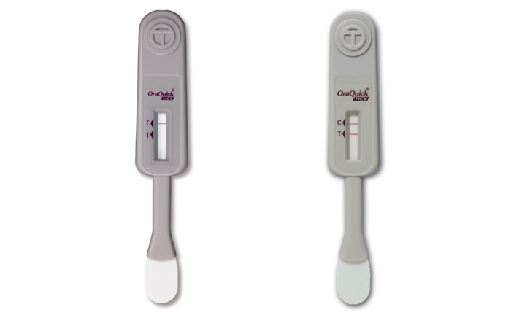
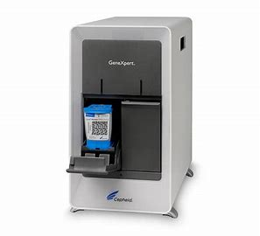
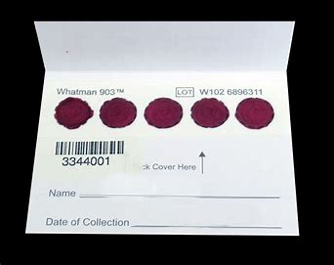
Testing pathway

Slide 15
Prison elimination

Slide 16
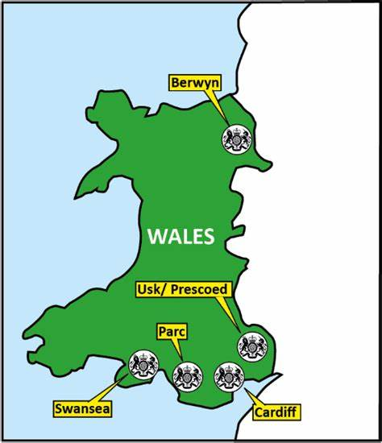

Prisons in Wales

Slide 17
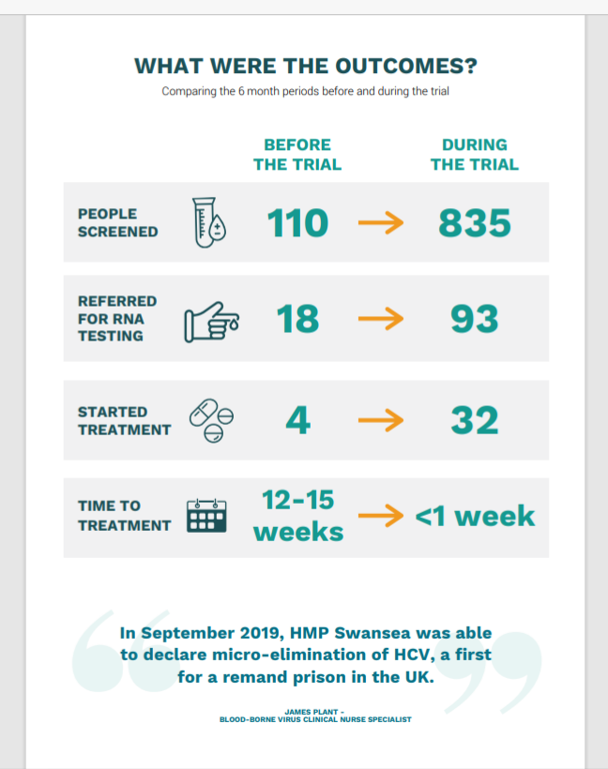
Swansea Prison
James Plant, Louise Davies et al

Slide 18
Prison | Type of prison | Number of prisoners | Number tested | Antibody positive | PCR tests | PCR positive | Treated | Set up date
Swansea | Remand | 219 | 1279 | 149 | 127 | 36 | 30 | 1/5/2021
Cardiff | Remand | 784 | 1000 | 65 | 65 | 20 | 20 (all within 3 days) | 16/5/22
Berwyn | Category C adult male | 2100 | 2071 | 145 | 219 | 46 | 34 | 21/7/2021
Parc | Category B local prison convicted male adult, young adults and young offenders | 1670 | 1622 (7 days) | 123 | 100 (microtubule) | 20
Usk | Category C adult vulnerable prisoners e.g. sex offenders | 273

Slide 19
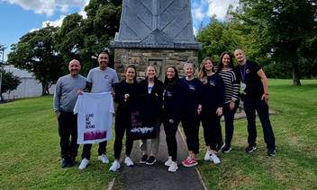
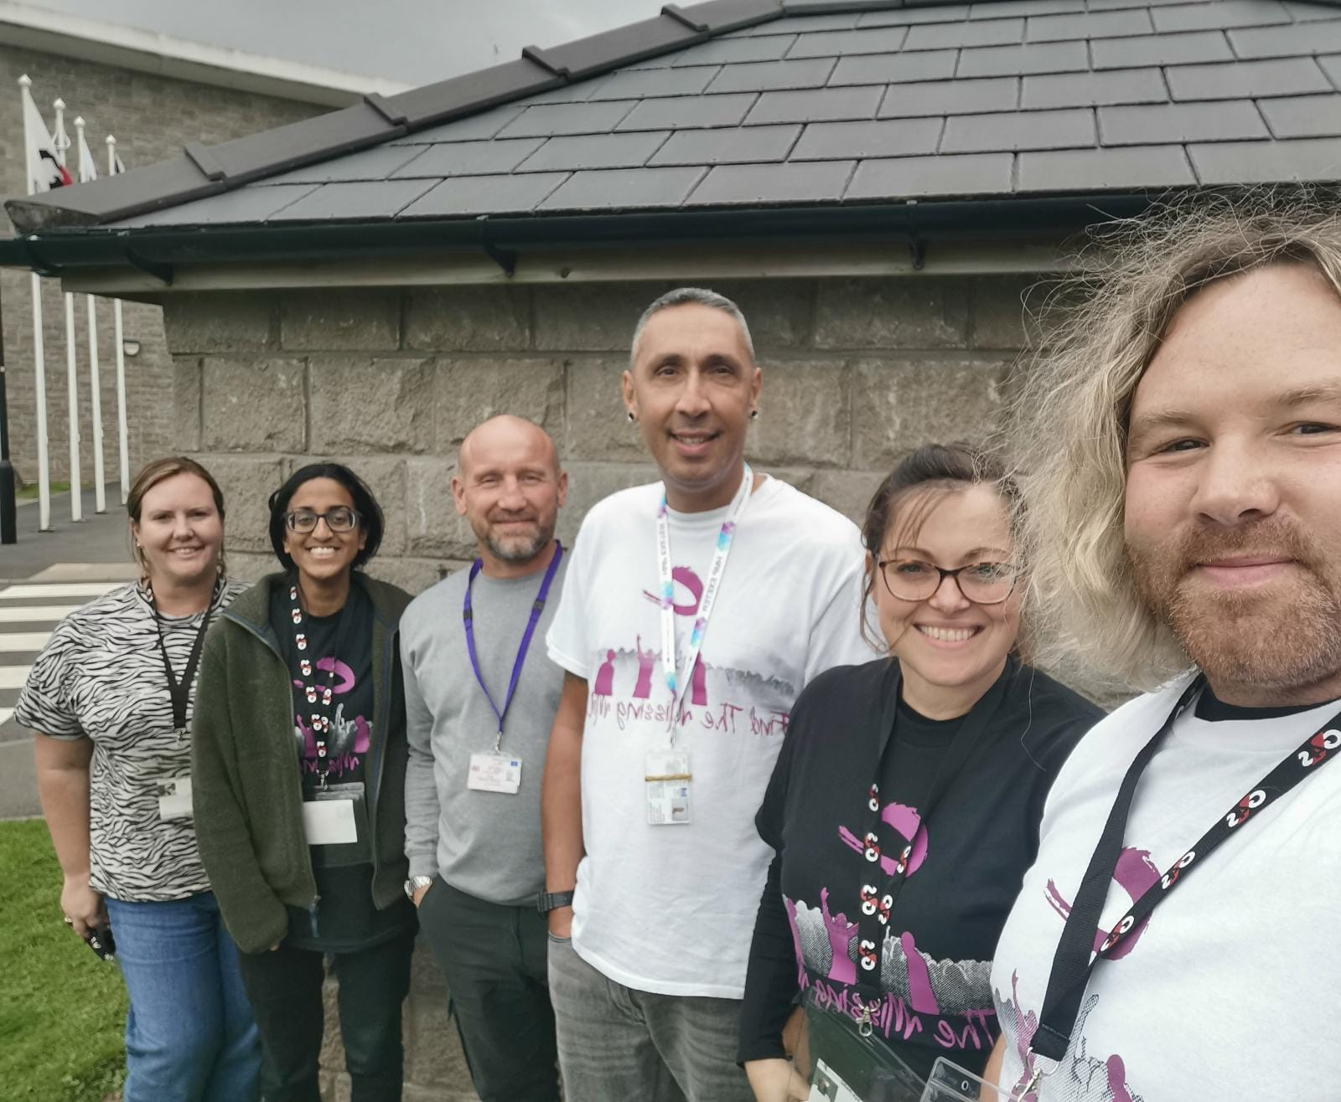
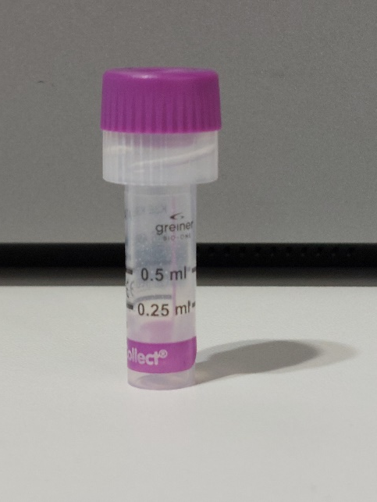
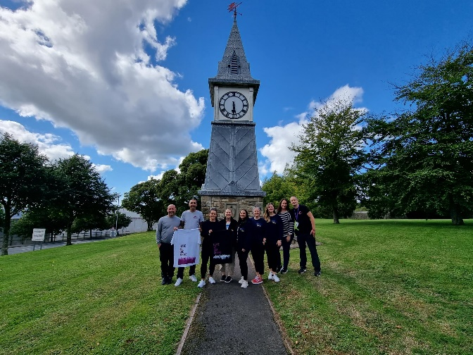
Parc Prison
1622 men tested - orasure in 7 days
1488 tested in 4 days
406 tested in 1 day
123 reactive tests
100 PCR so far (microtubule)
20 PCR positive

Slide 20
Impact on the wider Health service

Slide 25
Summary

Slide 26
Summary
Saved lives
Saved money
Reduced inequity
Delivered prudent, transparent and equitable health care across Health Board boundaries
Delivered care to the disadvantaged and marginalised
Delivered care built around the patient / client
Delivered UK and National firsts
Delivered innovation

Slide 27





In partnership with

Slide 28
The End

Slide 29

Questions

