Slide 2
Early Detection of Liver Disease: Past, Present & Future
Andrew Yeoman
March 14th 2023

Slide 3
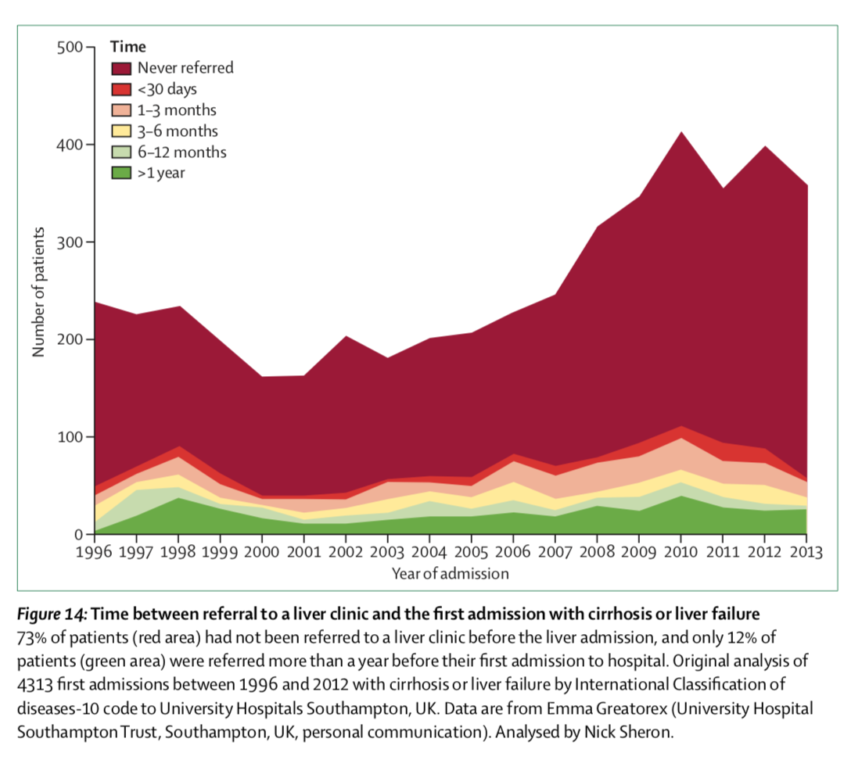
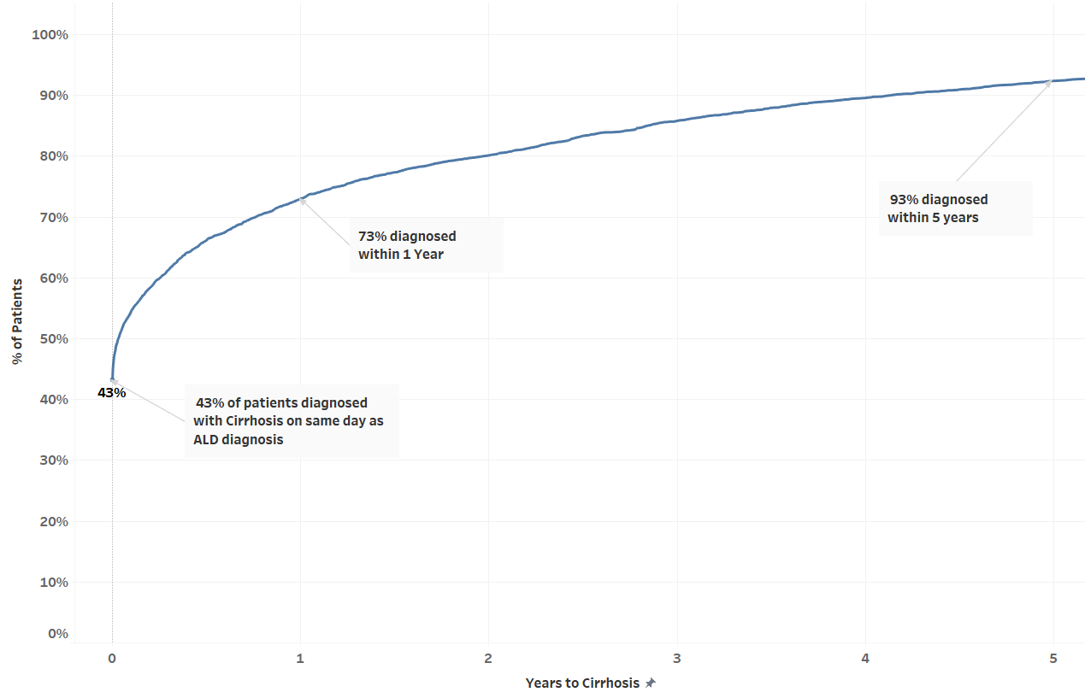
Late diagnosis of liver disease is common
4,544 ALD patients who developed cirrhosis
Williams et al. Lancet 2015:386;2098-2111
Wales Liver Registry

Slide 4
The UK Context
2016: 2 NICE Guidelines published
  Cirrhosis in over 16’s
  Diagnosis and management of NAFLD
2017: British Society of Gastroenterology Guidelines on the Management of Abnormal Liver Blood Tests

Slide 5
LDIG Approach
One of first LDIG activities was to commission a pilot project in ABUHB
Aim to ”reflexly” measure the AST when ALT abnormal for first time
If AST>ALT = increased risk of advanced fibrosis/cirrhosis
Direct to further testing predominantly via Fibroscan

Slide 6
Local Approach (GAP) Results: 2 Year Evaluation
17,770 patients with abnormal ALT
(8% of all LBTs)
89 (7%) known liver disease
2,117 (12%) AST:ALT >1
285 (38%) DNA Fibroscan
129 (9%) clear acute cause
103 (14%) known liver disease/other acute cause
750 (40%) referred
28 (2%) not referred & later diagnosed with cirrhosis
14 (2%) diagnosed cirrhosis w/out Fibroscan
348 attended for Fibroscan
Fibroscan <8kPa
N= 150 (43%)
Fibroscan 8-15 kPa
N=97 (28%)
Fibroscan >15kPa
N= 101 (29%)

Slide 7
Diagnosis in Patients Undergoing Fibroscan

Slide 8
Early Detection: A 4 Pronged Approach
Development of the liver blood test pathway
Production of an educational platform that also supports implementation
Increase diagnostic (Fibroscan) capacity
Additional pathways (NAFLD and ALD)

Slide 9
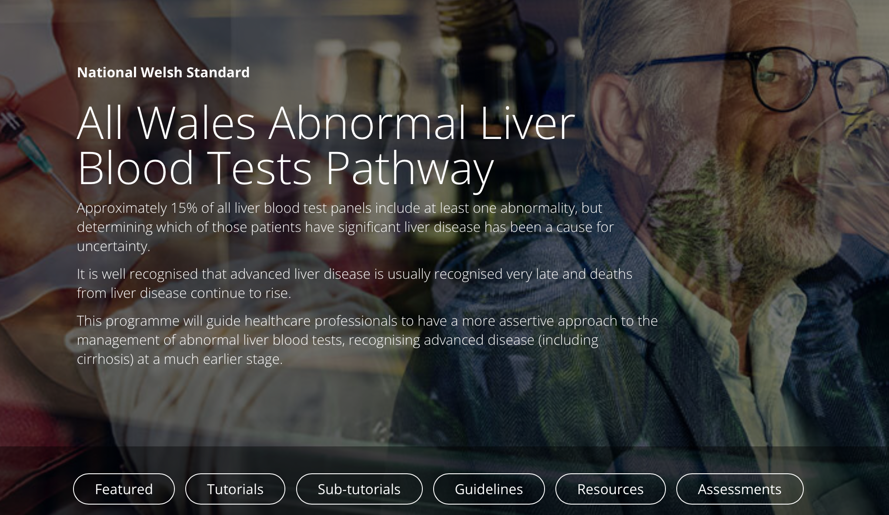

Slide 11
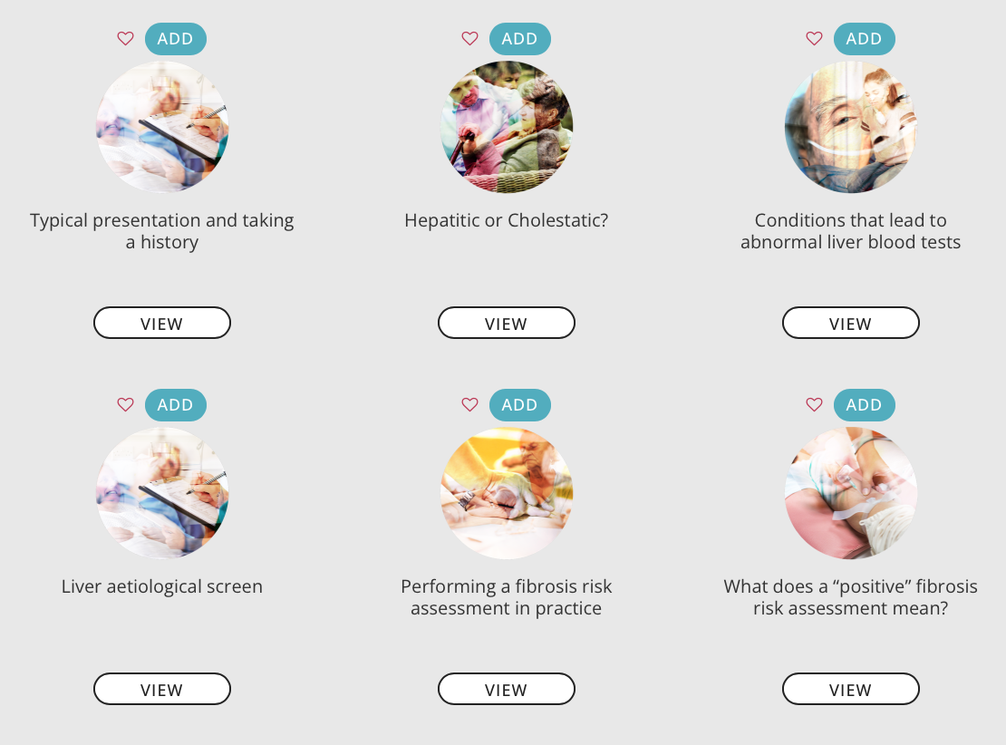
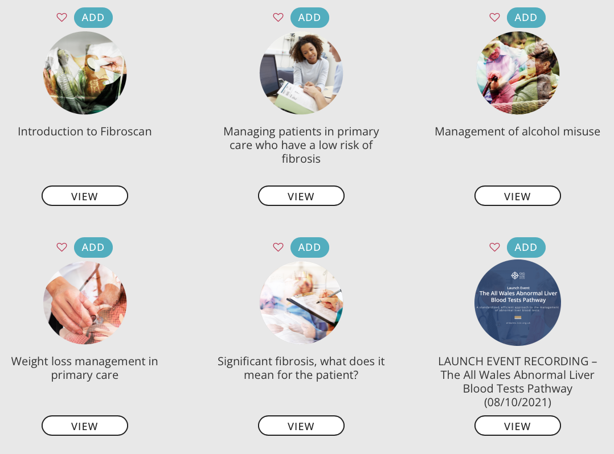

Slide 12
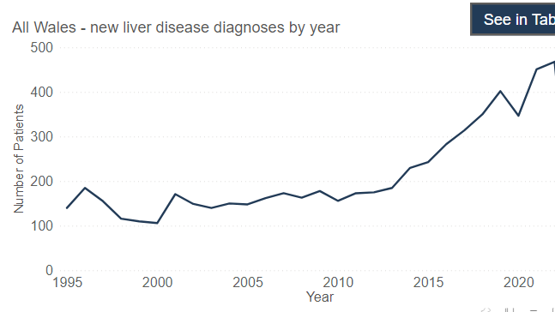
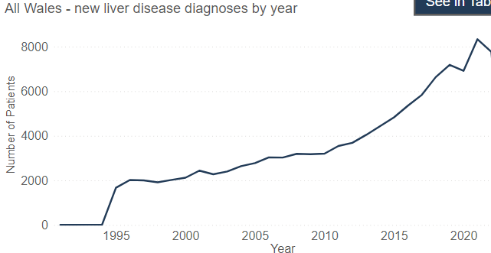
Liver Dashboard Data for Cirrhosis/All Liver Disease
Cirrhosis
All Liver Disease

Slide 13
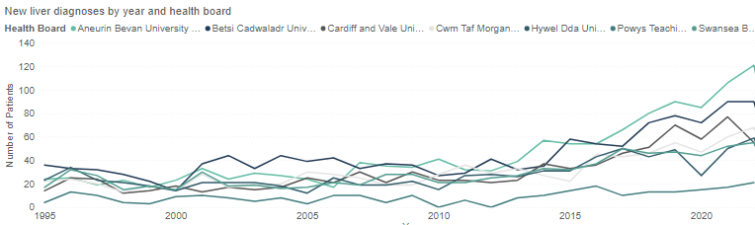
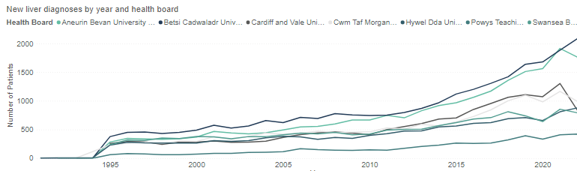
Cirrhosis
Cirrhosis
All Liver Disease
All Liver Disease

Slide 14
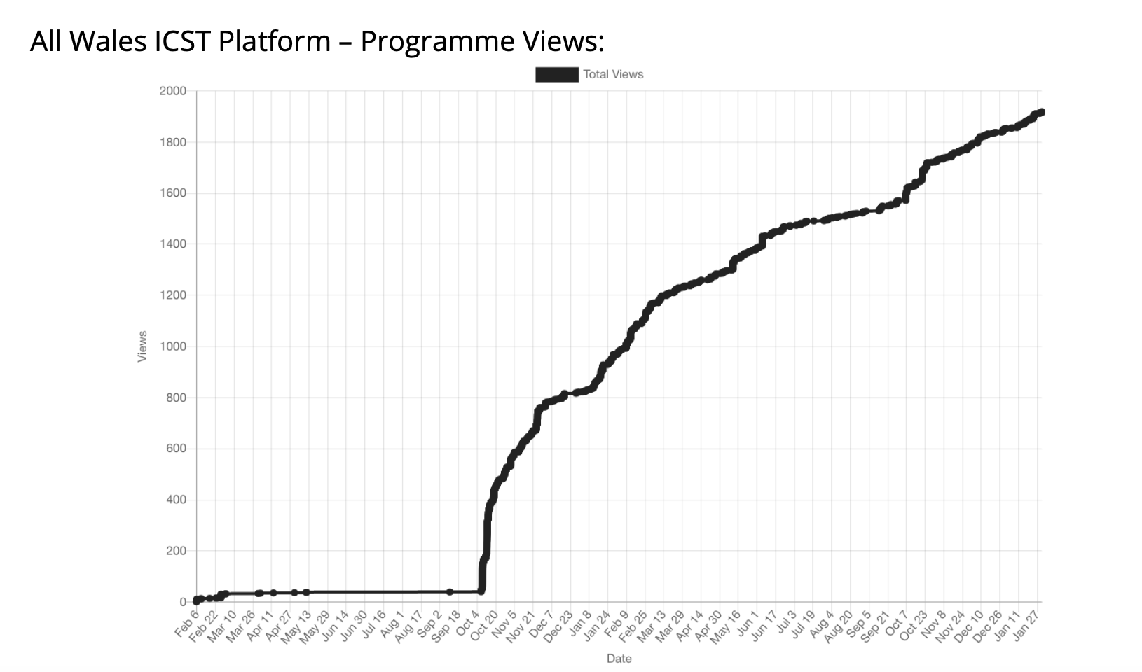
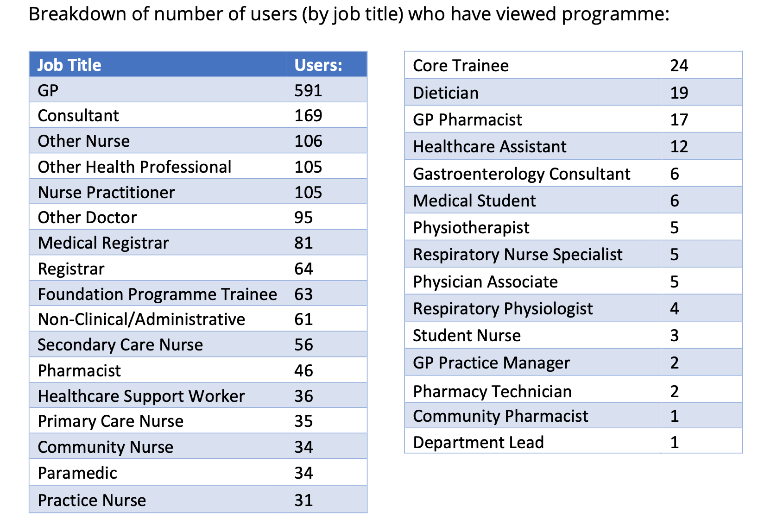
All Wales Liver Blood Test Platform Views

Slide 15
The Next Step
Improving early detection in other scenarios outside of those with abnormal liver bloods is also needed
Despite NICE Guidance the evidence base is a developing field
UK based published pathways show cost effectiveness across the patients lifetime but that is hard to recoup from Health Board budgets

Slide 16
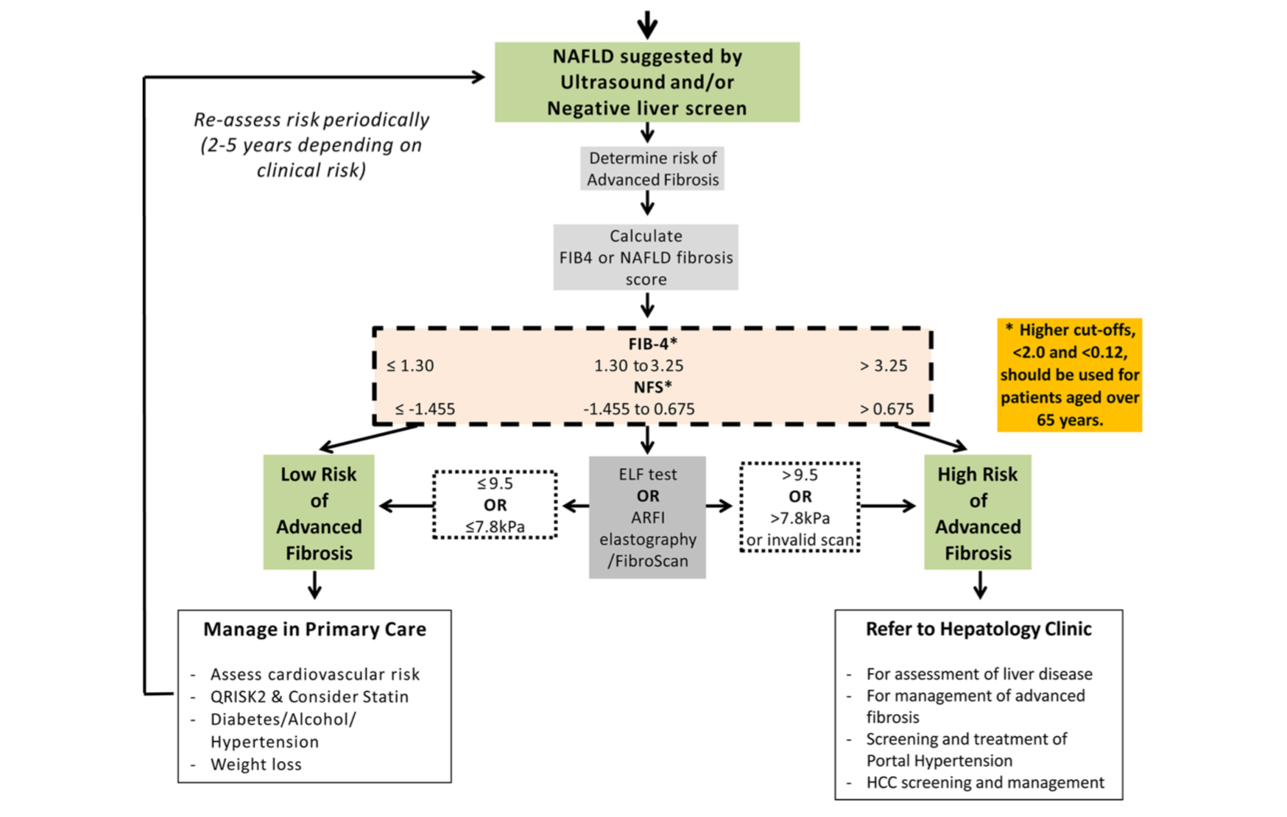

BSG Guideline
BSG abnormal LBT guideline
⁴Newsome PN, et al. Gut 2017;0:1–14
Notes:
Thiele paper support FS in ALD

Slide 17
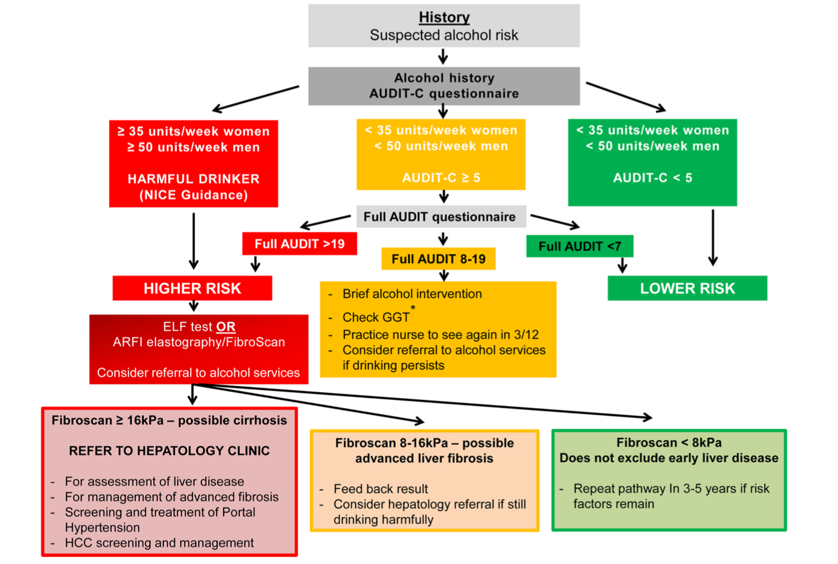
⁴Newsome PN, et al. Gut 2017;0:1–14

Slide 18
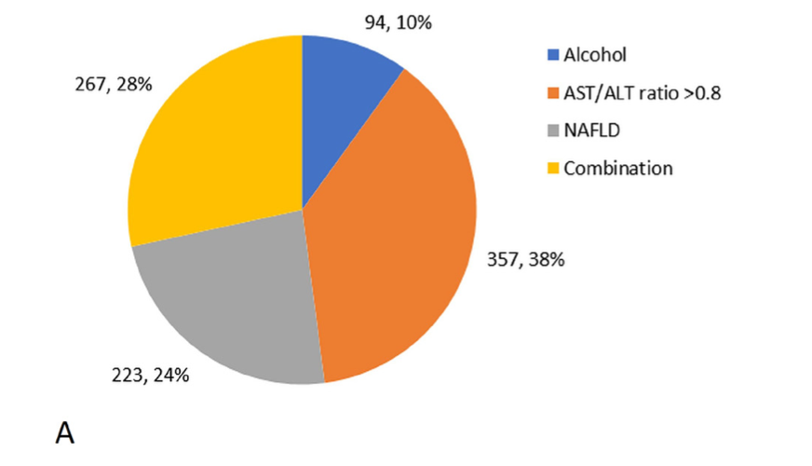
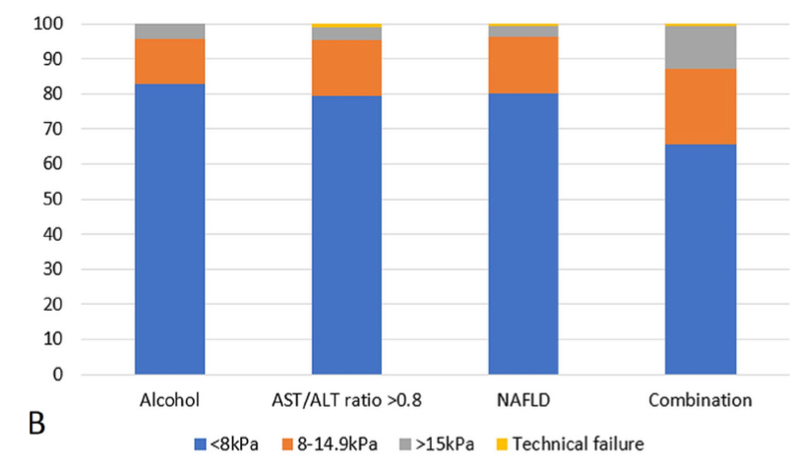
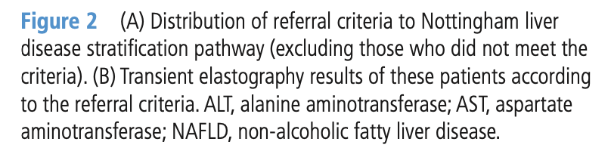

Slide 19
Workforce Development and Benefits
The increase in the Hepatology Workforce can support the establishment of the existing pathway and development of new ones
Additional Fibroscan technicians can assist
  Currently 4 Health Boards have them
ELF testing also soon to come online
Stronger ACTs can also help through outreach to community and provision of OP services
ABUHB ACT has its own scanner

Slide 20
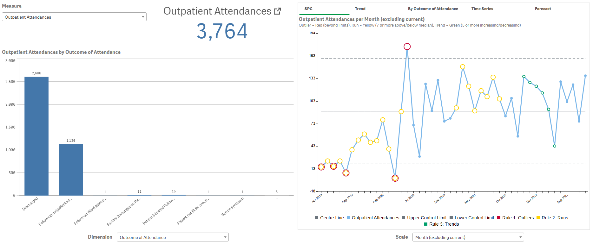
Improving Fibroscan diagnostic capacity
Just 31% of Fibroscan results
lead to an OP appointment

Slide 21
Summary
Early detection remains critical to detect advanced liver disease and treat to prevent progression and/or survey for complications
The ALBT pathway is just the start but has laid the foundation
Firmly establishing the pathway and continuing to build diagnostic and follow up capacity is crucial
Triangulation with dashboard data critical

Slide 22

Questions

