Slide 1
Liver disease implementation group show case
14th March 2023
Reflections on the liver registry & hepatocellular carcinoma service development
Dr Tom Pembroke
Consultant Hepatologist
University Hospital of Wales
Hon Senior Research Fellow
Cardiff University

Slide 2
Developing services inside and outside LDIG
Liver registry
LDIG funded NWIS support
Hepatologist lead TP/ AG
HCC service
Hepatology lead funding for recognition and restructuring of an ad hoc service at risk

Slide 3
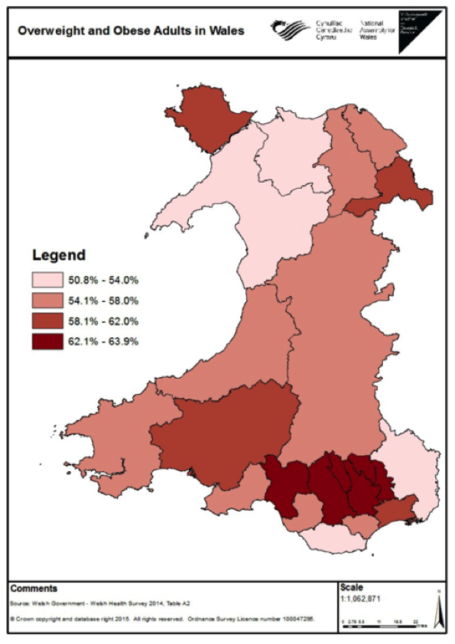
Background & aim
Wales has a population of 3.1 million
Known challenges of excess alcohol consumption and obesity
2015 Liver Disease Delivery Plan :
      Assess population need and plan delivery
      Reduce burden of liver disease
      Deliver liver disease services to the highest standard
      Demonstrate improved outcomes
The majority of epidemiological studies are based on mortality data limiting our
understanding of liver related morbidity on a population scale
AIM: Establish a liver disease registry to understand the burden and
progression of liver disease in Wales

Slide 4
Method
Registry populated by ICD10 code liver disease diagnoses 1999-2019 for Welsh residents from:
  Inpatient and Day Case activity - NHS Wales Informatics Service Patient Episode Database
  Mortality Data - Office for National Statistics
Defined hierarchy of liver diseases and step wise progression of liver disease in individuals
Individual level pseudo-anonymized data linkage
Aetiology
1: Fatty liver disease ALD
HBV
HCV
HH & Metabolic
Autoimmune liver disease
ALD combined
Non-ALD combined
2: Hepatitis not specified
Toxic liver disease
Congestive hepatopathy
3: Miscellaneous
3. Portal hypertension
Months to years
4. Decompensation / liver failure
6. Death
2. Cirrhosis
5. HCC
¹ Pimpin et al 2018

Slide 5
Results – Liver disease diagnoses in Wales 1999-2019
69,290 individuals had an
index liver disease diagnosis
Aetiology | Number | %
ALD | 14118 | 26.4
Fatty Liver Disease | 12502 | 23.4
HH/A1AT | 6933 | 13.0
HCV | 2891 | 5.4
ALD overlap | 2325 | 4.4
Autoimmune liver disease | 2260 | 4.2
HBV | 873 | 1.6
Non ALD overlap | 775 | 1.5
Hepatitis not specified | 1865 | 3.5
Congestive Hepatopathy | 870 | 1.6
Toxic liver disease | 829 | 1.6
Miscellaneous | 7184 | 13.4
61.2%
Stage of liver disease
Number
24.5%
18.6%
15%
8%
All cause mortality

Slide 6
Results – Changing incidence of liver disease over 20 years

Slide 7
Results – ALD, Fatty liver disease and HCV in Wales 1999-2019
ALD
HCV
Fatty Liver Disease
0 Proportion 1
10 years
10 years
10 years
Alive no progression
Alive Decompensation
Alive cirrhosis
Alive HCC
Alive Portal Htn
Died – all cause mortality

Slide 8
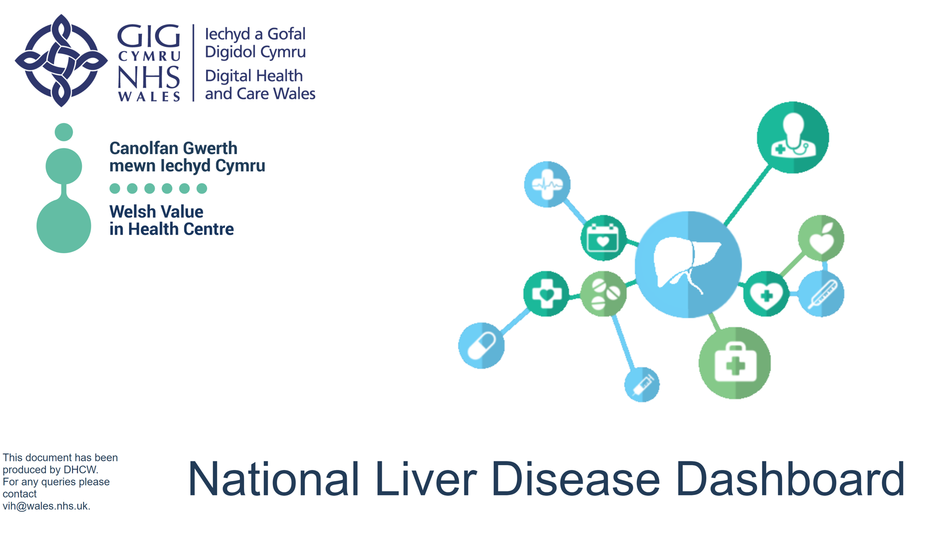
Cover Page
Notes:
image
No alt text provided
image
No alt text provided
textbox
No alt text provided
textbox
No alt text provided
image
No alt text provided

Slide 9
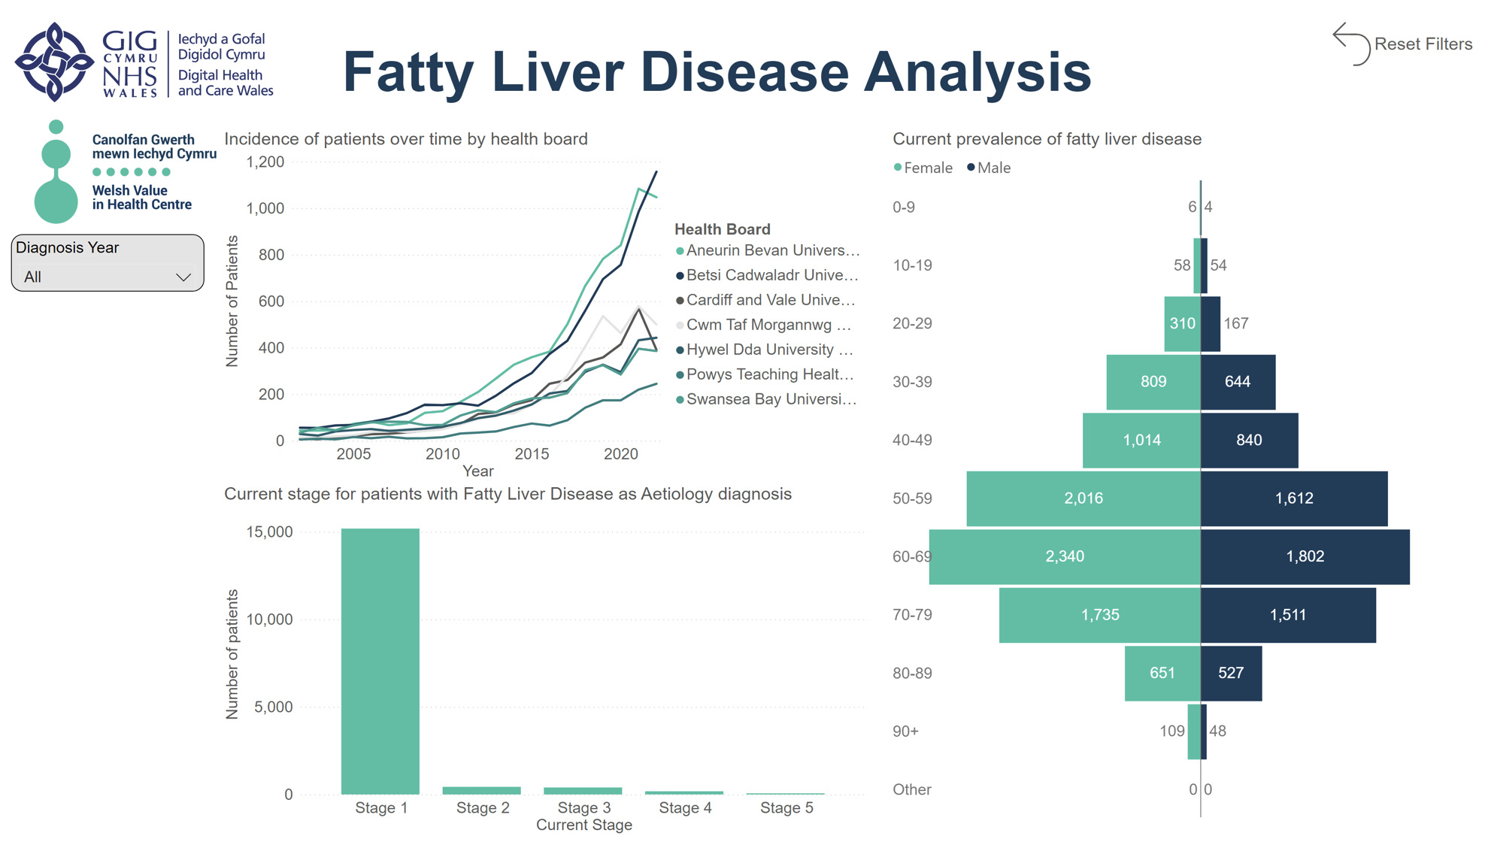
Fatty Liver disease
Notes:
image
No alt text provided
textbox
No alt text provided
actionButton
No alt text provided
image
No alt text provided
Incidence of patients over time by health board
No alt text provided
Current prevalence of fatty liver disease
No alt text provided
Current stage for patients with Fatty Liver Disease as Aetiology diagnosis
No alt text provided
Diagnosis Year
No alt text provided

Slide 10
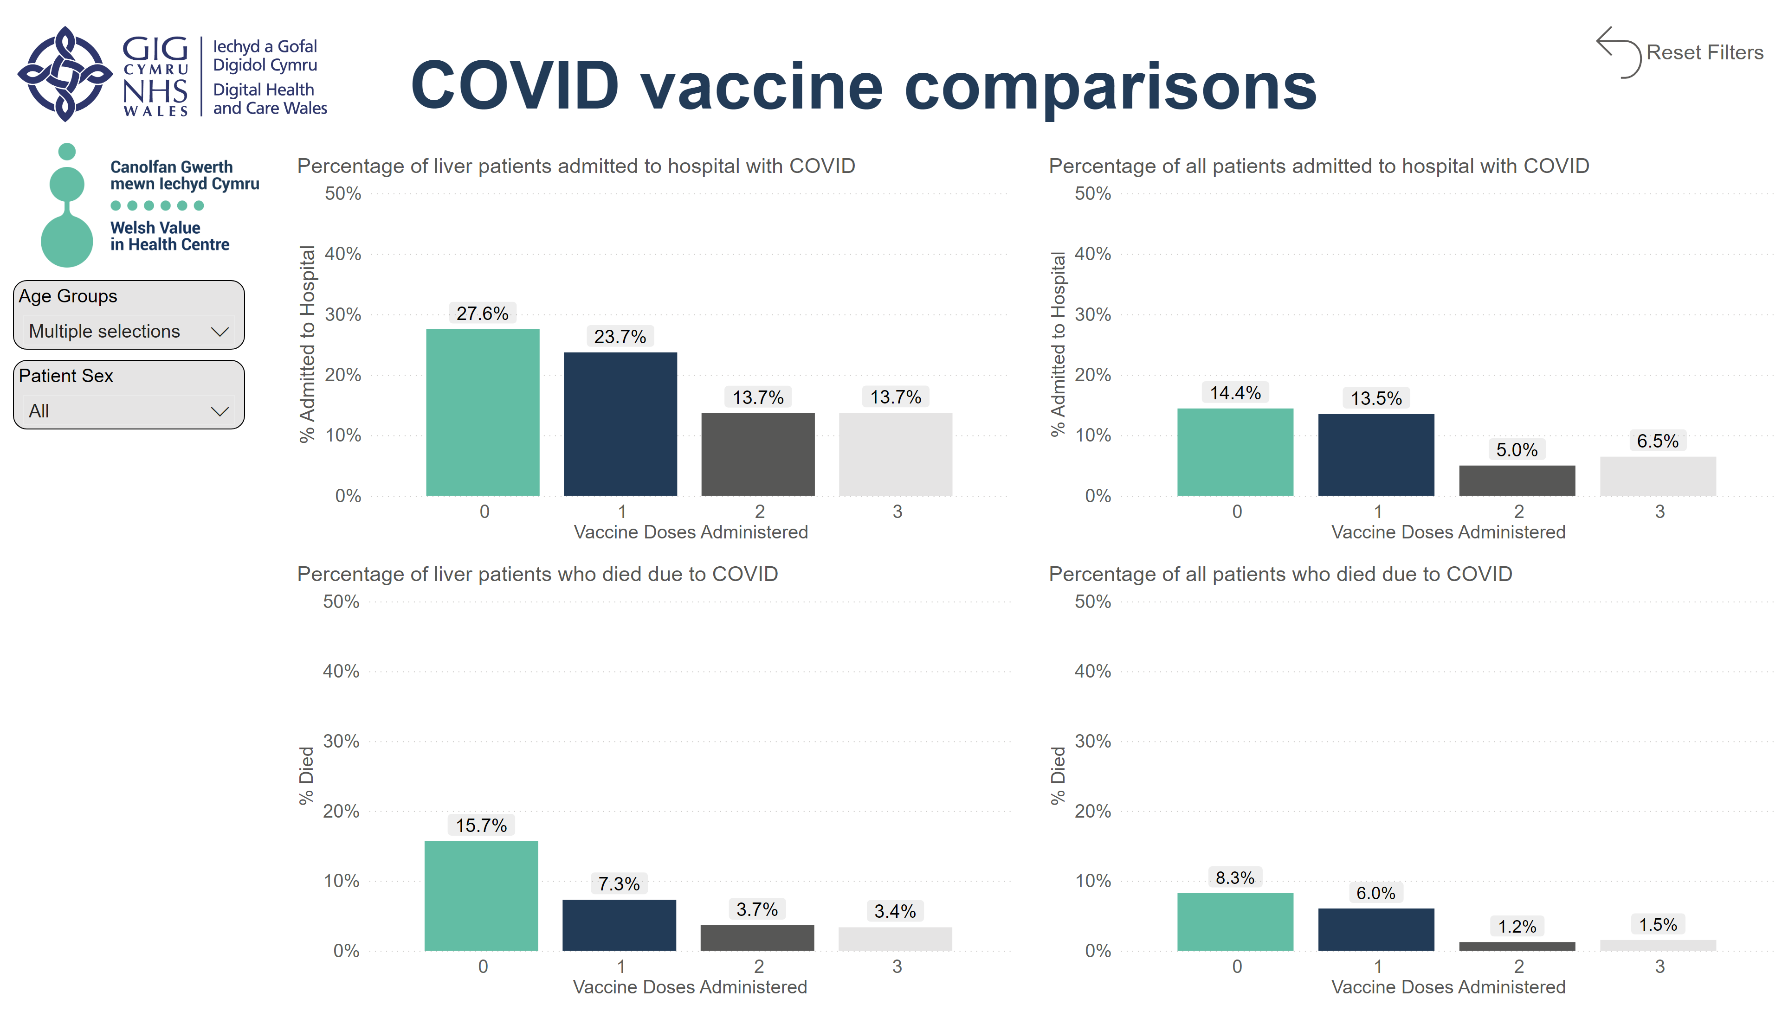
COVID vaccines comparison
INDIVIDUALS >50YRS
Notes:
image
No alt text provided
image
No alt text provided
textbox
No alt text provided
Age Groups
No alt text provided
actionButton
No alt text provided
Patient Sex
No alt text provided
Percentage of liver patients admitted to hospital with COVID
No alt text provided
Percentage of all patients admitted to hospital with COVID
No alt text provided
Percentage of liver patients who died due to COVID
No alt text provided
Percentage of all patients who died due to COVID
No alt text provided

Slide 11
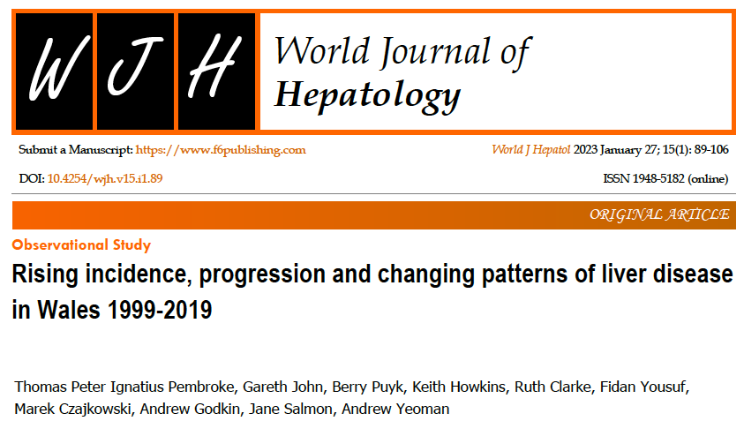

Ongoing work
Formed basis for NIHR grant to develop Liver Research Cymru network £100,000 2023-4
Liver Registry contributed to building business cases for HCC regional, Alcohol care teams (CTM) and hepatology service (CAV)

Slide 12
HCC service
UK 6100 cases pa
18th most common cancer 2% of all cancers
Rapid growth
Wales
280 cases pa
Rapid increase in incidence

Slide 13
Flow through the MDT Jan 2017-July 2019 683 patients discussed, 212 received active treatment
New patients
370
Time from PoS to MDT
Mean -23 days
59% by day 21
Follow up discussions 313
Further surveillance 137 – 20%
Additional information required
Biopsy 32 – 4.7%
Imaging 77- 11.2%
Clinic review 15 – 2.2%
MDT
Transplant
Resection
Ablation
SBRT
TACE
Sorafenib
Best supportive care
Proportion of
Treated or BSC
n=7
2%
n= 34
10%
n=36
10.9%
n=2
1%
n= 104
31.7%
n=26
7%
n=121
37%
23% curative
46% definitive treatment by day 62

Slide 14
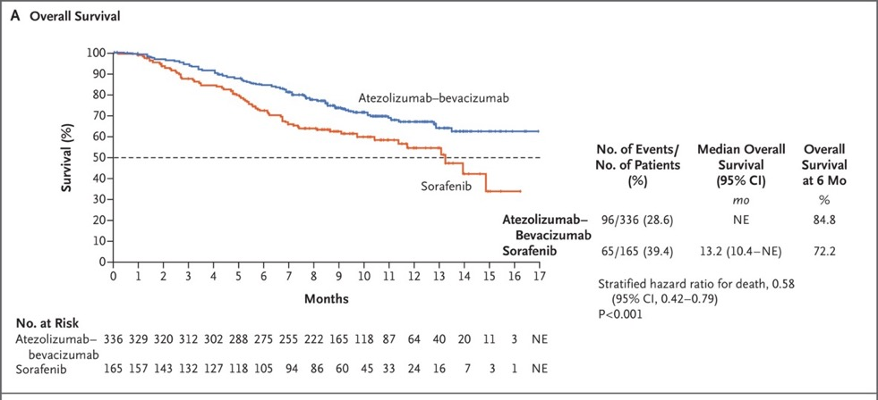
National Optimal Cancer pathway HCC
From point of suspicion to MDT 21 days
PoS to first definite treatment <62 days
Suggests routes of investigation and referral to HCC MDT
Novel therapies
- Immunotherapies
- Stereotactic Ablative Radiotherapy
- Selective Internal Radiotherapy treatments

Slide 15
Service development
2015
MDT meeting good will
1 radiology session
Surgery funding centrally (10%) patients
WHSCC funding 2022
£360,000
2x HCC CNS full time east and west base
Centralised clinic Cardiff
Drs Fi Yousuf & Dai Samuel
Governance structure for clinic
Recognised MDT
Oncology / diagnostic and interventional radiology time

Slide 16
Developing services inside and outside LDIG reflections
Liver registry
Public health leaning
Indirect patient benefit
  Service development
Research development
HCC service
Secondary care
Service provision
Setting standards
Research delivery/opportunities
Shift from disease implementation groups to networks
Not within public health
Blood borne viruses (hepatitis B &C) under infectious disease
Opportunity to
Strengthen services for individuals identified by early detection
Build clinical networks and regional services for those with most advanced disease
Continue to spread best practice & develop best solutions to challenges in Wales for Wales

Slide 17
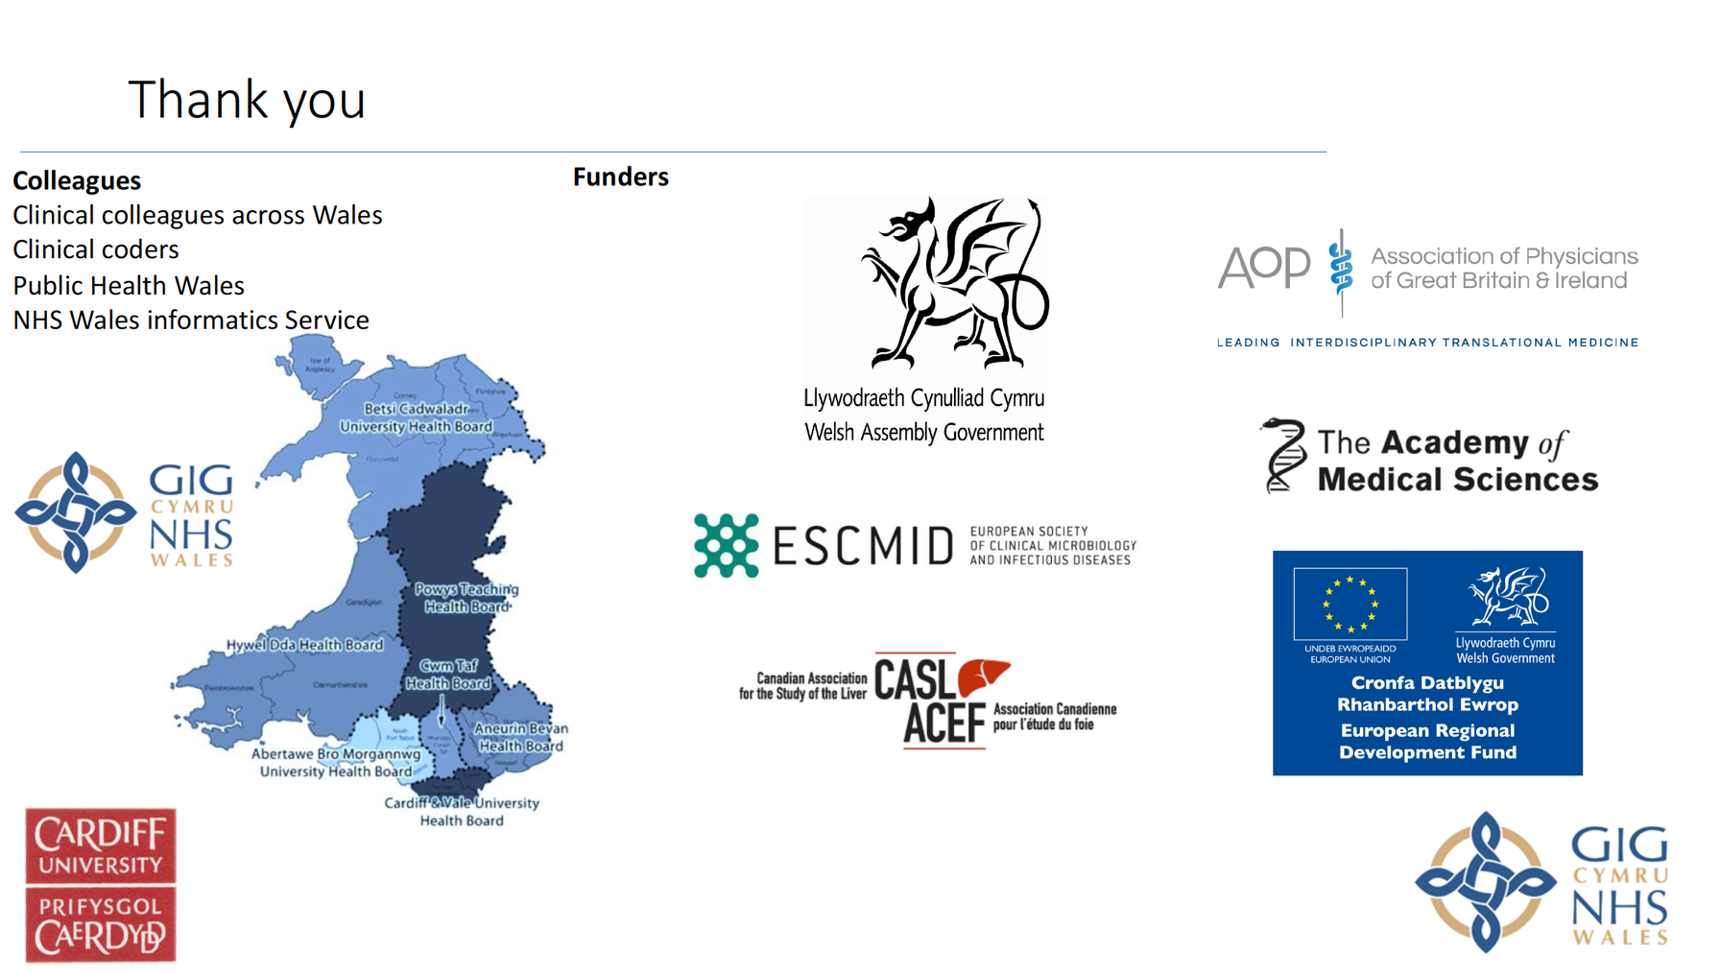
Thomas.Pembroke@wales.nhs.uk

Slide 18

Questions

