Slide 1
Collation of Additional Data Relevant to Liver Disease - discovery
Saheed Busari, Louisa Nolan, Jane Salmon, Andrea Pace
14 March 2023

Slide 2
High level project goals for the discovery project
Understand and prioritise
Understand and prioritise user needs for the collation of data sets required to develop our understanding and monitoring of liver disease, its characteristics and risk factors, and geographical variation
Develop
Develop a strategic approach to collating and, where appropriate, linking those datasets, aligned with PHW and NHS Wales data and digital strategy, and good practice in service design
Recommend
Produce recommendations based on outcomes of the discovery

Slide 3
Project outline
Identify potential additional datasets to support liver disease analysis and monitoring
Recruit business analyst – Saheed Busari
Prioritise datasets for exploration with stakeholders – liver disease and public health specialists
Create data dictionaries
Work with stakeholders to create process maps, options and recommendations for adding the data to the liver disease register and dashboard, in line with digital and data strategy and good practice

Slide 4
Summary of data considered for further investigation
Datasets | Comments and feedback
ONS deaths | Already in liver disease registry
PEDW admissions | Already in liver disease registry
Day case activity | Already in liver disease registry
Transplant data | small numbers, low priority at present
Cancer registry data | PHW data - how much does this change the dataset? Unclear how much extra information this would provide Compare the 2, understand differences, medium priority
Outpatient activity | to be picked up in the associated SAIL project
Fibroscan data | Would add granularity, early understanding, & risk factors for lower rate population – significant new information Not currently easily available, requires work to understand how best to bring in and make the data available, high priority
Welsh Results Reports Service | Pathology data, lots of free text Potential for a separate natural language processing project to better understand and use this
Biochemistry blood test data | Park for now – CDSC have done some initial work
Primary care data | to be picked up in the associated SAIL project
Alcohol services data | all individuals who have contacted specialist substance misuse service Alcohol detoxification, community & inpatient, clinical data via health boards, medium priority
Welsh National Database for Substance Misuse | Drugs & alcohol, referrals, treatments, outcomes, high priority, clinical teams in health services & alcohol teams, medium priority
Harm reduction database | PHW accessing screening blood born viruses, risk factor data, low priority
Antenatal testing hep b infection | low priority
Weight mx services | Could map childhood obesity with liver disease prevalence, eps fatty liver disease, although we would be comparing different age cohorts medium to low priority
Critical care | DHCW data warehouse, could link to APC – admitted patient care (PEDW), question on quality of coding
WAST | Free text in call outs e.g. on streets – can link WAST to ED to PEDW, WAST is in data warehouse. Would need to match on id & dates to admissions data, low priority
Sales data e.g. places licenced to sell alcohol / population | Kantar, loyalty cards – volume as well as locations Map liver disease & alcohol licences – LAs, did some work a while back, black market? Minimum unit pricing team have done work on this
Census data e.g ethnicity | SAIL
Other data sets?? | WIMD – already in dashboard

Slide 5
Datasets selected for further investigation
Echosens’ Fibroscan
  Data from liver disease scanners, 14 standalone units across Welsh Health Boards
  Benefits:
    Public health - increased granularity, earlier indicators, and information on lower-risk populations, some weight information
    Clinical – better access for clinicians to patient scan records
    Standardisation of care – understand variation by location
    Research – understand prevalence and risk factors of liver disease in Wales, identify trends and patterns in liver disease, effectiveness of different treatment, and inform policy decisions.
  Not currently collated centrally (anywhere in Europe!)
Welsh National Database for Substance Misuse (WNDSM)
  Data from adults and children presenting for substance misuse treatment in Wales
  Captures client, referral, assessment, treatment and discharge details
  Can be linked to other data to understand impact of substance mis-use on liver disease
Cancer Registry data
  Out of scope – consider under PHW’s registers strategic development work

Slide 6
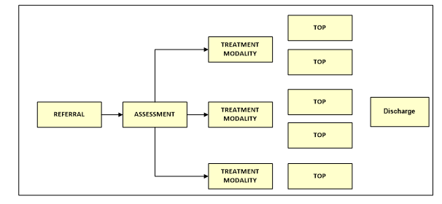
Findings
Welsh National Database for Substance Misuse
Data available from 2005, improved quality from 2014
Pseudonymised ID for linking
Monthly input from WG agencies
Data dictionary available
Data sharing subject to agreement via spreadsheet
Relatively straightforward to link and to add to register / dashboard
client journey in a substance misuse agency

Slide 7
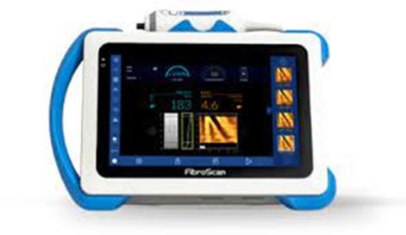
Findings
Fibroscan
14 standalone units across Wales
Data:
  scan results
  patient data including BMI sometimes, administrative data
Data could be ingested to Welsh Clinical Portal (subject to quality checks)
From there, can be incorporated into the liver disease registry and dashboard
Requirements:
  networked
  Windows 10 + servers
  Gateway installed
Echosens interested in partnering on this project as a European first
Would carry out their part of the work at cost

Slide 8
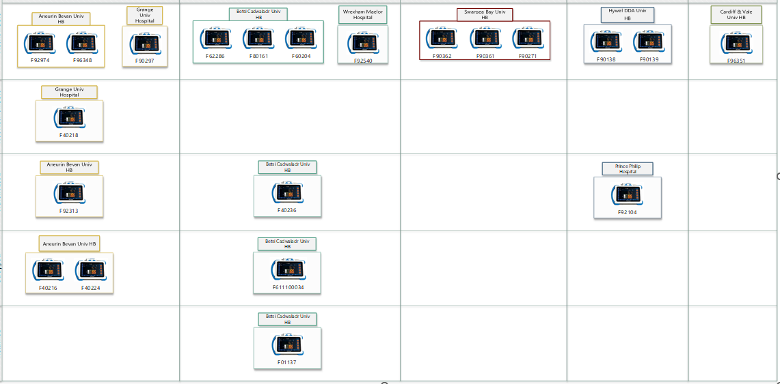
Fibroscan devices - current status and location
Aneurin Bevan UHB
Betsi Cadwalladr UHB
Swansea Bay UHB
Hywel Dda UHB
Cardiff & Vale UHB
can be networked
cannot be networked
warehoused
scrapped
returned

Slide 9
Fibroscan options
Option | Options | Benefits | Challenges
1 | integrate Fibroscan devices via a gateway integration, data flow into the Welsh Clinical Portal (WCP) and Liver Disease Dashboard | once implemented, low / no effort for real-time updates Echosens would carry out gateway installation at cost (~3 week’s work) as central collation of data would be a first for them would improve demographic data quality via networked validation & monitoring supported by DHCW strategic and sustainable | requires Windows 10 servers security and networking assessment required by all Health Boards with devices – resource implications for HB IT teams
2 | download Fibroscan data onto USB and import into the WCP | low-tech solution with no need for significant IT involvement | requires committed resource to carry out task on a regular basis – not sustainable or strategic lag between data collection and ingest into WCP reduces clinical benefits not clear if HL7 standard can be loaded on a USB no benefits from networked data validation
3 | one-off download of historical Fibroscan data into bespoke database for analysis | least resource requirement except do nothing would allow historical analysis | no benefits from ongoing monitoring or timely use by clinicians not strategic no benefits from networked data validation
4 | do nothing | zero resource implications | no data benefits
Collation of Additional Data Relevant to Liver Disease

Slide 10
Recommendations
Incorporate the WNDSM data into the liver disease registry and dashboard
Network the Fibroscan units ->WCP -> liver disease registry and dashboard
  requires buy-in and resources from Health Boards’ IT
  requires some additional funding
Consider linking the liver disease register to the cancer register under PHW strategic register development
Collation of Additional Data Relevant to Liver Disease

Slide 11

Questions?
Collation of Additional Data Relevant to Liver Disease

Slide 12
Annex

Slide 13
Fibroscan Devices - Current State
Collation of Additional Data Relevant to Liver Disease

Slide 14
Fibroscan Devices - Future State (Option 1 – Preferred Option)
Collation of Additional Data Relevant to Liver Disease

Slide 15
Fibroscan Devices - Future State (Option 2)
Collation of Additional Data Relevant to Liver Disease

