Slide 1

Children & Young People Advisory Group
Chair: Andy Goldsmith
Chief Executive, Hope House Children's Hospices
Notes:
Importantly the patient journey needed to be followed through all aspects of care, importantly to have a voice in the newly formed advisory groups, co production being key.
Including all health professionals from specialist to non specialist palliative care roles.
Cross cutting themes are important and will weave through all work undertaken.
The aim is to encompass the full age range, young people, smaller in number but clearly huge in terms of the impact of their illnesses and their needs.
It also encompasses importantly not only work in the statutory sector but the significant work done by a number of voluntary sector organizations, local independent organizations, larger national charities and other third sector organizations who do important work in research, education and policy.

Slide 2
Membership of the group
Broad multi disciplinary membership representing
Allied Health Professionals
Bereavement Support charity
Children’s Hospices
Children’s Public Health
Children's Nursing
Clinical Psychologist
Compassionate Cymru
NEST (Mental Health and Wellbeing Support)
Neonatal consultants
Palliative Care Nurse leads
Social Care
Special Schools
Children & Young People Advisory Group

Slide 3
Group’s current focus
Areas of work
Define what is (or should be) the Wrap Around Care offer for children with life threatening conditions in Wales?
Determine the priority for this offer from children with a life threatening condition and their families?
Assess the adequacy of Wrap Around Care across Wales
Determine how the offer can be best delivered in Wales
  Closer to home
  Most efficiently
  Utilising existing support, services and wider community
Feed into the Service Specification --- December 2024
Children & Young People Advisory Group

Slide 4
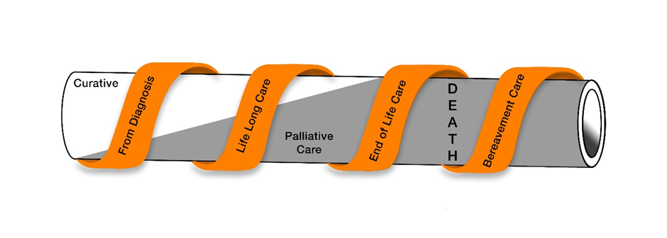
Wrap Around Care
“Palliative care for children and young people with life-limiting conditions is an active and total approach to care, embracing physical, emotional, social and spiritual elements. It focuses on enhancement of quality of life for the child and support for the family and includes the management of distressing symptoms, provision of respite and care through death and bereavement.”
ACT and the Royal College of Paediatrics and Child Health (RCPCH), 1993
Children with palliative care needs present with a unique array of complex and diverse conditions, leading to illness trajectories that are notoriously difficult to predict. The conditions present with varying prognoses of days to many years, thus resulting in children potentially needing complex support for most of their life. The intensity of palliative care support can change at different stages of the illness trajectory.
Taken from the NHS Wales End of Life Care Implementation Group, Review of Specialist Palliative Care Services in Wales 2010- 2021
Children & Young People Advisory Group
Notes:
Children with palliative care needs present with a unique array of complex and diverse conditions, leading to illness trajectories that are notoriously difficult to predict. The conditions present with varying prognoses of days to many years, thus resulting in children potentially needing complex support for most of their life.

Slide 5
Number of children with a life threatening condition is increasing
3655 babies and children with a life threatening condition in Wales in 2019.
Number has increased by almost a quarter since 2009
Children & Young People Advisory Group
Notes:
Further 700 young adults under 25
Further 11% increase predicted by 2030

Slide 6
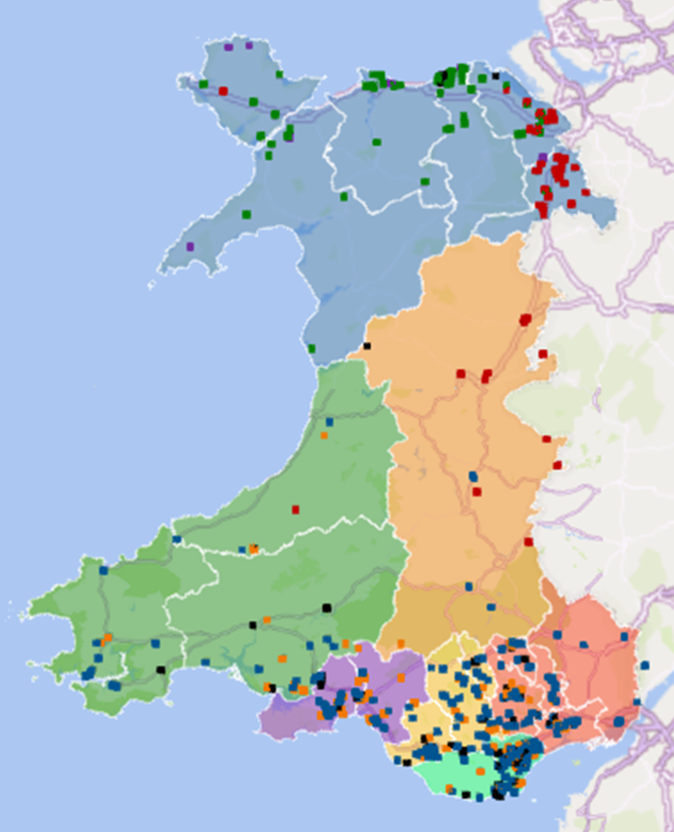
Children are resident throughout Wales
404 Children registered with Tŷ Hafan or Hope House/Tŷ Gobaith Children’s Hospices
Further 59 registered with the All Wales Specialist Managed Clinical Network.
Children & Young People Advisory Group
Notes:
Total of 463 registered with a provider of palliative care ( 12.5%) but this hides regional differences.

Slide 7
What Matters most?
Children & Young People Advisory Group
Notes:
Family Voices – limited voices of children and families that are registered with children’s hospices – no data on the needs of the majority that are not

Slide 8
Distance to access services is a real barrier
92% families experience financial hardship
Children & Young People Advisory Group
Notes:
1 hour, 2 hour and over travel times by road

Slide 9
Children & Young People Advisory Group
Question
How do we remove barriers to accessing overnight short breaks for children and respite for their families?
What organisations are best placed to do this?
Please consider the questions in your groups, feel free to use the flip charts/post-its on each table to capture your ideas.
20 minutes have been allocated for the discussion.
Thank you for your support.
Children & Young People Advisory Group

