Slide 1



PEoLC Engagement Event
Health Economics
Dr. Emily Holmes
Senior Research Fellow, Centre for Health Economics and Medicines Evaluation (CHEME)
North Wales Medical School, Bangor University
Notes:
Preference elicitation research
How people’s preferences impact the value of NHS services

Slide 2
The Plan
What is economics?
How do we use health economics?
Challenges when applying health economics to PEoLC
Patient-centred solutions

Slide 3
What is economics?
Branch of knowledge concerned with the production, consumption, and transfer of wealth.
How we provide health and social care
How we use of health and social care
How we fund health and social care

Slide 4
Scarcity and decision making
Economics is essentially the study of :
Scarcity [short-supply]
How people use resources / respond to incentives
Decision-making
Economics often involves topics like wealth and finance, but it's not …
all about money.
MAKING DECISIONS BASED ON VALUE
And that’s what we do every day …
  Take the example of how you got here today…
Notes:
The reason we need economics is because resources are scarce and demands are infinite.

Slide 5

Notes:
So if you thought £$
I encourage you to replace those thoughts with this image ..

Slide 6
The Plan
What is economics?
How do we use health economics?
Challenges when applying health economics to PEoLC
Patient-centred solutions

Slide 7

How do we use health economics?
Standard approach
Alternative
Patient preferences
Builds on workshop…
How do we define, identify, and measure the value of palliative care services in Wales?
Notes:
When we think about how we use health economics, I’m going to run through 3 examples.

Slide 8
Health Economics
Allocation of scarce resources to maximise benefit
Economic evaluation is the comparative analysis of alternatives in terms of both their costs and benefits
Inputs
[resources]
Process of healthcare
[options]
Outputs
[outcomes]
Inputs
[resources]
Outputs
[outcomes]
Process of healthcare
[options]
Notes:
Health economics is concerned with the problem of allocating health care resources under conditions of scarcity and uncertainty.

Slide 9
The challenge
Interventions at the end of life are often complex
Economic evaluations require information on the inputs and outputs of care
Economic evaluation of palliative care services are limited by:
  Capturing accurate information on relevant activities and costs
  Identifying, measuring and valuing outcomes
Notes:
Johnston BM. The application of economic evaluation techniques to studies of palliative and end-of-life care. Care at the end of life: an economic perspective. 2016:19-30.

Slide 10
Consider…
Service are often personalised
Patient may lack capacity
Relevant outcomes can be difficult to capture
Ethical considerations
Costs perspective
Defining the episode of care
Attributing benefits
Notes:
One of the first challenges for health services research in palliative care is study design…. here I have highlighted just some of the points for consideration
Services are personalised and vary between patients, making it difficult to standardise the design and delivery of care
Patients may lack capacity to consent
Relevant outcomes can be difficult to capture when patients lack capacity
An overprotective culture can result in gatekeeping by healthcare professional
Clinicians may have ethical concerns about enrolling patients in studies where they may not receive the comprehensive range of services
Varying level of willingness to prioritise research amongst healthcare professionals
Patients living with advanced illness may die before the study is completed
Page 21: Johnston BM. The application of economic evaluation techniques to studies of palliative and end-of-life care. Care at the end of life: an economic perspective. 2016:19-30.

Slide 11
Health economics toolkit
Cost-utility analysis
Cost per QALY
Capabilities approach
Measuring wellbeing
Lancaster's Theory of Value
Eliciting preferences

Slide 12

To make healthcare decisions we need to measure people's health
  Ask patients standard questions about their health
  Provides a description of health that is converted into numbers
  Attach utility scores based on population survey

Slide 13
Quality-Adjusted Life-Years
(QALYs)
1.0
Quality-
Adjusted Life Years-Gained
New
Intervention
QUALITY OF LIFE (Weights)
Comparator
0.0
Death
Death
QUANTITY OF LIFE (Years)
Calculate QALYs by combining length of life and quality of life
Notes:
Useful for decision-making across the NHS, but not without issue here

Slide 14
Cost utility analysis
Measure of value:
How many additional QALYs are gained?
… At what cost?
Facilitates comparisons to be made across different:
  Disease areas
  Patients
  Treatments
Useful for resource allocation decision-making (required by HTA agencies)
Main objective is to maximise health outcome
Priority is given to those interventions with the lowest cost per QALY

Slide 15
QALY debate in end-of-life care*
Objective is not to extend life
  … but to improve QoL for the time remaining
Even when substantial improvements in QoL are achieved
  … often short-lived
The QALY framework is patient centric
  …. externalities for family members or informal care givers
QALYS are concerned with health
  … evidence to suggests that patients nearing the end of their life value alternative attributes not be captured by focusing on health
  … spiritual and psychosocial wellbeing are domains of palliative care that are not included in QALY scores
*Care at the End of Life: An Economics Perspective (2016)

Slide 16
The Plan
What is health economics?
How do we use health economics?
Challenges when applying health economics
Patient-centred solutions

Slide 17
Health economics toolkit
Cost-utility analysis
Cost per QALY
Capabilities approach
Measuring wellbeing
Lancaster's Theory of Value
Eliciting preferences

Slide 18


Slide 19

Capabilities approach
Measures of wellbeing for use in economic evaluation.
Conceptually linked to Amartya Sen's capability approach
Defines wellbeing in terms of an individual's ability to 'do' and 'be' the things that are important in life.
Two examples developed for economic evaluation:
  ICECAP Supportive Care Measure
  Carer Experience Scale
https://www.bristol.ac.uk/population-health-sciences/projects/icecap/icecap-scm/

Slide 20
Defining, identifying and measuring capability
ICECAP Supportive Care Measure
  Choice
  Love and affection
  Physical suffering
  Emotional suffering
  Dignity
  Being supported
  Preparation
The Carer Experience Scale
  Activities
  Support (from family and friends)
  Assistance (from organisations)
  Fulfilment
  Control
  Getting-on (with the care recipient)
CES focuses on 'care-related quality of life' rather than health-related quality of life, comprising attributes that are pertinent to unpaid carers.

Slide 21
The Plan
What is health economics?
How do we use health economics?
Challenges when applying health economics
Patient-centred solutions
Notes:
What is health economics?
How we use health economics
Challenges of applying health economics to care at end of life
Patient-centred solutions

Slide 22
Health economics toolkit
Cost-utility analysis
Cost per QALY
Capabilities approach
Measuring wellbeing
Lancaster's Theory of Value
Eliciting preferences

Slide 23

Patient Preferences

Slide 24
PATIENT EXPERIENCE EVIDENCE
Patient reported outcomes
Aim to capture the patients experience of the condition
Examples: symptoms, functioning, quality-of-life
Patient preference information
Aim to capture what is important to or preferred by patients in terms of outcomes of treatments / pathways
Examples: stated preference methods
Patient Engagement
Guides how patient experience data can be captured and how it is relevant
[active, meaningful, collaborative interaction]
ISPOR SIG

Slide 25
Economic theory
Usefulness of interventions/service for the consumer depends on their properties or characteristics
  Individuals have rational preferences that can be identified and valued
  Individuals maximise utility
Individual’s preferences are revealed through choices (Lancaster 1966)
Choices can be described in terms of bundles of attributes
Attributes are traded to maximise utility (McFadden 1974)
Value depends on characteristics
We trade characteristics to maximise VALUE

Slide 26

What drives your preference for a car?
Usefulness of interventions/service for the consumer depends on their properties or characteristics

Slide 27
Luggage capacity
Colour
No. doors
Engine
Fuel type
Brand
Wheels

Slide 28
Defining, identifying and measuring preferences
We can measure preferences using a survey method
  Discrete choice experiments
  Hypothetical survey used in the absence of revealed preference data
  [identifies wants]
Use of discrete choice experiments has been shown as a useful tool for eliciting preferences for end-of-life care
Knowing which attributes of care patient value most:
  Provide valuable information for policy makers about how services are best delivered
  Help ensure that resources allocated towards palliative care are spent efficiently

Slide 29
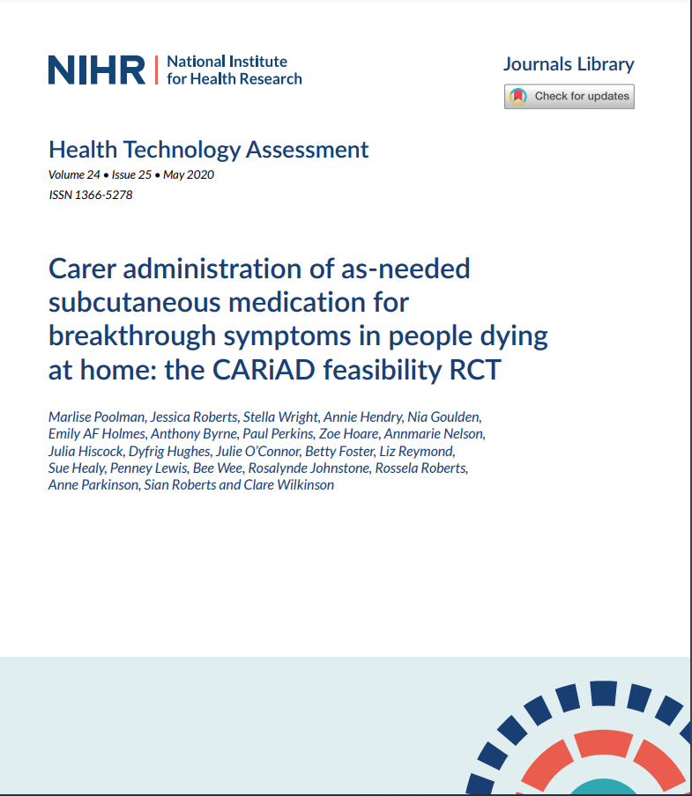
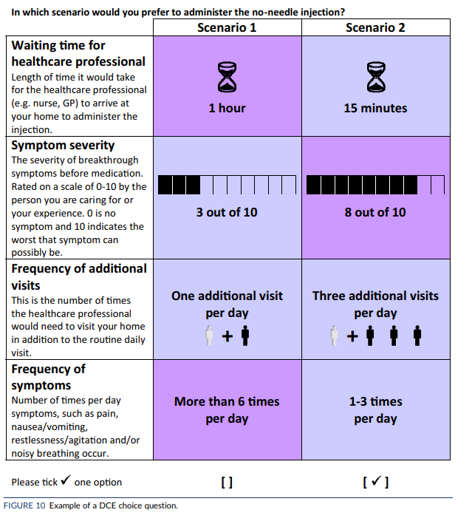
The relative importance of the individual attributes
The willingness to trade between different attributes
The total satisfaction or utility scores for different combinations of attributes

Slide 30
Discussion
Evaluation of end-of-life care is challenging
Evidence base for the cost-effectiveness of palliative care interventions is limited
Evaluations need to demonstrate the cost-effectiveness of palliative care services relative to other healthcare interventions
  “… if it is generally accepted that all people should have access to high quality end-of-life care, then it is important to ensure that resources allocated to end-of-life care are spent efficiently”
Knowing which attributes of palliative care packages patients and caregivers VALUE can provide useful information for policy makers about optimal service delivery with reduced waste

Slide 31

Next steps …
There is existing evidence on attributes of importance in end-of-life care
We have conducted formative work / feasibility assessment of the use of DCE in this setting
We have the skills and expertise to conduct this work in Wales

Slide 32
To close …
!
Returning to our first question …
What is economics?
WARNING … Lost in translation
to fail to have the same meaning or effectiveness when it is translated into another language.
If we lose meaning or effectiveness what would than mean for:
Provision, use and funding of care?
Highlights the importance of today….

Slide 33
Knowledge exchange
What is captured?
How is it relevant?
What is important?
Assess Value
Support Decision-making
Person-centred allocation of scare resources
Notes:
Preference elicitation research
How people’s preferences impact the value of NHS services

Slide 34
Diolch yn fawr / Many thanks
ACKNOWLEDEMENTS
Value-added palliative and end of life care in Wales
Dr Marlise Poolman, Bangor University/NHS Wales
Dr Idris Baker, NHS Wales
Palliative and end of life care team in North Wales

