Slide 1
Palliative & end of life care – Future Aspirations for Wales
Dr Idris Baker
National Clinical Lead
Cardiff
1 March 2024
idris.baker@wales.nhs.uk

Slide 2

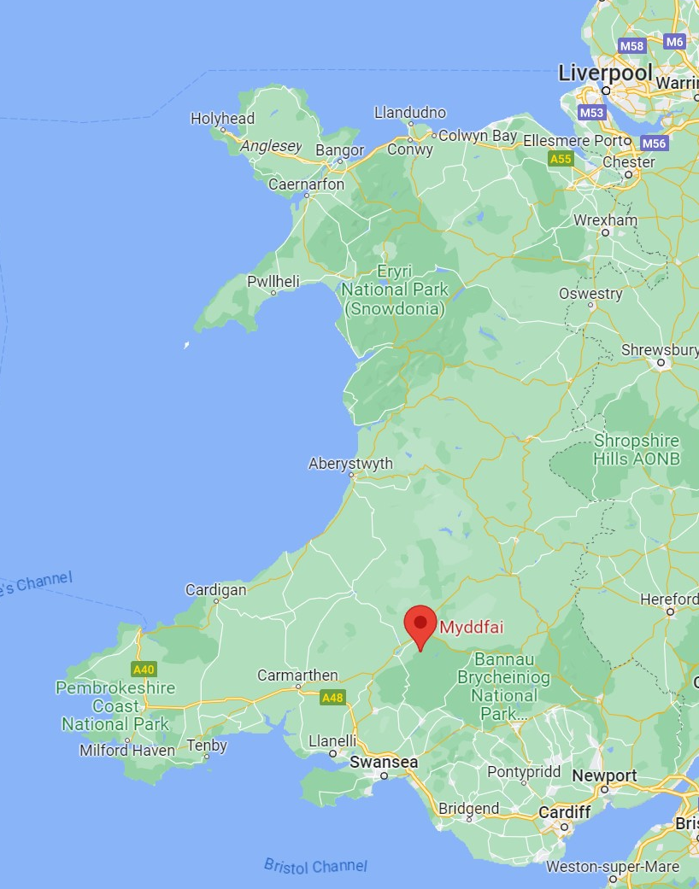

Slide 3
Where have we got to?
Strong multiprofessional specialist services across Wales for adults & children
Equity in provision of some degree of 7/7 & 24/7 specialist support
World class education, training, research engagement
Close link between specialists & the non specialist workforce which does most of the palliative care
  66% of people with some PEOLC need are never referred to a specialist
  The 34% are referred late
  Even when there’s specialist support much of their care is undertaken by non specialists

Slide 4
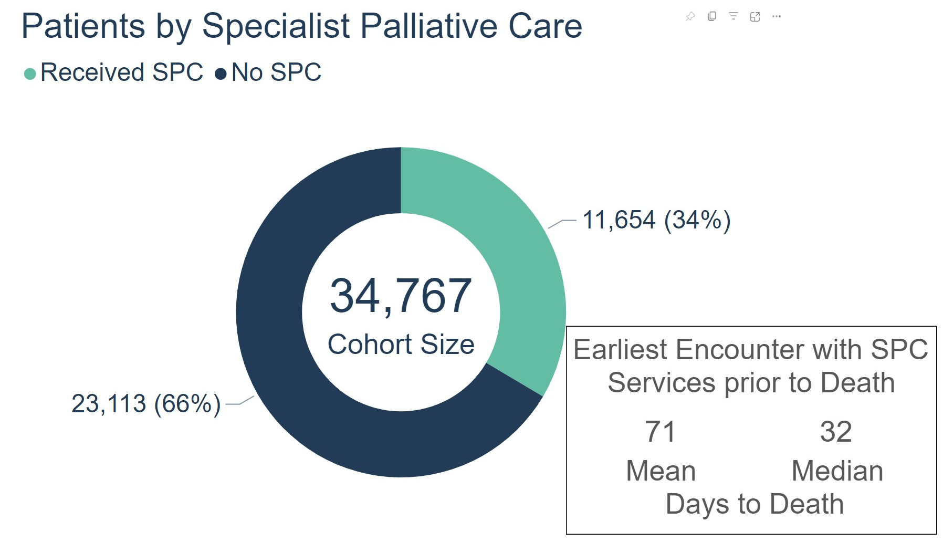
Extract from NHSW Last Year of Life Population Dashboard

Slide 5
Where have we got to?
Strong multiprofessional specialist services across Wales for adults & children
Equity in provision of some degree of 7/7 & 24/7 specialist support
Close link with the non specialist workforce which does most of the palliative care
  66% of people with some PEOLC need are never referred to a specialist
  The 34% are referred late
  Even with specialist support much of their care is undertaken by non specialists
And a Quality Statement which points the way ahead

Slide 6
Where have we got to?
But
  Persisting inequity
  Persisting concern about funding
  Relative dearth of systematic measurement of experience
  Near complete dearth of systematic measurement of outcomes
  Uncertain timely identification
  Uncertain track record on translating research into practice
  Pretty much no idea what it all costs

Slide 7
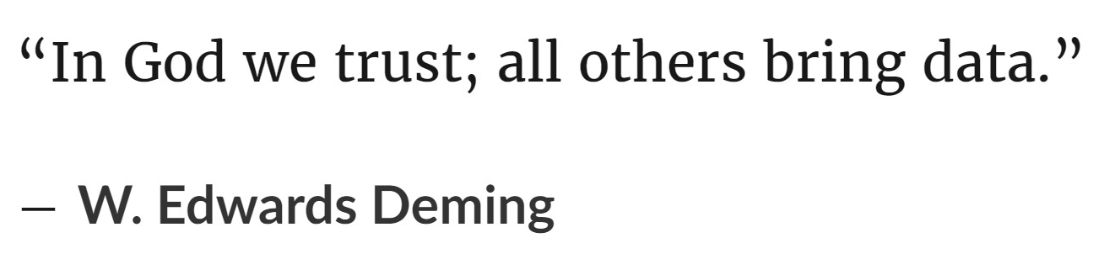
Where next?
How can we tackle questions of equity, quality, value?

Slide 8
What good do we do?
Evidence from research
  But however good the recipe, you have to follow it
Evidence from audit & QI
  But tends to focus on process not result
Person centred value based health & care
  Focuses on the outputs

Slide 9
What good do we do?
What effect does our care have in reality on patients & families?
Does it offer good value compared with other ways the resources could be used?
  HV vs OPA vs day care…
  Skill mix
  Prioritisation
  Proactive vs reactive

Slide 10
Where next?
Service specification - more ‘what?’, maybe some ‘how?’
Emphasis on value
Emphasis on equity
Across statutory & voluntary sectors
Across the whole spectrum of complexity & specialisation
What are we doing that isn’t working, & what aren’t we doing that would?
All of you are in the vanguard

Slide 11
Opportunity
Whole programme pulling together
  Groups working with shared understanding & shared goals
And helping the whole health & care system pull together because PEOLC is happening throughout it
  All functions/networks/programmes of the NHS Wales Executive
  Health Boards, Trusts, Regional Partnership Boards
  If we don’t use our reach & influence, we can’t help that wider provision

Slide 12
Future Aspirations
Timely identification
  What’s the point being brilliant months later?
AFCP
  What’s the point managing crises well if we don’t help plan ahead?
Digitalisation
  What’s the point recording good care if we don’t share information effectively?
Integration
  What’s the point doing good things in isolation from other people involved with the same patients and groups?

Slide 13
Future Aspirations
Equity
  What’s the point being brilliant for some people and mediocre for others?
Value
  What’s the point in all the investment & all the activity in the world if we can’t capture what it delivers for people?
Last days of life
  What’s the point in getting it right early if we let people down on the last lap?
Bereavement
  What’s the point getting it right for the person who’s died and leaving those who live on unsupported?

Slide 14
Future Aspirations
All of this to benefit all the people who need it
  35,000 per annum
  >1% of the population per annum
  >5% for bereavement care

Slide 15
Future Aspirations?
While there's always jam to-morrow,…
Evolutionary Hymn
CS Lewis, 1957

