Slide 1

Ordinary Dying:
How can we improve our conversations?
Toronto, June 2023
@drkathrynmannix

Slide 2


Why does it matter?
Public understanding has become lost
The lost wisdom has been replaced by unhelpful beliefs and tropes
Decision-making
(or avoidance of it)
is now driven by supposition, fear and dread

Slide 3
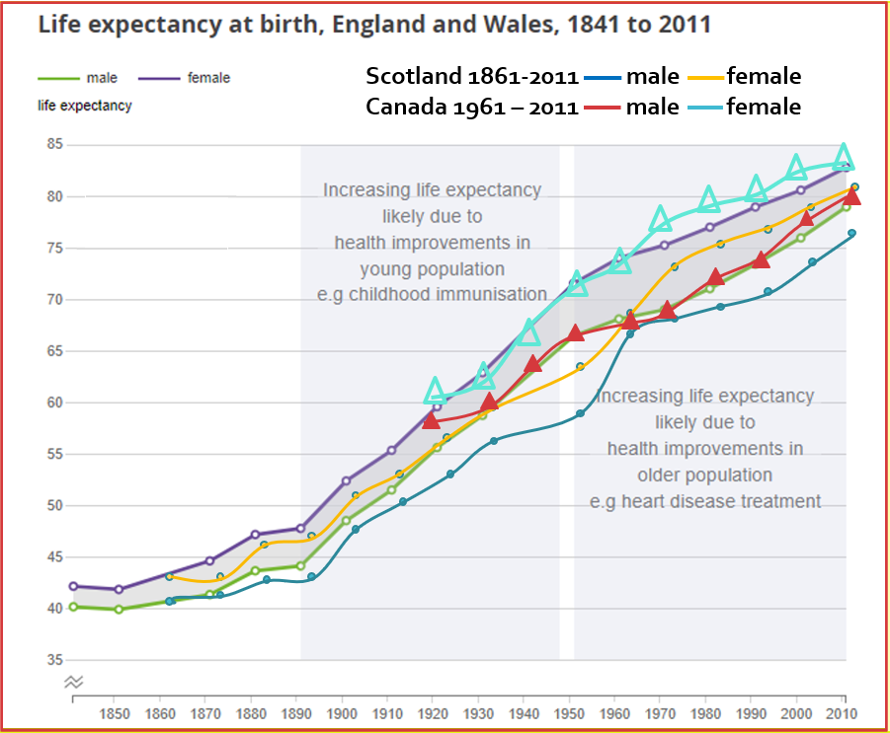
How did we stop recognising dying?
Sources: Decennial Life Tables, ONS, UK; Statistics Canada/Statistique Canada

Slide 4
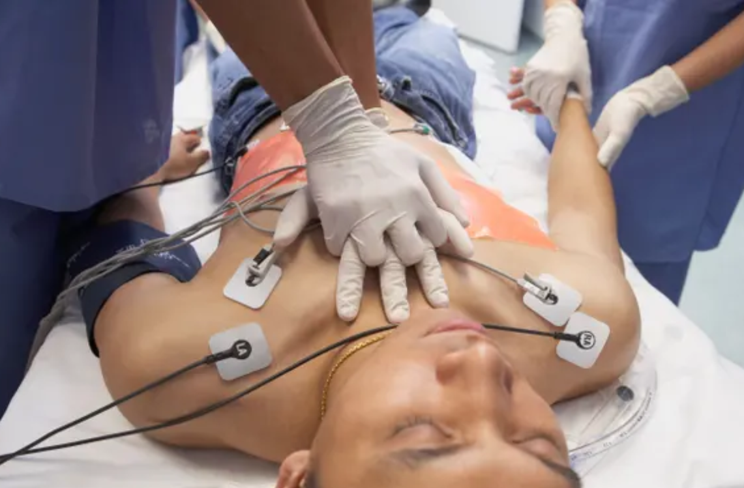

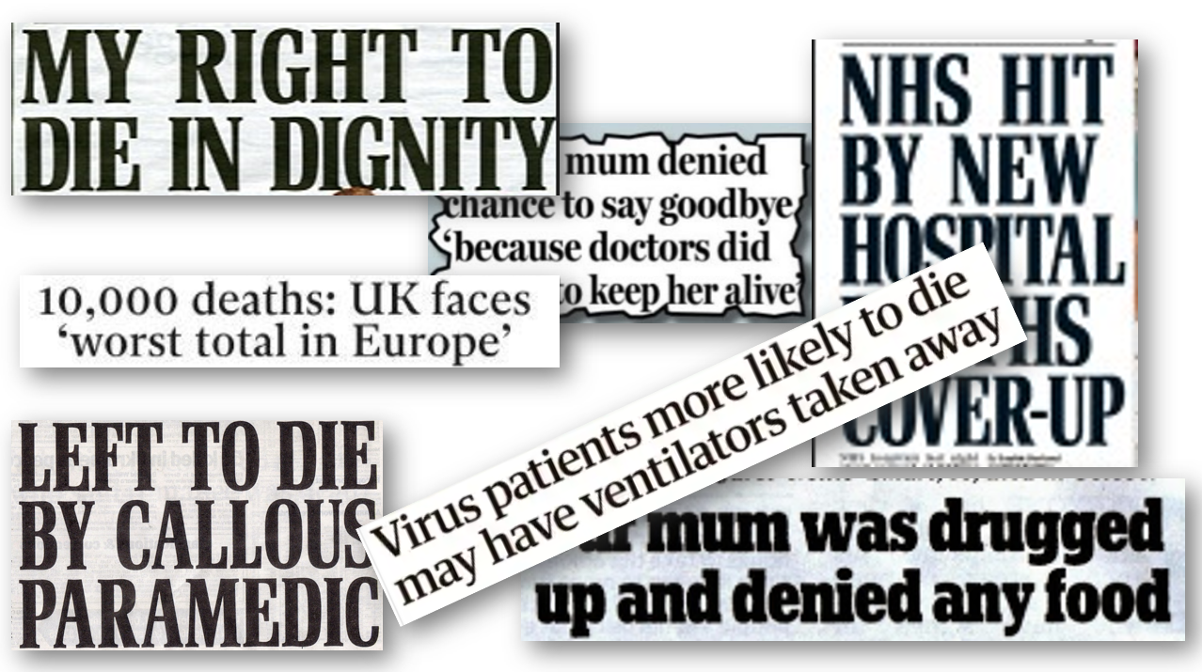

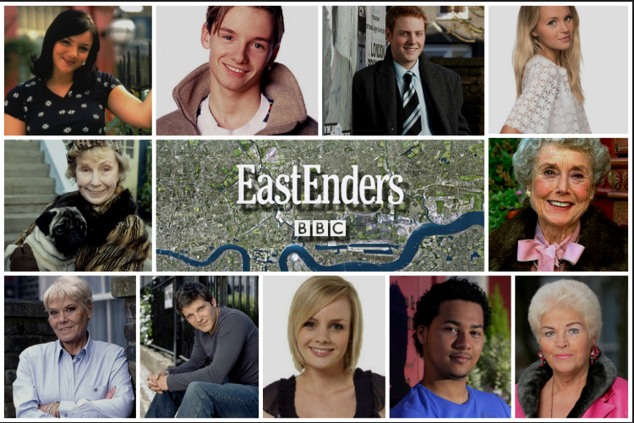
Modern Death Myths
Notes:
21st C awareness of death
Bad Deaths on screen
Unhelpful media reports
Death-as-Entertainment
Unrealistic expectations

Slide 5
The way palliative care and end of life experience is interpreted by the public affects all aspects of service planning
Reluctance by individuals to discuss progressive disease or dying
Reluctance by HCPs to begin conversations that may touch on dying, death or disease progression
Late referrals for palliative care
Delegation of ACP to palliative care/family doc/specialist/‘someone else’
Misunderstanding of CPR and fraught conversations based on differing underlying assumptions
End of life crises: paramedics, ER, OOH responders
Absence of strategic planning for end of life care at a population level

Slide 6
Key Message 1: The way humans die
Is a recognisable process
With clear stages
and predictable progression
The ‘Coma Talk’
‘Midwifing’ dying

Slide 7
Key Message 2: We can prepare and plan ahead
Individual Level
Conversations with our own nearest and dearest about values, wishes and preferences – ‘What Matters To Me’
ACP
  Powers of Attorney/choosing and briefing our decision-makers
  Advance Decisions to Refuse Treatment ADRT
  Emergency Health Care Plans – ‘What to do if…’
Funeral preferences, wills, letters of wishes
Strategic Level
Joined-up planning in health and social care – commissioning, provision
Joined-up electronic records
Shared curiosity about ‘never events’ – inc unplanned for but predictable crises

Slide 8
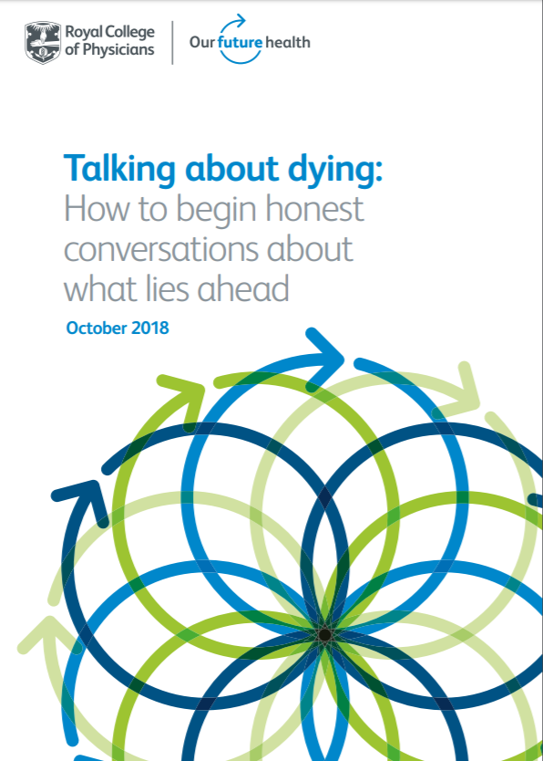
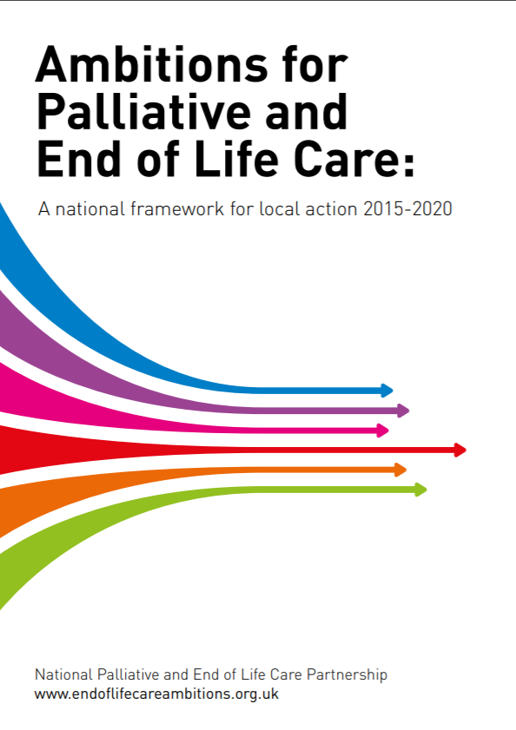

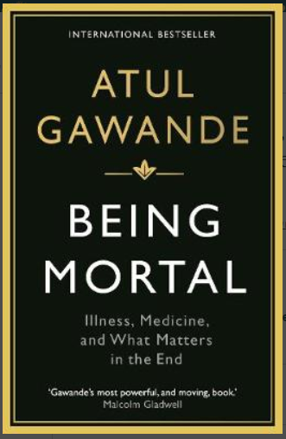
Resources:

Slide 9
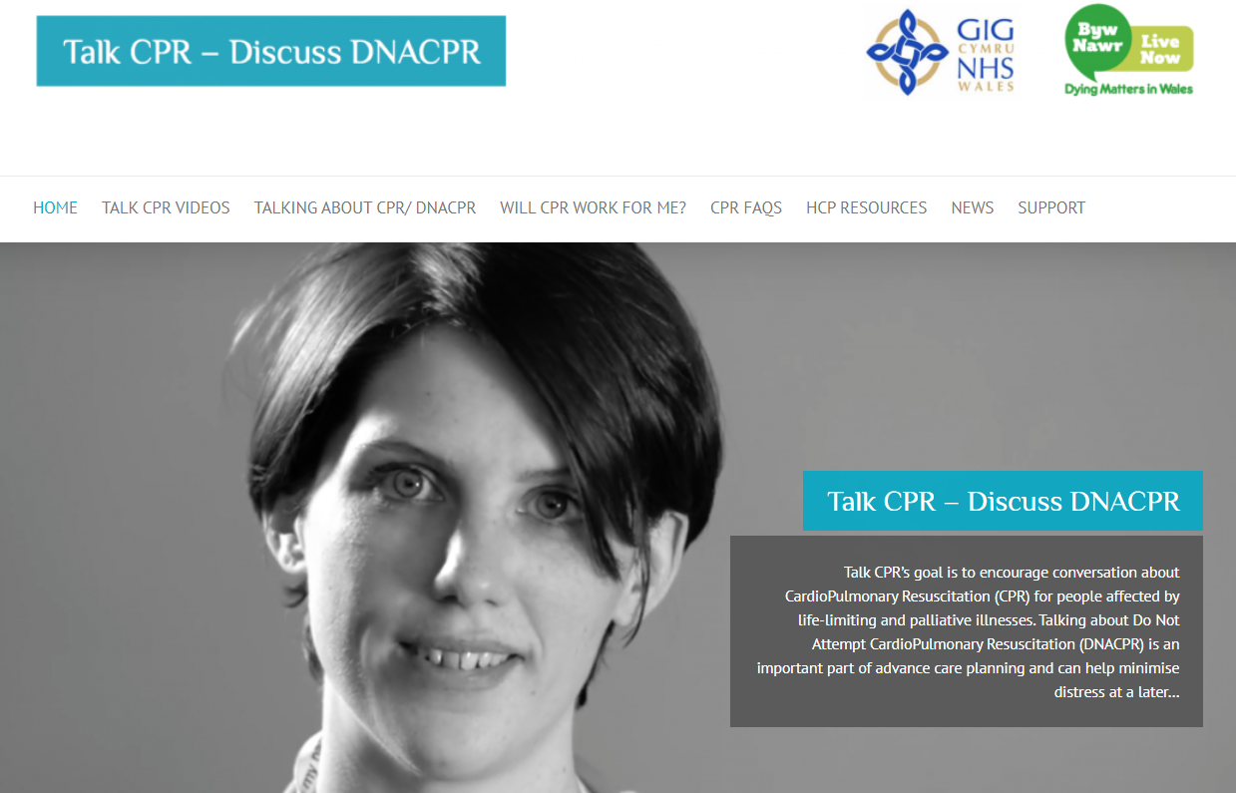

Slide 10
Feedback from With The End In Mind:
Nobody told us he could die.
I thought she was in agony/drowning – now I understand what we saw.
You’ve helped me to prepare my family.
I didn’t know you could explain things so fully.
I have new scripts to turn to that people really ‘get.’
Nobody taught us this in training.
“I don’t know how/whether/when to talk about dying with people.”

Slide 11
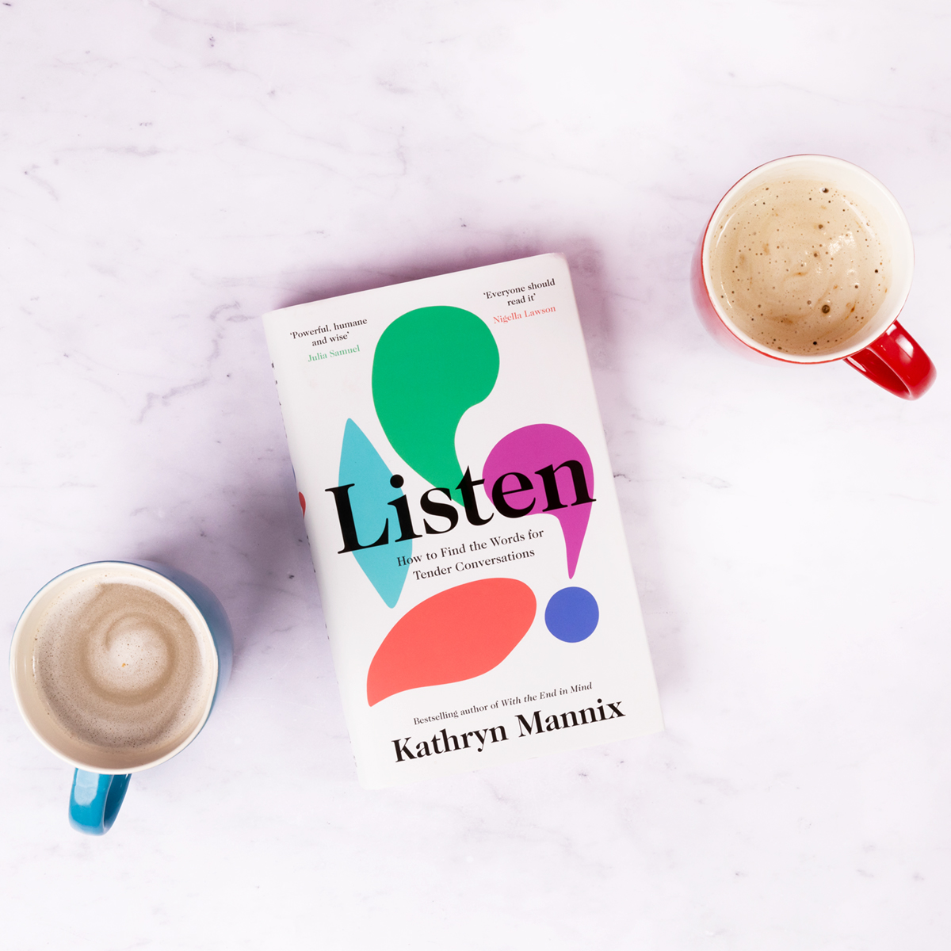
Key Message 3: keys to tender conversations
Invite, don’t insist
Listen to understand, not to speak/make your point
Be curious. What does this person think/know/believe?
Allow silences. That’s where the work happens
Expect and affirm difficult emotions. Give them space. Stay present.
Don’t try to talk about everything in a single discussion.
Finish safely.
Look after yourself. Look after each other.
LISTEN

Slide 12
To ponder…
How can we influence public understanding of dying?
How do we encourage each other to plan ahead?
Homework:
1. What two things can I discover about the provision and coordination of services today, that I didn’t know when I arrived?
2. What are the wider implications for services in Wales of people in my role not knowing this/becoming aware of this? What can we do better in future?

Slide 13
Dydd Gŵyl Dewi Hapus!

