Slide 1

Respiratory Strategic Network
North Wales Engagement Event
Dr Anthony Gibson

Slide 2
Aims of Today
Introduce the National Clinical Network Team
Describe how do we want to develop Respiratory Services across wales
  Where are we not delivering against agreed pathways
  How we prioritise with those within sub speciality areas and then with respiratory care ?
  Left shift services
How do start to report meaningful KPI’s, outcomes
  Data rich information poor
  How do identify some key metrics across key areas
  How do we start to collect PROM’s

Slide 3



Meet the network team
Joanne Oliver
Network Manager
Giorgie Rushton
Network Support Manager
Nicholas Francis
Project Support Officer

Slide 4



Asthma care levels have declined
Only 1 in 5 respondents have received all 3
elements of basic asthma care
Significant regional variation in care levels across
Wales
Basic asthma care levels
40%
40%
40%
Basic asthma care levels
36%
40%
35%
35%
34%
39%
31%
30%
29%
30%
UK 31%
30%
28%
30%
25%
32%
32%
25%
27%
26%
28%
26%
Wales 21%
20%
24%
20%
21%
13%
16%
17%
12%
10%
10%
0%
0%
2014 2015 2016 2017 2018 2019 2020 2021 2022 2023 2024

Slide 5
Asthma care levels have declined
~3 in 4 have an annual review
~half have their inhaler technique checked
Only 1 in 3 have a written asthma action plan
Provision of basic care elements
90%
80%
84%
80%
70%
60%
50%
40%
30%
20%
10%
0%
74%
74%
69%
72%
68%
68%
74%
59%
62%
63%
53%
56%
47%
51%
36%
39%
31%
31%
30%
Annual review Inhaler use check Action plan
25%
22%
27%
Aneurin
Bevan
Betsi Cardiff and
Cadwaladr Vale
Cwm Taf Hywel Dda
Morgannwg
Powys
Swansea
Bay
Wales

Slide 6
Asthma care levels have declined
Looking at provision of basic
asthma care elements:
# elements of basic asthma care
100%
Almost 1 in 5 aren’t receiving
90%
13%
16%
12%
basic asthma care
any elements
1 in 4 are only receiving 1
element
2 in 5 are receiving 2 elements
25%
28%
21%
30%
36%
80%
3
70%
35%
40%
47%
2
60%
39%
1
50%
32%
44%
43%
32%
0
40%
30%
34%
28%
14%
19%
24%
20%
19%
18%
24%
10%
19%
27%
18%
11%
17%
11%
17%
0%
8%
Aneurin Bevan
Betsi Cadwaladr
Cardiff and Vale
Cwm Taf Morgannwg
Hywel Dda
Powys
Swansea Bay
Wales

Slide 7
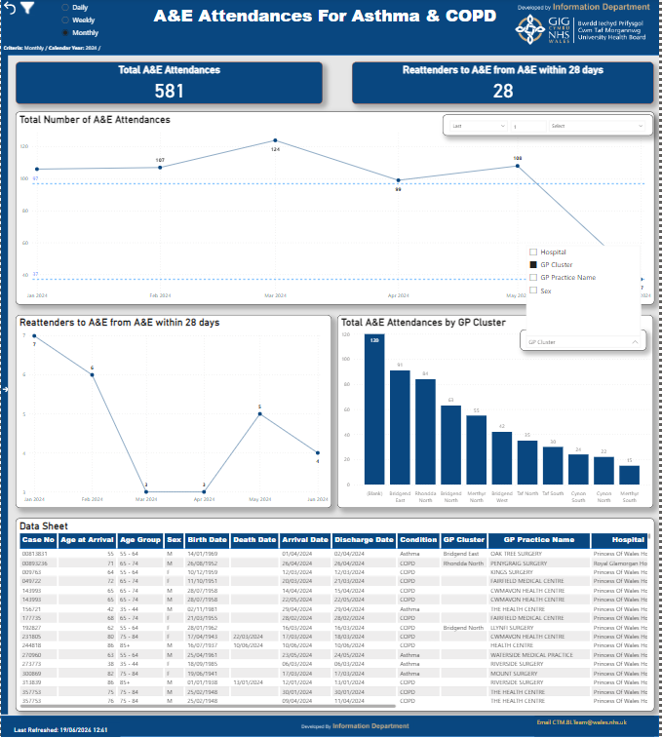
Example of what data could look like

Slide 8
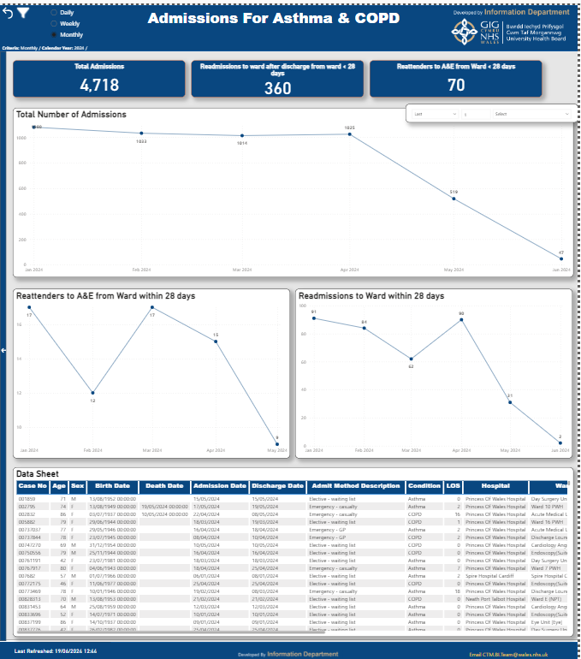

Slide 9
Spirometry
Access to spirometry is patchy across Wales
Some GP practices are doing spirometry and some are not
Different HB have different solutions to deliver spirometry
There is a lack of data on outcomes
Spirometry (and secondary care lung function tests) are not integrated into WCP, resulting in unnecessary repeated testing
The Respiratory Strategic Network sent out a spirometry survey to every practice in Wales in February 2024. The survey closed in May 2024 with the following results –
310 practices out of 387 responded (80.1% response rate)
58.4% are doing spirometry
41.6% are not doing spirometry, of these 54.3% are getting it done elsewhere

Slide 11
Spirometry next steps
A robust solution to provide spirometry not just for new patients, but to correctly diagnose existing patients on lists needs to be provided
A mixed model where practices that want to provide spirometry should be encouraged to do so, whilst others that can’t have a service that they can refer to
Spirometry results must be uploaded to WCP
Move away from primary/secondary care debate to a HB responsiblty to provide the service.

Slide 12
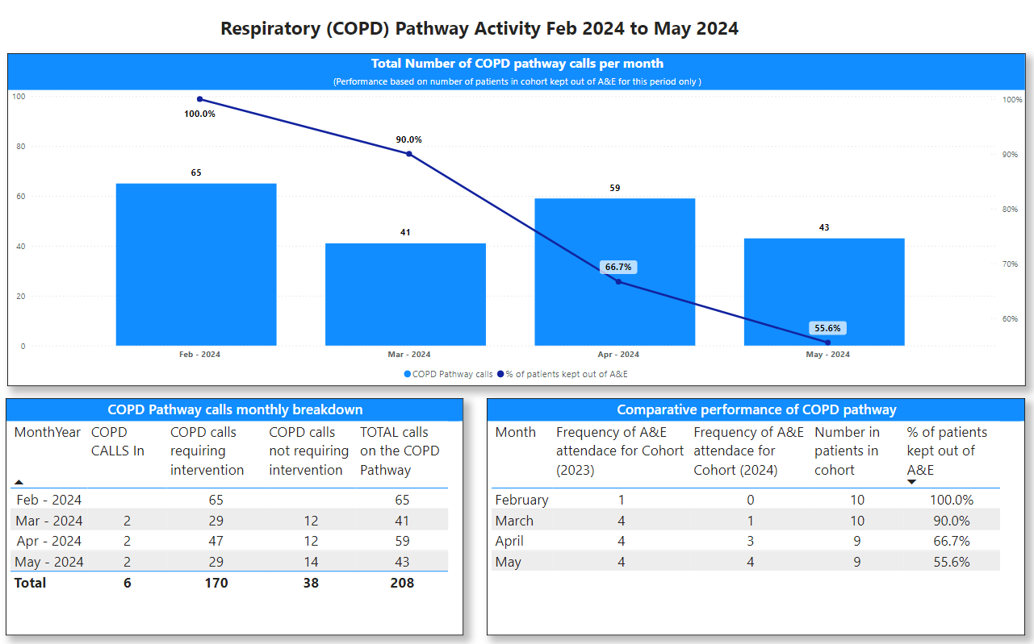
COPD Virtual Ward
The Clinical Navigation Hub (CNH) was developed in response to the Six Goals for Urgent and Emergency Care Programme. The aim is to implement an integrated service model that enables delivery of clinical assessment and care to avoid inappropriate conveyance to hospital.
The aim is to implement a Respiratory Virtual Ward, building on a recent trial which demonstrated positive results for one defined cohort of COPD patients from one CTMUHB locality.

Slide 13
COPD Virtual Ward
Once established the service will operate seven days a week and will offer several benefits-
Timely Intervention for Exacerbations
Continuous Monitoring and Support
Improved Capacity
Reduced Emergency Department Visits
Improved Adherence to Treatment Plans
Support for High-Risk Patients

