Slide 1




#RPLDcymru
Croeso
Croeso
Welcome
Codi Ymwybyddiaeth o Arferion Cyfyngol
Raising Awareness of Restrictive Practice
Notes:
Welcome to todays event
I am Ruth Wyn Williams and I will be your Co-chair with …………………
Together with Learning Disability Wales and Social Care Wales Improvement Cymru have invited you here to talk about restrictive practices
The day has been co-produced and we have designed the day to help you
All slides will be in Easy Read

Slide 2
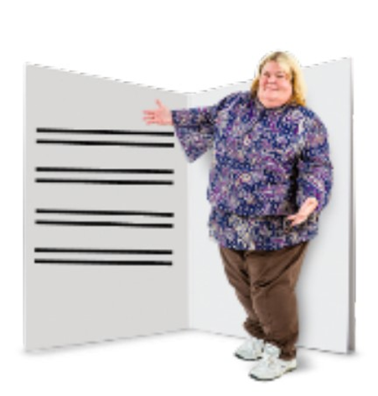
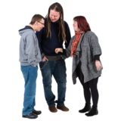
Amcanion y Dydd
Aims of the workshop
Arferion Cyfyngol
Beth yw e
Hawliau dynol
Beth allwn ni ei wneud
Dysgu drwy siarad
Cymorth ar gael
Hamddenol a gafaelgar
Restrictive Practice
What is it
What does it look like
What are our rights
Learning through talking
Support available
Relaxed and engaging
Notes:
The day will start at 10:15 this morning and will finish at 3pm
We have plenty of breaks including lunch at 12:35
During the day we want to help you:
Understand Restrictive Practices
How to recognise restrictions when they happen
Understand why restrictions may be used and what your rights are
We believe the best way to learn about restrictive practices is through talking
We want to give you opportunity to as questions
To help you volunteers will be with you on your tables. (encourage to put hands up) These people will help you throughout the day.
It is important to us that you get the most out of today and have a positive experience. We will ask you for feedback at the end.

Slide 3



Symud o gwmpas yr adeilad
Moving around the building
Larwm tân
Toiledau
Ystafell newid i oedolion
Ystafelloedd llai
Lluniaeth
Fire alarm
Toilets
Adult changing room
Smaller rooms
Refreshments
Notes:
We are not planning to test the fire alarm
If you hear the alarm make your way out the room and follow the instructions of staff
Toilets are located and if you are unsure just ask any of the people here to help you
We have adult change room located next to the hotel
If you don’t want to raise your hand you can use the Green and Orange cards located in front of you.
Green is I am ok and want to talk
Orange is I think I need some help
If you want some quiet time away for the room we have some small quiet rooms for you.
Please do not leave valuables in the room
We will come together for lunch and refreshments with opportunities to meet each other.

Slide 4

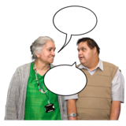

Rheolau Sylfaenol
Ground Rules
Byddwch yn garedig
Gwnewch amser i siarad
Parchu pob barn
Cewch fynd a dod fel y mynnwch
Rhowch amser i feddwl
Parchu preifatrwydd
Be kind
Give time to talk
Respect all views
Come and go as you please
Give time to think
Respect privacy
Notes:
We would like to beginning by setting some ground rules.
Here are some of the ground rules that we have
We think it is important to be kind to each other
We don’t always agree with each other but we should respect opinions
We want to give everyone chance to talk
We think I tis important to share our experiences but we don’t feel it is necessary to name people. We should be aware that this may upset people.
Are there some more you think we should include?

Slide 5
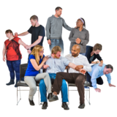
Beth yw Ataliaeth
What is Restraint
Pan mae rhywun yn stopio person arall rhag gwneud beth maen nhw eisiau ei wneud, neu gorfodi rhywun i wneud rhywbeth nad ydynt eisiau ei wneud
Is when someone stops another person from doing what they want or making them do something they don’t want to do
Notes:
Our government says that restraint Is when someone stops another person from doing what they want or making them do something they don’t want to do
Sometimes people who care and support us may use restraint and restrictions practices to keep you and others around you safe from harm
However, there are often concerns that other alternatives could have been used instead
There are 6 types of restrictive practice
To understand what restrictive practice is we will use video, discussion and storytelling

Slide 6


Slide 7
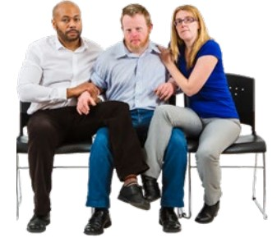
Ataliaeth Corfforol
Physical Restraint
Notes:
Physical Restraint is when people use their arms and legs to stop you from doing something or make them do something they don’t want to do.
In this picture Johnny is being made to sit down on a chair
The two people to his side are holding him on his arm, shoulder and legs to prevent Johnny moving
This is physical restraint
It looks different to other forms of physical contact from friends and family hugging and partners cuddling
Can you have a look at the photos on your table and decide which photos do you think look like physical restraint
Talk to each other. There are no right or wrong answers here

Slide 8
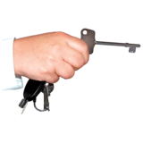
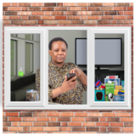
Ataliaeth Amgylcheddol
Environmental Restraint
Notes:
Environmental restraint is when the persons surroundings have been used to stop them doing something they want to do
Mary lives in a house with other people and staff care for them all every day and through the night
Throughout the day the doors and windows are locked to keep Mary safe
Mary does not have a key and cannot leave the house without permission
Can you have a look at the photos on your table and decide which photos do you think look like environmental restraint
Talk to each other. There are no right or wrong answers here

Slide 9
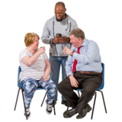
Time for a Break
Amser Egwyl
Notes:
Coercion is when someone makes you do something or stops you from doing something by using wards that make you feel frightened or upset
This type of restrictive practice is sometimes difficult to recognise and can be subtle
In this picture Harry is being told that he cannot go swimming until he takes his medication

Slide 10
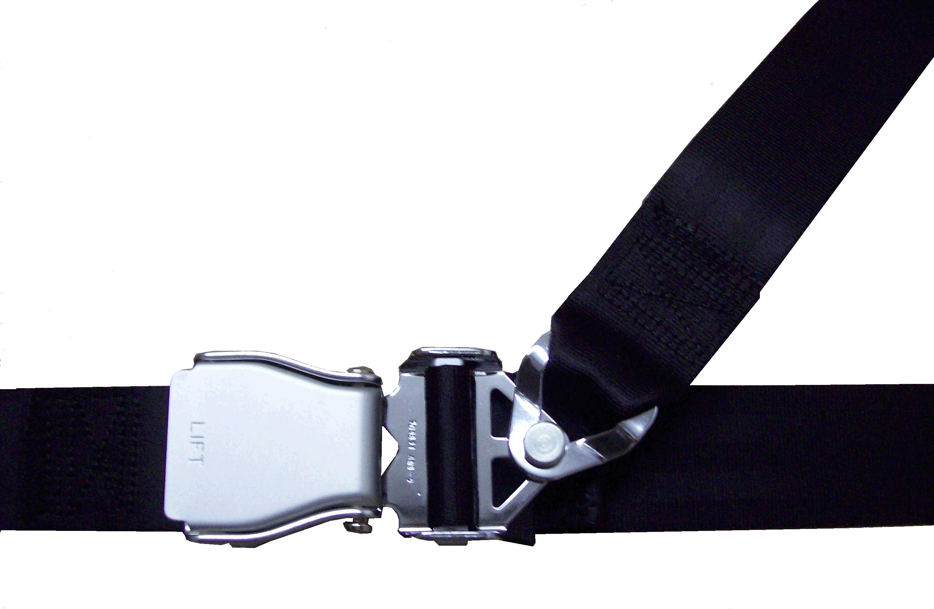
Ataliaeth Fecanyddol
Mechanical Restraint
Notes:
Mechanical restraint is when equipment is used to prevent a person from moving and they cannot remove the equipment themselves
When Johnny is in the car a belt is used to keep him in the seat. Johnny cannot remove the belt himself.
Can you have a look at the photos on your table and decide which photos do you think look like physical restraint
Talk to each other. There are no right or wrong answers here

Slide 11
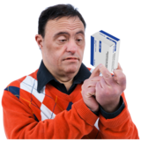
Ataliaeth Gemegol
Chemical Restraint
Notes:
Chemical restraint is when medicine that can make you sleepy and relaxed is used to manage a persons behaviour and to stop them doing things they want to do
Bill is given medicine everyday because he gets angry
Sometimes he is given extra medication when he very angry
Can you have a look at the photos on your table and decide which photos do you think look like physical restraint
Talk to each other. There are no right or wrong answers here

Slide 12
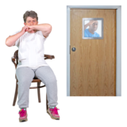
Arwahaniad
Seclusion
Notes:
Seclusion is when a person is put in a room or area on their own away from anyone else, including people who are caring from them.
The person in seclusion is unable to leave the room by themselves
In this picture Wendy has been put in a room on her own and the carer is seen looking through the window to check she is ok.
Can you have a look at the photos on your table and decide which photos do you think look like physical restraint
Talk to each other. There are no right or wrong answers here

Slide 13
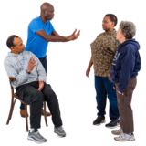
Arwahaniad neu Ynysu Gorfodol
Segregation or Forced Isolation
Notes:
Segregation is when a person is separated from other people they live with or their friends and family but the carer stays with them at all times
This can be a separate room or part of a building
Can you have a look at the photos on your table and decide which photos do you think look like segrgation
Talk to each other. There are no right or wrong answers here

Slide 14
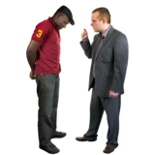
Coercion
Gorfodaeth
Notes:
Coercion is when someone makes you do something or stops you from doing something by using wards that make you feel frightened or upset
This type of restrictive practice is sometimes difficult to recognise and can be subtle
In this picture Harry is being told that he cannot go swimming until he takes his medication

Slide 15
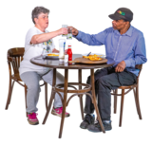
Cinio
Lunch
Notes:
Coercion is when someone makes you do something or stops you from doing something by using wards that make you feel frightened or upset
This type of restrictive practice is sometimes difficult to recognise and can be subtle
In this picture Harry is being told that he cannot go swimming until he takes his medication
We are back in the room at 1:30pm

Slide 16
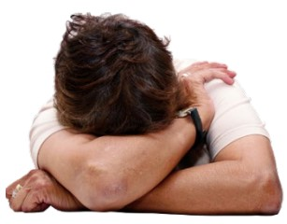

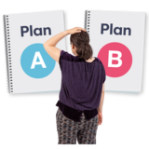
How Restrictive Practices are Used
Sut Mae Arferion Cyfyngol yn cael eu defnyddio
Notes:
Restrictive practices are used to keep people safe
When restrictive practices are used it can be very upsetting and sometimes people can be hurt
It is not a nice experience for anyone
Because of this the government has laws to make sure that restrictive practices can only be used with permission and when all alternatives have been tried
If a person cannot give consent because they cannot make a decision about the use of restrictive practice then there are rules that must be used to decide if the restriction is
Proportionate
Time limited
Last resort
We are going to show you another video from Welsh Government about how people should listened too and involved in decisions about their lives.

Slide 18






Beth yw Eich Hawliau Dynol
What are Your Human Rights
Notes:
You often hear people talk about peoples human rights
It can be difficult sometimes to understand what our human rights
This afternoon we are going to explore what this means for you and how it is important you understand your rights when we talk about restrictive practice
We will look at times when restrictive practices are used to keep people safe
We will explore how restrictive practices cannot be used
We will explore why knowing your rights is important and why asking questions about the use of restrictive practices can help
We will also talk about how some people will need help to have their voices heard and the role of an advocate

Slide 19

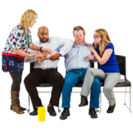
Hawliau Dynol ac Ataliaeth
Human Rights and Restraint
+
Notes:
Human Rights act says Restraint is an action to limit a person's movement, liberty or freedom to act independently.
Restraint can include physical, mechanical and chemical forms of control, coercion and forced isolation. These can also be called ‘restrictive interventions’ (European Commission on Human Rights)
Restraint should only ever be used within the principles of least restrictive and last resort. That is the least restrictive method with the least amount of force (proportional to the risk) for the minimum amount of time. They should only be
used if absolutely necessary (if there is a genuine belief that harm is likely to occur to the individual or others if it is not used, and if other less restrictive methods have been tried and have failed). Restraints that cause pain intentionally should never be used
An act of restraint must comply with the basic legal principles below when carried out by a person performing a public function or providing a public service, whether they are employed by the state or private contractors. This includes restraint by teachers,
police, prison and immigration detention officers, NHS and social care professionals.
It is never lawful to use:
1. restraint with intent to torture, humiliate, distress or degrade someone5
2. a method of restraining someone that is inherently inhuman or degrading,
or which amounts to torture
3. physical force as a means of punishment, or
4. restraint that unnecessarily humiliates or otherwise subjects a person to
serious ill–treatment or conditions that are inhuman or degrading.

Slide 20

Cydsynio
Consent
Notes:
One of the rights that we have; is the right is the freedom to choose what we do and what we don’t do
In the UK it is assumed that all adults have the ability to make their own choices, even if others disagree with those choices
This is called giving consent and it is an import right that all adults have
For children, parents will give consent
When we give consent we give permission
Can you have a discussion on your table about what things you give people permission to do and without your permission they could not do

Slide 21

Dim i Mi Hebdda i
Nothing to Me Without Me
Notes:
There are rules about how restrictive practice is used
Nobody can use restrictive practice on you without your consent
You should be included in all discussions about restrictions and there must be a plan on when, how and what should be used
When a person cannot give permission
Family and advocate should be involved
A decision on whether restrictions are in the persons best interest should be used.
What questions would you want to ask about restrictive practice
If it is a restrictive practice
If it is lawful

Slide 22
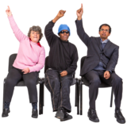
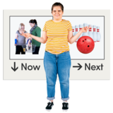
Questions & Next Steps
Cwestiynau a'r Camau Nesaf
+
Notes:
Any questions from the room
What would help you to know more about restrictive practices e.g. video, leaflets, people talking in groups
We also want to know what you thought of today
Post it: Blue/green was good Orange what could we do better red/pink what we could do better

Slide 23
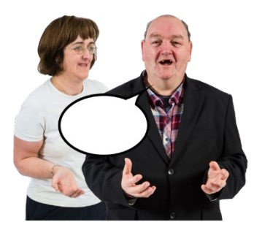
Eiriolwr
An Advocate
Notes:
Would anyone like to share what they think an advocate does?
An Advocate is someone who knows you, knows what you like and what you don’t like
This person can represent your wishes and act on your behalf
Advocates are important for people who cannot give permission themselves (Consent)
or
need a little help to be heard

