Slide 1
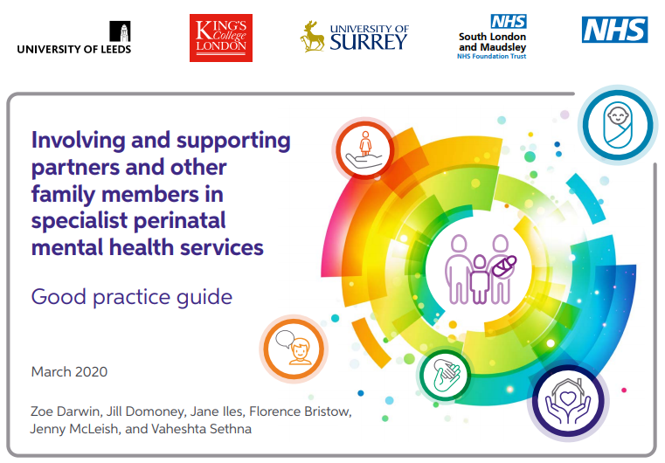
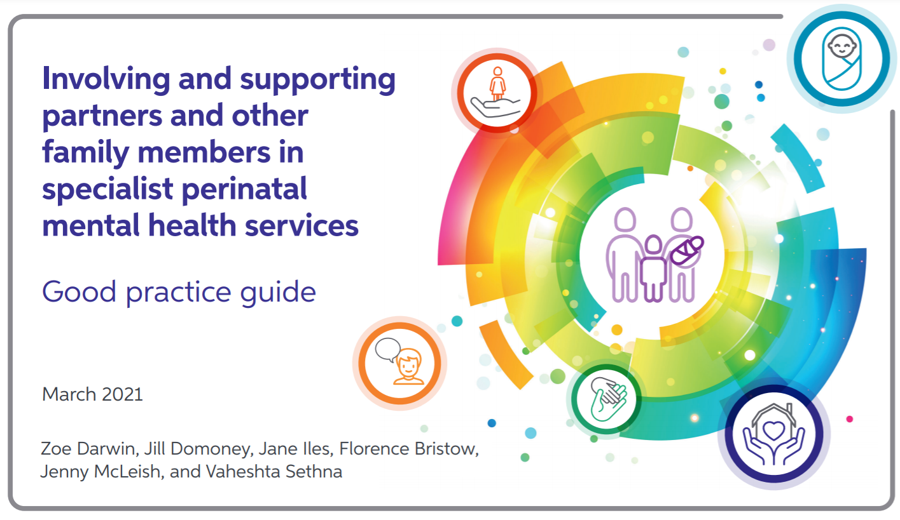
Dr Zoe Darwin, University of Huddersfield
Dr Jane Iles
University of Surrey PsychD
On behalf of the Perinatal Mental Health Families Team
January 2024

Slide 2

How is this relevant to my role?
Will I do anything differently as a result of this session?

Slide 3
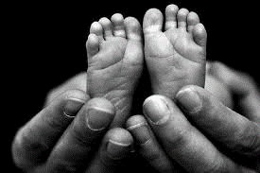



Why is the guide needed?
The whole family can be affected by perinatal mental health
Can be a very stressful time, as the whole family adjusts
Fathers, other co-parents, partners and other family members may face demands & worries
May play a key role in a birthing person/ mother’s recovery, e.g. notice deterioration, provide support
Support can improve mental health & relationship outcomes, reducing input needed from specialist mental health services
In-patient and community specialist PMH services need to support birthing people and mothers, AND also think about the other important people around them/ in the infant’s life

Slide 4
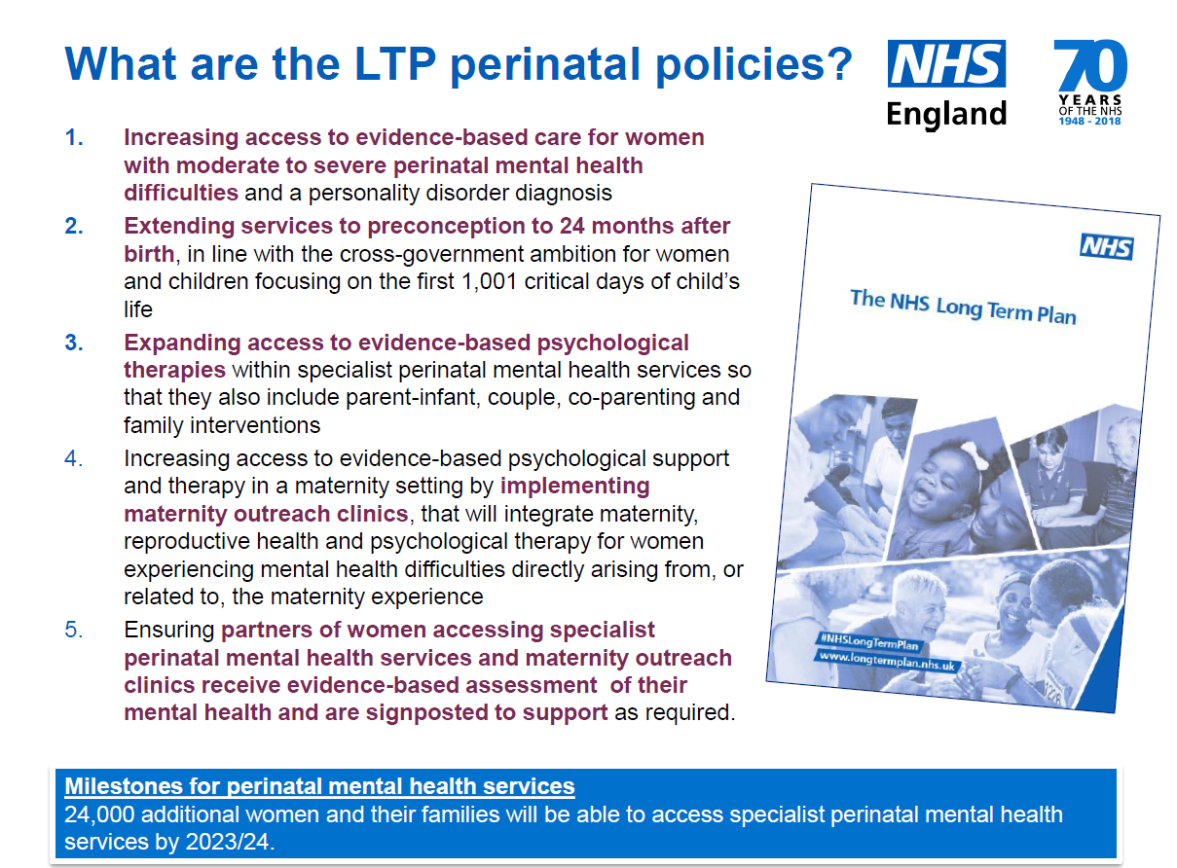
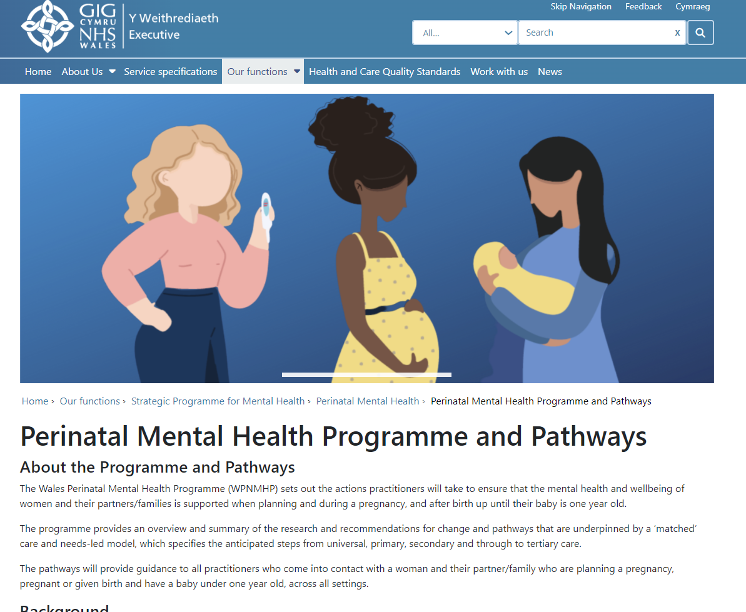

Slide 6
The remit…
To develop, publish, and disseminate a good practice guide & case study series on involving and supporting partners of women accessing specialist perinatal mental health services as well as other significant family members.
This will guide staff in inpatient and community specialist perinatal mental health services to deliver high-quality care that includes appropriate involvement and support for partners and significant family members of the women and babies who are accessing these services.

Slide 7

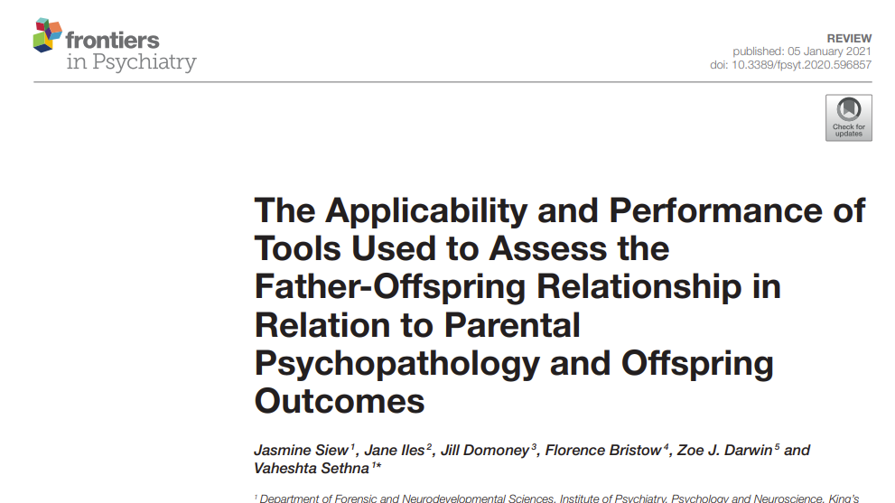
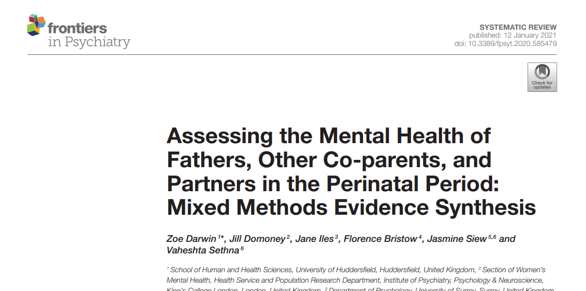
Development of the Guide
Rapid reviews
(published literature)
Signposting to related existing guidance
Practice examples
(services in England)
Development of the guide
Patient & Public Involvement
Online survey
(professionals & service users)
Expert reference group

Slide 8
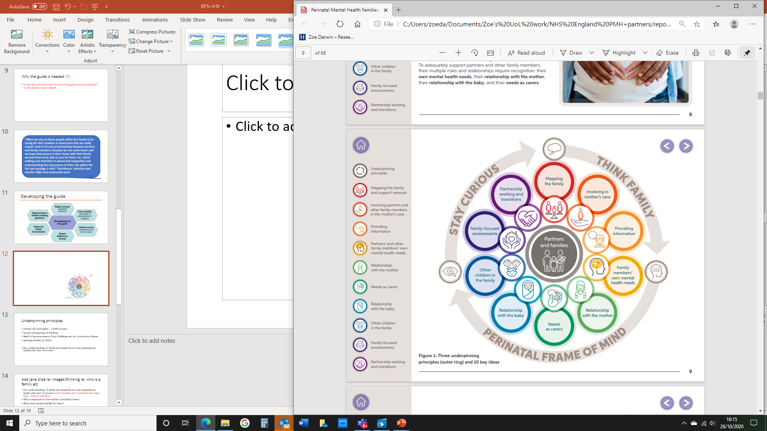
Overview of the guide
3 underpinning principles that build on existing concepts for working with families
10 key ideas
Practice tips offer suggestions to guide services
Practice examples helps to illustrate ways of working

Slide 9

Families…..

Slide 10
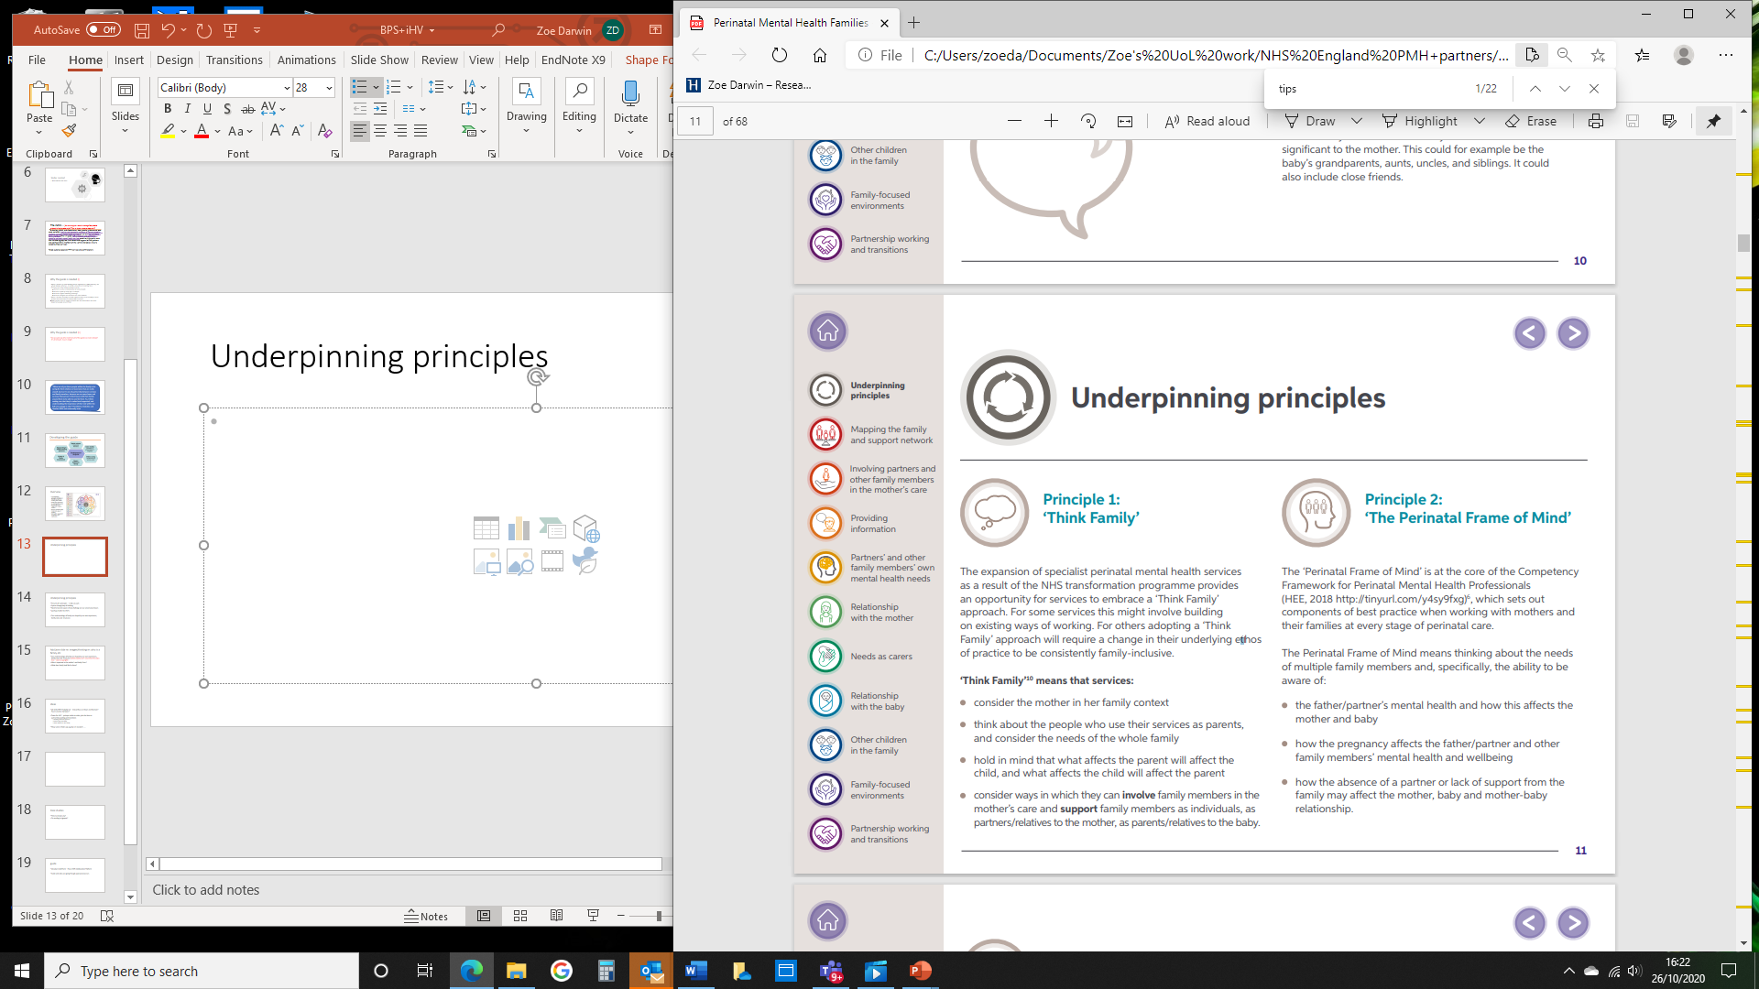
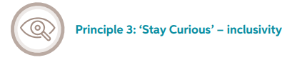
Three Underpinning Principles
Consider the mother in their family context & the needs of the whole family
Think about the needs of multiple family members, including the co-parent’s/partner’s mental health & how this affects the mother and baby
Think inclusively about how families are formed and who may be important to the mother and baby

Slide 11
10 key ideas

Slide 12
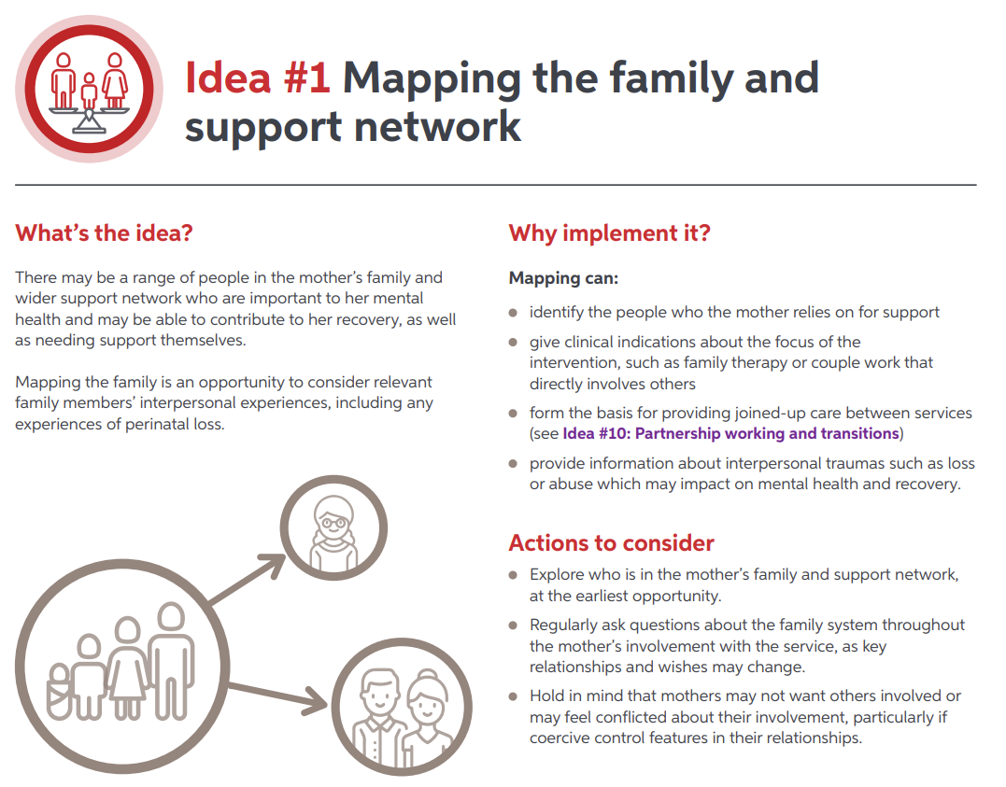

Slide 13
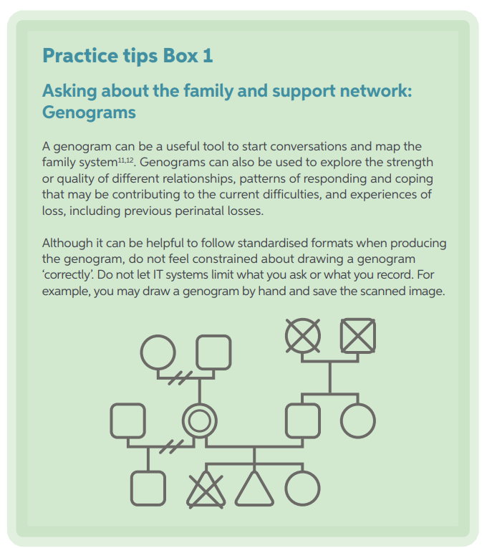

Idea Number 1: Mapping the Family

Slide 14

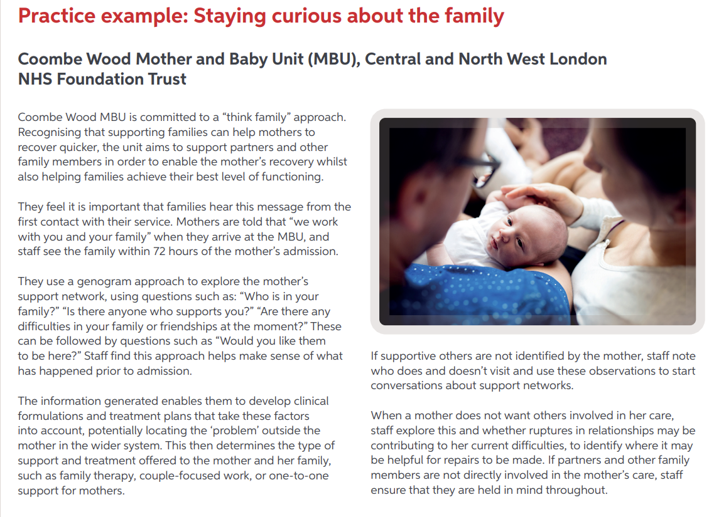

Slide 15
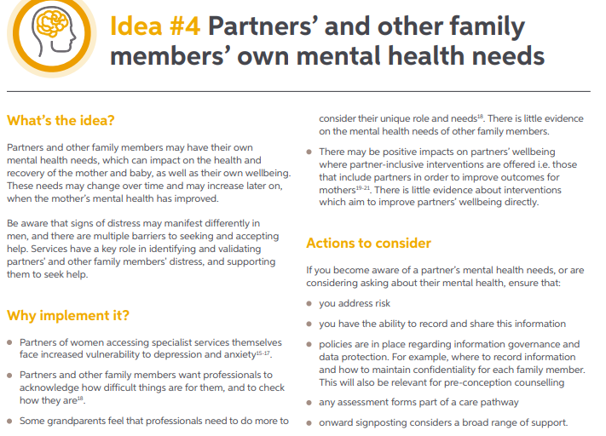

Slide 16
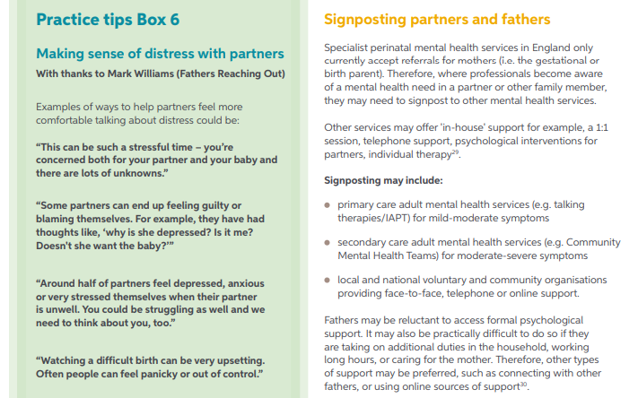

Slide 17
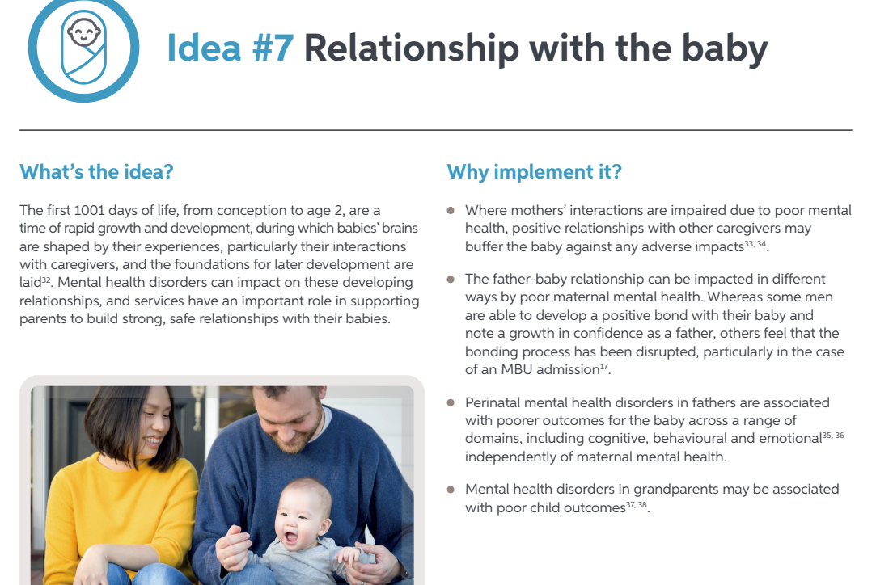

Slide 18
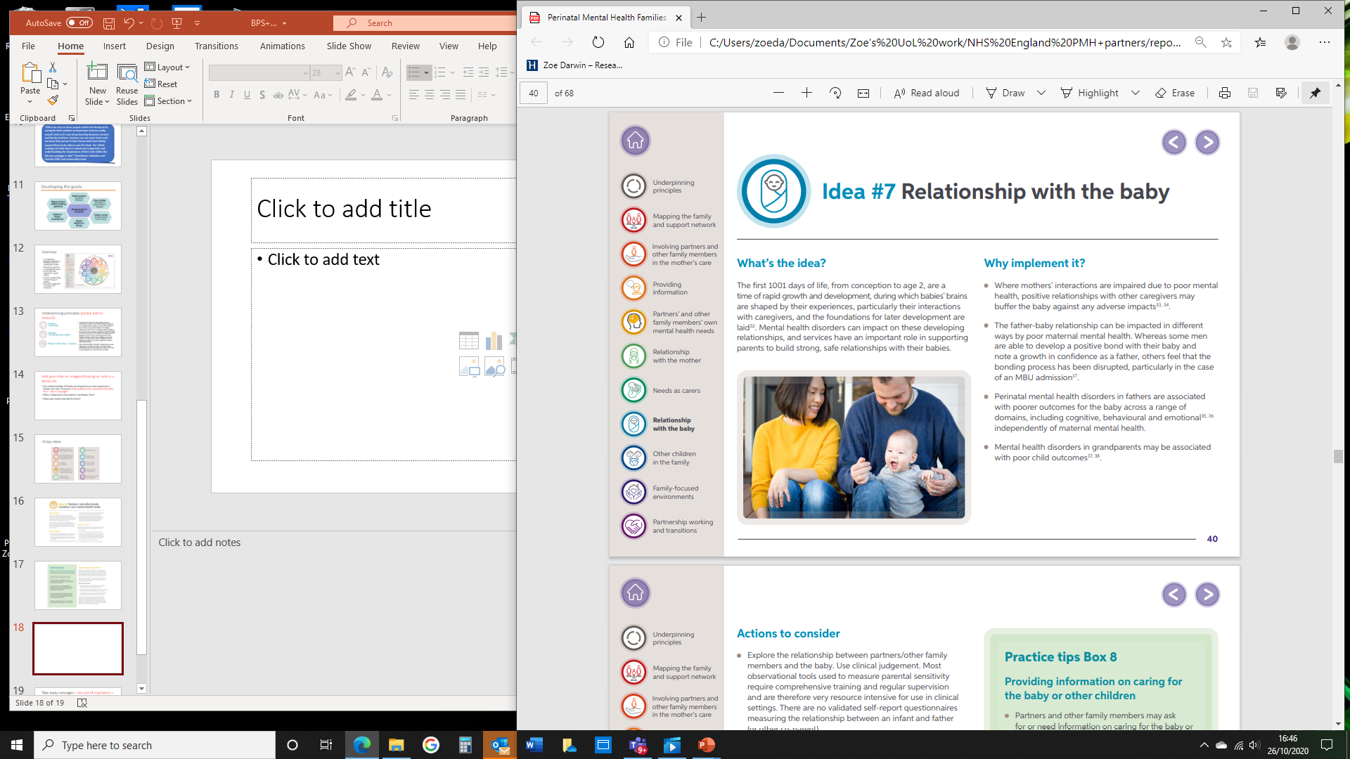
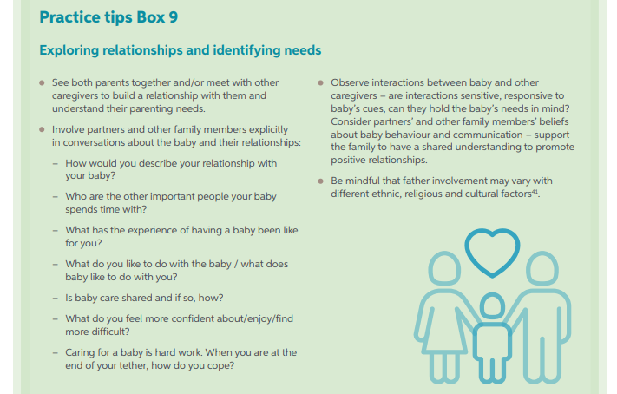

Slide 19
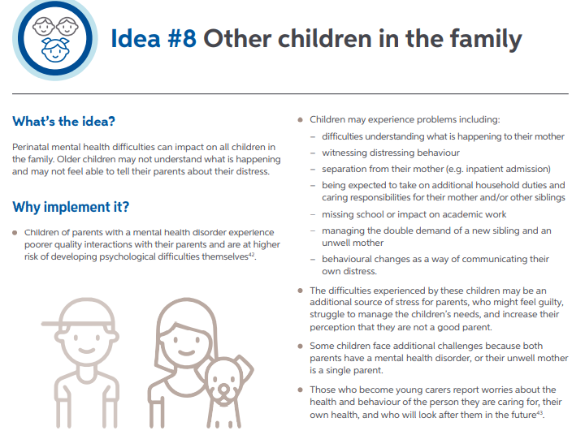

Slide 20
VIDEO

Slide 21
How is this relevant to my role?
Will I do anything differently as a result of this session?

Slide 22

Implementing into Practice!
What can be done?

Slide 23

Stay curious & change ‘excluding’ language
Ask questions
Who is in the family & who is important?
Who may be struggling & may need support?
What has changed for you and your family/ network?
Don’t make assumptions
Recognise own biases and assumptions about families and mental health
And challenge these!
Ask partners what support they want or need

Slide 24
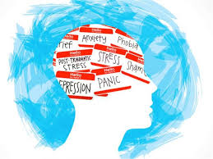
Validate and reduce shame
Validate fathers’, other co-parents’ and partners’ experiences
Reduce stigma and shame
Help them to make sense of their experiences and their distress
Provide information on the importance of self-care & seeking help
Consider their needs as a carer
How do they feel about this role?
Are they entitled to any additional support?

Slide 25
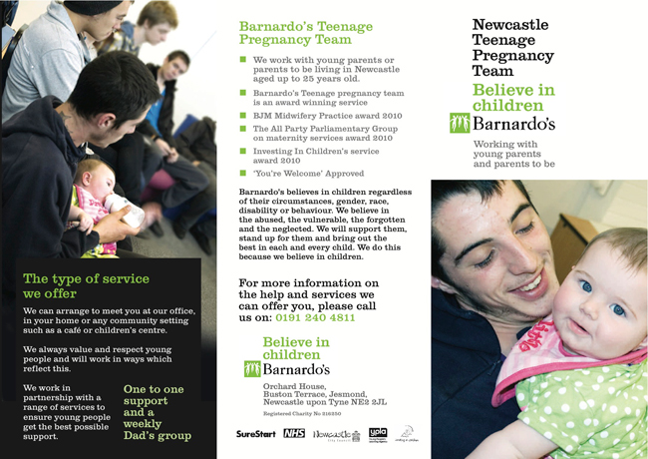
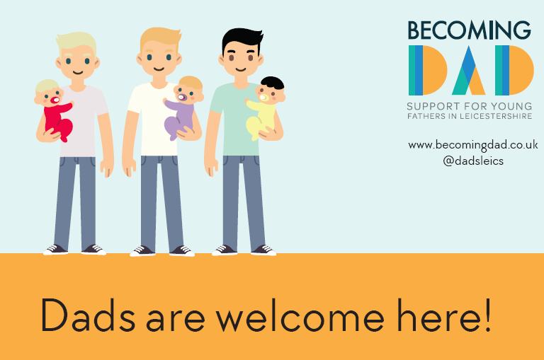
Family-focused environments:
Positive imagery of fathers, co-parents & partners, including from diverse backgrounds, representing local population
Include extra chairs at appointments
Consider clinic times/ working hours
It's quite uncomfortable as a man … you've gotta be one of the mums …. It's not really a male environment, or an environment where they thrive (Kemp, 2011)

Slide 26

A changing landscape…

Slide 27

In Conclusion….
Contact details: Jane Iles - j.iles@surrey.ac.uk Zoe Darwin - z.darwin@hud.ac.uk

