Slide 1

Dads – why their mental health matters.
Kim Jones
Specialist Health visitor perinatal mental health – CAVUHB.
Notes:
Hi thank you for allowing me to speak today.
My name is Kim Jones and I am the specialist health visitor perinatal mental health for Cardiff and the Vale UHB.
I am going to be looking at dads, the science of becoming a dad and why their mental health is as important as the mums.
My presentation today is based around training delivered by the iHV,.

Slide 2
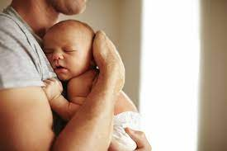
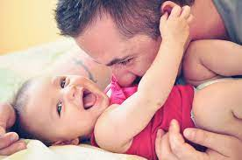

Why do dads matter?
Dads make a difference!
Majority adjust well to changes and challenges of fatherhood
Human men – select group that provide direct care to their infants (only 10% mammals do)
Babies can form as strong an attachment to their dads as their mums.
Fathers are as capable as mothers at responding sensitively to their child's needs
Notes:
Dads make a difference!
Human men – select group that provide direct care to their infants (only 10% mammals do) – Orangutans. Seals, elephants and sea lions.
Research attachment theory concentrated on the attachment between the mother and the infant –
Researchers come to the same conclusion babies can form as strong an attachment to their dads as their mums.
Father infant relationship important - Views are changing- dads have always had the power to nurture!
Studies have found that fathers are as capable as mothers at responding sensitively to their child needs. The majority of children will have established an attachment relationship with their father by the time they are 8 months old if the father is living with them (Kotelchuck, 1976, Lamb & Lewis 2010)
Ultimately - Ensuring the health and wellbeing of families with young children is the foundation of a healthy society.

Slide 3


Father-Infant relationship
Men’s hearts race as fast as women’s when they hear their baby cry
Fathers can recognise their own infants, blindfold, just by touching their hands – after only an hour spent cuddling them
Frequent, regular, quality interactions with infant are associated with positive child outcomes through to adolescence
Babies with strong attachments to their dads tend to have fewer behavioural problems later on
Substantial father involvement from at least the first month after birth promotes better language development and better cognition skills (higher IQ scores)
Fatherhood Institute (2014, 2022)
Notes:
A study by the fatherhood institute in 2014 highlighted the following around fathers relationships with their children.
Men’s hearts race as fast as women’s when they hear a baby scream
Fathers can recognise their own infants, blindfold, just by touching their hands – after only an hour spent cuddling them
Quality and quantity of baby-father contact has a direct impact on how secure children feel growing up
Children who spend more time playing with their dads, are more likely to be sociable when starting school.
Babies with strong attachments to their dads tend to have fewer behavioural problems later on
Substantial father involvement from at least the first month after birth, promotes better language development and better cognition skills (higher IQ scores)

Slide 4
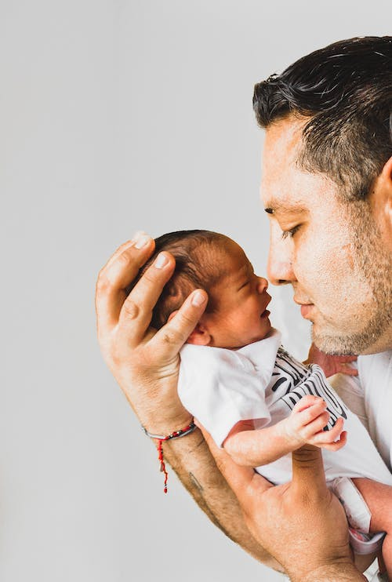
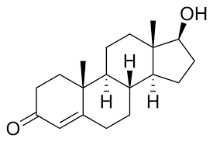

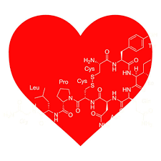
The science behind becoming a dad
Hormones
Testosterone – levels drop, never to return to pre-birth level. More sensitive parenting, better attuned to child’s needs.
Oxytocin – key bonding hormone. Oxytocin levels synchronise with partner – parenting team. Oxytocin released when interacting with the baby/child. Highest levels of oxytocin released with dads - when they play
Prolactin – More responsive and sensitive to babies cues.
Notes:
What makes a dad a dad .
We are aware of the biological and hormonal changes which occur in the mother when she is pregnant and has a baby, - hormones fluctuate, bodies change and brains rewire. But what about the father - well actually they go through similar changes!
Hormones
Testosterone –
Great when in mating/dating game – makes men more competitive, more motivated to look for a mate
Research shows that when a man becomes a father for the first time, testosterone levels drop (by about a third) never to return to the pre-birth level.
Shift the focus from mating (high levels are a bonus) to parenting.
Studies have shown that men with lower testosterone – more sensitive parent, more patient and better attuned to childs needs,
very helpful with toddler
(Make impact of oxytocin and dopamine greater – involved with bonding (produced when you cuddle and interact with baby)
However this drop can make more vulnerable to PND – testosterone protective factor.
Oxytocin – love hormone - key bonding hormone, (trigger for contractions and milk production).
Men have spikes in oxytocin too. It spikes when they hold their newborn, If live with partner, studies have shown that dads oxytocin levels synchronise with their partner, bringing them closer together – parenting team.
Released when playing/interacting with the baby/child. Activities which relases the most oxytocin for parents differ - Dads have higher levels when playing with child (Mum caring). Dads so get hit from care givining however not as high.
Prolactin – (Production of breastmilk) Fathers with higher prolactin levels play with their babies in ways that are beneficial to their learning and exploration. More responsive and sensitive to babies cues – increase dads desire to be close.

Slide 5
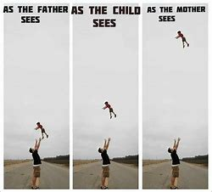
Science of dads…..
Brain
Womens brains rewire when become parent for first time – so do dads!
Increase in grey and white matter
Mums – peak activity centre of the brain; relates to nurturing, affection and threat detection Keeping baby close
Dads – peak activity outer area, neocortex; relates to social interaction skills and pushing boundaries Preparing for the world
Same sex couples – peaks in both areas!
(Machin, 2018)
Notes:
Brain:
We know that women's brains go through a rewire when they become mothers for the first time – recent studies have also shown that this is true for dads.
Scans have shown an increase in grey and white matter – neurons and connection in key areas. Linked to affectionate care and threat detection
However there are differences between parents when interacting with their children.
Mums – peak activity sits in the centre of the brain – nurturing and affection and threat detection.
Dads – peak is outer area neocortex – social interaction and pushing boundaries.
It is thought that differences represent splitting of responsibilities between sexes – roles complimentary. Each parent has a important and unique role.
Same sex couples – experience same changes – both fathers get peaks in both areas of the brain – meaning primed to fulfil both roles.
Dr Anna Machin – Evolutionary Anthropologist.

Slide 6
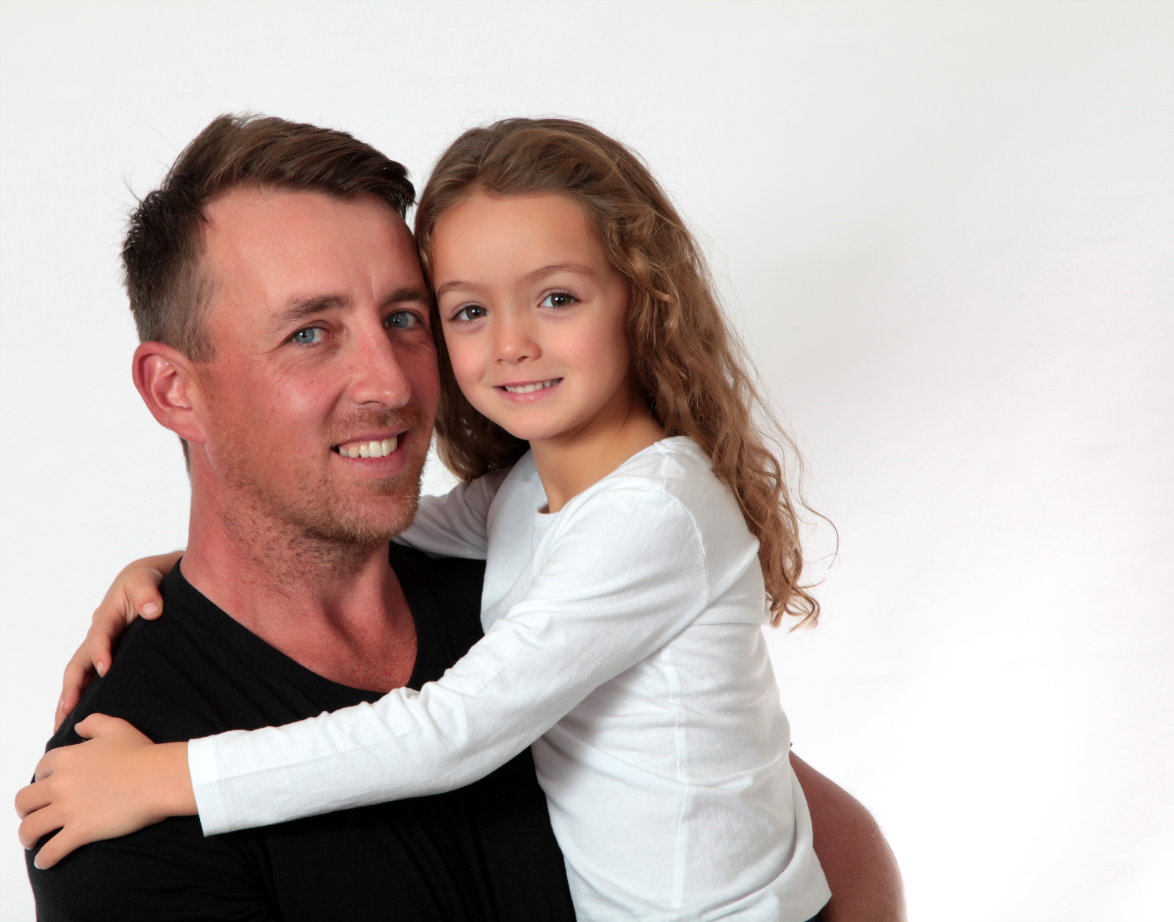

Why should we work with fathers?
Benefits to the child:
Greater empathy
Higher self esteem
Better relationships
Higher education
Fewer behaviour problems
Lower criminality.
Benefits to the mother:
Reduction in depression
Increased breastfeeding
Improved engagement with antenatal care.
This Photo by Unknown Author is licensed under CC BY-ND
Notes:
Why should we work with and support fathers
There has been an increasing focus on the earliest years of life, however comparatively few studies have addressed the role of fathers, despite their being an association with child behaviour development.
The children of fathers who are involved in a nurturing relationship with them;
Show Greater empathy
Have Higher self esteem
Have better relationships with their peers and in the future
Achieve higher education outcomes
Have fewer behaviour problems
And lower criminality.
We know that undiagnosed and treated mental ill health in Fathers can have an impact on their children:
Paternal mental illness can affect their child’s behavioural, social, cognitive and emotional development (Ramchandani et al, 2005)
A study by Ramchandani showed that severe depression in fathers is associated with high levels of emotional and behavioural problems in children aged 3.5 years, and in particular in boys
And that children with 2 depressed parents are at an even higher risk of poor developmental outcomes (Brennan et al 2002)
We also understand that ,
Depressed mothers more likely to turn to their partners for support
Perceived support from the baby’s father is strongly correlated with lower rates of depression in women in the perinatal period
‘Well’ fathers can act as ‘buffers’ protecting the child from any negative effects of the mother’s depression. The fathers’ support has been found to shield the infants of chronically depressed mothers from negative outcomes (Field, 1998), and reduce the mothers’ parenting stress (Jackson, 1999)
Fathers’ attitudes and behaviour play a significant role in mothers’ decision to breastfeed. Where fathers are supportive of breastfeeding it is more likely to be successful. Low-income women in particular suggest that male support is crucial in their decision to breastfeed.
Involved fathers can also reduce stress for the mother in pregnancy and as such contribute to the positive nurturing environment for the developing foetus.

Slide 7

And the fathers?
Fathers with close, connections with their children:
Live longer (Mansdotter, 2008)
Have fewer mental health problems
Have fewer physical health problems
Are less likely to abuse drugs
Are more productive at work
Report being happier than fathers who do not have this connection.
(MenCare 2015)
This Photo by Unknown Author is licensed under CC BY-SA-NC
Notes:
And for the fathers….
Fathers who are highly involved in caring for their babies and children:
Live longer (Mansdotter, 2008) and have high levels of satisfaction in mid life (Snarey, 1993)
They show activation of brain networks linked to emotional processing and social understanding (Abraham 2014)
Have fewer physical health problems
Are less likely to abuse drugs
Develop greater commuintment, attachment and responsiveness to their children (Atzil 2012)
And have fewer mental health problems –

Slide 8

Why father’s mental health matter?
Focus of recent years on maternal mental health in the perinatal period.
MH needs of fathers often neglected, inadequately understood and poorly addressed.
Recent growing body of research:
Importance of fathers and significant others
Fathers unaware of possibility of perinatal MH challenges (Das and Hodkinson 2019)
Fathers can also experience mental health difficulties in perinatal period (Genesoni and Tallandini 2009).
Paternal mental health can effect the child’s behavioural, social, cognitive and emotional development. (Ramchandani 2005)
Notes:
Why Fathers Matter.
One of the recent health awareness successes, has been the focus on maternal mental health in the perinatal period and the potential effect poor maternal mental health can have on the foetus and infant. MMH is now high on many political agendas, and there is a broad portfolio of national clinical guidelines, research and policies for professionals to draw from.
Conversely, the mental health needs of fathers are often neglected, inadequately understood and poorly addressed.
Yet research tells us:
the important role fathers play in the growth and development of their infants and children
That fathers are often unaware of the possibility of perinatal mental health challenges and can find seeking support challenging. They may feel pressure to be “the rock” or “providers” as opposed to recipients of support.
We know that a significant number of fathers suffer from poor mental health in the perinatal period.
And that the fathers mental health can effect the child’s behavioural, social, cognitive and emotional development

Slide 9

Mental health difficulties and fathers
Refer to poor mental health as stress rather than depression or anxiety (Darwin et al, 2017)
Estimates of depression in fathers vary significantly, ranging from 2.4 – 18.0% (probably underestimations) (Leach et al, 2016)
The peak time for fathers’ depression is between 3 and 6 months after the birth (Paulson & Bazemore, 2010)
First time fathers may be particularly prone to depression
Most at risk – preterm infants, low socio economic background, previous mental health distress, depression in partner (Fatherhood Institute, 2022)
Notes:
Darwin et al 2017 Interviewed 19 fathers for a study who had experienced symptoms of poor mental health. They found that, fathers had difficulty acknowledging their feelings- referring to their poor mental health as stress, rather than depression or anxiety. They felt they did not have a right to feel down and believed that they were not entitled to look for support from health and social care professionals. They experienced considerable guilt, as they felt they were letting their partner and baby down.
A systematic review of forty-three papers reported the prevalence rates for ‘any’ anxiety disorder in men ranged between 4.1% - 16.0% during the antenatal period and 2.4% – 18.0% during the postnatal period (Leach et al, 2016).
The peak time for fathers’ depression is between 3 and 6 months after the birth (Paulson & Bazemore, 2010).
First time fathers may be particularly prone to depression (Cowan et al, 1991)

Slide 10

Fathers and Perinatal Mental Health
Anxiety may be the most common mental illness experienced by fathers (Winter, Rowe & Fisher, 2013)
Include, Depression, obsessive-compulsive disorder, bipolar, psychosis and post traumatic stress disorder – traumatic delivery.
Severe Depression effecting 4% (Ramchandanu, 2006)
Fathers report pregnancy as the most demanding period for their psychological reorganisation of self.
Overall rate 1 in 10 - These rates rise to 50% if their partner is experiencing mental ill health in the perinatal period.
“HCPs ignoring or failing to ask questions about the PMH of men is problematic considering that they are less likely to seek help for MH problems” (RCOG, 2017)
Notes:
Fathers and perinatal mental health
Fathers are vulnerable to a range of mental health problems in the perinatal period. Literature is often focused on depression, however research suggests anxiety may be the most common mental health illness experienced by fathers (Winter, Rowe & Fisher, 2013)
Problems include depression, anxiety, obsessive-compulsive disorder (OCD), stress/post-traumatic stress disorder (PTSD), bipolar and psychosis (Bradley and Slade, 2010)
Fathers report pregnancy as the most demanding period for their psychological reorganisation of self.
And according to an NCT study, More than 1 in 3 new fathers are concerned about their mental health (NCT 2015)
Overall rates of mental illness is thought to be around 9% - however these rates rise to 50% if their partner is experiencing mental ill health in the perinatal period.
It is important to remember, this is the level of mental health difficulties in fathers that we know about. We can assume there is significant under reporting and detection.
Health Care Practitioners are ignoring or failing to ask questions about the perinatal mental health of men. This is problematic considering that we know that men are less likely to seek help for mental health problems, so they are often going undetected and unsupported.

Slide 11

Father Inclusive practice
Policies support father-inclusive practice however implementation is rare.
Fatherhood Institute, 2022
Services & Information addressed to them (Baldwin, 2019)
Information tailored to men (Darwin, 2017)
Services when they are available (Fatherhood Institute, 2016)
To know that support was available for both parents not just mothers.
Information around potential mental health problems
Early detection and effective intervention.
Notes:
A recent report by the Fatherhood institute (2022) - Bringing Baby Home, UK Fathers in the First Year After Birth.
Policies across all 4 nations support father inclusive practice however implementation is rare – work still needs to be done to include new fathers in routine practice and acknowledge their involvement in their infants life.
Fathers may be unintentionally marginalised by services and by the maternal focus on practices surrounding new babies. Men often feel their questions are ignored by midwives (Dheensa 2013), while health visiting is perceived as a service provided by women for women (Williamson, 2013).
So what do fathers want?
Research tells us, Fathers wanted a range of resources in a variety of sources and wanted to know what support was available for both parents not just mothers (Baldwin 2019). Specifically resources could be targeted to Fathers, informing them about the challenges of Fatherhood, breastfeeding and the possibility of mental health struggles.
Evidence around mental health needs to be tailored to men - framed around fatherhood rather than the mental illness, focused on stress, resilience, fatherhood and behaviors and align to men’s self-care with their role as supporter and protector (Darwin, 2017)
Men benefit from men-only sessions, at times when they are available - many children's centers offer Saturday morning dad groups (Fatherhood institute, 2016)
Educate both mothers and fathers about perinatal mental health so that they can access help if they notice any signs and symptoms in themselves or their partners. If the mother is mentally unwell, ensure that the father has adequate support systems in place as maternal mental health problems increase the risk of depression in fathers.
Assess the fathers mental health and wellbeing as well as the mothers at visits when dad is present, it can simply be “How are you feeling” . Then enable and support fathers to seek help if they are suffering from perinatal mental health problems – this can be online, self help or male specific groups. Men often just want to dip into a group for help when they need it.
An important opportunity for preventing problems is their identification in the perinatal period. It is important to identify strengths in the unborn/infants environment but also any potential risks, so that parents can be offered the support they need. Early intervention is so important– when it comes to identifying risks to fathers mental health and infant mental health, early detection and effective intervention yield better outcomes.

Slide 12

Finally……
“With greater attention to the importance of fatherhood and more support for fathers, we could give many more children, whatever their family background and circumstances, a better and healthier start in life”
Khan, 2017
Notes:
And finally…..
“With greater attention to the importance of fatherhood and more support for fathers, we could give many more children, whatever their family background and circumstances, a better and healthier start in life”

Slide 13

Resources.
The Life of Dad – The Making of the Modern Father (2018) – Dr Anna Machin
Fathers and Perinatal Mental Health (2020) – Jane Hanley & Mark Williams
Bringing Baby Home (2022) – Fatherhood Institute. Bringing Baby Home (fatherhoodinstitute.org)
Who’s the Bloke in the Room (2018) – Fatherhood Institute Who's the Bloke in the Room? Full Report (fatherhoodinstitute.org)
Fathers Reaching Out (2016) – Mark Williams MARK_WILLIAMS_FATHERS_REACHING_OUT_PMH_REPORT10_SEP_2020.pdf (maternalmentalhealthalliance.org)

Slide 14

Thank you.
Thank you….. Any questions?
Kim Jones – kim.jones4@wales.nhs.uk
iHV - https://ihv.org.uk
Notes:
Thank you.

