Slide 1


Perinatal Community of Practice Event
Cultural Awareness
14th March 2023

Slide 2
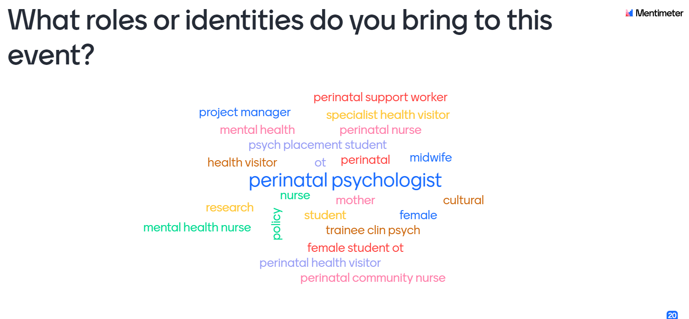

Slide 3
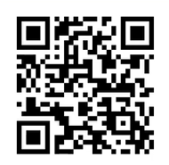
Useful Links
https://www.southeastclinicalnetworks.nhs.uk/the-bias-trap/
https://perinataltreatment.wordpress.com/workbook-for-women-who-have-experienced-trauma/
Great video to remind us about the importance of co-production and some of the pitfalls - https://www.youtube.com/watch?v=eJDO1rcJbBw
www.acacia.org.uk/bame
https://www.bamementalhealth.org/bereavement-survey

Slide 4
Meeting Recording
https://nhswales365-my.sharepoint.com/:v:/g/personal/helen_ranson_wales_nhs_uk/ETRJn-hOCpxCrcAqNaSa_AkBGj8h26pGLkMfcL2yt3_utg
Rob Ewers, Alfred and Amy
https://nhswales365-my.sharepoint.com/:v:/g/personal/helen_ranson_wales_nhs_uk/EQHS1jh2ZYVLkiwKV7ZfTpcBA1o8e7DusYXFtjTwMZcHFQ

Slide 5
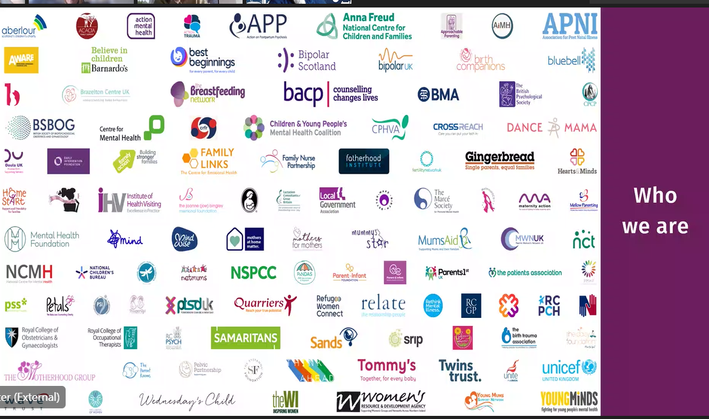

Slide 6
Feedback on the event
Hi sorry I've got to go. Thank you so much for today its been so informative. Thank you for all the links on the chat
Thank you very much for facilitating today. As always, very thought provoking. This is very timely for me as I am the person representing the women of North and Mid Wales in the new MBU development which will be the first MBU in the UK who will cross England and Wales and consideration needs to be given in every aspect of the development regarding women and families who speak Welsh as a first language and who may have different cultural values and beliefs.
Your feedback / comments
such an eye opener, really touching topic.
Hi all, thank you so much for today. All of the talks have been interesting and insightful. I have to leave now but I have had a great morning, thanks again!

Slide 7
