Slide 1
PNMH Community of Practice – 25th September 2023
Learning Disabilities and Cognitive Impairment

Slide 2
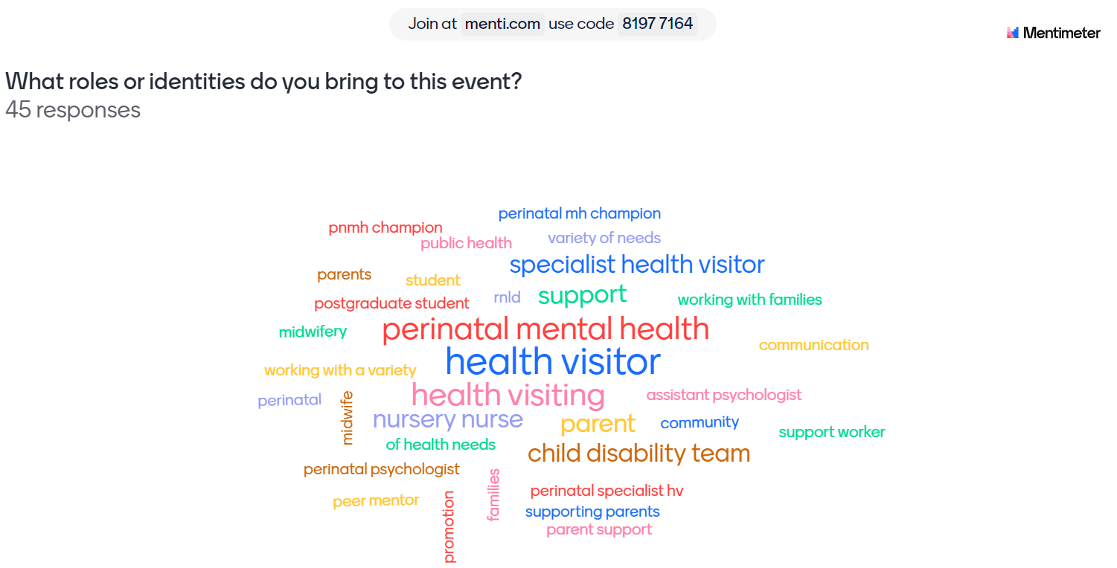

Slide 3

What you told us about the Community of Practice Event on Learning Disabilities and Cognitive Impairment
It was all very thought provoking. I only wish I had done this sooner than now.
It was informative and has made me more aware. It will be useful in the future.
I found the whole session very informative and it especially made me look at my own practice and the importance of ensuring clear communication as well as ensuring the information provided has been understood rather than presume
Thank you so much for today's speakers. It has been a very informative and inspiring day. I look forward to future opportunities to learn from your experiences.
Thank you, great session, loads to think about
Thank you for a really interesting and informative session

Slide 4
