Slide 1
Intrusive Thoughts
Lunch and Learn Webinar
Monday 29th April
1.00 – 2.30 pm

Slide 2
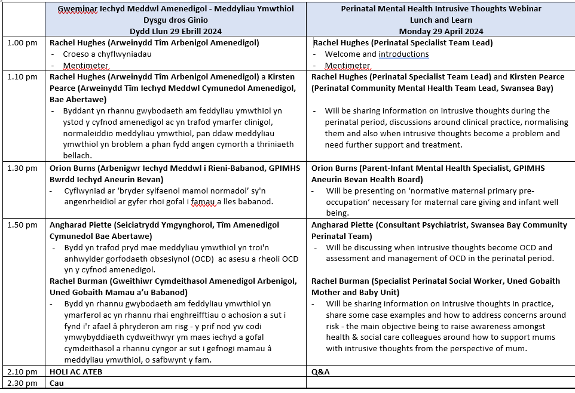

Slide 3







Lunch and Learn Webinar – 29th April 2024
Intrusive Thoughts
Welcome and Introductions
Format for the day
  Self care
  Presentations
  Q&A’s
  Lunch
House Keeping
Notes:
We would like to acknowledge that the topic we are about to explore may be emotionally challenging and evoke strong emotions for some individuals. If at any point during this presentation you feel uncomfortable, please note it is appropriate step outside of the room or reach out for support. Our goal for today is to provide valuable insights and resources whilst creating a safe and supportive environment for everyone.

Slide 4


Lunch and Learn Webinar – Intrusive Thoughts
Mentimeter
Q1 – What roles or identities bring you to today’s event?
https://www.menti.com/aluajcnskjfv
Q2 – What one word best describes the impact of today's event for you as participant?
https://www.menti.com/alsx6m7t2x4v

Slide 5
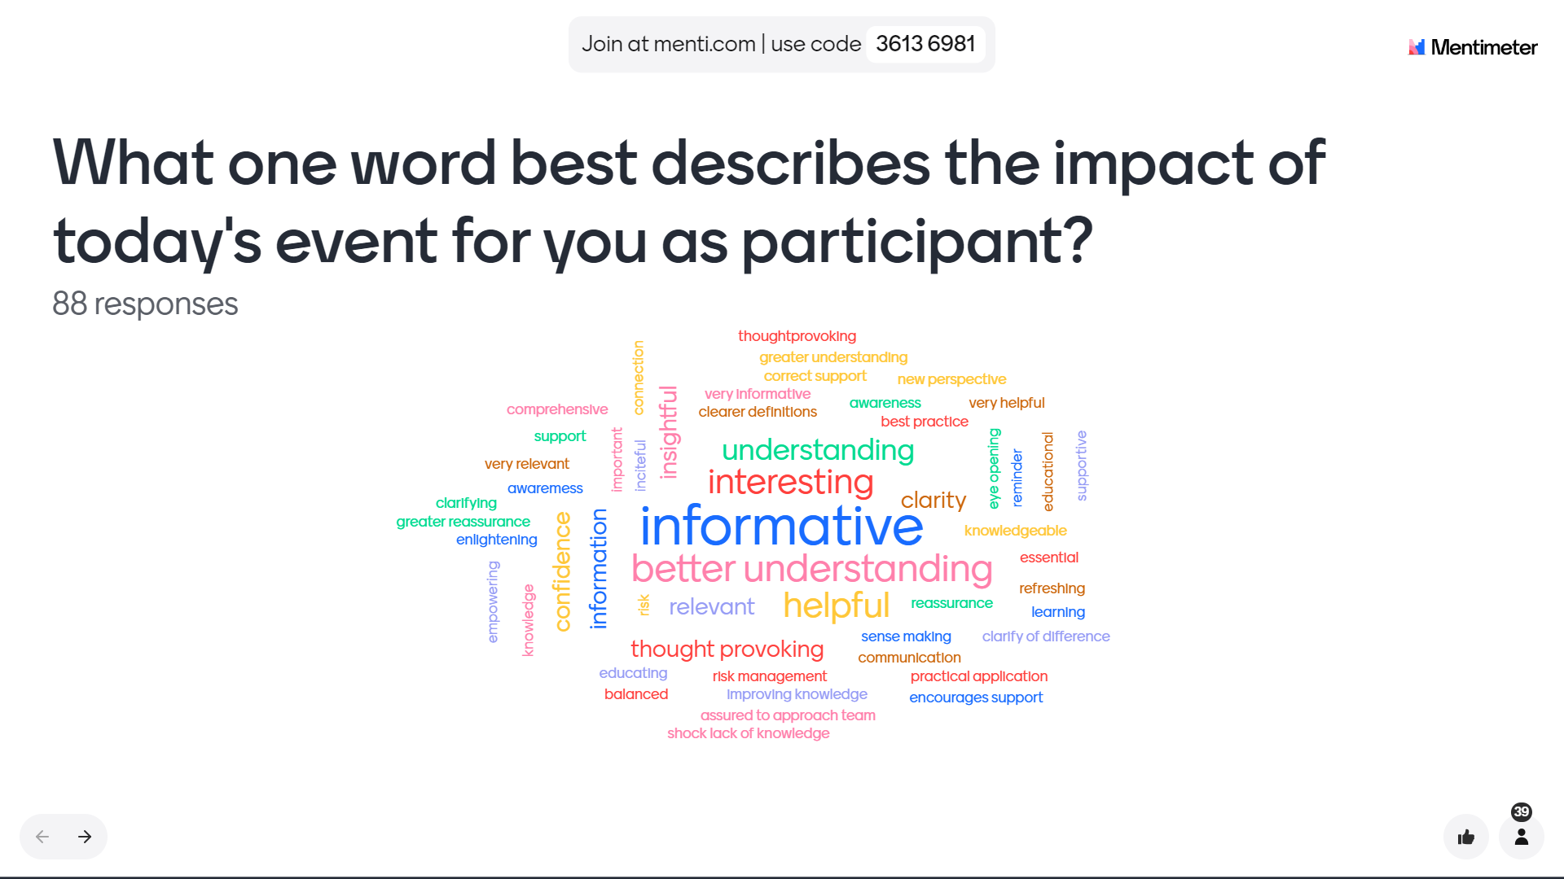

Slide 6
Rachel Hughes
Perinatal CBT Practitioner
&
Kirsten Pearce
Perinatal Community Team Leader

Slide 7

Statement
Inclusive Approach
Embracing Diversity & Nurturing Inclusivity
Use of language
  Perinatal mental health impacts
  High quality, compassionate perinatal mental health care for everyone who needs it.
Notes:
Inclusive Approach: Partners/Dads/LQBTQ+ and Perinatal Mental Health
“Embracing Diversity, Nurturing Inclusivity: Perinatal Mental Health for All”
The language used within this presentation uses the term ‘mothers’, but we recognise that perinatal mental health issues affect men, women, gender diverse individuals and people whose gender identity does not align with the sex they were assigned at birth. Our focus is not an exclusion, and we will continue to campaign for high quality, compassionate perinatal mental health care for everyone who needs it.

Slide 8
Aims and Objectives
Definition of intrusive thoughts
Intrusive thoughts in the Perinatal Period
Intrusive thoughts in clinical practice
Intrusive thoughts in assessment
Normalising intrusive thoughts
When intrusive thoughts become a problem and require further support and treatment
Intrusive thoughts within the safeguarding arena

Slide 9
Definition
Intrusive thoughts can present as clinical features within depression, anxiety, and obsessive-compulsive disorder (OCD).
Intrusive thoughts comprise of
  Unwanted negative thoughts and images that frequently intrude
  Difficult to dismiss
  When dismissed, recur
  Content is the same as those with a psychiatric disorder.
Narrowed focus of attention
  Can impair a person’s ability to respond to the external world.
  They can play an important role in maintaining the disorders in which they occur. (Lawrence et al, 2017)
Notes:
Intrusive thoughts can present as clinical features within depression, anxiety, and obsessive-compulsive disorder (OCD). In the UK: Occurrence of PND: 10–15% of mothers, Anxiety: 18-25% antenatally and 15% postnatally, OCD affects 2% and 2 -3% in postnatally (higher if OCD is already diagnosed).
Intrusive thoughts comprise of unwanted negative thoughts and images that frequently intrude, are difficult to dismiss, and, when dismissed, recur. They are common in the general population and their content is the same as those with a psychiatric disorder.
Furthermore, they lead to a narrowed focus of attention that, in turn, can impair a person’s ability to respond to the external world. They can play an important role in maintaining the disorders in which they occur. (Lawrence et al, 2017)

Slide 10
Perinatal Period & Intrusive Thoughts
Intrusive thoughts of harming one’s baby are common among clinical and non-clinical samples alike. However, they may become more distressing/challenging in mothers who are suffering from mental health problems & associated with increased feelings of guilt & shame.
Emphasising to parents that these are common and do not mean that they will act on them
Ability for parents to acknowledge and talk about these thoughts
  Helps to diminish in significance and frequency.
  Persistent intrusive thoughts will require further treatment.
Notes:
Intrusive thoughts of harming one’s baby are common among clinical and non-clinical samples alike. However, they may become more distressing/challenging in mothers who are suffering from mental health problems & associated with increased feelings of guilt & shame.
Emphasising to parents that these are common and do not mean that they will act on them
Once parents are able to acknowledge and talk about these thoughts, they often diminish in significance and frequency. Persistent intrusive thoughts will require further treatment.

Slide 11
Intrusive thoughts are not, in themselves, indicative of risk, however, they are likely to be of increased significance when they occur as part of depression, anxiety disorders, or OCD.
Although much of the research in this area has been with mothers, these intrusive thoughts also frequently occur in fathers.
Notes:
Intrusive thoughts are not, in themselves, indicative of risk, however, they are likely to be of increased significance when they occur as part of depression, anxiety disorders, or OCD.
Although much of the research in this area has been with mothers, these intrusive thoughts also frequently occur in fathers.

Slide 12
Enquiry In Clinical Practice
A common concern of clinicians is that, by enquiring about thoughts related to sensitive and undesirable behaviours they might in some way contribute to the likelihood of a patient acting on such thoughts.
Parents very rarely spontaneously volunteer having intrusive thoughts of harming their baby, even when answering questions concerning their mental health.
Notes:
A common concern of clinicians is that, by enquiring about thoughts related to sensitive and undesirable behaviours they might in some way contribute to the likelihood of a patient acting on such thoughts.
Parents very rarely spontaneously volunteer having intrusive thoughts of harming their baby, even when answering questions concerning their mental health.

Slide 13
Disclosure
Disclosure of intrusive thoughts is more likely within a trusting relationship, possibly one developed via continuity of care.
It has been found that, directly before enquiring about intrusive thoughts of harm, it can help to build a parent’s trust by explaining to them that negative intrusive thoughts of all kinds — for example, violent thoughts — are common among the general population.
Following such explanation and disclosure, patients have been able to reveal, often with great relief, that they have, indeed, experienced such thoughts.
Notes:
Disclosure of intrusive thoughts is more likely within a trusting relationship, possibly one developed via continuity of care.
It has been found that, directly before enquiring about intrusive thoughts of harm, it can help to build a parent’s trust by explaining to them that negative intrusive thoughts of all kinds — for example, violent thoughts — are common among the general population.
Following such explanation and disclosure, patients have been able to reveal, often with great relief, that they have, indeed, experienced such thoughts.

Slide 14
Assessment Following Disclosure
Intrusive thoughts need to be carefully assessed, by a GP, health visitor, or mental health professional, to distinguish them from those that should trigger child protection and safeguarding proceedings.
The assessment is likely to reveal that the thoughts are intrusive, ego-dystonic (that is, they are inconsistent with the mother’s view of herself), inconsistent with the mother’s behaviour, and cause the mother distress and dismay. There is no intention to act on them or a history of harming the baby; as such, the mother poses no risk of harm to her infant.
Notes:
Intrusive thoughts need to be carefully assessed, by a GP, health visitor, or mental health professional, to distinguish them from those that should trigger child protection and safeguarding proceedings.
The assessment is likely to reveal that the thoughts are intrusive, ego-dystonic (that is, they are inconsistent with the mother’s view of herself), inconsistent with the mother’s behaviour, and cause the mother distress and dismay. There is no intention to act on them or a history of harming the baby; as such, the mother poses no risk of harm to her infant.

Slide 15
Resources
Behav Res Ther, . 1993 Nov;31(8):713-20. doi: 10.1016/0005-7967(93)90001-b. Obsessive intrusive thoughts in nonclinical subjects. Part I. Content and relation with depressive, anxious and obsessional symptoms, C Purdon 1, D A Clark
https://www.postpartumstress.com/speak-the-secret
https://youtu.be/laeYq51SYA0?si=C441egkPS6REQrh_
https://youtu.be/0hdDVysvOsY?si=7w2lAnKECmKo6daK

Slide 16
Essential Maternal Primary Pre-occupation
…almost like an illness (Winnicott 1956)
making the distinction from
Perinatal Obsessive Compulsive Disorder
Orion Burns
Parent-Infant Mental Health Practitioner
PhD RN RM SCPHN-HV CBT Practitioner Trainee Psychotherapist
Gwent Parent Infant Mental Health

Slide 17
Maternal Primary Pre-occupation (MPP)
bio-behavioural mechanism that promotes survival of offspring
‘highly elaborate neural mechanisms mediating ‘complex maternal behaviours for vigilant protectiveness‘.
characterised by mental exclusivity and obsessive involvement with the infant.
driven by high levels of anxiety (95%), guilt/ blame (59%) and panic (37%) which serve as ‘potent stimuli that facilitate the establishment of selective bonds’ and activate ‘immediate care giving behaviour’ (Leckman et al 1999)
Features / sub-types of mood do not equal psychiatric disorder.
Evolutionary theories for features / sub-types of mood propose adaptive (normative) advantage conferred by their aversiveness ‘the function of which makes sense only with consideration of the specific characteristics of that situation by which they are aroused’.
Medical bias suggest MPP as “senseless and benign thoughts” that are misinterpreted as “very significant and threatening”, leading to “obsessive preoccupation and urges to perform anxiety-reducing rituals”
Consider context before making a diagnosis (DSM-1V (APA, 1994)) - MPP Vs preoccupations characteristic of psychiatric disorders and implicated in the transmission of mother-to-infant risk

Slide 18
Maternal Function
Optimum maternal mood and interactions
Early parental Preoccupations and Behaviours & Anxious Intrusive Thoughts & Harm Avoidance Behaviours (Leckman et al 1999)
Features /symptoms of mood states | M/P | %
Distress – if prevented from checking | M | 83%
Guilty - if prevented from checking | M | 59%
Anxiety - general | M | 95%
Panicky – if slept throughout the night | M | 37%
Repetitive checking – usually in response to infant cues | M | 90%
Repetitive thoughts or behaviour – at least one unrelated to infant care | P | 95%
Cleanliness/repetitive washing | P | 79%
Arranging behaviours – not usually associated with parental distress | P | 79%
Worry | P | 95%
EPPB stable and consistently higher for mother than for fathers. Shown to be distinct from OCD and D. Key : M = Mothers / P = Parental (Mothers & Fathers)

Slide 19
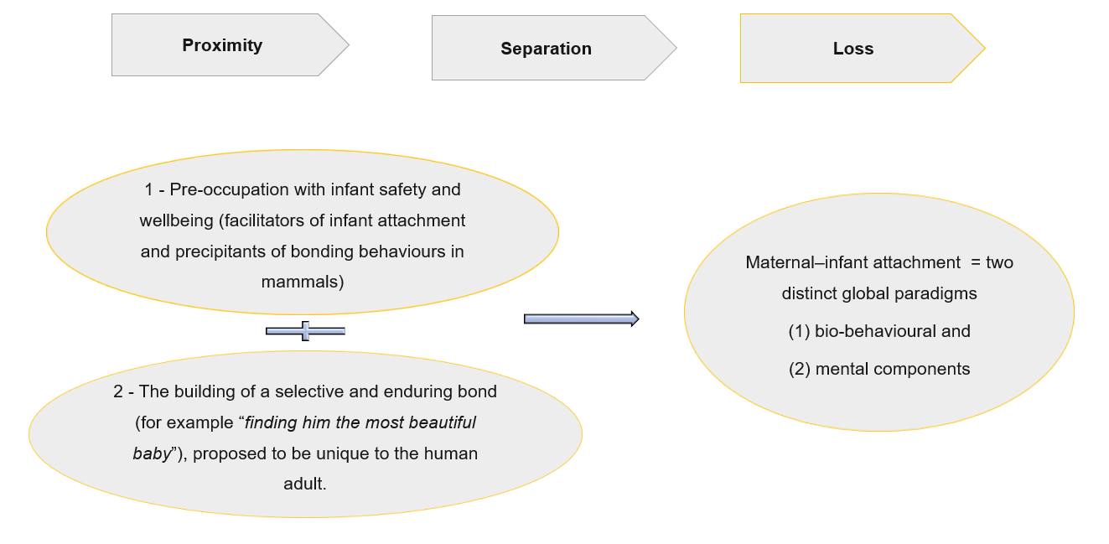
The Nature of the Mother's Tie (Feldman 1999)

Slide 20
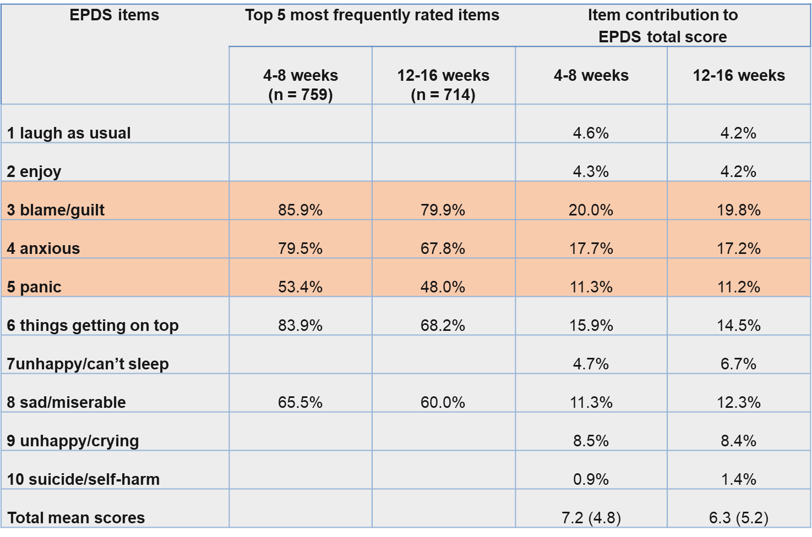
PND V’s Normative Mood – reinterpreting the evidence

Slide 21
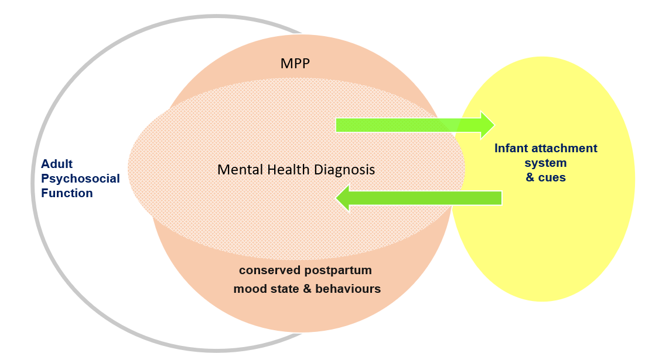
MPP: Triage Assessment ± Clinical Assessment > Formulation, Support and Intervention

Slide 22
‘‘What fascinated me most was how intimate relationships and the desire for being with the other precede the rest of cognitive development, and that this social motivation moves these other achievements forward, including meta-representation and theories about other minds. This intuitive, deeply encoded social orientation is first expressed in the mother’s arms and then forms the basis for all future I-Thou relationships.’’
Donald J Cohen (2001)

Slide 23
Essential Maternal Primary Pre-occupation
…almost like an illness
Thank you!

Slide 24
Angharad Piette
Consultant Psychiatrist
Swansea Bay Community Perinatal Team

Slide 25
When do Intrusive Thought Become OCD?
70 and 100% of new mothers report
  Unwanted, intrusive thoughts of infant-related harm
  Half of all new mothers reporting unwanted, intrusive thoughts of harming their infant on purpose.¹
May develop into clinical obsessions and in turn OCD¹
Normal intrusive thoughts vs clinical obsessions
  The time they take and the distress and impairment they cause.⁴
Compulsions are repetitive mental or behavioural acts
  Often undertaken to decrease the distress associated with obsessions.
  May include a range of behaviours including avoidance, reassurance seeking, and thought suppression.²
Notes:
Between 70 and 100% of new mothers report unwanted, intrusive thoughts of infant-related harm with as many as half of all new mothers reporting unwanted, intrusive thoughts of harming their infant on purpose.¹
Normally occurring, albeit unwanted, intrusive thoughts may develop into clinical obsessions and in turn OCD if the person experiencing the thoughts makes catastrophically negative appraisals of the meaning of the occurrence and/or the content of the thoughts.¹
Normal intrusive thoughts differ from clinical obsessions by virtue of the time they take and the distress and impairment they cause.⁴
Compulsions are repetitive mental or behavioural acts that a person engages in, and are often undertaken to decrease the distress associated with obsessions. They may include a range of behaviours including avoidance, reassurance seeking, and thought suppression.²

Slide 26
Diagnosis of OCD
Obsessive-compulsive disorder (OCD) affects 2-4% of women during pregnancy and postnatally
  Thought to be more common during this period.¹
  It can also affect fathers.²
Period prevalence of 7.8% in pregnancy and 16.9% in the postpartum.⁵
Notes:
Obsessive-compulsive disorder (OCD) affects 2-4% of women during pregnancy and postnatally, and is thought to be more common during this period.1 It can also affect fathers.²
Period prevalence of 7.8% in pregnancy and 16.9% in the postpartum. ⁵

Slide 27
ICD-10 F42:Obsessive-compulsive disorder
The essential feature is recurrent obsessional thoughts or compulsive acts. Obsessional thoughts are ideas, images, or impulses that enter the patient's mind again and again in a stereotyped form. They are almost invariably distressing and the patient often tries, unsuccessfully, to resist them. They are, however, recognized as his or her own thoughts.
Compulsive acts or rituals are stereotyped behaviours that are repeated again and again. They are not inherently enjoyable, nor do they result in the completion of inherently useful tasks. Their function is to prevent some objectively unlikely event, often involving harm to or caused by the patient, which he or she fears might otherwise occur. Usually, this behaviour is recognized by the patient as pointless or ineffectual and repeated attempts are made to resist. Anxiety is almost invariably present. If compulsive acts are resisted the anxiety gets worse.

Slide 28
ICD-10 F42:Obsessive-compulsive disorder…. Cont’d
F42.0
Predominantly obsessional thoughts or ruminations
These may take the form of ideas, mental images, or impulses to act, which are nearly always distressing to the subject. Sometimes the ideas are an indecisive, endless consideration of alternatives, associated with an inability to make trivial but necessary decisions in day-to-day living. The relationship between obsessional ruminations and depression is particularly close and a diagnosis of obsessive-compulsive disorder should be preferred only if ruminations arise or persist in the absence of a depressive episode.

Slide 29
ICD-10 F42:Obsessive-compulsive disorder…. Cont’d
F42.1
Predominantly compulsive acts [obsessional rituals]
The majority of compulsive acts are concerned with cleaning (particularly handwashing), repeated checking to ensure that a potentially dangerous situation has not been allowed to develop, or orderliness and tidiness. Underlying the overt behaviour is a fear, usually of danger either to or caused by the patient, and the ritual is an ineffectual or symbolic attempt to avert that danger.

Slide 30
DSM-5 Diagnostic Criteria for Obsessive -Compulsive Disorder (300.3)
A. Presence of obsessions, compulsions, or both:
Obsessions are defined by (1) and (2):
1. Recurrent and persistent thoughts, urges, or impulses that are experienced, at some time during the disturbance, as intrusive and unwanted, and that in most individuals cause marked anxiety or distress.
2.The individual attempts to ignore or suppress such thoughts, urges, or images, or to neutralize them with some other thought or action (i.e., by performing a compulsion).
Compulsions are defined by (1) and (2):
1. Repetitive behaviours (e.g., hand washing, ordering, checking) or mental acts (e.g., praying, counting, repeating words silently) that the individual feels driven to perform in response to an obsession or according to rules that must be applied rigidly.
2.The behaviours or mental acts are aimed at preventing or reducing anxiety or distress, or preventing some dreaded event or situation; however, these behaviours or mental acts are not connected in a realistic way with what they are designed to neutralize or prevent, or are clearly excessive.
Note: Young children may not be able to articulate the aims of these behaviours or mental acts.

Slide 31
DSM-5 Diagnostic Criteria for Obsessive -Compulsive Disorder (300.3)
B. The obsessions or compulsions are time-consuming (e.g., take more than 1 hour per day) or cause clinically significant distress or impairment in social, occupational, or other important areas of functioning.
C. The obsessive-compulsive symptoms are not attributable to the physiological effects of a substance (e.g., a drug of abuse, a medication) or another medical condition.
D. The disturbance is not better explained by the symptoms of another mental disorder (e.g., excessive worries, as in generalized anxiety disorder, body dysmorphic disorder, hoarding disorder; trichotillomania, skin picking, skin-picking disorder, stereotypic movement disorder, eating disorders, addictive disorders, illness anxiety disorder, guilty ruminations, as in major depressive disorder, thought insertion or delusional preoccupations, as in schizophrenia spectrum and other psychotic disorders; or repetitive patterns of behaviour, as in autism spectrum disorder.

Slide 32
Assessment
If suspected, ask directly about common intrusive thoughts.
Ask specifically about:
Avoidance of baby care
Reassurance seeking
Mental compulsions
Assess if attempting to avoid or suppress intrusive thoughts (indicative of pnOCD) Vs. engaging in the thoughts with an increasing amount of detail (other diagnoses)
Assess if pnOCD fears that are bizarre and senseless (e.g., contaminating the baby by nappy changing) vs. depressive ruminations (e.g., “I’m an inadequate parent”) Vs. delusions (e.g., “The FBI is coming to take my baby”)
Avoidance, thought suppression and reassurance seeking (OCD diagnosis) Vs. for example withdrawal/amotivation (depressed mood) Vs. negative symptoms of Schizophrenia
Assess if voiding triggers that increase intrusive thoughts (OCD) Vs. seeking out stimuli associated with these taboo thoughts (indicative of other mental health concerns e.g. delusions)⁶
Notes:
If suspected, ask directly about common intrusive thoughts including sexual intrusions as these carry potential for shame and stigma and women will rarely disclose voluntarily.

Slide 33
Associated Mental Health Conditions
Depression
Link with PTSD
Differential or comorbid diagnoses of GAD/panic disorder/agoraphobia etc
Notes:
Obsessions that begin in pregnancy are likely to focus on contamination and can be accompanied by cleaning and washing compulsions.
Postpartum onset obsessions are more likely to focus on infant harm and be accompanied by checking and avoiding compulsions.

Slide 34
Risk Factors for Maternal OCD
Some studies suggest obstetric complications and mode of delivery affect risk, not consistent
Avoidant, obsessive compulsive personality
History of mood disorder
History of OCD
Primiparity
Sleep deprivation

Slide 35
Perinatal OCD –
Nature of symptoms in our population
Obsessions that begin in pregnancy:
  Likely to focus on contamination
  Can be accompanied by cleaning and washing compulsions
Postpartum onset obsessions:
  More likely to focus on infant harm
  And be accompanied by checking and avoiding compulsions
Notes:
Obsessions that begin in pregnancy are likely to focus on contamination and can be accompanied by cleaning and washing compulsions.
Postpartum onset obsessions are more likely to focus on infant harm and be accompanied by checking and avoiding compulsions.

Slide 36
Risk
Risk of suicide
Consider increased risk when starting SSRI
Particular increased risk in teenage and younger adult population

Slide 37
Risk to Others
We are not aware of any recorded cases of people with OCD acting on intrusive thoughts (challacomb)²
Severe depression
Intrusive thoughts of harming the baby are not so clearly ego-dystonic, such as “the baby would be better off without me” or “I can’t cope with his crying and want to throw him out of the window.” (challacomb)²
OCD
There can be serious secondary risks resulting from measures people take to avoid harm, such as avoiding time spent with the baby, excessive food restriction, or excessive cleaning with products such as bleach. (challacomb)²
Some studies show reduced maternal responsiveness in those with perinatal OCD³
Notes:
We are not aware of any recorded cases of people with OCD acting on intrusive thoughts (challacomb) ²
In disorders such as severe depression, intrusive thoughts of harming the baby are not so clearly ego-dystonic, such as “the baby would be better off without me” or “I can’t cope with his crying and want to throw him out of the window.” (challacomb) ²
In OCD there can be serious secondary risks resulting from measures people take to avoid harm, such as avoiding time spent with the baby, excessive food restriction, or excessive cleaning with products such as bleach. (challacomb) ²
Some studies show reduced maternal responsiveness in those with perinatal OCD ³

Slide 38
Treatment
Psychological
Cognitive behaviour therapy (CBT) that includes exposure and response prevention (ERP) as a core component as a first-line treatment option. Individual or group-based.
Treating clinicians should safely involve the infant in CBT (e.g., during exposure-based exercises) if the theme of obsessions/compulsions relates to the infant.
Include family and carers around reassurance-seeking.
Clinicians should be aware that combined therapy including both pharmacotherapy and CBT may be more effective than monotherapy (i.e., pharmacotherapy or CBT alone) for some individuals with pnOCD.
Notes:
Psychological
Cognitive behaviour therapy (CBT) that includes exposure and response prevention (ERP) as a core component as a first-line treatment option. Individual or group-based.
Treating clinicians should safely involve the infant in CBT (e.g., during exposure-based exercises) if the theme of obsessions/compulsions relates to the infant.
Include family and carers around reassurance-seeking. When family members or carers of people with OCD or BDD have become involved in compulsive behaviours, avoidance or reassurance seeking, treatment plans should help them reduce their involvement in these behaviours in a sensitive and supportive manner.
Clinicians should be aware that combined therapy including both pharmacotherapy and CBT may be more effective than monotherapy (i.e., pharmacotherapy or CBT alone) for some individuals with pnOCD

Slide 39
Treatment
Medication
Selective Serotonin Reuptake Inhibitors (SSRIs) or Tricyclic Antidepressants (TCAs) should be considered as a recommended pharmacological treatment option for pnOCD.
TCAs - not usually advised in pregnancy. Low RID so OK in breastfeeding.
If there is an inadequate response to either pharmacotherapy alone (by 12 weeks) or CBT alone (more than 10 therapist hours), the treatment plan should be reviewed.
If treatment for OCD with an SSRI is effective, it should be continued for at least 12 months to prevent relapse and allow for further improvements.
Clomipramine should be considered in the treatment of adults with OCD or BDD after an adequate trial of at least 1 SSRI has been ineffective or poorly tolerated, if the patient prefers clomipramine or has had a previous good response to it.
Notes:
Medication
Selective Serotonin Reuptake Inhibitors (SSRIs) or Tricyclic Antidepressants (TCAs) should be considered as a recommended pharmacological treatment option for pnOCD.
TCAs- not usually advised in pregnancy. Low RID so OK in breastfeeding.
If there is an inadequate response to either pharmacotherapy alone (by 12 weeks) or CBT alone (more than 10 therapist hours), the treatment plan should be reviewed
If treatment for OCD with an SSRI is effective, it should be continued for at least 12 months to prevent relapse and allow for further improvements.
Clomipramine should be considered in the treatment of adults with OCD or BDD after an adequate trial of at least 1 SSRI has been ineffective or poorly tolerated, if the patient prefers clomipramine or has had a previous good response to it.

Slide 40
MDT Input in Perinatal Context
Nursery Nurse
  Attachment and bonding pathway
  Baby massage
  Gro brain
  VIG etc
Occupational Therapist
  Assessment and input dependent on functional impairment
Heath professionals should consider the effect on the infant if the parent is very anxious, and how this may affect the parent–child relationship and interactions.
Consider MBU admission if OCD is severe
Notes:
Nursery nurse- attachment and bonding pathway, baby massage, gro brain, VIG etc.
OT- assessment and input dependent on functional impairment.
Heath professionals should consider the effect on the infant if the parent is very anxious, and how this may affect the parent–child relationship and interactions.
Consider MBU admission if OCD is severe.

Slide 41
References
Collardeau, Fanie, et al. "Maternal unwanted and intrusive thoughts of infant-related harm, obsessive-compulsive disorder and depression in the perinatal period: study protocol." BMC psychiatry 19.1 (2019): 1-15.
Challacombe, Fiona L., Maria Bavetta, and Stephanie DeGiorgio. "Intrusive thoughts in perinatal obsessive-compulsive disorder." BMJ 367 (2019).
Miller, Michelle L., and Michael W. O’Hara. "Obsessive-compulsive symptoms, intrusive thoughts and depressive symptoms: a longitudinal study examining relation to maternal responsiveness." Journal of reproductive and infant psychology 38.3 (2020): 226-242.
NICE guidelines obsessive compulsive disorder and body dysmorphic disorder (2005)
Hudepohl, Neha, Joanna V. MacLean, and Lauren M. Osborne. "Perinatal obsessive–compulsive disorder: epidemiology, phenomenology, etiology, and treatment." Current psychiatry reports 24.4 (2022): 229-237.
Mulcahy, Melissa, et al. "Consensus recommendations for the assessment and treatment of perinatal obsessive–compulsive disorder (OCD): A Delphi study." Archives of women's mental health 26.3 (2023): 389-399.
‘don’t‘ drop the baby’ book
Overcoming intrusive thoughts

Slide 42
Rachel Burman
MBU Social Worker

Slide 43
How to Address Concerns About Risk
Intrusive thoughts are a characteristic feature of OCD
  May lead to compulsive behaviour
  High levels of anxiety
Patients are reluctant to disclose their thoughts
They find it difficult to seek help
They feel shame and guilt
They fear they will be judged a potential harmful parent
We have experienced the above during our time MBU and within the Swansea Bay Community Team
Notes:
As we have heard already from the speakers before me, intrusive thoughts are a characteristic feature of OCD and may lead to compulsive behaviour and high levels of anxiety in the person that is experiencing them. We have also heard from the speakers that the evidence base clearly shows that individuals with an OCD diagnosis do not act on their thoughts and are very distressed by them.
As Angharad has also described, patients will often be reluctant to voluntarily disclose these thoughts (particularly those of intentional physical or sexual harm to the infant) and therefore there is need to ask patients directly about whether they are experiencing these thoughts.
It is recognised in the literature that seeking help is very difficult for these individuals due to feelings of shame and guilt, and fears they will be judged as a potential harmful parent.
Unfortunately, there have been case examples which describe this being the experience of patients who have sought help, and this is something we have also experienced throughout our time in the MBU and within the community team in Swansea Bay.

Slide 44
Case Study Example
Challacombe & Rowe 2013
OCD was not recognised
The woman was classified as high risk of harming their children
Child protection proceedings were initiated
  Reinforced the mother’s own fears that their symptoms meant they would harm their babies
  Mum and baby were separated for a period of time and restrictions placed on their contact with each other
Notes:
For example, a case study detailed by Challacombe & Rowe 2013 describes a case where OCD was not recognised and the woman was classified as high risk of harming their children, and subsequently child protection proceedings were initiated.
This not only served to reinforced the mother’s own fears that their symptoms meant they would harm their babies, but also meant that mum and baby were separated for a period of time and restrictions placed on their contact with each other.

Slide 45
MBU cases whereby intrusive thoughts expressed by mums with OCD can often be met with
alarm by child protection workers
They may hear inflammatory language or thoughts of harm to baby
Assumptions made that these thoughts means that there is a high risk of the person acting
on the thoughts
Example
Mum was being referred to social services by her midwife after disclosing her experience of
intrusive thoughts.
Social services were very concerned about the expression of intrusive thoughts and the impact
of these on her ability to parent the infant.
An interim care order was put in place and new mum was subject to continuous supervision
from family members.
This was then dropped when Mental Health Professionals became involved and were able to
provide reassurance that this mum was not at risk of acting on these thoughts.
A typical example we come across in the MBU and perinatal mental health in general
Mums with OCD disclosing intrusive thoughts to harm the baby by various violent means
Child protection professionals concluding there is an actual risk of harm to the baby, without any understanding or knowledge of OCD
Notes:
There have been a number of cases in the MBU whereby intrusive
thoughts expressed by mums with OCD can often be met with alarm by child protection workers, who hear the inflammatory language or thoughts of harm to baby, and assume that presence of these thoughts means that there is a high risk of the person acting on the thoughts.
One example is of a mum being referred to social services by her midwife after disclosing her experience of intrusive thoughts. Social services were very concerned about the expression of intrusive thoughts and the impact of these on her ability to parent the infant. They ordered that the infant be subject to an interim care order and for the new mum to be subject to continuous supervision from family members. This was later dropped when Mental Health Professionals became involved and were able to provide reassurance that this mum was not at risk of acting on these thoughts.
A typical example we come across in the MBU and perinatal mental health in general, is around mums with OCD disclosing intrusive thoughts to harm the baby by various violent means, and child protection professionals concluding there is an actual risk of harm to the baby, without any understanding or knowledge of OCD.

Slide 46
Misunderstanding between the intrusive thoughts as a characteristic feature of OCD, and delusional thoughts / command hallucinations
  a product of post-partum psychosis
Individuals with OCD do not act on their thoughts of harm
Thoughts of harm in postpartum psychosis is a psychiatric emergency and urgent attention is required
A clear distinction between intrusive thoughts in OCD and those relating to other mental disorders (such as PPP) is the level of distress being vocalised by the person experiencing the thoughts. Thoughts of harm in post-partum OCD are experienced as ‘ego dystonic’ (Ie at conflict with the view they hold of themselves) and therefore not associated with a greater risk of violence (Fairbrother and Woody 2008, Lawrence et al 2017).
vs
Postpartum psychosis, delusional thoughts are associated with loss of reality and there is an absence of ability to assess consequences of actions.
Notes:
We have observed that there can be a misunderstanding between the intrusive thoughts as a characteristic feature of OCD, and delusional thoughts / command hallucinations which are a product of post-partum psychosis. Individuals with OCD do not act on their thoughts of harm, whereas thoughts of harm in postpartum psychosis is a psychiatric emergency and urgent attention is required.
- A clear distinction between intrusive thoughts in OCD and those relating to other mental disorders (such as PPP) is the level of distress being vocalised by the person experiencing the thoughts. Thoughts of harm in post-partum OCD are experienced as ‘ego dystonic’ (Ie at conflict with the view they hold of themselves) and therefore not associated with a greater risk of violence (Fairbrother and Woody 2008, Lawrence et al 2017).
- In contrast, in postpartum psychosis, delusional thoughts are associated with loss of reality and there is an absence of ability to assess consequences of actions.

Slide 47
What Do Our Case Studies Tell Us?
Illustrate lack of awareness and understanding of differing mental health diagnosis and the risk associated with each diagnosis.
Vital that the individual is assessed by a mental health specialist who is able to provide specialist assessment of the disorder that is causing the intrusive thoughts.
  This is particularly important in situations where child protection services are considering restrictions on mother / baby contact due to the presence of these thoughts.
  This is because in an OCD diagnosis, there is no link between the presence of these thoughts and actual threat of harm to the infant, and the separation of mother / infant is clearly damaging for a whole range of reasons.
The key point for treatment in perinatal OCD is for mum to receive the right support and treatment, in order for her and the infant to thrive.
Notes:
These case studies illustrate that even among professionals, there is a lack of awareness and understanding of differing mental health diagnoses and the risk associated with each diagnosis. It is therefore vital that the individual is assessed by a mental health specialist who is able to provide specialist assessment of the disorder that is causing the intrusive thoughts.
This is particularly important in situations where child protection services are considering restrictions on mother / baby contact due to the presence of these thoughts.
This is because in an OCD diagnosis, there is no link between the presence of these thoughts and actual threat of harm to the infant, and the separation of mother / infant is clearly damaging for a whole range of reasons.
The key point for treatment in perinatal OCD is for mum to receive the right support and treatment, in order for her and the infant to thrive.

Slide 48
To Conclude……
Our aim
  Raise awareness among professionals about this disorder
  Achieve more understanding of how to manage and respond to intrusive thoughts among the perinatal population
Support from a specialist perinatal mental health team is sought in the first instance.
  Best placed to provide advice on the nature of the mental disorder
  Is the expression of intrusive thoughts are cause for professional concern?
    This should certainly be the course of action ahead of any restrictions being placed on mother/ infant contact.
Notes:
We hope that this is helpful in providing further information around the topic of perinatal OCD and one of its defining features, intrusive thoughts. Our aim is to raise awareness among professionals about this disorder in the hope that this will lead to more understanding of how to manage and respond to intrusive thoughts among the perinatal population.
We would encourage that wherever possible, that support from a specialist perinatal mental health team is sought in the first instance. They will be best placed to provide advice on the nature of the mental disorder and whether the expression of intrusive thoughts are cause for professional concern. This should certainly be the course of action ahead of any restrictions being placed on mother/ infant contact.

Slide 49
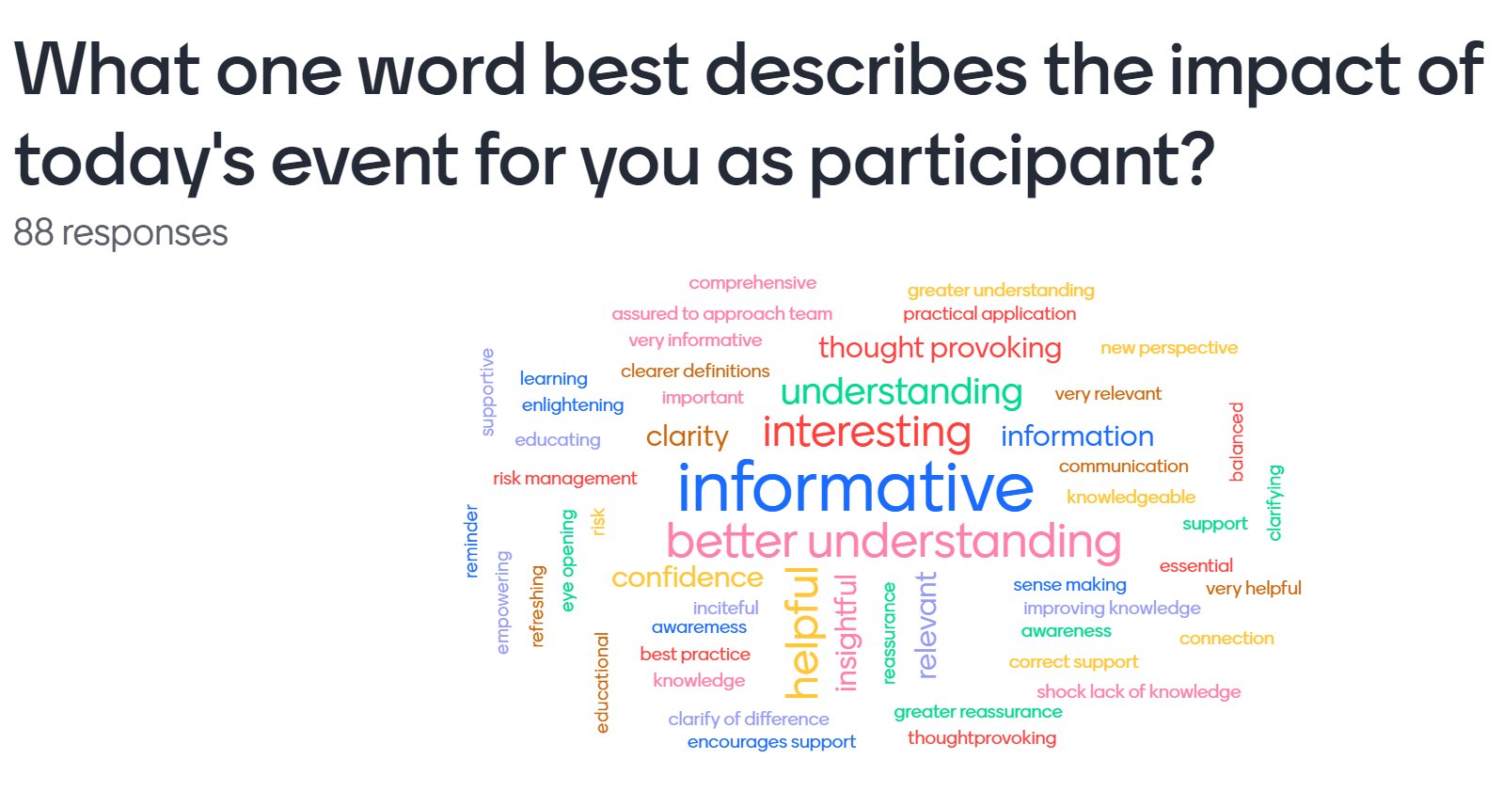

Slide 50
Feedback
Excellent presentation. Learned a lot and pleased I attended.
Not a question but two great books that demystify intrusive thoughts for parents are 'Good Moms Have Scary Thoughts A healing Guide to the Secret Fears of New Mothers' and 'What about us A new parents guide to safeguard your over-anxious, over-extended, sleep deprived relationship' by Karen Kleiman who also has a #speakthesecret campaign again to demystify IT
Thank you ladies. very informative
Excellent webinar - thank you
Thank you, great to know more about the work you do
Excellent presentation. Learned a lot and pleased I attended
Thanks all for a great informative webinar

