Slide 1

Mapping your QMS
Resource

Slide 2
Introduction
This activity guide was developed to support the QMS Wales Learning and Delivery Network, supported in partnership by the Q community and Quality Improvement Clinic.
It provides a step-by-step guide to map how your organisation is currently organising for quality.
It is designed to be used at the early stages of QMS development.
After this activity, you and your team will have thorough understanding of what is happening within your systems.
You will have:
Explored how your current QMS is operating and have a tangible map.
Discussed what 'good' looks like in your systems and then identified areas for improvement and actionable steps towards this.
Had the conversations to help you create your vision statements, answer the matrix and begin to identify steps for action planning.
Why system map?
It allows you to understand the interdependencies and relationships between system components.
It will enable your team to build consensus and align understanding and vision for your systems.
System maps can allow you to translate complexity into something tangible that enables you to understand current problems and identify solutions.
It can help inform future decision making
The best maps
Focus on usability over perfection
Are iterated on to reflect your evolving systems, rather than seen as a one-time activity
Shared with stakeholders in the system to get feedback and to harness a broad range of vantage points in the system

Slide 3
Common challenges with system mapping
Unclear scope or boundaries | Over or under mapping. Getting the right level of detail can be a challenge | No ownership of the map which leads to stagnation and the map not being updated to reflect the system | Patients not being embedded in the map | People can get confused between mapping what they desire their system to look like, and what it currently looks like.
Ideas to overcome these challenges
Start high level and then go into more detail. Only add the detail that improves collective understanding, or helping you to achieve the purpose of the map. If you feel you are adding too much detail, ask 'so what?' to see whether this addition changes something on the map. If it doesn't, it is likely an unnecessary addition to the map. | Define the purpose of the map in one sentence. This can help orientate both the boundary, but also the level of detail. Defining what is in and out of scope from the offset can be helpful. | Discuss roles and responsibilities upfront Identify a map owner Articulate a roadmap for how you want to use and iterate the map. | Consider and talk about patients from the offset If possible, consider if there are any people/ forums that you can share your map with to gain broader perspectives. | We are mapping current (as-is) states, so use this as your anchor

Slide 4
Getting prepared
Before you begin the activity
Schedule in meetings with your team:
There are 3 steps to this activity. We suggest you take 1 hour 15 mins per step in the activity
Decide how you will create your map:
It is always easier to create maps using paper in a face-to-face meeting. If you are meeting online it will make more sense to use a Digital whiteboard tool. You could try the Whiteboard tool in Teams meetings or other online tools like Miro.
System mapping process
Step 1: Understand your current quality activities and processes
Step 2: Visualise your current quality activities
Step 3: Compare your current system with a desired future state

Slide 5
Step 1: Understand your current quality activities and processes
Before you begin system mapping spend time as a team understanding what you are currently doing in each QMS quadrant.
You will find worksheets with questions to use a prompts. Write down everything about what you know. You are focusing on how your system currently works.
A suggested way to harness all knowledge quicker is to give everyone 5 minutes per quadrant to brainstorm what they think. Then spend 10 minutes discussing each quadrant
Note: Discussing this should help you to answer the Maturity Matrix

Slide 6
Step 1: Understand your current quality activities and processes
Feedback system
Who is doing this? Which teams? | How are we doing this? What's our approach? How are we connecting to QMS components? | What's working well? | What needs to be improved? What blockers are there? What people/ roles/ processes are missing?

Slide 7
Step 1: Understand your current quality activities and processes
Quality assurance
Who is doing this? Which teams? | How are we doing this? What's our approach? How are we connecting to QMS components? | What's working well? | What needs to be improved? What blockers are there? What people/ roles/ processes are missing?

Slide 8
Step 1: Understand your current quality activities and processes
Quality control
Who is doing this? Which teams? | How are we doing this? What's our approach? How are we connecting to QMS components? | What's working well? | What needs to be improved? What blockers are there? What people/ roles/ processes are missing?

Slide 9
Step 1: Understand your current quality activities and processes
Quality improvement
Who is doing this? Which teams? | How are we doing this? What's our approach? How are we connecting to QMS components? | What's working well? | What needs to be improved? What blockers are there? What people/ roles/ processes are missing?

Slide 10
Step 1: Understand your current quality activities and processes
Quality planning
Who is doing this? Which teams? | How are we doing this? What's our approach? How are we connecting to QMS components? | What's working well? | What needs to be improved? What blockers are there? What people/ roles/ processes are missing?

Slide 11
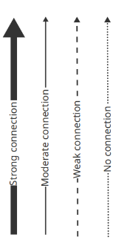
Step 3: Compare your current system with a desired future state
Now it is time to map your QMS. System mapping enables you to see how parts of the system are connected (or not).
You have surfaced everything you know about who and what is in your system, and how processes are currently operating in each QMS quadrant. System mapping allows us to articulate the relationships and connections between infrastructure, processes, teams, which help us to understand how the system is operating as a whole.
This is to enable your team to understand how the system is connected - aim for collective understanding over the perfectly drawn map.
Tips to get you started
Don't focus on what you think the 'perfect' QMS may look like, focus on how your system is connected right now.
Begin in one quadrant of QMS and build further from that.
Identify one person to draw the map but ensure everyone can see the map as it is drawn.
Helpful talking points
What is (and is not) connected? Use a key to show the strong and weak connections.
How are you connecting parts of your QMS? (what processes, infrastructure, relationships, projects exist?)

Slide 12
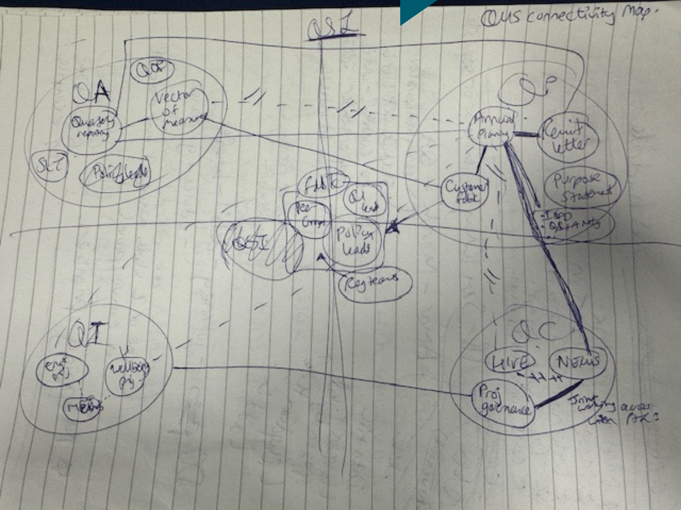
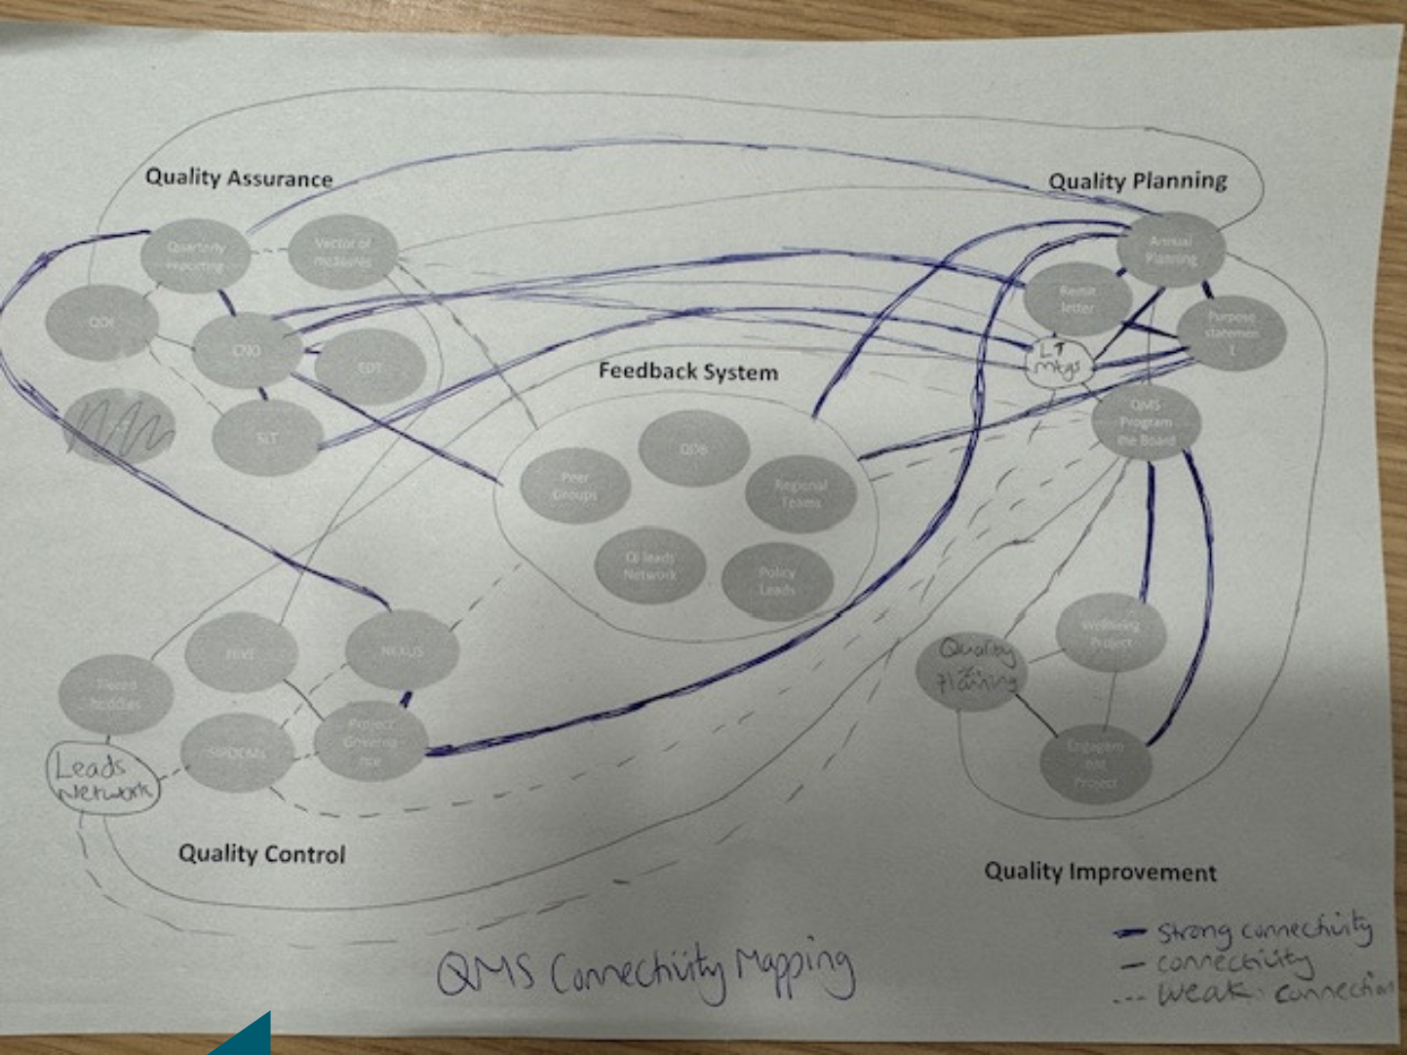
Step 2: Visualise your current quality activities and processes
The visuals below are provided by the Quality, Safety and Improvement team to examples of their early maps.
We listed infrastructure, meetings, processes to be able to lay all of it out. The map is a combination of these things.
The exercise was useful to understand connectivity. It also allowed us to prioritise and identify low hanging fruit that we could tackle first.

Slide 13
Step 3: Compare your current system with a desired future state
Now that you have visualised your system your team should spend time answering the questions in step 3.
Until now, all the steps have focused on the current state of your system. In the second half of this activity, spend time articulating what you think good looks like, and how you want the future of your system to look.
Note: Articulating your desired future should help you with the organisational position statement

Slide 14
Step 3: Compare your current system with a desired future state
Reflecting on your map and current QMS
Reflecting on your map and current QMS As a system, where and what are we working really well? What is working really well, and can we replicate this in other parts of the system that need improvement? What needs strengthening? What gaps exist? Why do they exist? What is hindering us? (information flows, siloes etc) | Where do you want to be? What does 'great' look like for us as a collective? What do we want to be known for? What unites us beyond our job titles and sectors? What must we collectively improve or change? How does the current state fall short of what we collectively want? What outcomes matter most for patients, communities, staff and partners? How will we know we are living our purpose?

Slide 15
About Q and Quality Improvement Clinic
The Q community​
We are a vibrant membership community of people working to improve health and care across the UK and Ireland.
We learn, share and collaborate to address pressing health system challenges. And we share our insight and skills widely to create the culture and conditions for improvement efforts to succeed. ​
​Together, to improve health and care. ​​
Q is hosted by The NHS Alliance and supported by the Health Foundation and partners across the UK and Ireland.​
Find out more: Q.thenhsalliance.org
Quality Improvement Clinic
We work with healthcare organisations to enact positive change. We help healthcare organisations design and deliver quality strategies that drive real impact. Our work combines board development, QMS design, and measurement for impact to embed improvement at every level.
We align governance, strategy, and delivery so quality is actively managed, not just assured. Through bespoke coaching and learning, we build confident leaders, capable teams, and a culture of continuous improvement that improves outcomes for patients and staff.
Find out more: qualityimprovementclinic.com

Slide 16
Diolch
Thank You

